Slide 1
WEEK 6 DEMO
Personal Expense Tracker MCP
A local MCP server for adding, reviewing, updating, deleting, and summarizing personal expenses.
Rafeef Sholy — Computer Engineer
3–5 MINUTES
1/5

Slide 2
The problem → a focused solution
Why we built the Personal Expense Tracker MCP
PROBLEM
SOLUTION
• Expense records can be scattered across notes and messages.
• Finding a specific expense or calculating totals manually is slow.
• An AI client should not receive unlimited access to files, commands, or the internet.
• Five focused MCP tools handle the core expense actions:
add_expense • list_expenses • get_spending_summary
update_expense • delete_expense
• Inputs are validated before the expense logic runs.
• Data stays in one fixed local file: data/expenses.csv.
2/5

Slide 3
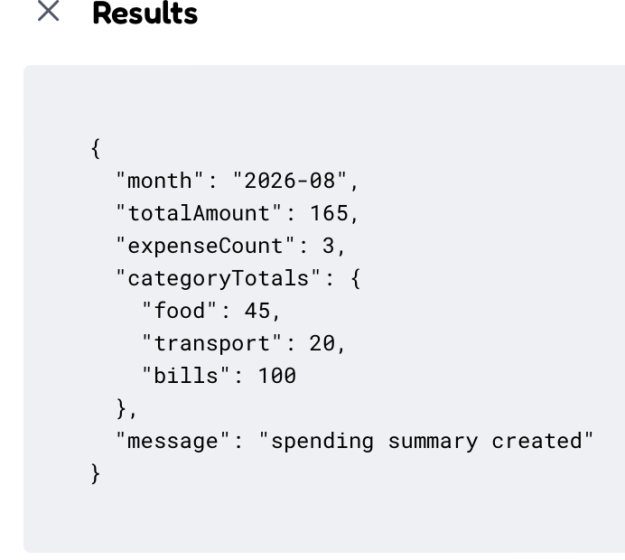
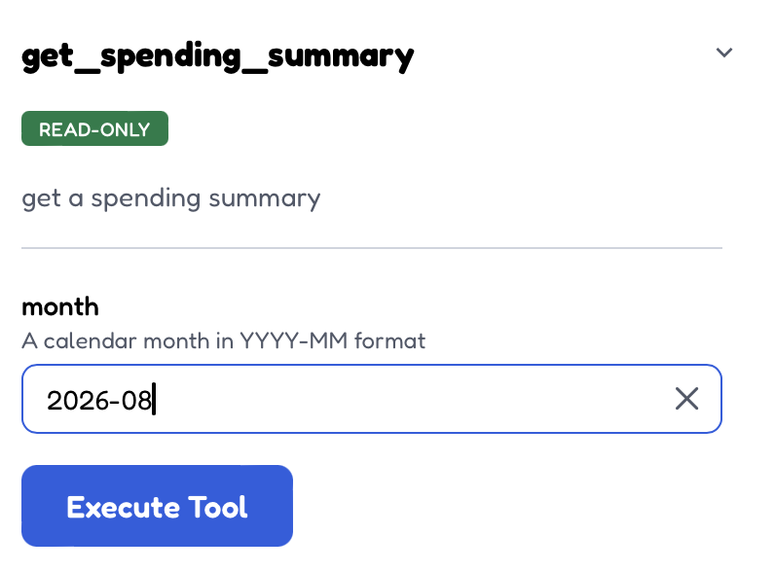
MY CONTRIBUTION
Spending Summary — My Project Part
TOOL INPUT
REAL RESULT
I focused on get_spending_summary.
• Connected the MCP tool to the real local expense data.
• Calculated monthly total amount, expense count, and totals grouped by category.
• Validated the tool input and verified the structured output.
• Tested the complete flow in MCP Inspector using August 2026 data.
Verified result: $165 total • 3 expenses • category totals
MCP Inspector proof: get_spending_summary executed successfully on local data.
3/5

Slide 4
Live demo: exactly two prompts
The live section shows one core write action and the spending-summary feature
5 TOOLS
add_expense
list_expenses
get_spending_summary
update_expense
delete_expense
Backup prompt
Summarize August 2026 spending and show the category with the highest total.
Tool: get_spending_summary
PROMPT 1
Add a $25 groceries expense for milk and bread on August 16, 2026.
PROMPT 2
Show my spending summary for August 2026.
MY FEATURE
4/5

Slide 5
Next steps & demo takeaway
Future improvements after the complete project journey
01
02
03
Encrypted backup
Better insights
Safe CSV import
Optional backup while keeping the local-first design.
Clearer spending charts and summaries for users.
Preview and validate imported data before writing.
Takeaway: focused MCP tools + strict validation + safe local storage + bounded permissions.
READY FOR QUESTIONS
5/5

