Slide 1
Capstone Project
Singapore HDB Resale Market Analysis
Improving sales performance with data: 628,000 transactions, 2000 – 2024
Prepared by Rafeek Ahamed
Notes:
Good [morning/afternoon], everyone. I'm Rafeek, and today I'll show you what I learned from about 24 years of Singapore HDB resale data. Buying a flat is the biggest purchase most people ever make, so I wanted to see whether data can make that decision clearer. I'll walk you through the problem, the data, how I worked with it, and what I found.

Slide 2
The problem
Resale prices vary widely by town, flat type, size and storey, yet most people rely on island-wide averages. How can data help everyone price and choose better?
1
2
3
Buyers
Investors
Agents
Which town, flat type and storey give the best value for the budget?
How have prices moved over time, and what is the downside risk?
How do I price a flat accurately instead of using a single island median?
Notes:
Here's the problem. When we hear 'the average resale price', it sounds like one number for everyone. But a flat in Queenstown on a high floor and a flat in Woodlands on a low floor are very different products. Three groups feel this most. Buyers want to know where their budget goes furthest. Investors want to know how risky prices can be. Agents need to price a unit fairly, not just quote an island-wide figure. So my question was: how can data help each of them decide better?

Slide 3
What the data tells me
627,442
2000–2024
26 / 7
10
clean records
time horizon
towns / flat types
features per sale
Each record
Things to watch
Month, town, flat type, block, street
Storey range, floor area (sqm), flat model
Lease start year and resale price (target)
Two date bases (approval vs registration)
Prices are nominal, not inflation-adjusted
2024 holds January only (411 sales)
Notes:
So what's in the data? After cleaning I have 627,442 resale transactions from 2000 to January 2024, across 26 towns and 7 flat types. Each sale tells me where the flat is, how big it is, which floor band, when the lease started, and what it sold for. I also want to be upfront about three limits. The dates come from two systems, approval date early on and registration date later. Prices are not adjusted for inflation, so part of the growth you'll see is just rising costs. And 2024 only has January. I kept these in mind when interpreting the results.

Slide 4
How I did it
1
2
3
4
5
Combine
Clean
Explore
Model
Share
5 CSV files merged into 628,591 rows
Removed 1,134 duplicates and 15 invalid records
EDA and visuals in Google Colab
Random Forest vs Linear Regression
Power BI dashboard and Streamlit app
Raw 628,591 rows → clean 627,442 rows
Notes:
Now, how I did it. First, I combined five CSV files, about 628,000 rows. Second, I cleaned them: I removed 1,134 duplicates and 15 invalid records, and fixed issues like a missing header in one file. Third, I explored the data in Google Colab, looking at trends and comparing towns, flat types and floors. Fourth, I built two prediction models, Linear Regression and Random Forest, trained on 2012 to 2021 and tested on 2022 onwards, so the test is on data the model hasn't seen. Finally, I made the results usable through a Power BI dashboard and a Streamlit app.

Slide 5
Prices up 130% since 2000
+130%
2000 to 2023
+38%
rebound, 2019 to 2023
Notes:
Let's start with the big picture. The median resale price went from about 239 thousand dollars in 2000 to 550 thousand in 2023, a 130 percent increase. But it wasn't a straight line. Prices peaked around 455 thousand in 2013, then slid to about 400 thousand by 2019, which is a reminder that prices can fall. After that they rebounded 38 percent by 2023. This matters most to investors: the past shows both strong growth and a long flat stretch.

Slide 6
What drives price
55%
61%
Importance in Random Forest
1
Floor area
more per sqm in prime towns
more per sqm on storey 20+
2
Storey
Queenstown, Central Area and Bukit Merah vs Jurong West, Woodlands and Choa Chu Kang
compared with storeys 1 to 5
3
Flat type
4
Remaining lease
Notes:
Next, what moves the price? Two things stood out. Location: prime towns like Queenstown, Central Area and Bukit Merah cost about 55 percent more per square metre than towns like Jurong West, Woodlands and Choa Chu Kang. And height: flats on the 20th floor or above cost about 61 percent more per square metre than those on floors one to five. When I asked the Random Forest model what it relied on most, floor area came first, then storey, flat type and remaining lease. So size, floor and location matter more than the age of the lease on its own.

Slide 7
Predicting price
R² 0.75 vs 0.43
Random Forest beats Linear Regression, with about 11% average error
493 flats (0.9%)
sold over 10% below predicted value, mostly in Bukit Merah, Jurong West, Jurong East and Geylang
Notes:
Now, can we predict price? I compared two models. Linear Regression explains 43 percent of price variation and is off by about 112 thousand dollars on average. Random Forest explains 75 percent and is off by about 65 thousand, roughly 11 percent. So it's much better, because prices don't follow simple straight-line rules. I then used it to look for bargains: 493 flats, under 1 percent of recent sales, sold more than 10 percent below what the model expected, mostly in Bukit Merah, Jurong West, Jurong East and Geylang. These are leads worth checking, not guaranteed deals, because the model can't see things like renovation or exact view.

Slide 8
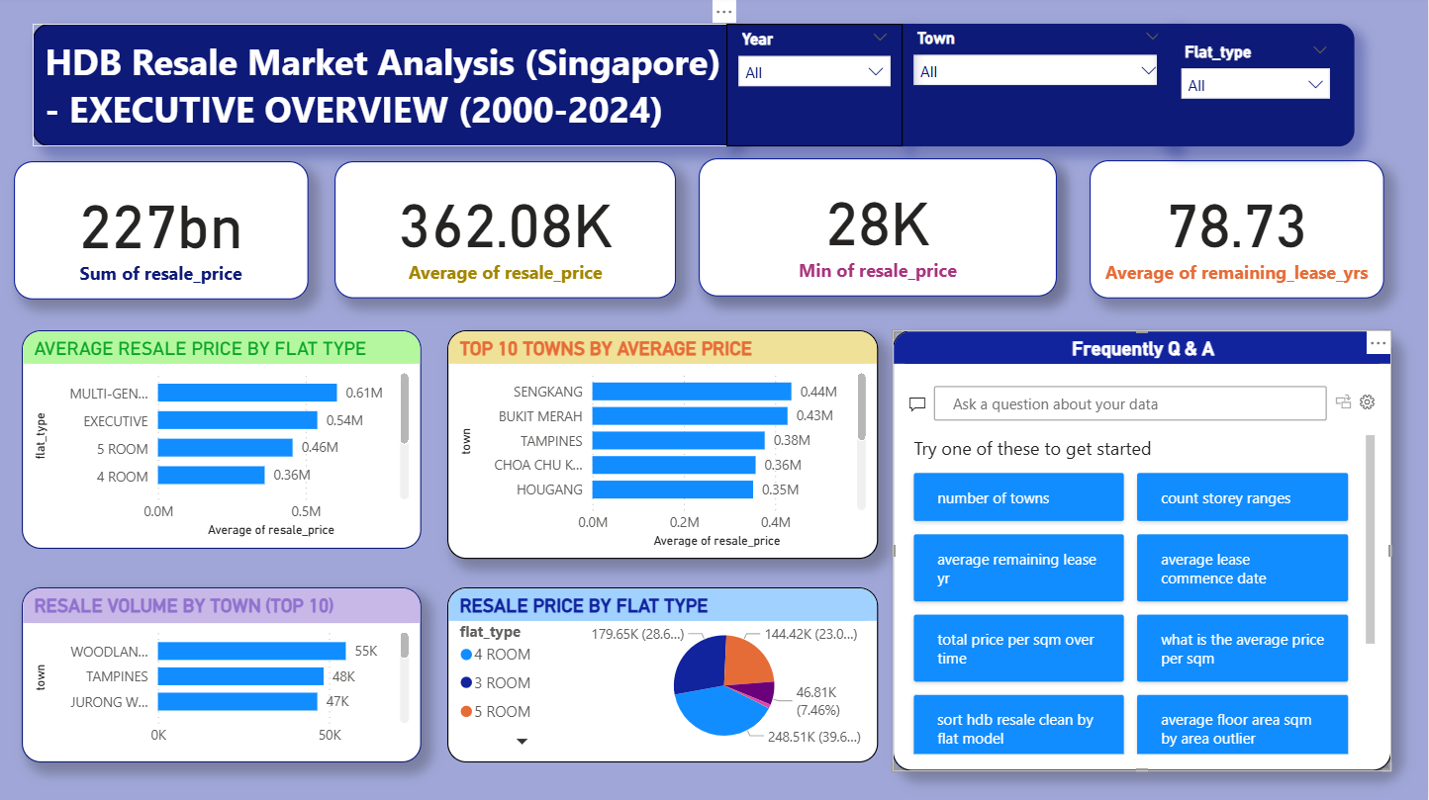
The Power BI dashboard
1
Filter: Year, town and flat type slicers
2
Track: Total value, average and lowest price, average remaining lease
3
Compare: Average price by flat type and top 10 towns
4
Volume: Sales by town and share by flat type
5
Ask: Q&A box for plain-English questions
Notes:
This is the dashboard I built in Power BI, an executive overview for 2000 to 2024. At the top you can filter by year, town and flat type, and everything below updates together. The cards give the headline numbers, the bar charts compare average prices by flat type and by town, and the pie chart shows how sales split across flat types. There is also a Q&A box, so someone can type a question in plain English. [If possible, demo live: pick one town, then one flat type, and point out how the numbers change.]

Slide 9
What the dashboard shows
362K
227bn
average resale price
total sales value
28K
78.7 yrs
lowest price
average remaining lease
Busiest markets: Woodlands (55K sales), Tampines (48K), Jurong West (47K)
Notes:
Here is what it shows when nothing is filtered. Across all 24 years the average resale price is about 362 thousand dollars, the total value of sales is about 227 billion, and the lowest sale is only 28 thousand, a reminder of how far prices have moved. The average flat has about 79 years of lease left. By average price, Sengkang and Bukit Merah lead at around 0.44 and 0.43 million, but the busiest markets are Woodlands, Tampines and Jurong West. One thing to remember: this is average price, not price per square metre. Sengkang looks expensive partly because its flats are newer and larger. Per square metre, the central towns I mentioned earlier lead. [The pie chart also shows 4-room flats are about 40 percent of sales, then 3-room and 5-room.]

Slide 10
Recommendations
Buyers
Investors
Agents
Compare a 4-room flat in a cheaper town with a 3-room in a better one, and weigh the storey premium against size.
Stress-test for flat-price periods like 2014 to 2019, and do not judge value by remaining lease alone.
Price by town, flat type and storey, not island-wide medians.
Notes:
So what should people do with this? If you're a buyer, don't only compare prices. Compare trade-offs: a 4-room in a cheaper town versus a 3-room in a better one, and ask whether a high floor is worth the premium over extra space. If you're an investor, test your plan against a flat period like 2014 to 2019, and don't judge value by remaining lease alone. If you're an agent, price by town, flat type and storey, not by island-wide medians, because that's where the real differences are.

Slide 11
Thank you
Questions and discussion
Try the live app: rafeek-ahamedcapstone-project-007.streamlit.app
Rafeek Ahamed
Notes:
That's my analysis. To sum up: prices have grown strongly but not without dips, location, floor and size drive value, and a good model can help spot unusual deals. Thank you for listening. I'm happy to take questions, and you're welcome to try the live app yourself.

