Slide 1
A Fast Implementation of RSA using GNU MP Library
[Student Paper]
Rajorshi Biswas, Shibdas Bandyopadhyay Anirban Banerjee
Indian Institute of Information Technology Calcutta
rajorshi_biswas@rediffmail.com
shibdas@rediffmail.com
anir_iiit@yahoo.co.uk

Slide 2
Synopsis
RSA is the most popular Public Key Encryption Technique in use today.
Large numbers are needed for encryption, hence the need for handling those numbers efficiently.
GNU MP is a library designed from scratch to handle numbers of arbitrary precision. So, we have used it for implementing RSA.

Slide 3
Keywords
Cryotography, RSA, PKI, GMP

Slide 4
Introduction
Data protection is becoming more and more important as the data communication increases exponentially.
One way is to encrypt the data stream with one key which is also used for decryption (Private key approach). The entire communication can be decrypted if the key is known.

Slide 5
Introduction…
Improvement over this system is Public Key Infrastructure where one key ( Public Key) is used to encrypt the data while another key (Private Key) is used to decrypt it. So, private key is never exposed.
RSA is most widely used public key system. RSA (named after its authors Rivest, Shamir and Adleman) relies on the factorization problem that indicates it is quite difficult in today’s aspect to find two prime numbers whose product is a given large number.

Slide 6
Introduction…
As we increase the given number the possibility for factoring the number decreases.
We have used GNU MP arbitrary precision library to implement RSA and done a performance analysis by varying the number of characters processed together.

Slide 7
RSA Algorithm
Generate two large distinct primes p and q randomly
Calculate n = pq and x = (p-1)(q-1)
Select a random integer e (1<e<x) such that gcd(e,x) = 1
Calculate the unique d such that ed = 1(mod x)
Public key pair : (e,n), Private key pair : (d,n)

Slide 8
Implementation
We have implemented the RSA cryptosystem in two forms : a console mode implementation, as well as a user friendly GUI implementation.
The console application uses a 1024 bit modulus RSA implementation, which is adequate for non-critical applications. By a simple modification of the source code, higher bit-strengths may be easily achieved, with a slight performance hit.

Slide 9
Large numbers & GMP Library
Any practical implementation of the RSA cryptosystem would involve working with large integers (in our case, of 1024 bits or more in size).
The GMP library aims to provide the fastest possible arithmetic for applications that need a higher precision than the ones directly supported under C/C++ by using highly optimized assembly code. Further the GMP library is a cross-platform library, implying that our application should work across platforms with minimal modifications.

Slide 10
Application Overview
The program is meant for use on a per user basis where each user's home directory stores files containing the private and public keys for the particular user. The application stores the private and public keys for a user in the files $HOME/.rsaprivate and $HOME/.rsapublic respectively.
The application will generate the keys if they are not present using random number and current time as seed.

Slide 11
RSA Key Generation
The application maintains a constant named 'BITSTRENGTH' which is the size of the RSA modulus (n) in bits. Two random arrays p and q are generated.
At the end of this process, we have strings containing binary representations of the numbers p and q, but they are not prime yet. To achieve that, two gmp integers are first initialized with the contents of these strings and mpz_nextprime() is called which changes p and to the next possible primes.

Slide 12
RSA Key Generation…
Now that we have the two 512-bit primes p and q, calculating the values of n (=pq) and x (=(p-1)*(q-1)) is a simple matter of invoking mpz_mul() with the proper arguments.
We then determined ‘e’ such that gcd(e,x)=1 starting from e=65537. Now there exists a procedure in the gmp library with the prototype int mpz_invert(mpz_t ROP, mpz_t OP1, mpz_t OP2) which computes the multiplicative inverse of OP1 modulo OP2 and puts the result in ROP. ). In this way, we obtain the value of ‘d’.

Slide 13
RSA Encryption
The entire file to encrypt is processed as a group of strings each containing the specified number of characters (except possibly the last such string). Each character in such a string is converted to ASCII code, and the entire resulting numeric string is our message m.
Encrypting it is achieved by computing m ^ e mod n. There is a gmp routine specifically for such a computation having the prototype void mpz_powm (mpz_t ROP, mpz_t BASE, mpz_t EXP, mpz_t MOD) which sets ROP to (BASE raised to EXP) modulo MOD.

Slide 14
RSA Decryption
The operation of this routine is really quite straightforward. From the file to decrypt (the path to which is input from the user),the function processes each encrypted integer. It does so by computing the value of c ^ d mod n by invoking gmp_powm(m,c,d,n) and stores the decrypted part in m.
Here m however contains the integer representation of the message where each 3 integer sequence signifies the ASCII code of a particular character. An inverse mapping to the relevant character is carried out.

Slide 15
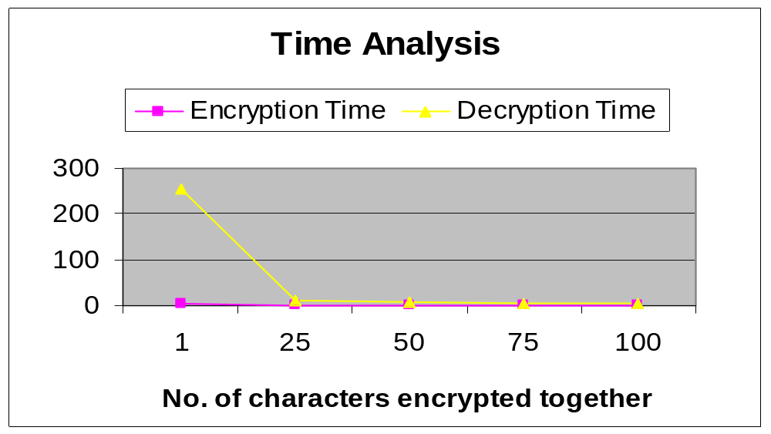
Time Analysis

Slide 16
Overall Analysis
We have noticed the speed improvements in key generation and encryption/decryption while using keys of lower strength.
Encryption and decryption times decrease considerably when number of characters encrypted together increases.
So, a balance is to be made considering both. We found out 1024 bit RSA with 100 characters encrypted together is very efficient in terms of speed and security.

Slide 17
GUI Implementation
The GUI application was developed using KDE/Qt libraries on Red Hat Linux 8.0. We used KDevelop 2.1 as our integrated development environment.
Our application consists of three C++ classes, of which the class named RSA is the most important. It provides slots (signal handlers) for encrypting files, decrypting files, mailing the encrypted file to another user, loading the values of the RSA keys from the key-files, saving encrypted/decrypted files and so on.

Slide 18
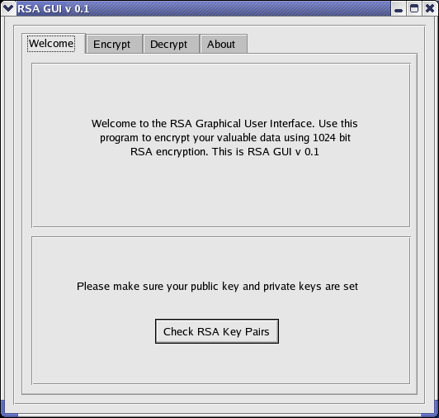
Screenshots
This is the main
dialog of the
RSA GUI.

Slide 19
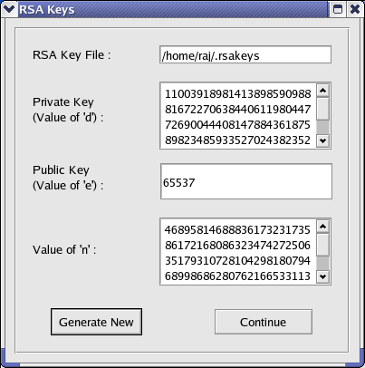
Screenshots…
This is the window
showing the keys
generated by the
application.

Slide 20
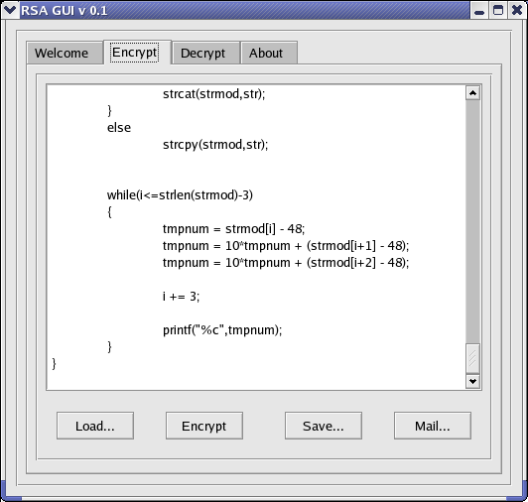
Screenshots…
This is the screen showed for encryption.

Slide 21
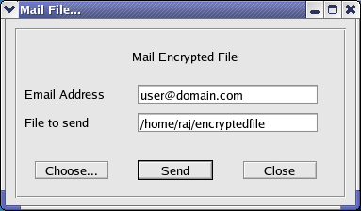
Screenshots…
User can also mail the encrypted file.

Slide 22
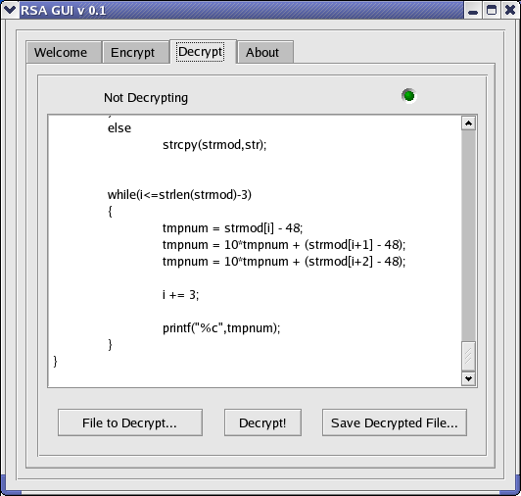
Screenshots…
User can decrypt the encrypted file using his private key.

Slide 23
Conclusion
In this paper an efficient implementation of RSA is shown by using various functions of the GMP library. Feasibility analysis is done by comparing the time taken for encryption and decryption. It shows that when we increase the number of bits of information to be encrypted together the total time including encryption and decryption steadily decreases. It must always be kept in mind that the integer representation of the message to be encrypted should lie within the range specified by the modulus (that is, m lies in the range [0,n-1]), which poses a limitation on the maximum number of characters that can be encrypted at a single time.

Slide 24
References
[1] Paul Syversion and Illiano Cervesato, The logic of authentication protocols,
FOSAD’00, Bertinoro, Italy, 2000.
[2] Dario Catalano, Rosario Gennaro and Shai Halevi, Computing inverse over a shared secret modulus, IBM T. J. Watson Research center, NY, USA, 1999.
[3] Don coppersmith, Markus Jakobsson, Almost optimal hash sequence traversal, RSA Laboratories, NY, 2001.
[4] Elichiro Fujisaki, Tatsuaki Okamoto, David Pointcheval and Jacques Stern, RSA- OAEP is secure under the RSA assumption, Journal of Cryptology, 2002.
[5] Daniel M. Gordon, A survey of fast exponentiation methods, Journal of algorithms, 27, 1998, 126-146.
[6] Adrian Perrig, Robet Szewczyk, Victor Wen, David Culler and J.D. Tygar, SPINS: Security protocols for sensor networks, Mobile Computing and Networking, Rome, Italy, 2001.
[7] David Pointcheval and Jacques Stern, Security proofs for signature schemes, EUROCRYPT ’96, Zaragoza, Spain, 1996.
[8] Giuseppe Ateniese, Michael Steiner, and Gene Tsudik, New multiparty authentication services and key agreement protocols, IEEE Journal of Selected Areas in Communication, 18(4), 2000.
[9] Cetin Kaya Koc, High speed RSA implementation, RSA Laboratories, CA, 1994.
[10] Anand Krishnamurthy, Yiyan Tang, Cathy Xu and Yuke Wang, An efficient implementation of multi-prime RSA on DSP processor, University of Texas, Texas, USA,2002.
[11] Handbook of Applied Cryptography, A. Menezes, P. Van Oorschot, S. Vanstone, CRC Press, 1996 ( www.cacr.math.uwaterloo.ca/hac )

