Slide 1
Network Based Modeling of Infectious Diseases Spread
Faculty of Science and Technology, Dept. of Computer Science
Undergraduate thesis
Student Name | ID | Contribution
1. Dihan, MD. Rafee-uzzaman | 19-40320-1 | 30%
2. Ayon, Israd Ahmed | 19-40638-1 | 25%
3. Jim, Shanjida Sultana | 19-40621-1 | 25%
4. Bari, K.M.Wasimul | 19-40288-1 | 20%
Supervisor: | Supta Richard Philip Lecturer , Department of Computer Science

Slide 2
Introduction
Infectious diseases are a global concern
Traditional models may not capture complex transmission dynamics
Network-based modeling offers a powerful alternative

Slide 3
Problem Statement
Modern infectious disease modeling often simplifies transmission processes, necessitating the development of network-based models using Graph Theory as a framework to address this issue.
The objectives of this project are to investigate the dynamics of disease transmission within populations, evaluate the influence of network structures on disease spread, and identify efficient disease management and prevention solutions.

Slide 4
Research Questions
How can models based on graph theory be modified and used to represent the connections and interactions important to the transmission of infectious diseases?
how may graph theory-based models, as opposed to conventional epidemiological models, improve the precision and prognostication of disease spread simulations?
Node and Edge Attributes
Disease Dynamics
Dynamic Networks
SIR Modeling
SEIR Modeling
SIRD Modeling

Slide 5
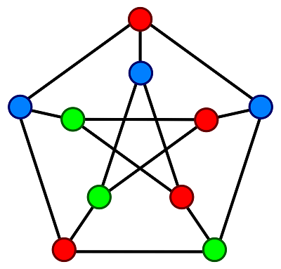
Power of Graph Theory
Graph theory studies connections between entities
In disease modeling, nodes represent individuals, edges represent contacts

Slide 6
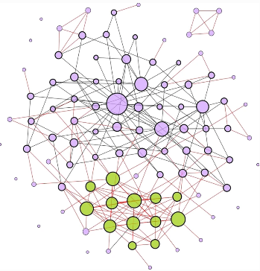
Epidemic Models
Epidemic models are mathematical and computational models that are used to investigate and forecast the spread of infectious illnesses within a population.
SIR, SEIR, and other epidemic models
Incorporating network structure into these models

Slide 7

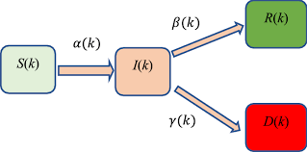
SEIR
SIR
Susceptible
Infectious
Recovered
SIRD

Slide 8
Literature Review
Networks and the epidemiology of directly transmitted infectious diseases are fundamentally linked.
The link between social networks and the transmission of disease is one of the factors driving the scientific community’s significant investment in the field. Diseases spread through networks of human connections. [1]

Slide 9
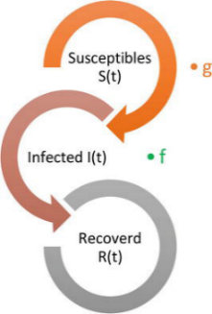
Literature Review
A sort of compartmental modeling called SIR modeling is used to research and assess how infectious illnesses propagate through a population. The code word ”SIR” stands for Susceptible (S), Infectious (I), and Recovered (R), the three basic compartments that make up the model. [2]
The basic differential equations of the SIR model:
dS/dt = -β * S * I dI/dt = β * S * I - γ * I dR/dt = γ * I

Slide 10
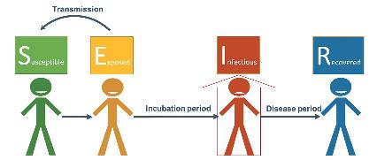
Literature Review
The SEIR model is a mathematical model used to study the spread of infectious diseases in a population. It divides the population into four compartments: Susceptible (S), Exposed (E), Infected (I), and Recovered (R). The model tracks the flow of individuals between these compartments over time. [3]
The basic differential equations of the SEIR model:
dS/dt = -β * S * I dE/dt = β * S * I - α * E dI/dt = α * E - γ * I dR/dt = γ * I

Slide 11
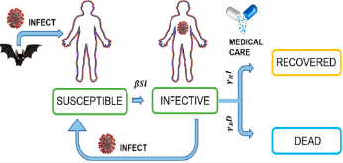
Literature Review
In epidemiology, SIRD modeling is a mathematical framework used to understand and predict the spread of infectious diseases within a population. It categorizes individuals into four groups: Susceptible (S), Infected (I), Recovered (R), Deceased (D). [3]
The basic differential equations of the SIRD model:
dS/dt = -β * S * I dI/dt = β * S * I - (γ + μ) * I dR/dt = γ * I dD/dt = μ * I

Slide 12
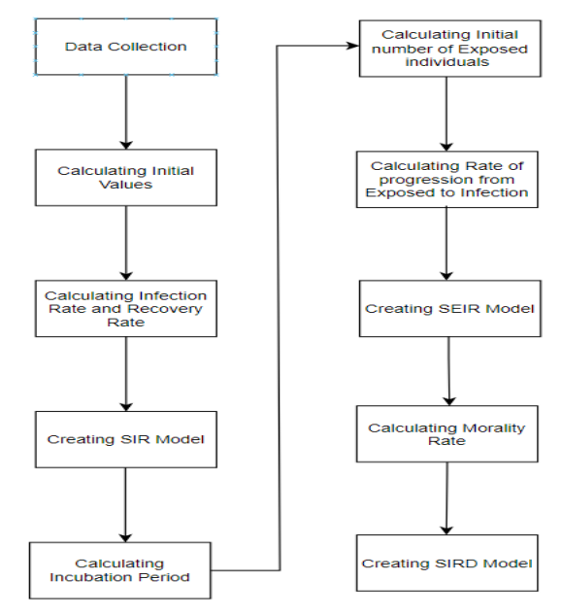
Methodology
Data Collection
Calculating the initial Susceptible, Deaths and Recoveries
Calculating the Infection rate and Recovery rate
Calculating the Incubation period and Rate of Progression from Exposed to Infection
Creating Network Models

Slide 13
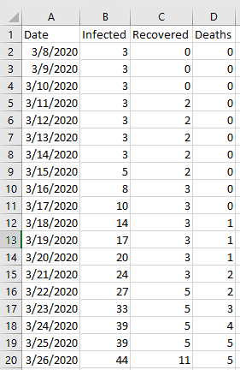
Initial values, Infection rate & Recovery rate for SIR Model
Estimated value of Infection rate: 0.25 Estimated value of Recovery rate: 0.07

Slide 14
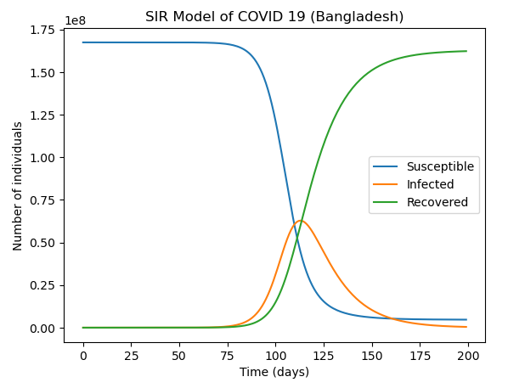
SIR Model

Slide 15
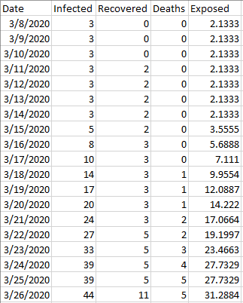
Initial values, Incubation Period & Rate of Progression for SEIR Model
Incubation Period: 6.4 days Infectious period: 9 days
Percentage of individuals in the exposed compartment = (Incubation period / Total infectious period) * 100
Estimated value of Infection rate: 0.25 Estimated value of Recovery rate: 0.07
Estimated value of rate of progression : 0.1515

Slide 16
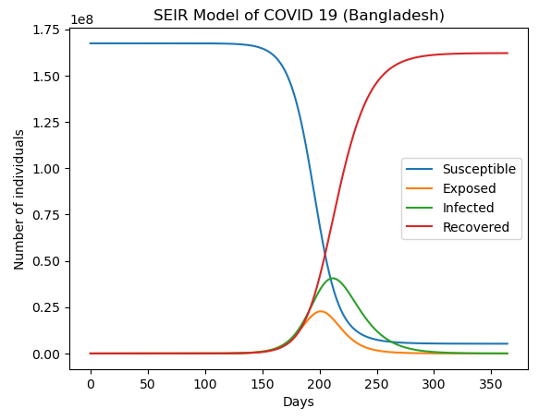
SEIR MODEL

Slide 17
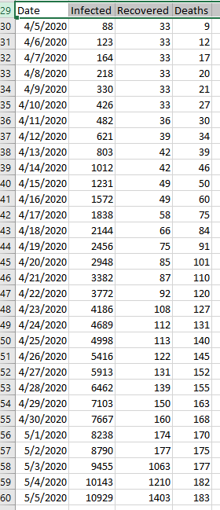
Initial values & Mortality rate for SIRD Model
Mortality Rate (mu) = (183 / 10,929) ×100 ≈ 1.67%
Estimated value of Infection rate: 0.25 Estimated value of Recovery rate: 0.07
Estimated value of Mortality rate : 0.0167

Slide 18
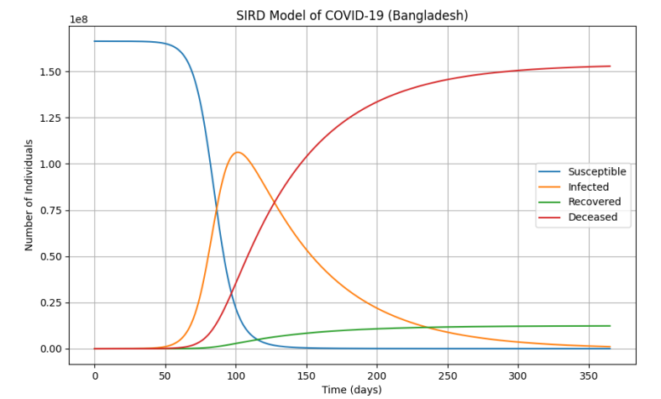
SIRD MODEL

Slide 19
RESULT
Considering infectious diseases pose serious risks to public health, modeling and analysis of these diseases are essential for efficient disease control and prevention.
This study models the spread of infectious diseases within communities using a graph theory approach, providing useful knowledge into the dynamics of disease.
The outcomes and conclusions of this study give us a complete understanding of how network-based modeling might improve our capacity to predict, control, and manage infectious disease epidemics.

Slide 20
FUTURE WORK
Model Refinement
Incorporate behavioral dynamics into the network models to better understand the influence of human actions on disease transmission
Compare and contrast the network-based models for different infectious diseases to identify common principles and disease-specific factors.
Enhance the predictive accuracy of network-based models for disease forecasting.

Slide 21
Reference
[1] C. a. D. Filippo Menczer, Santo Fortunato, A First Course in Network Science. Cambridge University Press, 2020.
[2] G. H. A. K. V. M. M. V. S. A. T. Z. Eubank, S. and N. Wang, Modelling disease outbreaks in realistic urban social networks. Nature, 429(6988), 2004.
[3] M. Newman, Networks: An Introduction. United Kingdom: OUP Oxford, 2010.
[4] K. T. E. Matt J Keeling, Networks and epidemic models. J.R. Soc. Interface, 2005.
[5] S. e. a. Paul, Study of SEIR epidemic model and scenario analysis of covid-19 pandemic. Ecological Genetics and Genomics, 2021.
[6] G. C. Calafiore, C. Novara, and C. Possieri, “A time-varying sird model for the covid-19 contagion in italy,” Annual reviews in control, vol. 50, pp. 361–372, 2020.

Slide 22


Slide 23


