Slide 1
AcCAPPCHA: Design, Development and Security Analysis of an Invisible CAPPCHA based on an acoustic side-channel
Master degree in Computer Engineering
Candidate:
Di Nardo Di Maio Raffaele
Supervisor:
Migliardi Mauro

Slide 2
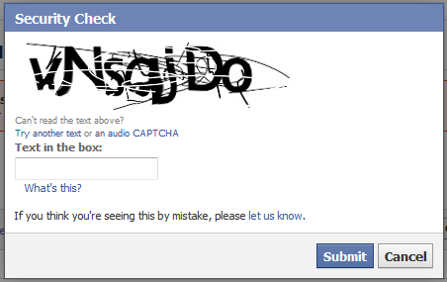
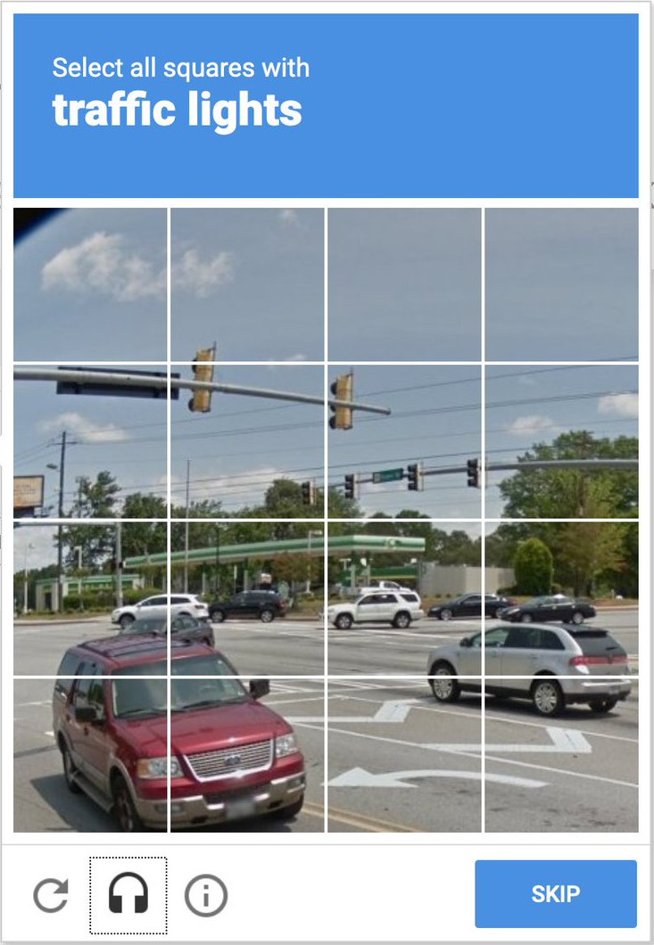

CAPTCHA (Completely Automated Public Turing-test-to-tell Computers and Humans Apart)
Traditional CAPTCHAs
based on cognitive capabilities of the user (e.g. Image-based and text based CAPTCHAs)
Modern CAPTCHAs
based on the human’s physical identity and on the evaluation of data from sensors or activity of the users on the web site (e.g. Google ReCAPTCHAs)
Di Nardo Di Maio Raffaele
03/01/2021
1

Slide 3
AcCAPPCHA
Acoustic CAPPCHA (Completely Automated Public Physical test to tell Computer and Humans Apart)
based on the analysis of an acoustic side-channel of the PC microphone
Main phases of the analysis:
Noise evaluation
Noise evaluation
Evaluation of the user’s activity during the password insertion
Communication between client and server
Before the user types the password
A 2 seconds long audio file is recorded and a noise threshold is evaluated
During the insertion of the password
An audio file is recorded to find all the audio peaks that have intensity greater than noise threshold and are related to the keyboard events

Slide 4
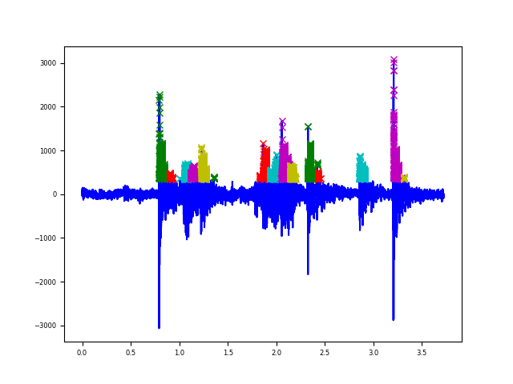
Evaluation of the user’s activity
Time correspondence
A human user is detected:
Exact problem
if the time instants of keyboard events, generated during the insertion of the password, overlap with the time instants of audio peaks detected during the insertion of the password
Relaxation of the problem
if a fixed percentage of the time instants of the audio peaks overlaps with the time instansts related to keyboard events

Slide 5
Noise evaluation
Evaluation of the user’s activity
Time correspondence
Character correspondence

Slide 6
Character correspondence
Type of features

Slide 7
Data Acquisition
Classification

Slide 8
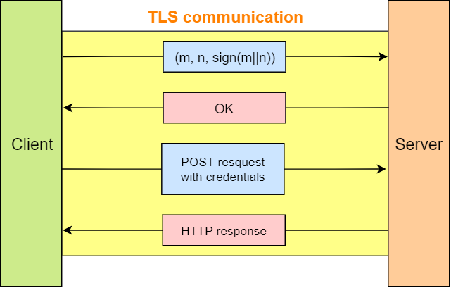
Communication between client and server

Slide 9
Human detection
Results
Relaxation results

Slide 10
Bot detection
Pipe bot
Pynput bot
Team viewer

Slide 11
Strength against most known attacks
Eavesdropping
Replay

Slide 12
Future work
Improvement of character correspondence
Implementation on other devices (smartphones & tablets)
Relationship between accuracy and:
different users typing styles
different level of wear and tear of a same hardware

Slide 13
Thanks for your attention

