Slide 1
AcCAPPCHA: Design, Development and Security Analysis of an Invisible CAPPCHA based on an acoustic side-channel
Master degree in Computer Engineering
Candidate:
Di Nardo Di Maio Raffaele
Supervisor:
Migliardi Mauro

Slide 2
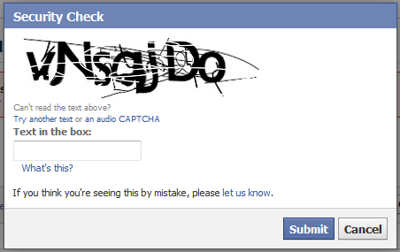
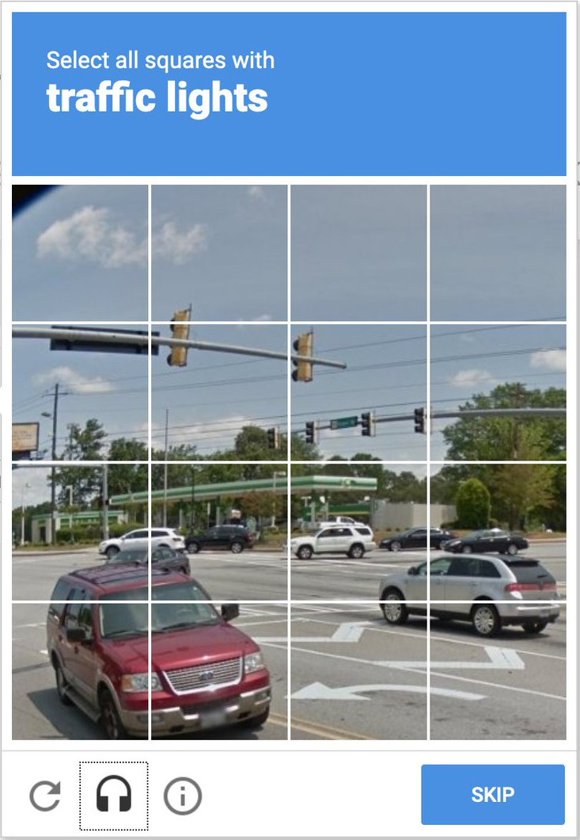

CAPTCHA (Completely Automated Public Turing-test-to-tell Computers and Humans Apart)
program used to detect bot activity on web services
Traditional CAPTCHAs
based on cognitive capabilities of the user
Modern CAPTCHAs
based on the human’s physical identity (e.g. the behaviour of the users on the website)
Di Nardo Di Maio Raffaele
03/01/2021
1

Slide 3
Design of a new CAPTCHA
Invisible CAPPCHA
AcCAPPCHA
An implementation of modern CAPTCHA
an accelerometer side-channel
difference between hardware vibrations and hand movements during the insertion of the password
New CAPTCHA based on the analysis of:
an acoustic side-channel of the PC microphone
the audio peaks during the insertion of the password, related to the keyboard events
Main phases of the analysis:
Noise evaluation
Evaluation of the user’s activity during the password insertion
Communication between client and server

Slide 4
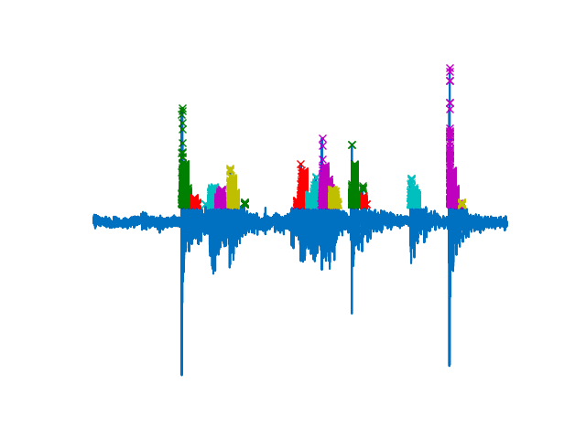
Evaluation of the user’s activity
Time correspondence
A human user is detected:
Exact problem
if the time instants of keyboard events, generated during the insertion of the password, overlap with the time instants of audio peaks detected during the insertion of the password
Relaxation of the problem
if a fixed percentage of the time instants of the audio peaks overlaps with the time instansts related to keyboard events

Slide 5
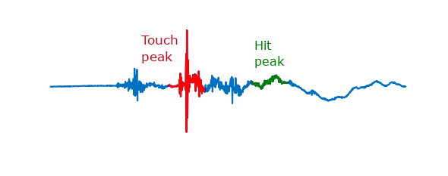
Evaluation of the user’s activity
Character correspondence
Each audio peak, detected during the insertion of the password, is identified by a key of the keyboard.
A human user is detected:
if all the characters of the password are found in the sequence of keys associated to the audio peaks.

Slide 6
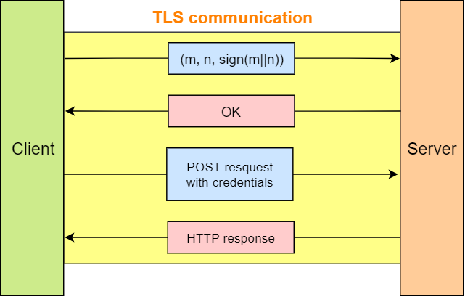
Communication between client and server
m: user’s evaluation response
n: nonce
Limited amount of trials

Slide 7
Human detection
Experimental Results
Strength against known attacks
Results
Time correspondence is the best method
Accuracy of 100%
with a password of 14 characters
Relaxation results
the best relaxation percentage was 90%
Replay attack
Reverse engineering attack
Human solver relay attacks
Brute force attack
Denial of Service attack (DoS)
Eavesdropping attack
Type of problem | 1st trial | 2nd trial | 3rd trial
Standard | 80% | 19% | 1%
Relaxed | 83% | 17% | 0%

Slide 8
Future work
Improvement of character correspondence
Implementation on other devices e.g. smartphones & tablets
Relationship between accuracy and:
different users typing styles
different level of wear and tear of a same hardware

Slide 9
Thanks for your attention

Slide 10
AcCAPPCHA (Acoustic CAPPCHA)
Noise evaluation
Main phases of the analysis:
Before the user types the password
A 2 seconds long audio file is recorded and a noise threshold is evaluated
During the insertion of the password
An audio file is recorded and filtered with the previous threshold, trying to find the audio peaks related to the keyboard events.
Noise evaluation
Evaluation of the user’s activity during the password insertion
Communication between client and server

Slide 11
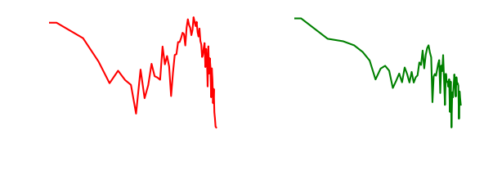
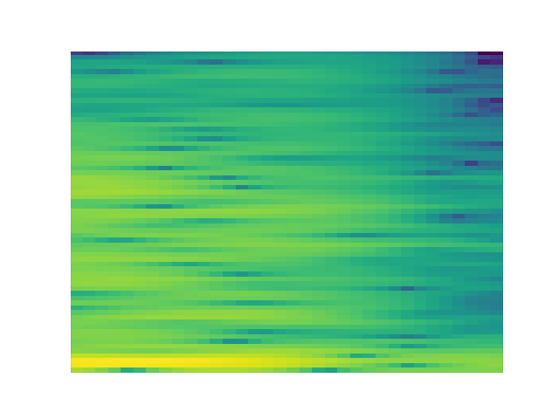
Evaluation of the user’s activity
Training of the neural network
over 200 audio files per key of the keyboard
Type of possible features:
Normalized FFT of touch peak
Normalized FFT of touch peak concatenated with the normalized FFT of hit peak
Spectrogram of press peak
Classification of the audio peaks detected during the insertion of the password

Slide 12
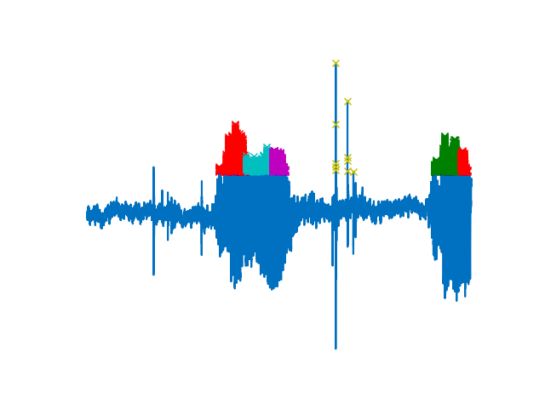
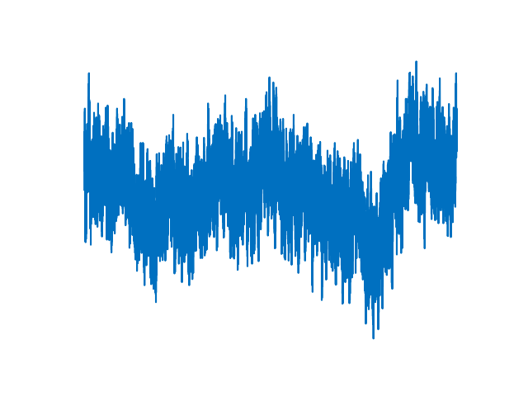
Bot detection
Low noise during noise evaluation
High noise during noise evaluation

