Slide 1
AcCAPPCHA: Design, Development and Security Analysis of an Invisible CAPPCHA based on an acoustic side-channel
Master degree in Computer Engineering
Candidate:
Di Nardo Di Maio Raffaele
Supervisor:
Migliardi Mauro

Slide 2
CAPTCHA
Traditional CAPTCHAs
Modern CAPTCHAs

Slide 3
AcCAPPCHA
Noise evaluation
Audio during the password insertion
Time correspondence
Character correspondence
Press peak structure

Slide 4
Time correspondence
Initial tests
Relaxation of the problem

Slide 5
Character correspondence
Type of features

Slide 6
Data Acquisition
Classification

Slide 7
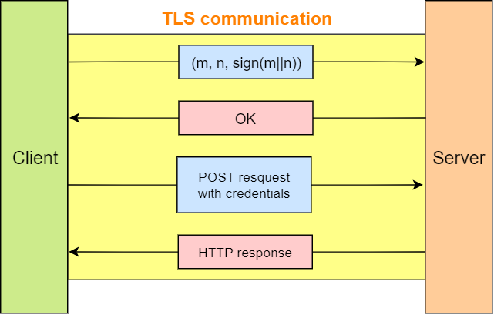
Communication between client and server

Slide 8
Human detection
Results
Relaxation results

Slide 9
Bot detection
Pipe bot
Pynput bot
Team viewer

Slide 10
Strength against most known attacks
Eavesdropping
Replay

Slide 11
Future work
Improvement of character correspondence
Implementation on other devices (smartphones & tablets)
Relationship between accuracy and:
different users typing styles
different level of wear and tear of a same hardware

Slide 12
Thanks for your attention

