Slide 1
AcCAPPCHA: Design, Development and Security Analysis of an Invisible CAPPCHA based on an acoustic side-channel
Master degree in Computer Engineering
Candidate:
Di Nardo Di Maio Raffaele
Supervisor:
Migliardi Mauro

Slide 2
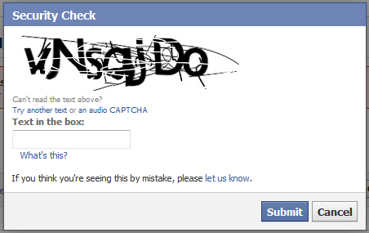
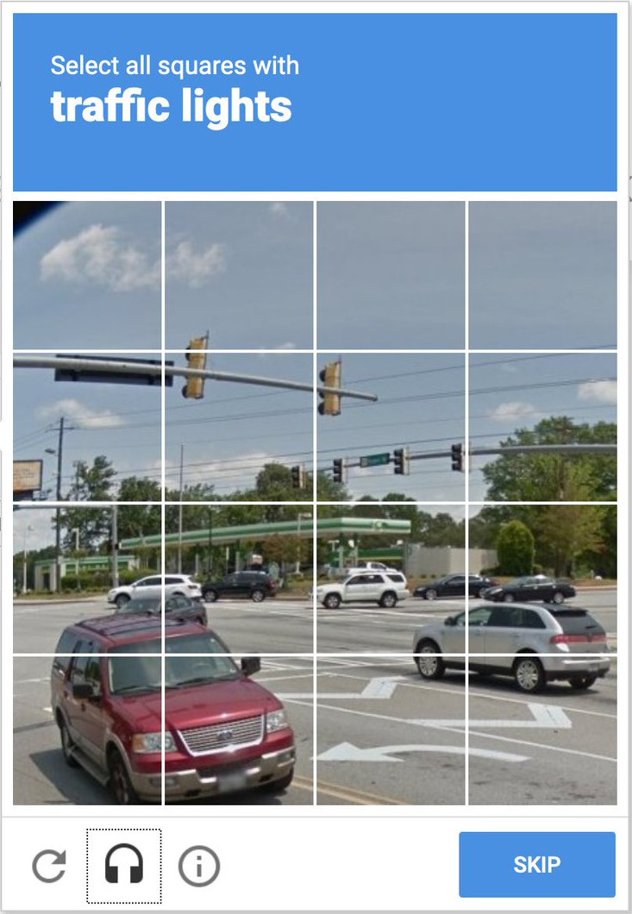

CAPTCHA (Completely Automated Public Turing-test-to-tell Computers and Humans Apart)
Traditional CAPTCHAs
based on cognitive capabilities of the user (e.g. Image-based and text based CAPTCHAs)
Modern CAPTCHAs
based on the human’s physical identity and on the evaluation of data from sensors or activity of the users on the web site (e.g. Google ReCAPTCHAs)
Di Nardo Di Maio Raffaele
03/01/2021
1

Slide 3
AcCAPPCHA
Acoustic CAPPCHA (Completely Automated Public Physical test to tell Computer and Humans Apart)
based on the analysis of an acoustic side-channel of the PC microphone
Main phases of the analysis:
Noise evaluation
Noise evaluation
Evaluation of the user’s activity during the password insertion
Communication between client and server
Before the user types the password
A 2 seconds long audio file is recorded and a noise threshold is evaluated
During the insertion of the password
An audio file is recorded to find all the audio peaks that have intensity greater than noise threshold and are related to the keyboard events

Slide 4
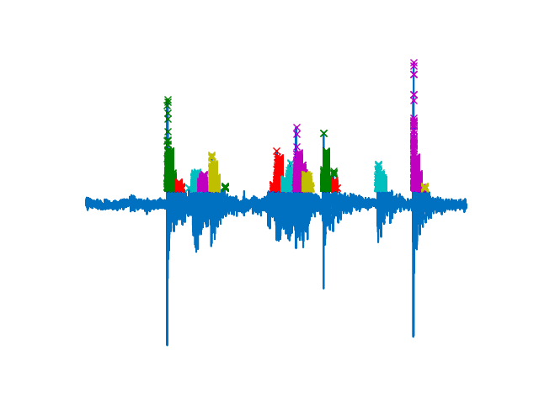
Evaluation of the user’s activity
Time correspondence
A human user is detected:
Exact problem
if the time instants of keyboard events, generated during the insertion of the password, overlap with the time instants of audio peaks detected during the insertion of the password
Relaxation of the problem
if a fixed percentage of the time instants of the audio peaks overlaps with the time instansts related to keyboard events

Slide 5
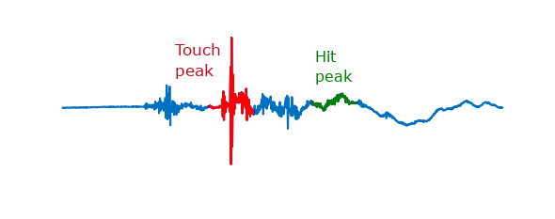
Evaluation of the user’s activity
Character correspondence
Data acquisition
200 audio files per key of the keyboard + data augmentation

Slide 6
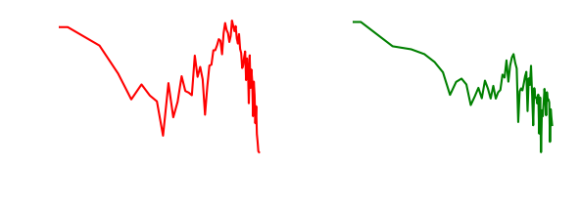
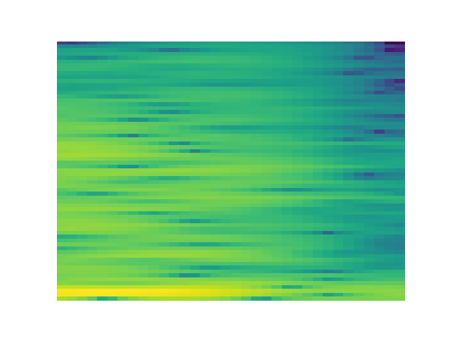
Evaluation of the user’s activity
Extraction of features from the audio peak in every file
Three possible types of features:
Normalized FFT of touch peak
Normalized FFT of touch peak concatenated with the normalized FFT of hit peak
Spectrogram of the press peak
Training of a neural network
Classification of the audio peaks detected during the insertion of the password

Slide 7
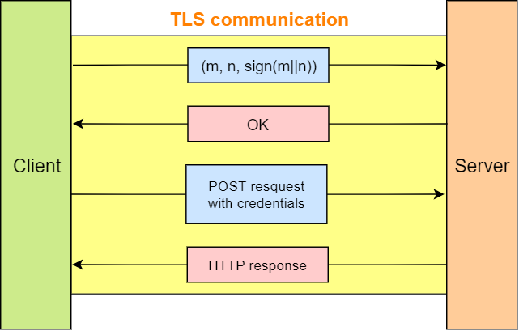
Communication between client and server
m: user’s evaluation response
n: nonce

Slide 8
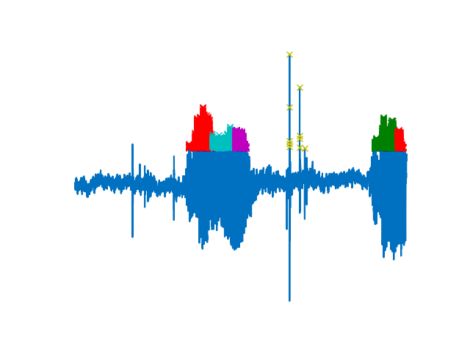
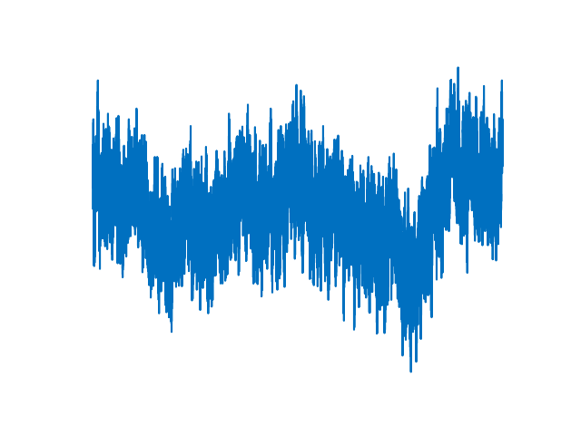
Bot detection
It was tested using a bot (implemented using Python) and Team Viewer.
Two possible scenarios:
Low noise during noise evaluation
some audio peaks are detected during the insertion of the password
High noise during noise evaluation
no audio peaks are detected during the insertion of the password

Slide 9
Human detection
Results
Time correspondence is the best method
It reaches an accuracy of 100% by inserting a password of 14 characters “he35ghibn564st”
Relaxation results
the best relaxation percentage was 90%
Strength against known attacks
Replay attack
Reverse engineering attack
Human solver relay attacks
Brute force attack
Denial of Service attack (DoS)
Eavesdropping attack
Type of problem | 1st trial | 2nd trial | 3rd trial
Standard | 80% | 19% | 1%
Relaxed | 83% | 17% | 0%

Slide 10
Future work
Improvement of character correspondence
Implementation on other devices (smartphones & tablets)
Relationship between accuracy and:
different users typing styles
different level of wear and tear of a same hardware

Slide 11
Thanks for your attention

