Slide 1
AutoChef

Slide 2









Problem
Health Problems
Unbalanced
Diet
Unorganized
Weekly Meals
Overspending
Overshopping
Food Waste
Notes:
Problem: Unorganized weekly meals -> Unbalanced Diet, Overshopping -> More food than needed -> Food Waste

Slide 3





Solution: Autochef
AutoChef allows you to:
Plan what to eat in advance, choosing from your favourite recipes!
Manage the plan across different groups
Keep nutrients intake in check
Generate the optimal shopping list for your chosen meals considering pantry leftovers
Browse and rate user created recipes

Slide 4
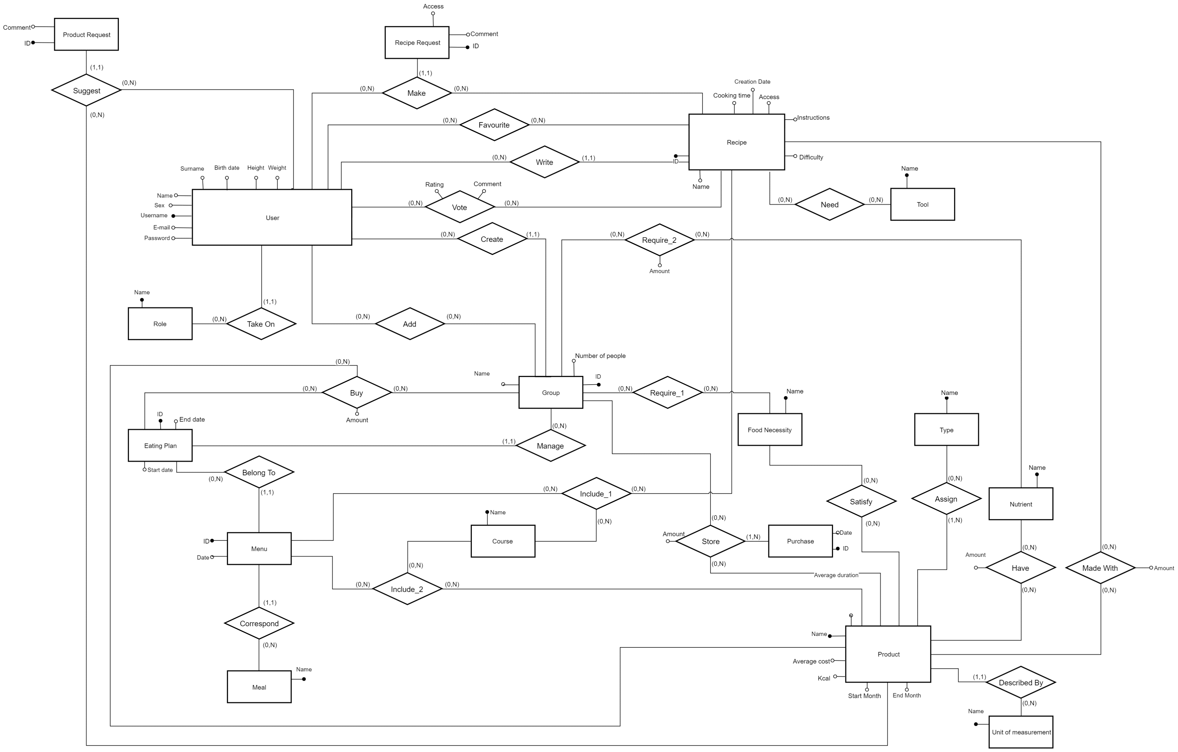
ER Schema

Slide 5
User-Group

Slide 6
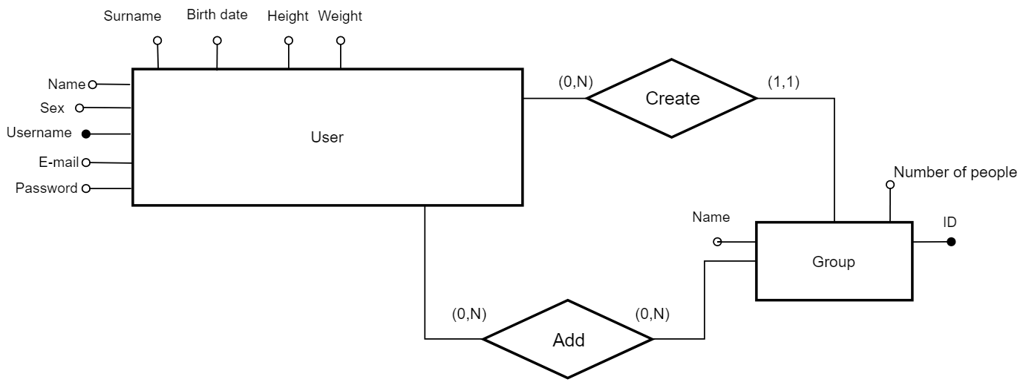
User-Group

Slide 7
Main Features

Slide 8
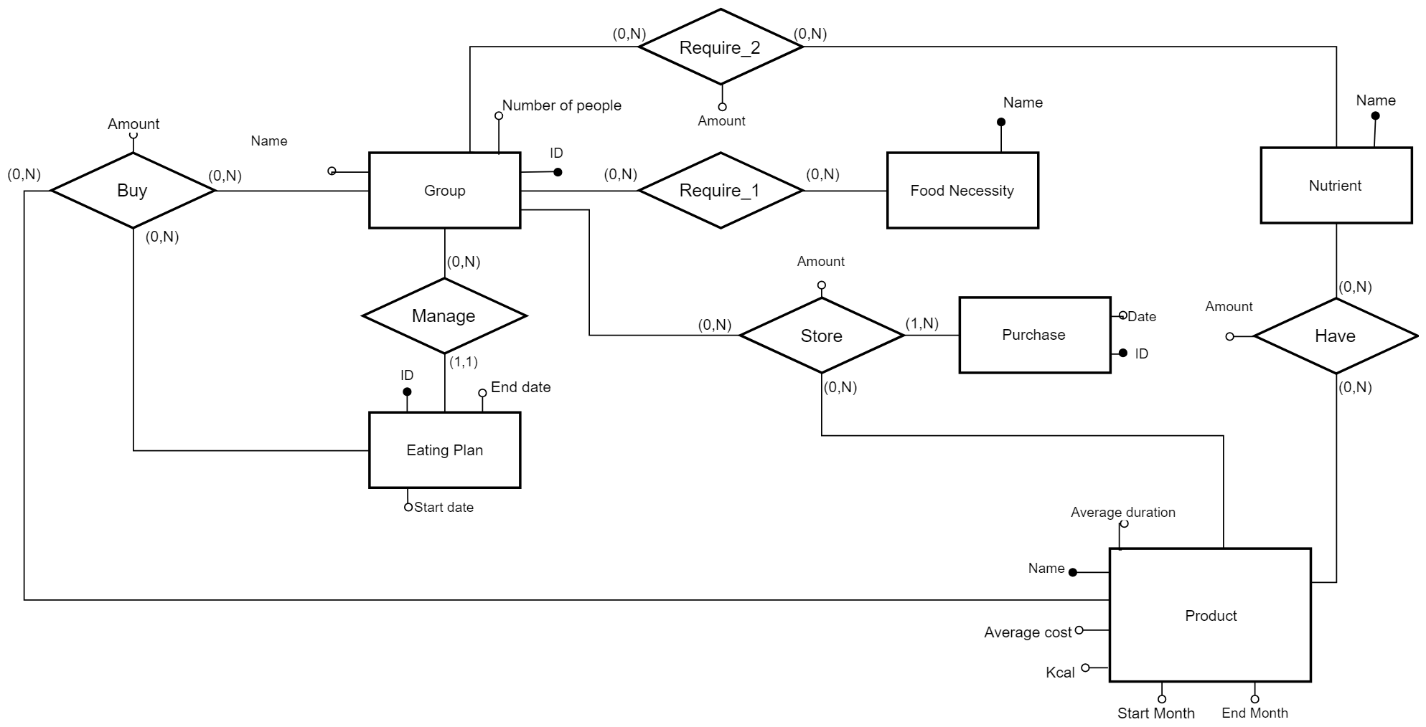
Main Features

Slide 9
Management of Recipes

Slide 10
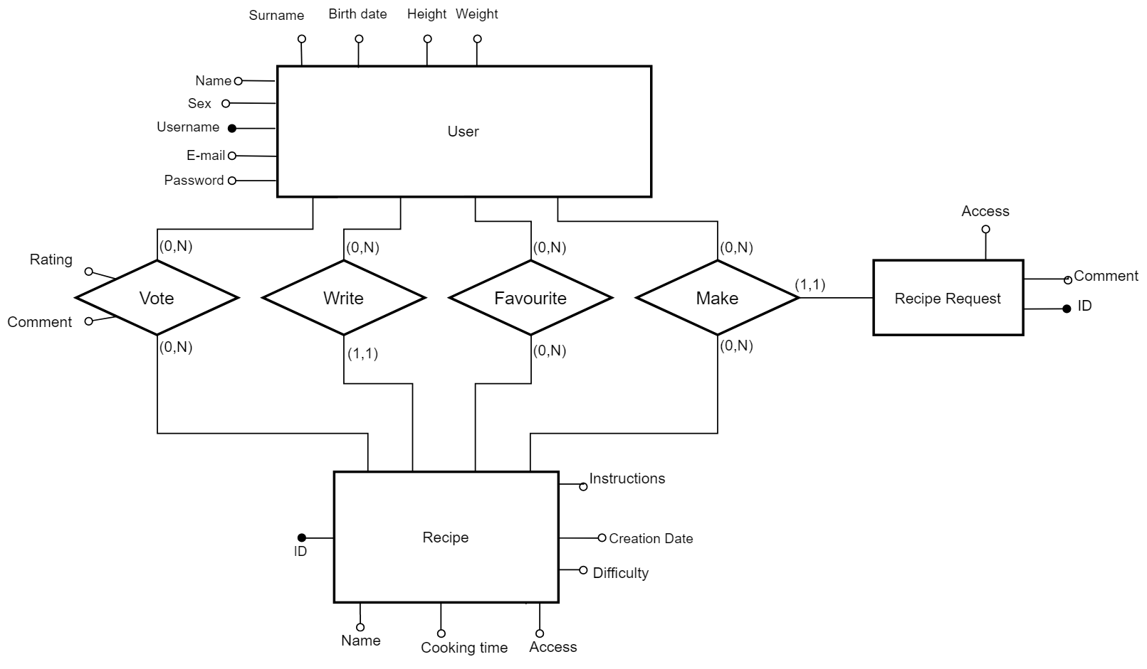
Management of Recipes

Slide 11
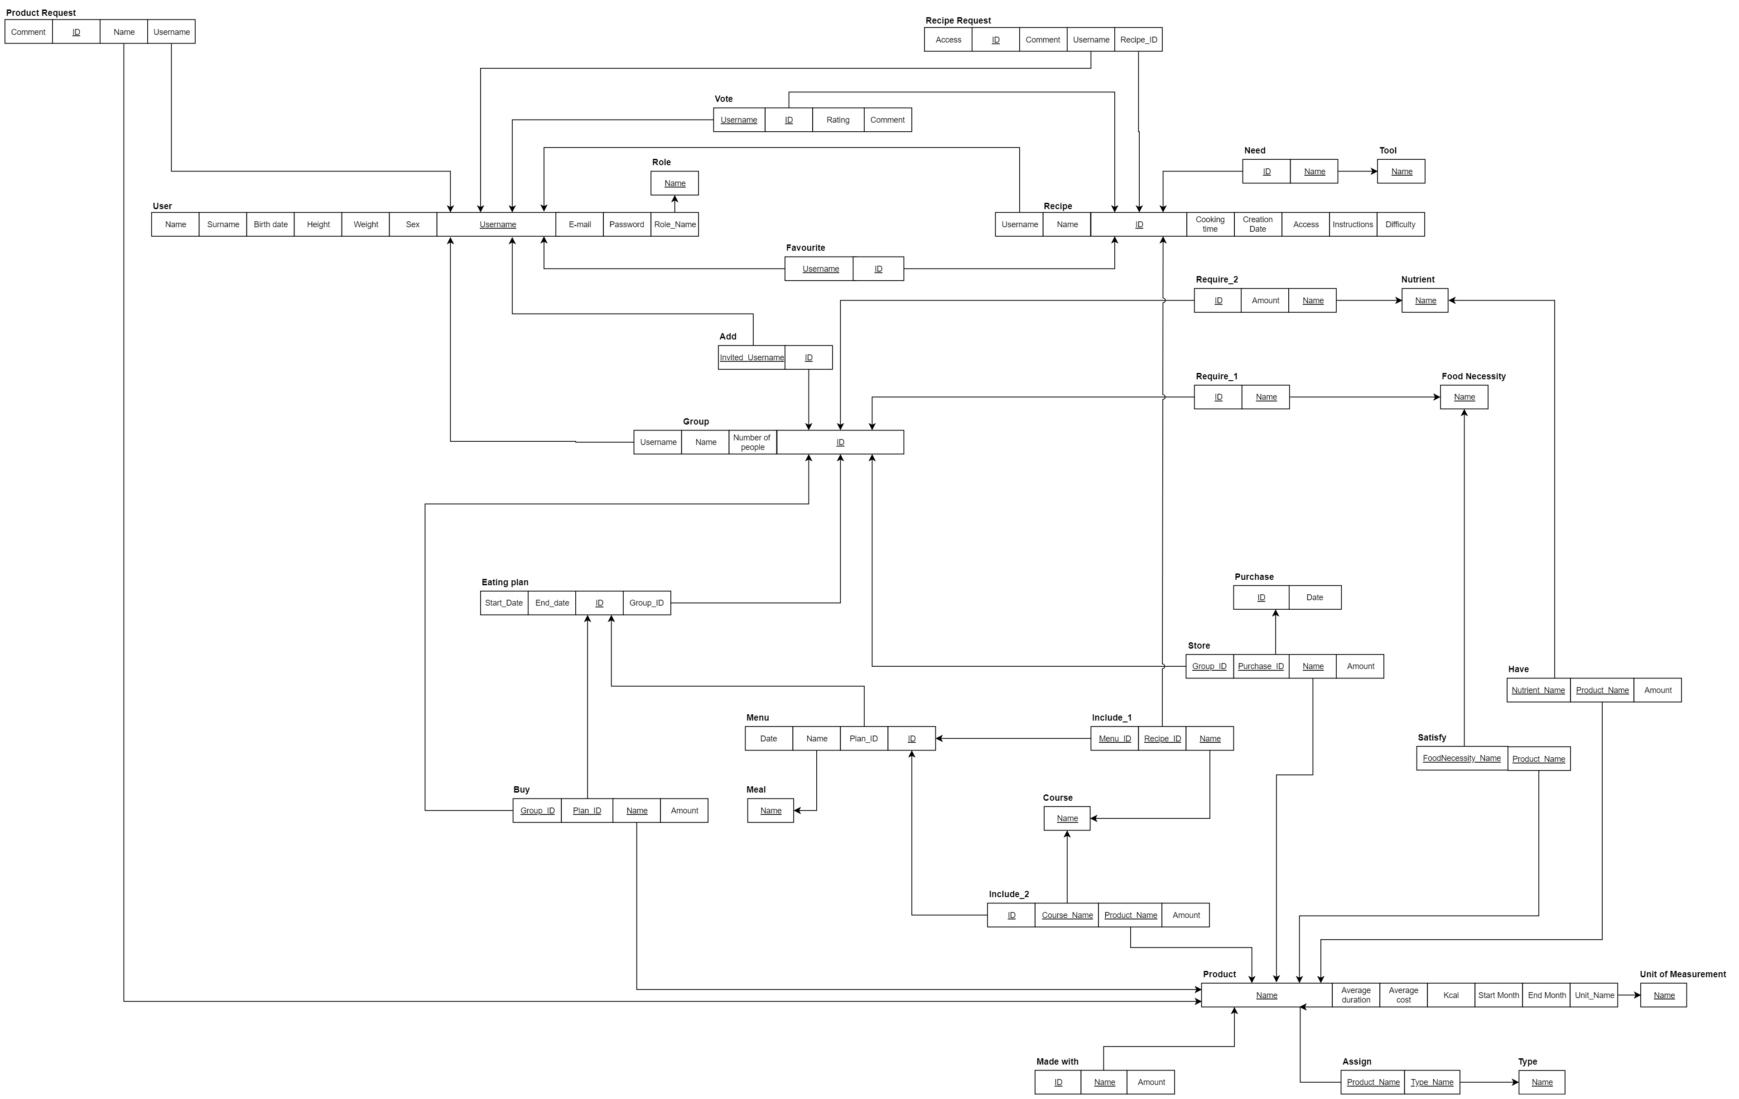
Relational Model

Slide 12
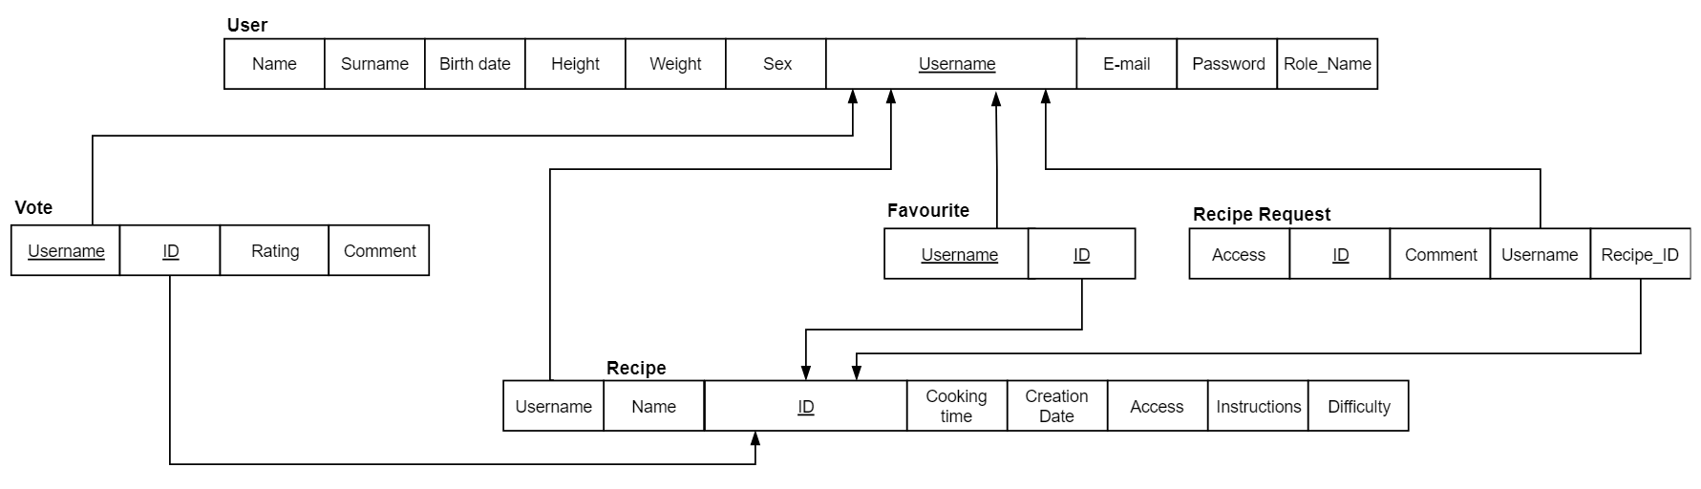
Management of Recipes

Slide 13
Normalization
First Normal Form: Composite and multivalued attributes have been removed
Second Normal Form: By analyzing the relations with a primary key composed by more than one attribute we can see that every non-prime attribute is totally dependent on the key
Third Normal Form: The 3NF is achieved, since there are no transitive dependencies in the relational schema

Slide 14
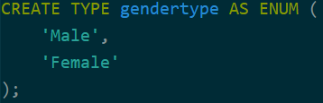
Domain constraints
Enumeration

Slide 15
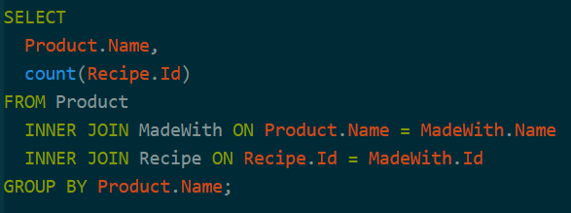
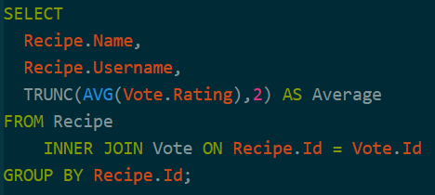
Query
List of products and number
of recipes in which they are contained
List of recipes with their author and average rating

Slide 16
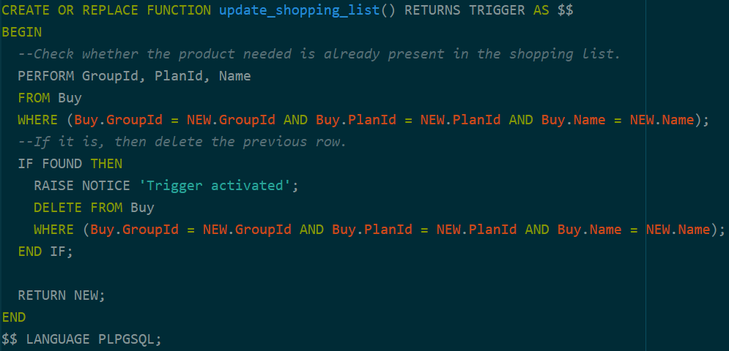
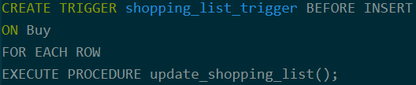
Trigger

Slide 17
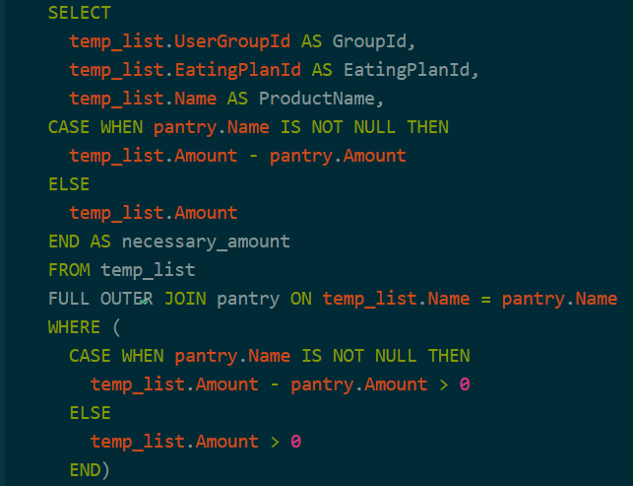
Stored Procedure

Slide 18
NOW THE DEMO

