Slide 1
AndroidMote
Raffaele Carillo

Slide 2
Analisi progetto diapositiva 2
Premessa
Wireless devices are a highly sought-after category of consumer electronics items today. Examples of such devices include wireless headphones and speakers, mice, keyboards, smartwatches, and various IoT devices.
In addition to consumer electronics, the use of wireless technology is also of fundamental importance in areas in industrial environments where machinery must be controlled remotely and the use of cables can be problematic.
The design of these devices has become of fundamental importance and takes on an increasingly important role thanks to the improvement of the processing capabilities of the devices combined with the reduction of consumption and the improvement of other technologies such as batteries.
In this project, an early-prototype of a Bluetooth pointing device (IEEE 802.15.1) is developed by combining various technologies and tools. Some technical/economic considerations will also be made that led to the choice and use of certain components.

Slide 3
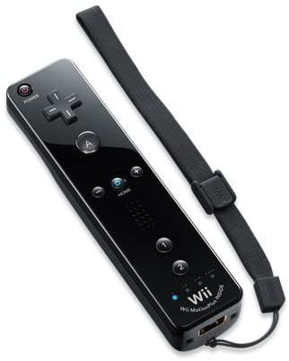
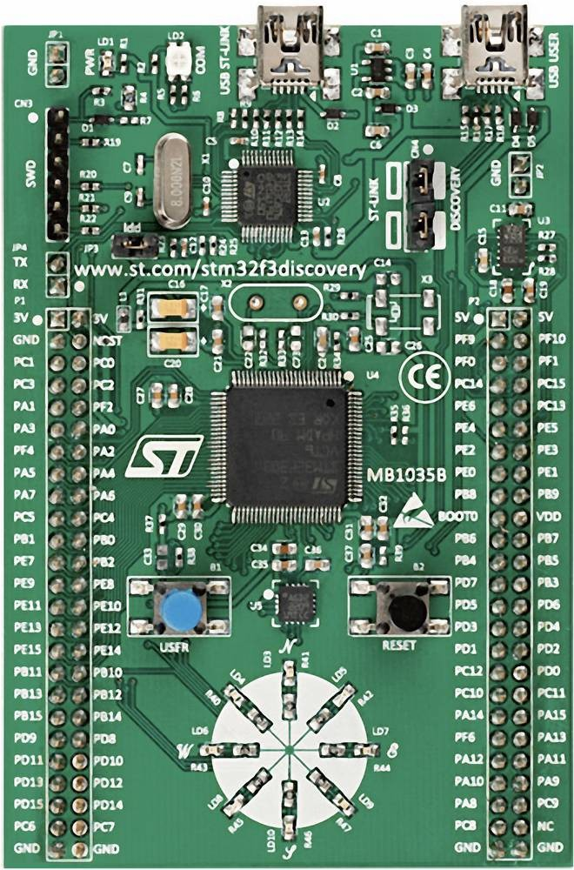

Analisi progetto diapositiva 2
Initial idea and inspiration
The initial idea was to attach the Wii console's remote control (known as Wiimote) and use its infrared-based readings to display a pointer on a display connected to the STM32 board. This initial idea had some positive and negative points.
POSITIVE
NEGATIVES
Precision, quality and performance
Bluetooth Standard Human Interface Device (HID) Profile
The Wiimote, being equipped with dedicated hardware, is able to offer remarkable pointer precision as well as low consumption. The Wiimote is able to project a pointer also taking into account the perspective and does not require a perfectly frontal positioning of the user
The use of this profile of the Bluetooth standard involves the use of complex drivers in conjunction with the use of operating systems such as FreeRTOS. Bluetooth cards that support the HID profile are very expensive on the market. Adapters that are compatible with your budget and hardware support serial profile only.

Slide 4
Analisi progetto diapositiva 2
Solution: Recreate the Wiimote
(in part...)

Slide 5
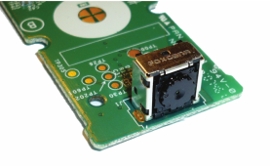
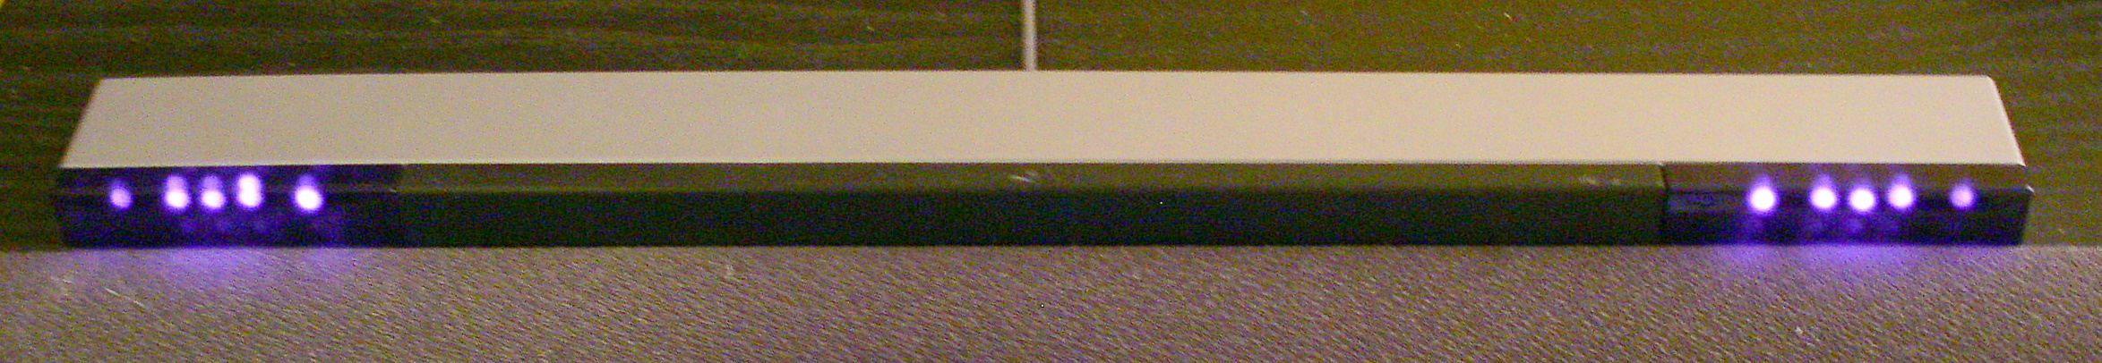
Analisi progetto diapositiva 3
How it works
The Wiimote is equipped with a suite of sensors and devices including: A low-resolution monochrome camera (128x96) placed behind an infrared filter attached to the remote control housing. A three-dimensional accelerometer. A speaker. A vibration motor. Some buttons for gaming functions. Bluetooth connectivity (IEEE 802.15.1). In addition, there is an Image Signal Processor (ISP) that uses camera detections to derive the position of the pointer.
The console also comes with a "sensor bar" to be placed below or above the screen. Despite the name, it does not include any sensor but only 940 nm infrared LEDs placed at the end that serve as a reference for the Wiimote.

Slide 6
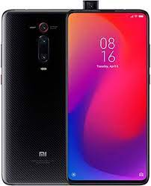
Analisi progetto diapositiva 3
Hardware used
Most smartphones on the market have cameras capable of capturing the light of 940nm IR LEDs, thanks to Bluetooth connectivity and image processing capacity it is possible to use a smartphone as a pointing device.
In particular, an Android application has been created that uses the open source tool OpenCV to identify the bright areas captured by the camera. The position of the bright spots is used to send the pointer coordinates via Bluetooth.
The STM32F3DISCOVERY board is a development board that allows the creation of embedded systems in a simple and fast way. This board is equipped with:
ARM Cortex-M4 @72 Mhz-based STM32F303VCT6 MCU with 256 KB of flash memory and 48 KB of RAM.
Digital Analog Converter, Analog Digital Converter, Comparators, Operational Amplifiers. 8 LEDs and two buttons connected to the GPIO interface.
Connectivity via USART, SPI, I2C, USB and CAN protocols.

Slide 7
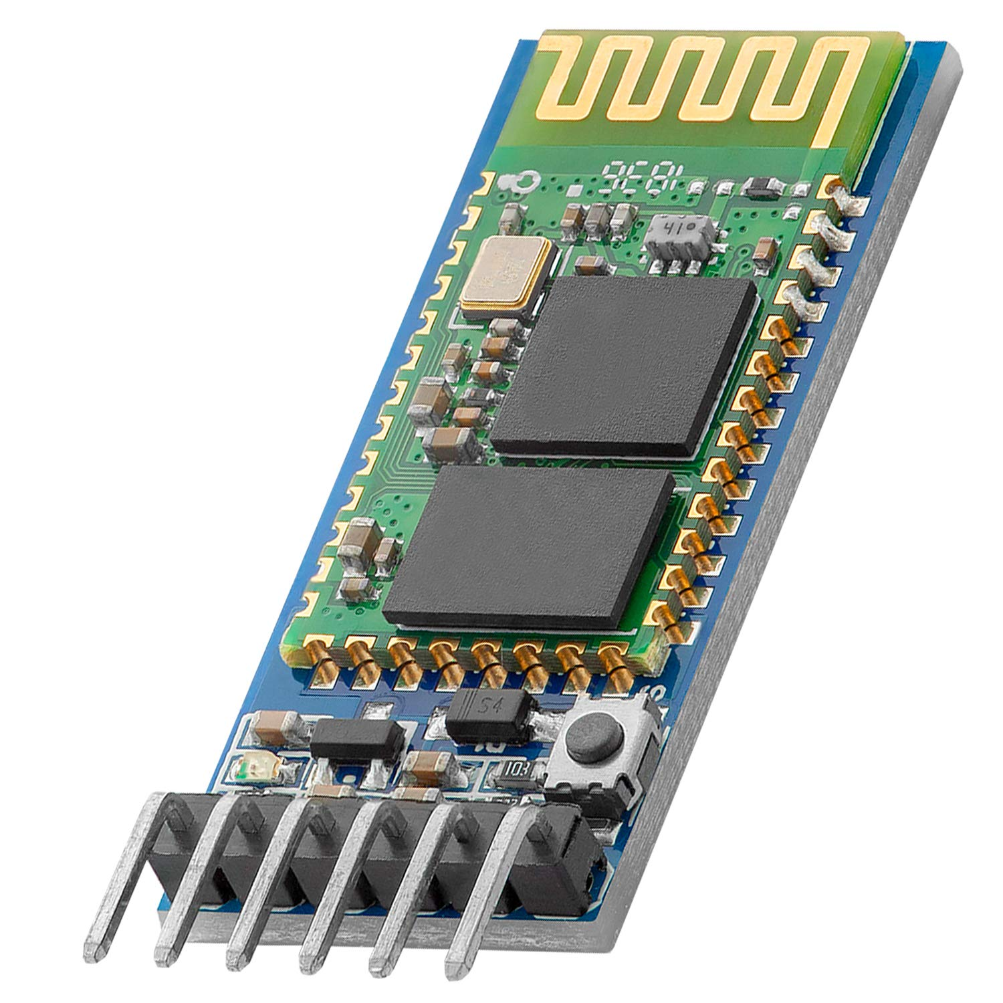
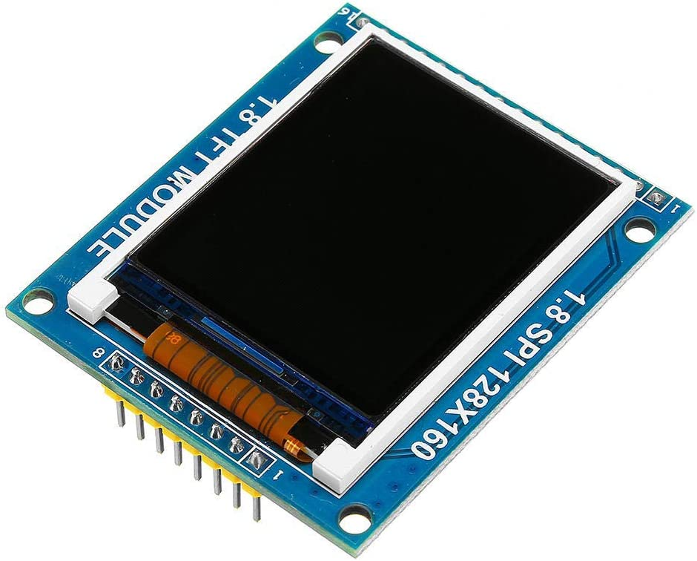
Analisi progetto diapositiva 3
Hardware used
The HC-05 is a serial-to-Bluetooth converter module. In particular, it can convert messages received via UART and send them via the Serial Port Profile (SPP) of the Bluetooth standard. Within a Bluetooth connection it can function both as a Master and as a Slave. Supports secure PIN pairing. It is powered by 5V and has a status LED and a button to start scanning nearby devices. The default baud rate is 9600 bits/s.
The ST7735 is a cost-effective microcontroller that is based on simple color LCD displays. The sample used has a resolution of 128x160 and supports colors in RGB 5-6-5 format with 65k of displayable colors. It is backlit by two white LEDs whose light is reflected all over the screen. It uses the Serial Periferal Interface (SPI) protocol, but also supports parallel connection (Intel 8080). It also has an SD card reader to be able to view images in bitmap format (.bmp). It is powered at 5V with a separate connection for backlighting.

Slide 8
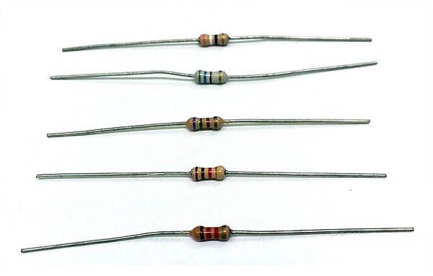
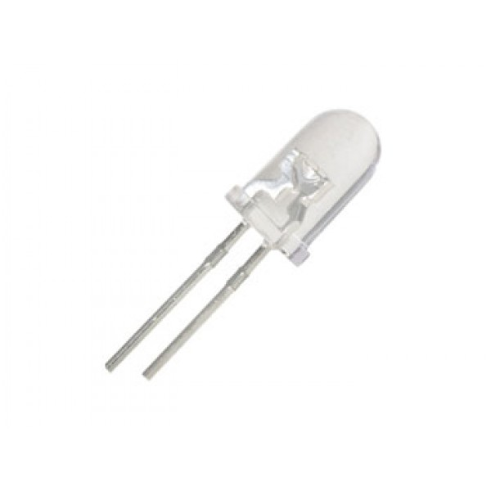

Analisi progetto diapositiva 3
Hardware used
940 nm IR LED. With Vf = 1.5-1.6V and current consumption of 60 mA
Resistors
9V battery

Slide 9
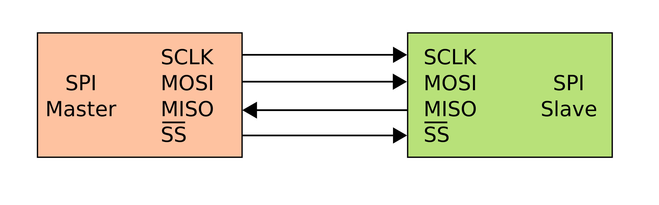
Analisi progetto diapositiva 3
ST7735: SPI Protocol
It is a communication standard bus developed by Motorola. The transmission takes place between a Master and one or more Slaves. The Master in addition to controlling the bus also emits the clock signal.
As far as the transmission speed is concerned, there is no lower or upper limit and the speed is dictated by the physical limits (parasitic capacitance) or by the specifications provided with the device datasheet.
The SPI protocol is serial, synchronous and full-duplex.
SPI is realized with four signals:
SCLK (also called SCK, CLK) – Serial Clock.
SDI (also called MISO, SOMI, DI, SO) – Serial Data Input (Master Input Slave Output).
SDO (also called MOSI, SIMO, DO, SI) – Serial Data Output (Master Output Slave Input).
CS (SS, nCS, nSS, STE) – Chip Select used by the Master to select the Slave, to start the communication the slave must be placed at a low logic level.

Slide 10
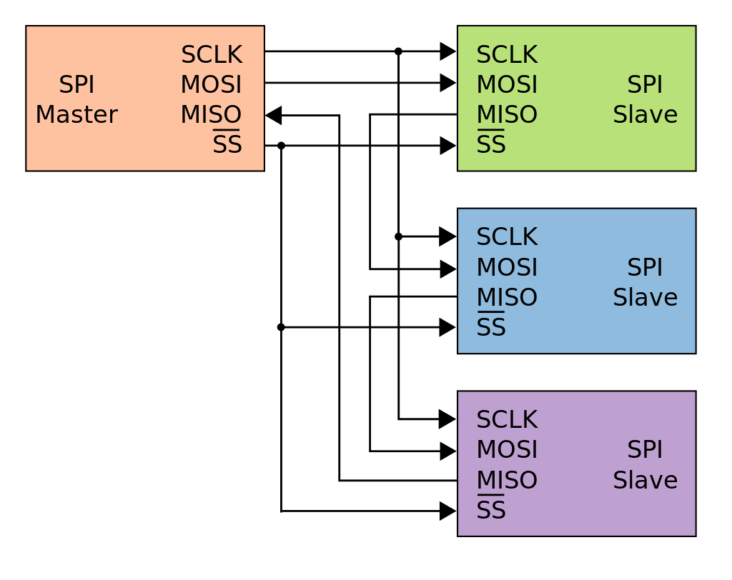
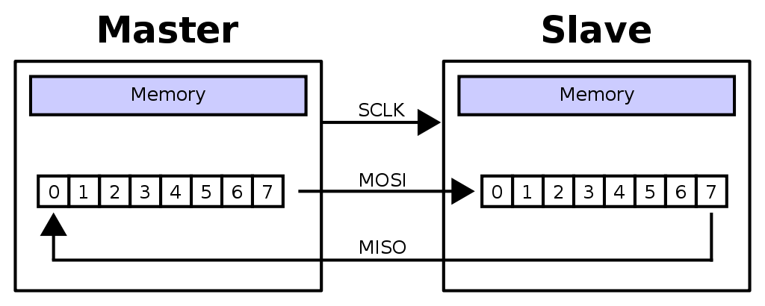
Analisi progetto diapositiva 3
ST7735: SPI Protocol
As can be seen from the figure, both master and slave are equipped with a slip register connected circularly through MISO and MOSI signals. In this way, the most significant bit of its sliding register is exchanged at each clock stroke. Each transfer is done at byte quanta. During the transfer, the Master will lower the CS line corresponding to the desired Slave and with the clock will run both its own and the Slave's shift register, sending its MSB and receiving that of the Slave. After 8 clock strokes, the register of one will contain the data previously present on the other.
SPI also allows you to daisy chain devices to use a single line of CS. In this case, the CS line is also used to signal to slaves when to sample their scroll register. The Master injects the data on the MOSI line starting from the most significant bit to be sent to the last slave. When the Master has sent the least significant bit of the first slave, he will then enable the CS line, allowing the sampling of the sliding registers.

Slide 11
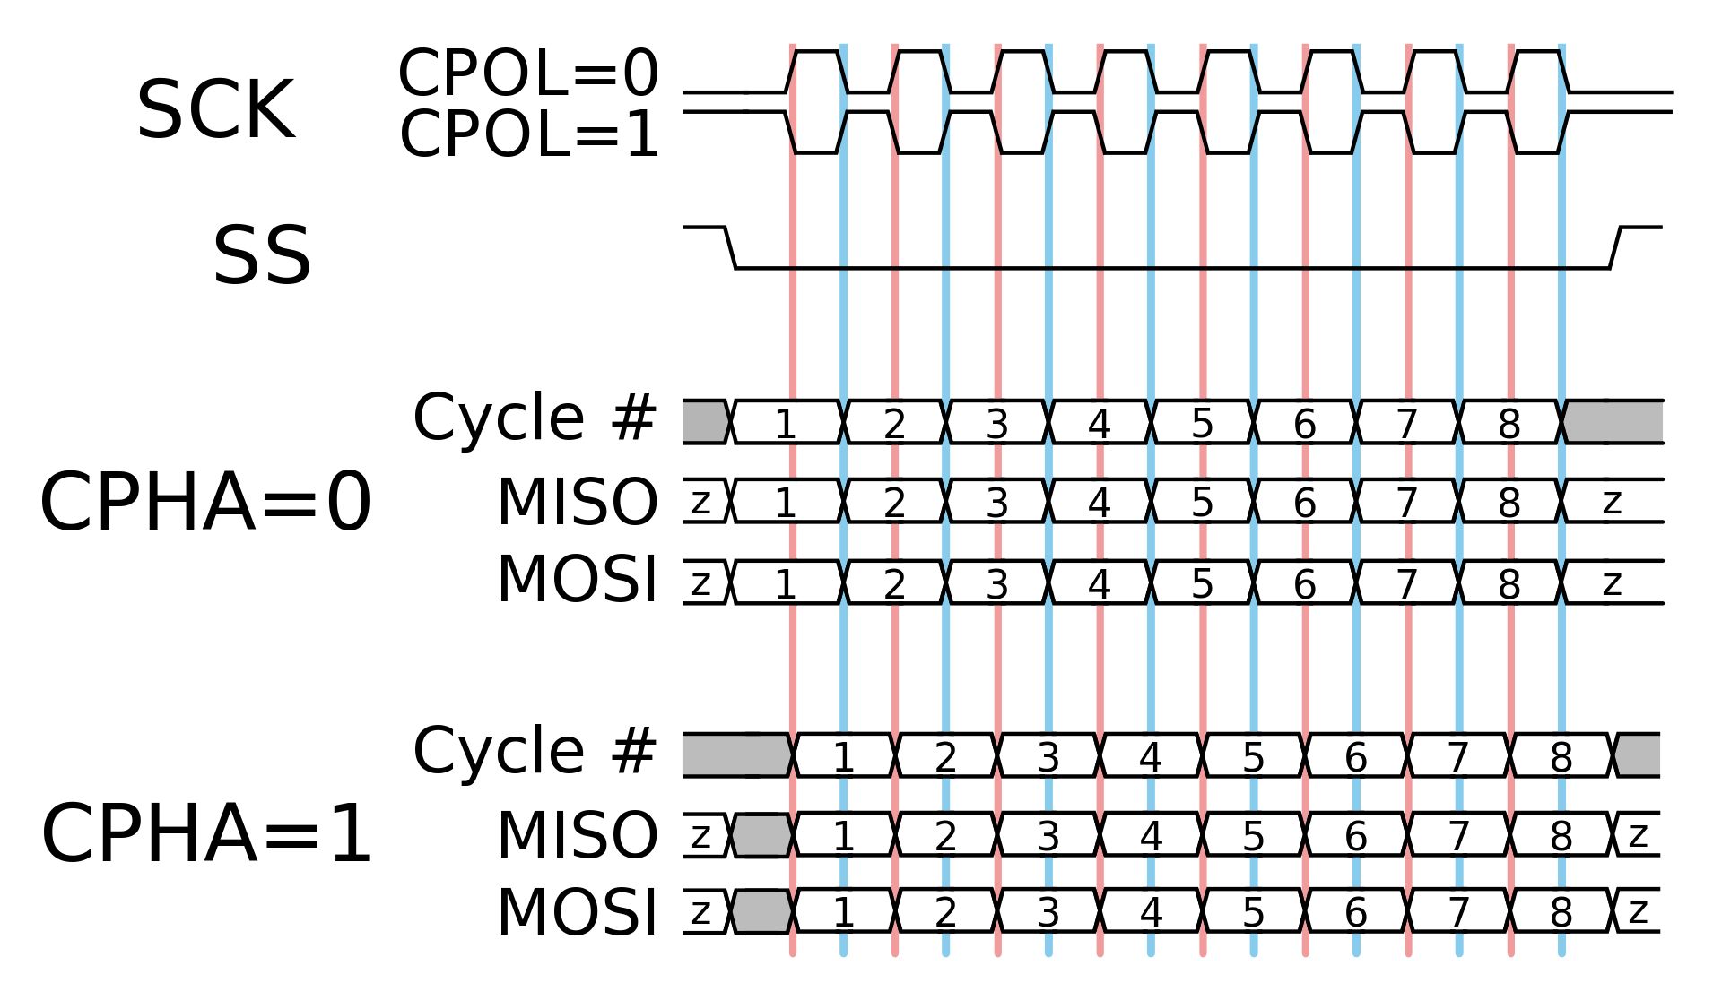
Analisi progetto diapositiva 3
ST7735: SPI Protocol
The Master can be configured according to CPOL and CPHA parameters. The first indicates whether the base of the clock is 1 or 0. The second instead indicates the clock edge used for the strobe of the data. If CPOL = 0, the data is sampled on the rising edge if CPHA is 0, on the falling edge if CPHA is 1. Conversely, if CPOL = 1, the data is sampled on the falling edge if CPHA is worth 0, on the rising edge if CPHA is worth 1.

Slide 12
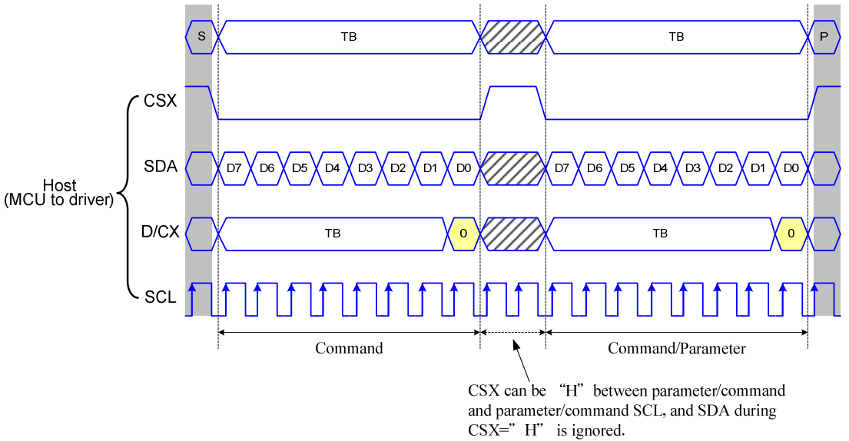
Analisi progetto diapositiva 3
ST7735: Data/Command
In addition to the connections for the operation of the SPI protocol, the ST7735 microcontroller displays also have a reset connection and a Data/Command (D/CX) connection. When 8 bits are received via the SPI protocol, they can represent both a command for the controller and data to be written to RAM. The D/CX link is used to interpret the data received via SPI as a command if the line is low, as data if the line is high. The D/CX signal is sampled on the rising edge of the eighth clock stroke of SCLK. Commands are always identified by 8 bits and can be accompanied by parameters that are transmitted in subsequent bytes. Among the various commands, it is worth mentioning those of RASET and CASET that are used to set the memory address window that you want to change before the color information is transmitted and the RAMWR command that enables the writing of the internal RAM within the window set with RASET and CASET.

Slide 13
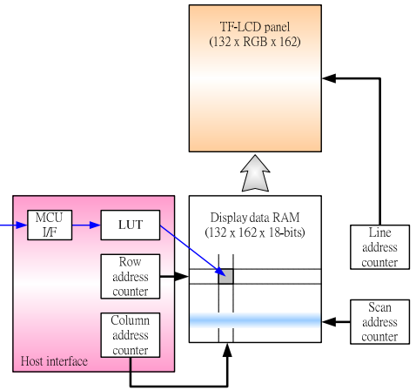
Analisi progetto diapositiva 3
ST7735: Internal Architecture
The ST7735 controller is equipped with a static RAM of 132x162x18-bit. When you want to transmit a new image, you first set up an address window that is identified by the parameters XS and XE for column addresses, and YS and YE for row addresses, this is done with the CASET and RASET commands seen above. When the new color information is transmitted, a row counter and a column counter will be used to set the colors received by SPI pixel by pixel. There are also a line counter and a scan counter that are used to read the image from the RAM and refresh the image on the display.

Slide 14
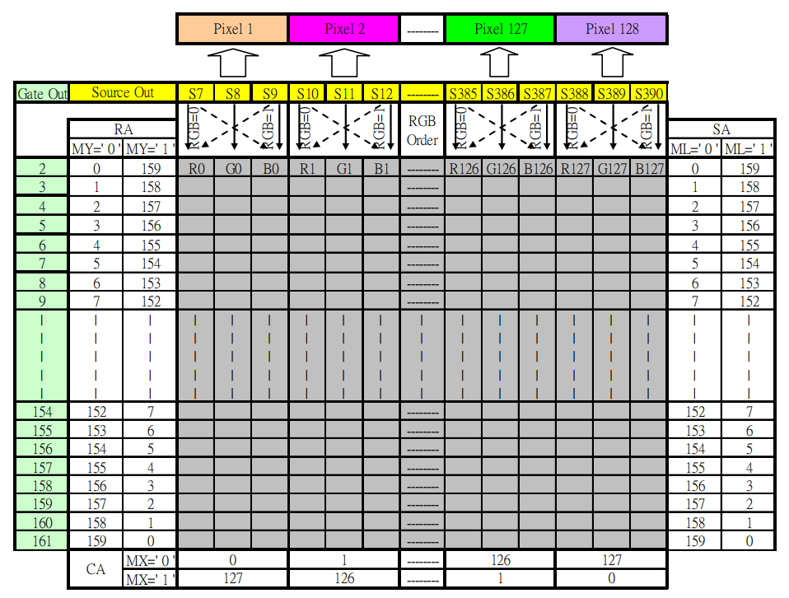
Analisi progetto diapositiva 3
ST7735: Mapping della memoria

Slide 15
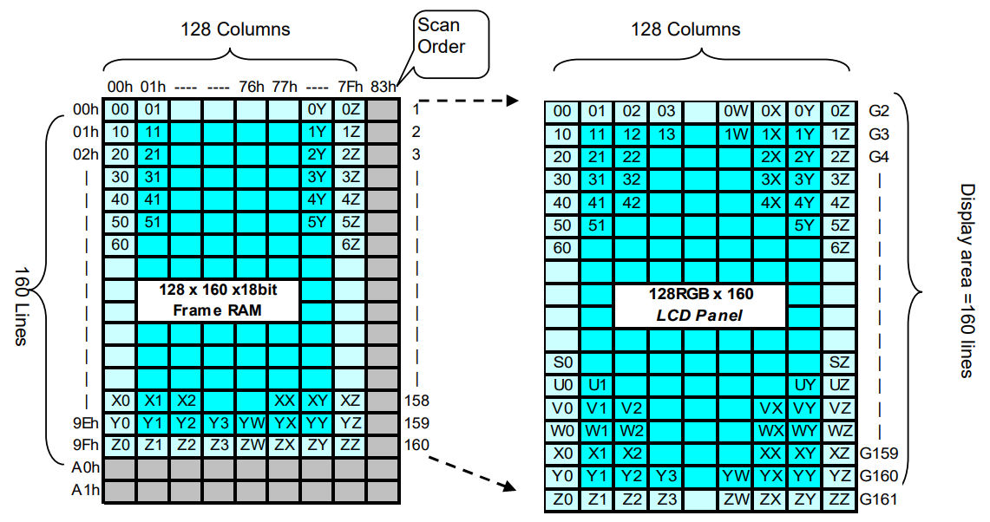
Analisi progetto diapositiva 3
ST7735: Mapping della memoria

Slide 16
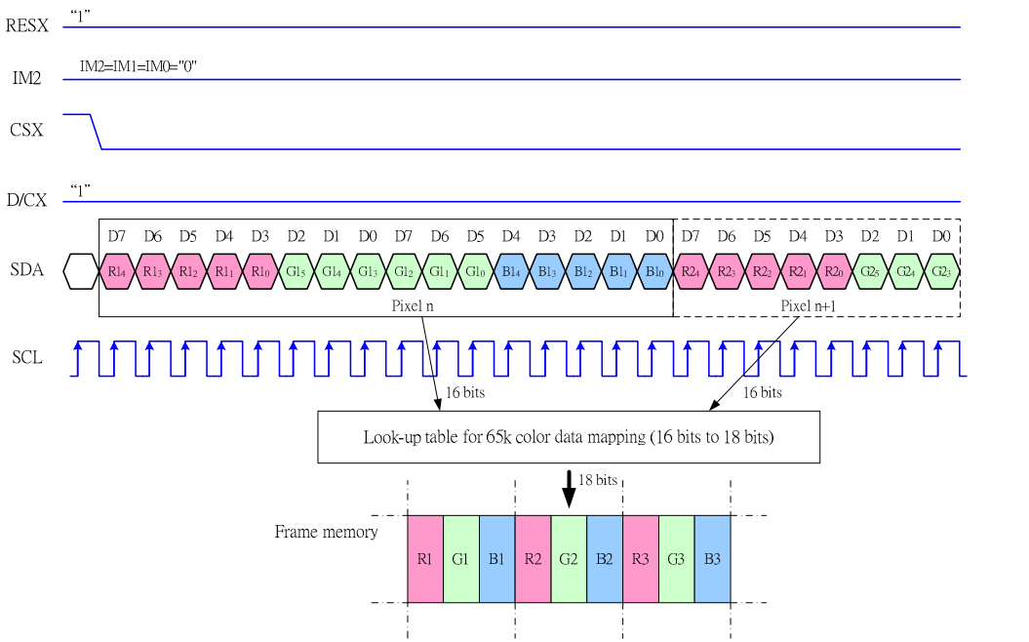
Analisi progetto diapositiva 3
ST7735: Pixel Write
With the RGB 5-6-5 format, we transmit a total of 16 bits via the SPI protocol to change the color of a pixel. Therefore, two SPI transmissions are needed to transmit all the information of one color. In the first group of 8 bits, the 5 bits of channel R and the first 3 bits of channel G are transmitted, in the second byte the remaining 3 bits of channel G and the 5 bits of channel B are transmitted. In this case the D/CX line is high throughout the transmission and clearly CS is low. When the color information is transmitted, it is converted by means of a look-up table in RGB 6-6-6 format. Then, thanks to the memory window previously set with the RASET and CASET commands, the colors are written to RAM pixel by pixel, using the row and column counters seen previously. The next time the refresh is restored, the display scan will show the new data in memory on the screen.

Slide 17
Analisi progetto diapositiva 3
ST7735: Power-On Sequence
# | Comando | Hex | Parametri | Delay | Descrizione
1 | SWRES | 0x01 | - | 150 ms | Software Reset.
2 | SLOUT | 0x11 | - | 255 ms | Out of sleep mode.
3 | FRMCTR1 | 0xB1 | 0x01, 0x2C, 0x2D | - | Frame rate ctrl – normal mode. Rate = f/((args[0]+20)*(128+args[1]+args[2] = ~60 Hz. F vale 333 klHz. Imposta il framerate in normal mode.
4 | FRMCTR2 | 0xB2 | 0x01, 0x2C, 0x2D | - | Frame rate ctrl – idle mode.
5 | FRMCTR3 | 0xB3 | 0x01, 0x2C, 0x2D, 0x01, 0x2C, 0x2D | - | Frame rate dot inversion e line inversion mode.
6 | INVCTR | 0xB4 | 0x07 | - | Turn off reverse display refresh.
7 | PWCTR1 | 0xC0 | 0xA2, 0x02, 0x84 | - | Power control.
8 | PWCTR2 | 0xC1 | 0xC5 | -
9 | PWCTR3 | 0xC2 | 0x0A, 0x00 | -
10 | PWCTR4 | 0xC3 | 0x8A, 0x2A | -
11 | PWCTR5 | 0xC4 | 0x8A, 0xEE | -
12 | VMCTR1 | 0xC5 | 0x0E | -
13 | INVOFF | 0x20 | - | - | Do not reverse display.
14 | MADCTL | 0x36 | 0xC0 | - | Refresh from bottom to top. Normal rotation.
16 | COLMOD | 0x3A | 0x05 | - | RGB color mode 5-6-5 16-bit.
17 | CASET | 0x2A | 0x00, 0x00, 0x00, 0x7F | - | Column Address Set.
18 | RASET | 0x2B | 0x00, 0x00, 0x00, 0x9F | - | Row Address Set.
19 | GMCTRP1 | 0xE0 | 0x02, 0x1C, 0x07, 0x12, 0x37, 0x32, 0x29, 0x2D, 0x29, 0x25, 0x2B, 0x39, 0x00, 0x01, 0x03, 0x10 | - | Gamma correction (positive polarity).
20 | GMCTRN1 | 0xE1 | 0x03, 0x1D, 0x07, 0x06, 0x2E, 0x2C, 0x29, 0x2D, 0x2E, 0x2E, 0x37, 0x3F, 0x00, 0x00, 0x02, 0x10 | - | Gamma correction (negative polarity).
21 | NORON | 0x13 | - | 10 ms | Normal display on
22 | DISPON | 0x29 | - | 100 ms | Main screen on.

Slide 18
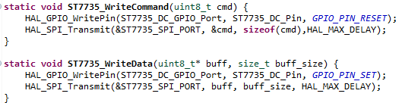
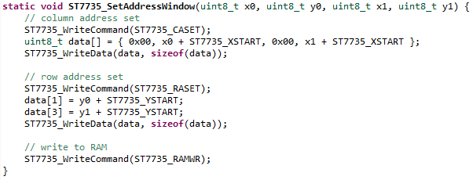
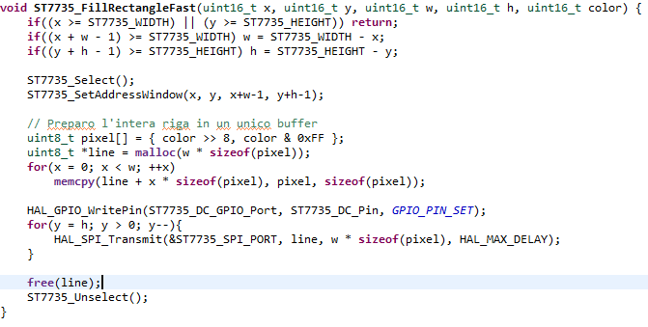
Analisi progetto diapositiva 3
ST7735: code for STM32
WriteCommand and WriteData Functions
SetAddressWindow and FillRectangle Functions

Slide 19
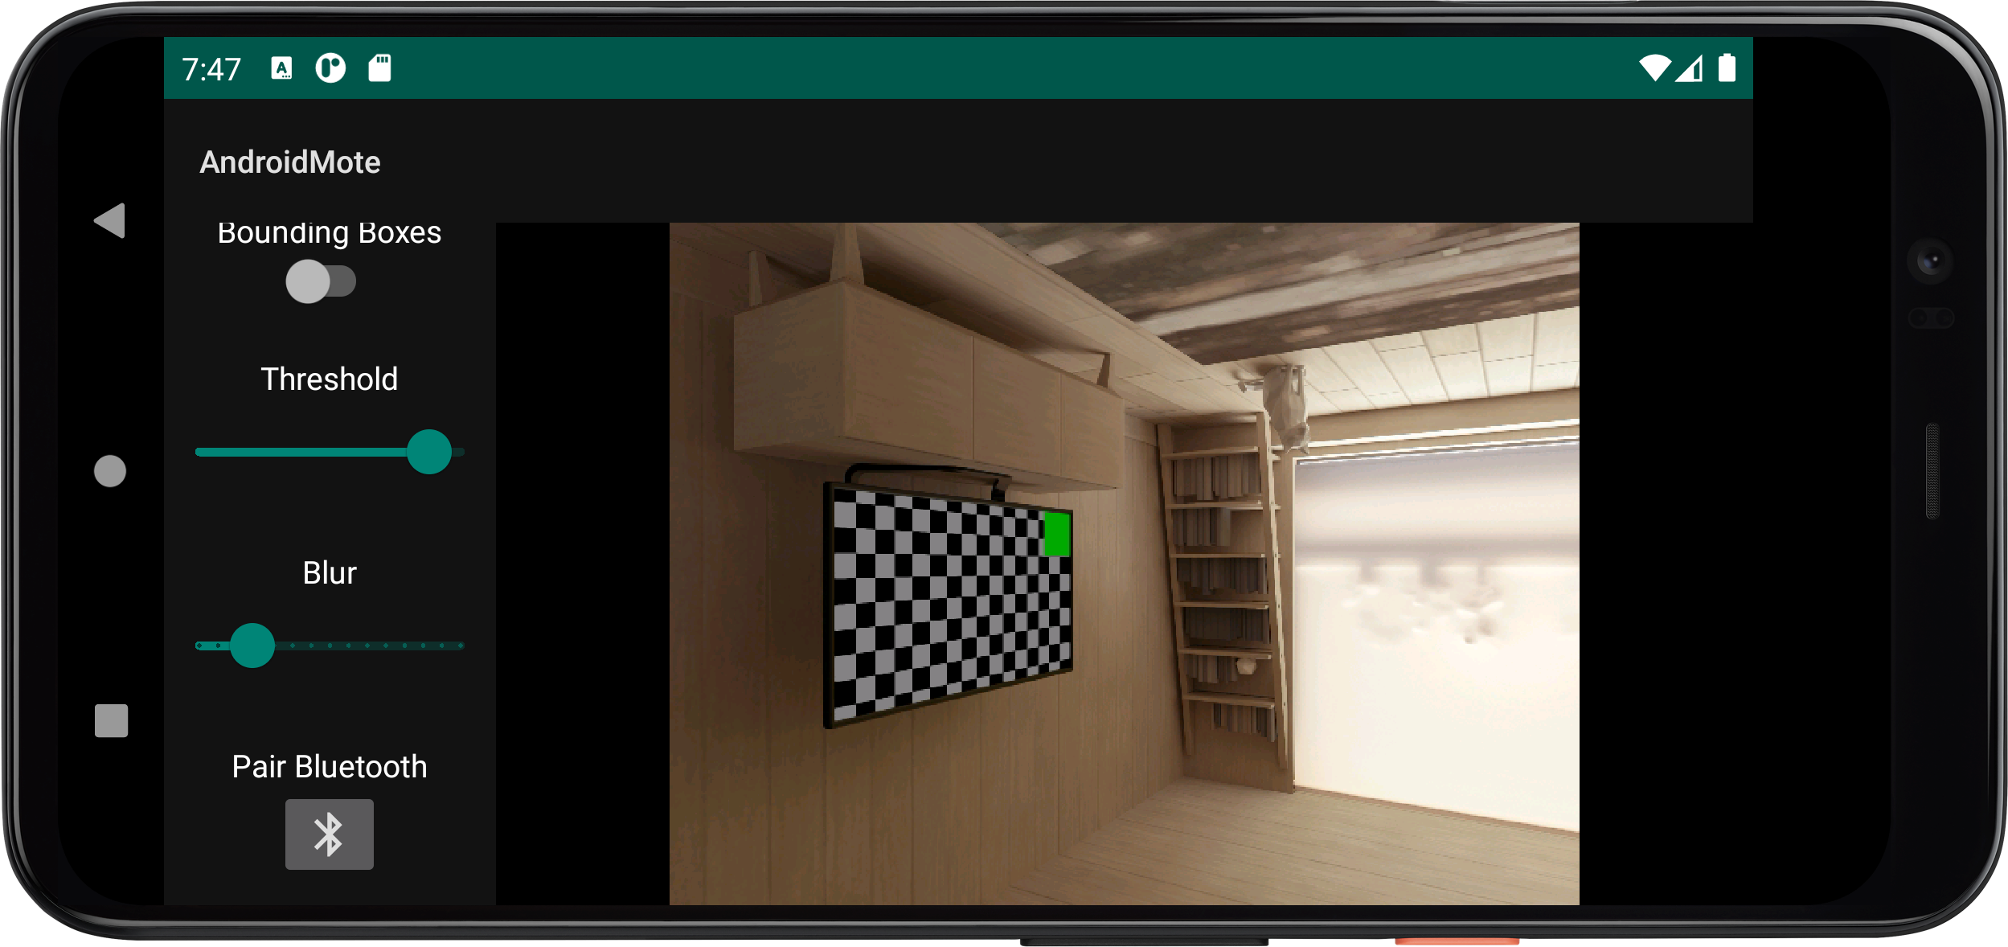
Analisi progetto diapositiva 3
AndroidMote
AndroidMote is the application made to use your phone as a pointing device. The interface consists of the camera preview accompanied by a vertical slider bar that includes controls for image processing and Bluetooth connectivity. The OpenCV library was used for image processing, while a library was also used for Bluetooth connectivity using the SPP profile. Among the controls we have the possibility to change the preview mode, to modify the brightness threshold for the detection of bright spots, the adjustment of the Gaussian blur and the activation / deactivation of the bounding boxes.

Slide 20
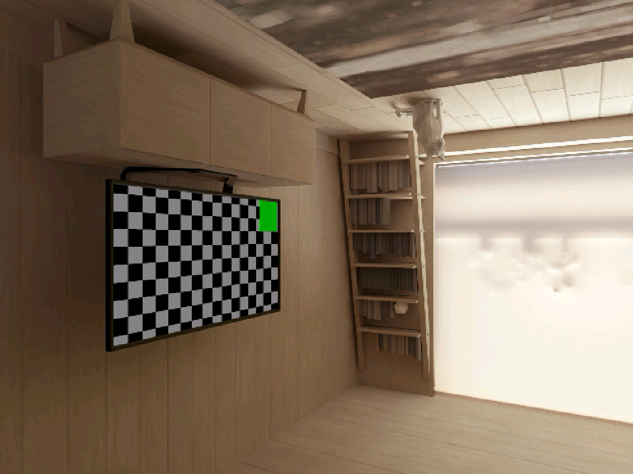
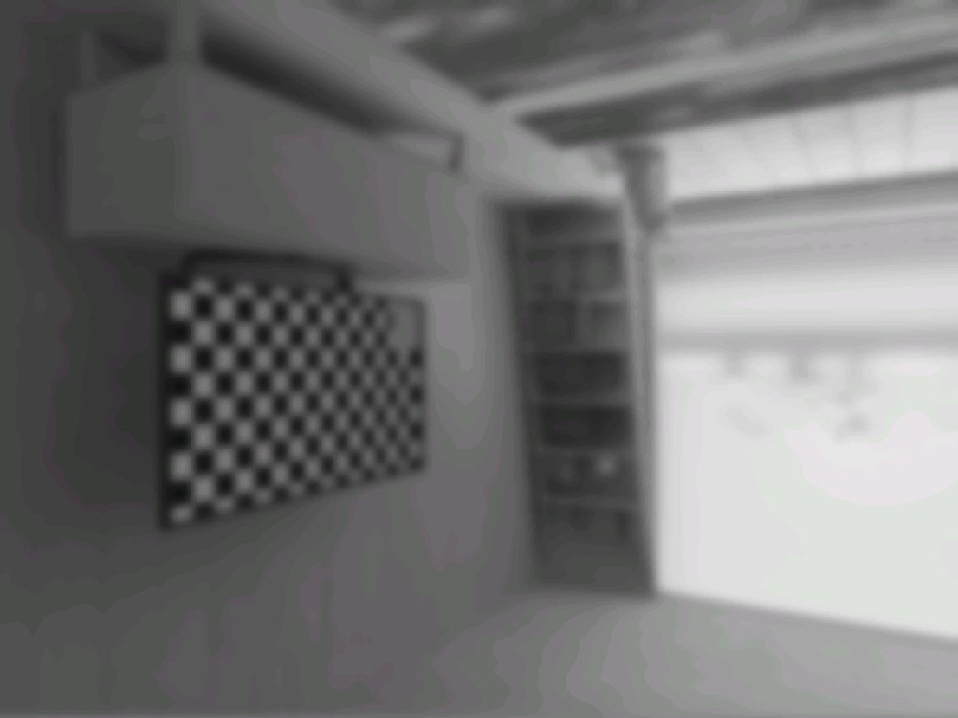

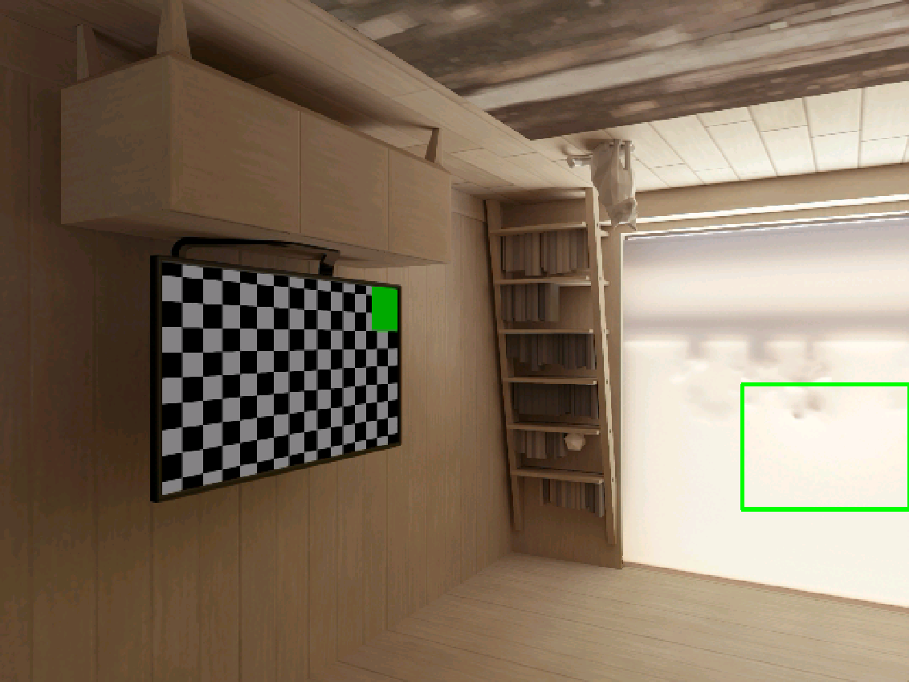
Analisi progetto diapositiva 3
OpenCV
Raw
Black and white and Gaussian Blur
Threshold
Connected Components e Bounding Box
The processing done in OpenCV every time a frame arrives first performs a grayscale conversion. Gaussian blur is then applied to eliminate any noise from small points of light and to reduce the effect of minor variations in a bright area. Subsequently, with a threshold, all the areas of low brightness are discarded. The last processing consists of identifying the connected pixels (Connected Components) and drawing a bounding box around each of the identified areas. Starting with OpenCV processing, the center of up to two light zones and their relative size are sent via Bluetooth SPP to the HC-05.

Slide 21
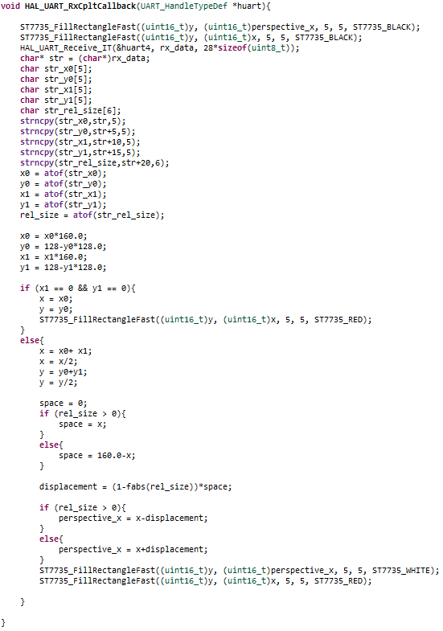
Analisi progetto diapositiva 3
HC-05: Bluetooth Data Reception
If only one bright area is found, it is used as a pointer by drawing a red square on the ST7735.
If two bright areas are identified, their midpoint is drawn on the screen as a red square. The relative size of the two highlights is used to calculate and display a pointer approximation (white square) that takes perspective into account.
In fact, if a bright area on the right is larger than one on the left, the pointer must be moved more to the left; vice versa, if the bright area on the left of the image is larger than the one on the right, then you can move the pointer more to the right.
As far as the implementation aspect is concerned, an interruption has been made on reception through UART. In this interruption, the areas previously occupied by the pointers are first colored black, then the information received from the HC-05 is extracted and converted, and finally, after the necessary calculations, the new pointers are drawn.

Slide 22
Thank you

