Slide 1
WELCOME

Slide 2
INTRODUCTION
Student Management System is website which is helpful for students as well as the school authorities. In the current system all the activities are done manually. Our Student Management System deals with the various activities related to the students. In the website we can register as a user and user has of Three types, student and Teacher and administrator. Administrator has the power to add new user and can edit and delete a user. A student can register as user and can add edit. The administrator can get detailed student information. All the users can get some details of student when They search for particular name and they can search based on blood group which will inform details of the student whom all have that particular blood.It also possible to send file to particular class or send individual file or sms to any one

Slide 3
Admin
Features Provided
Insert another admin
View files uploaded to the admin by admin
Send file to the class, teacher, or admin.
Insert teacher

Slide 4
Update teacher
Insert student
Update student
Send individual file to the person (sms system).
Inbox
Sent
Trash
Compose
Delete file that uploaded by anyone
Delete student
Delete teacher
Update profile
Search based on blood group.

Slide 5
Teacher
View file uploaded by admin for particular department teacher or all teachers
Send file to the class, teacher or admin
Delete the file that uploaded by that teacher
Insert student
Update student
Delete students
Update profile
Send file or sms for anyone

Slide 6
Student
Update profile
View files uploaded by teacher r or admin
Send individual file or message to anyone

Slide 7
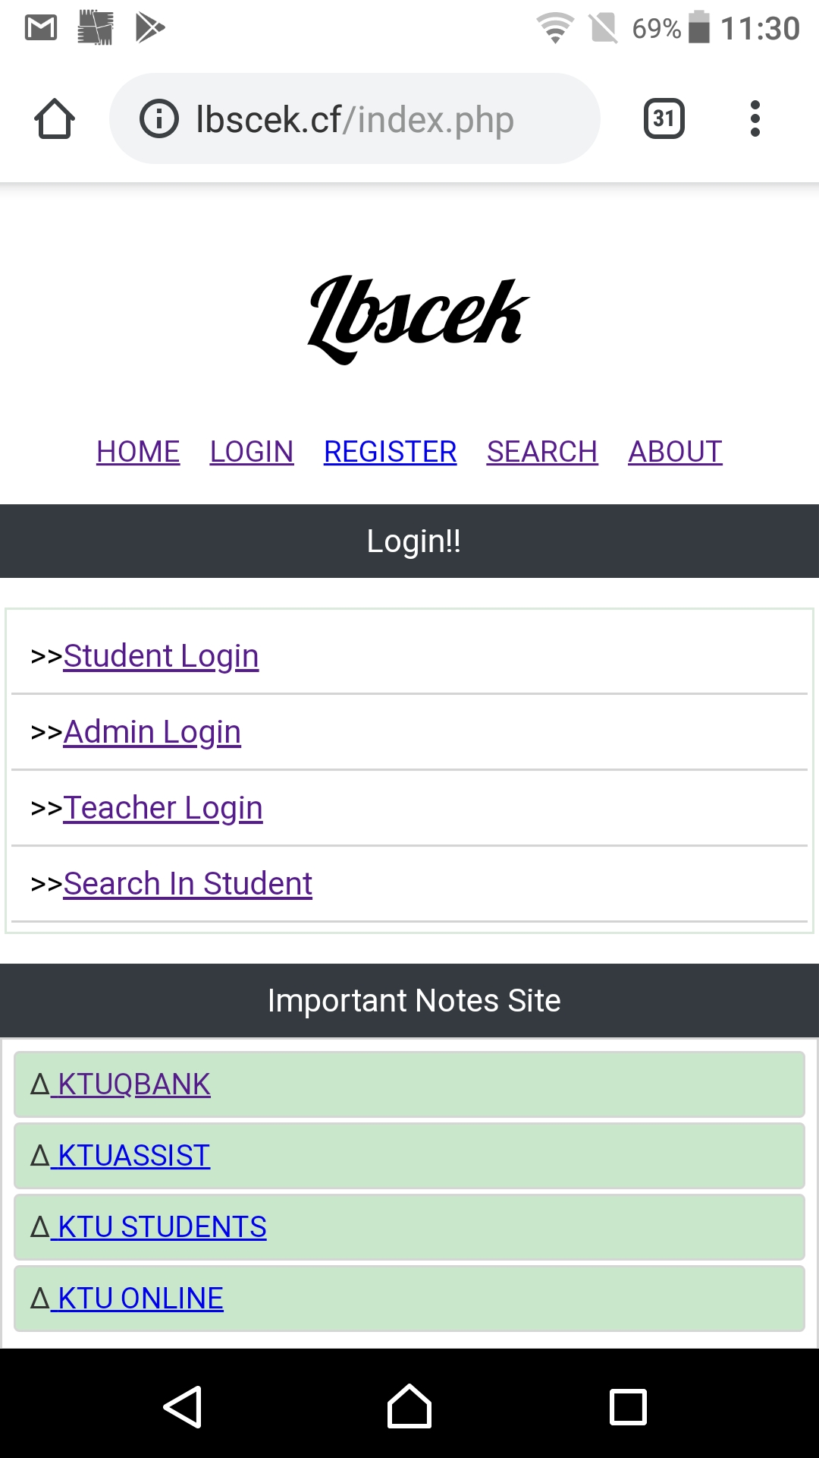

Slide 8
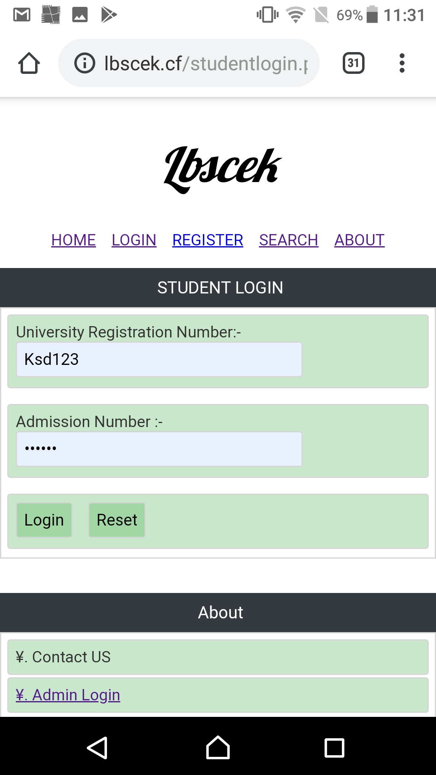

Slide 9
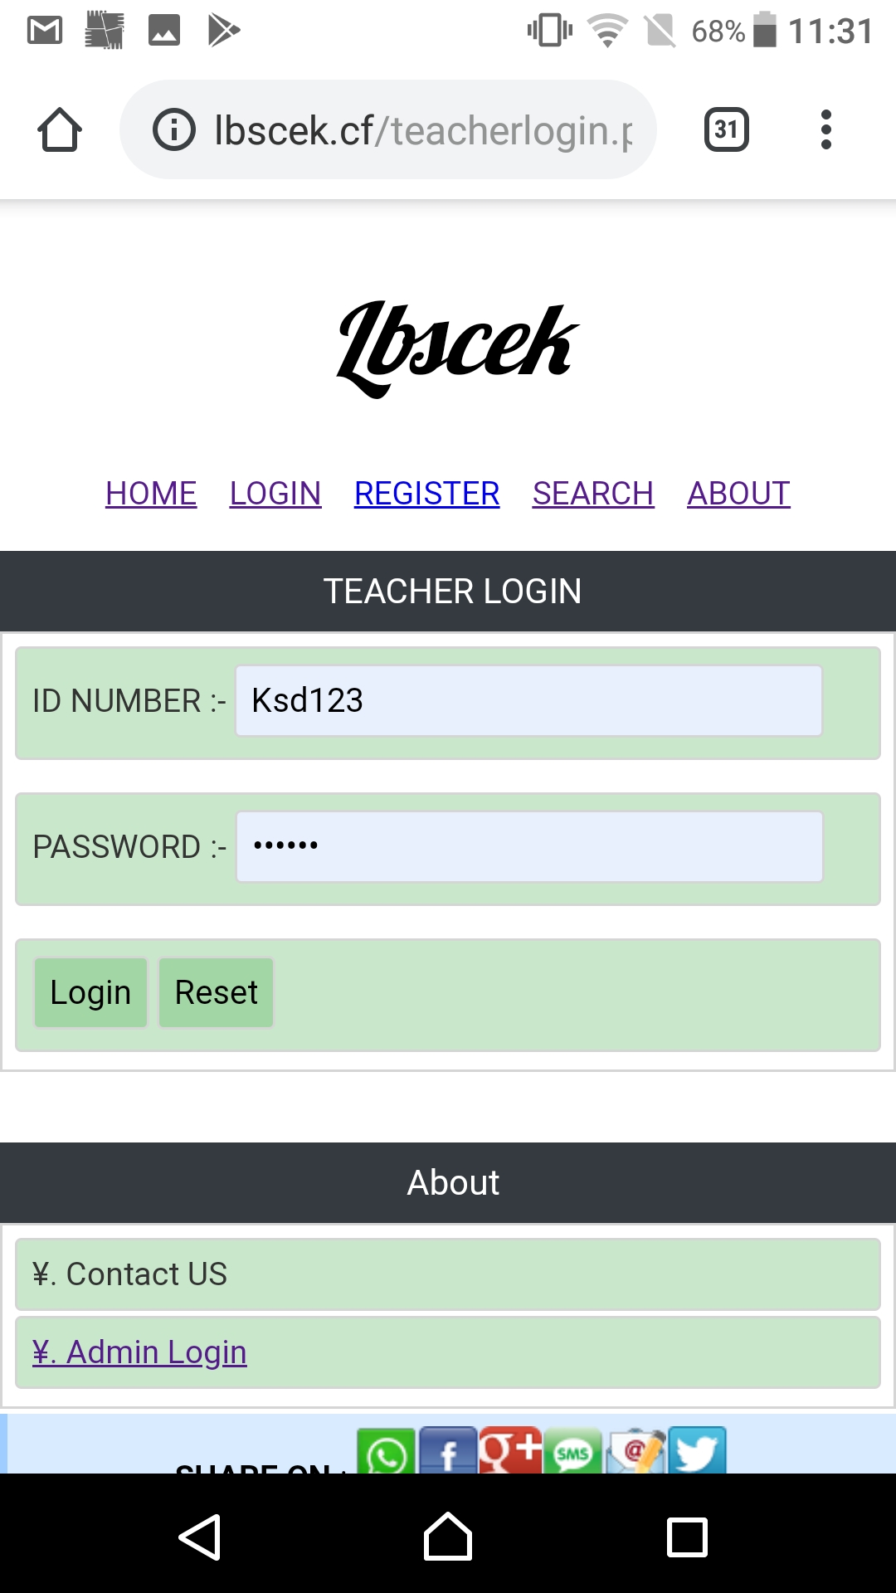

Slide 10
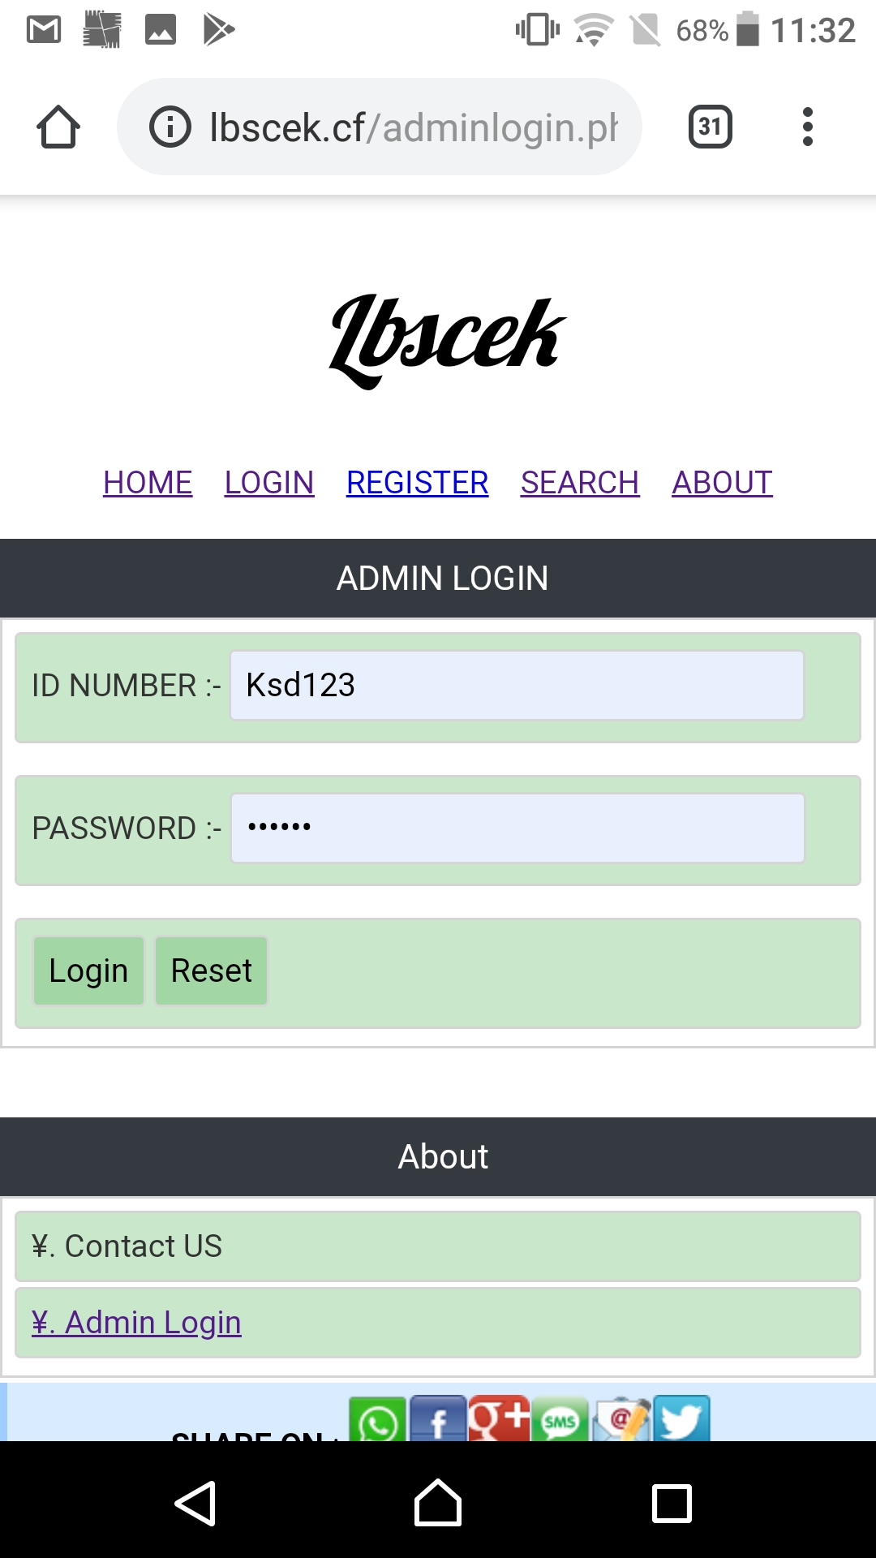

Slide 11
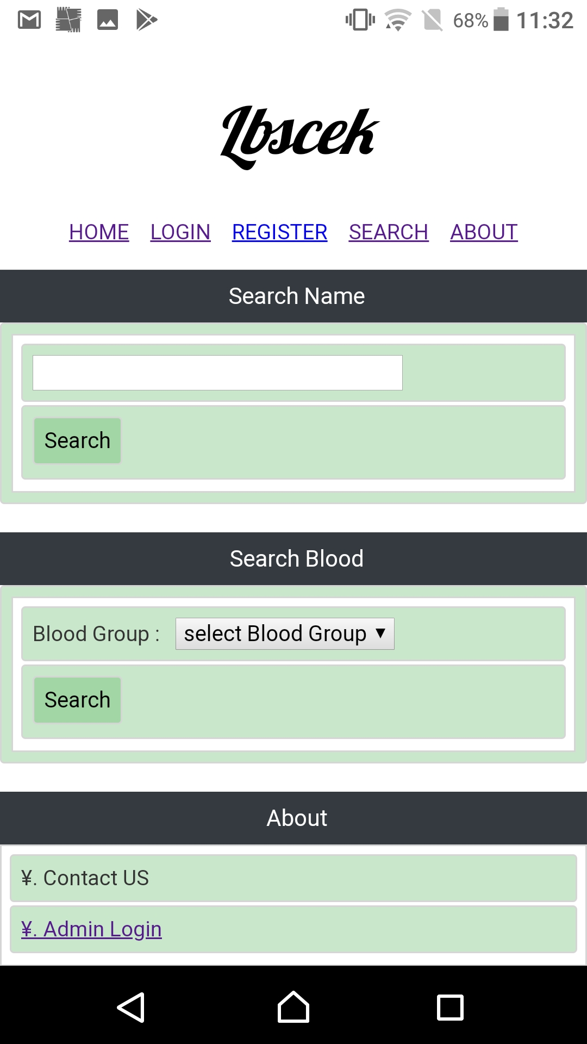

Slide 12
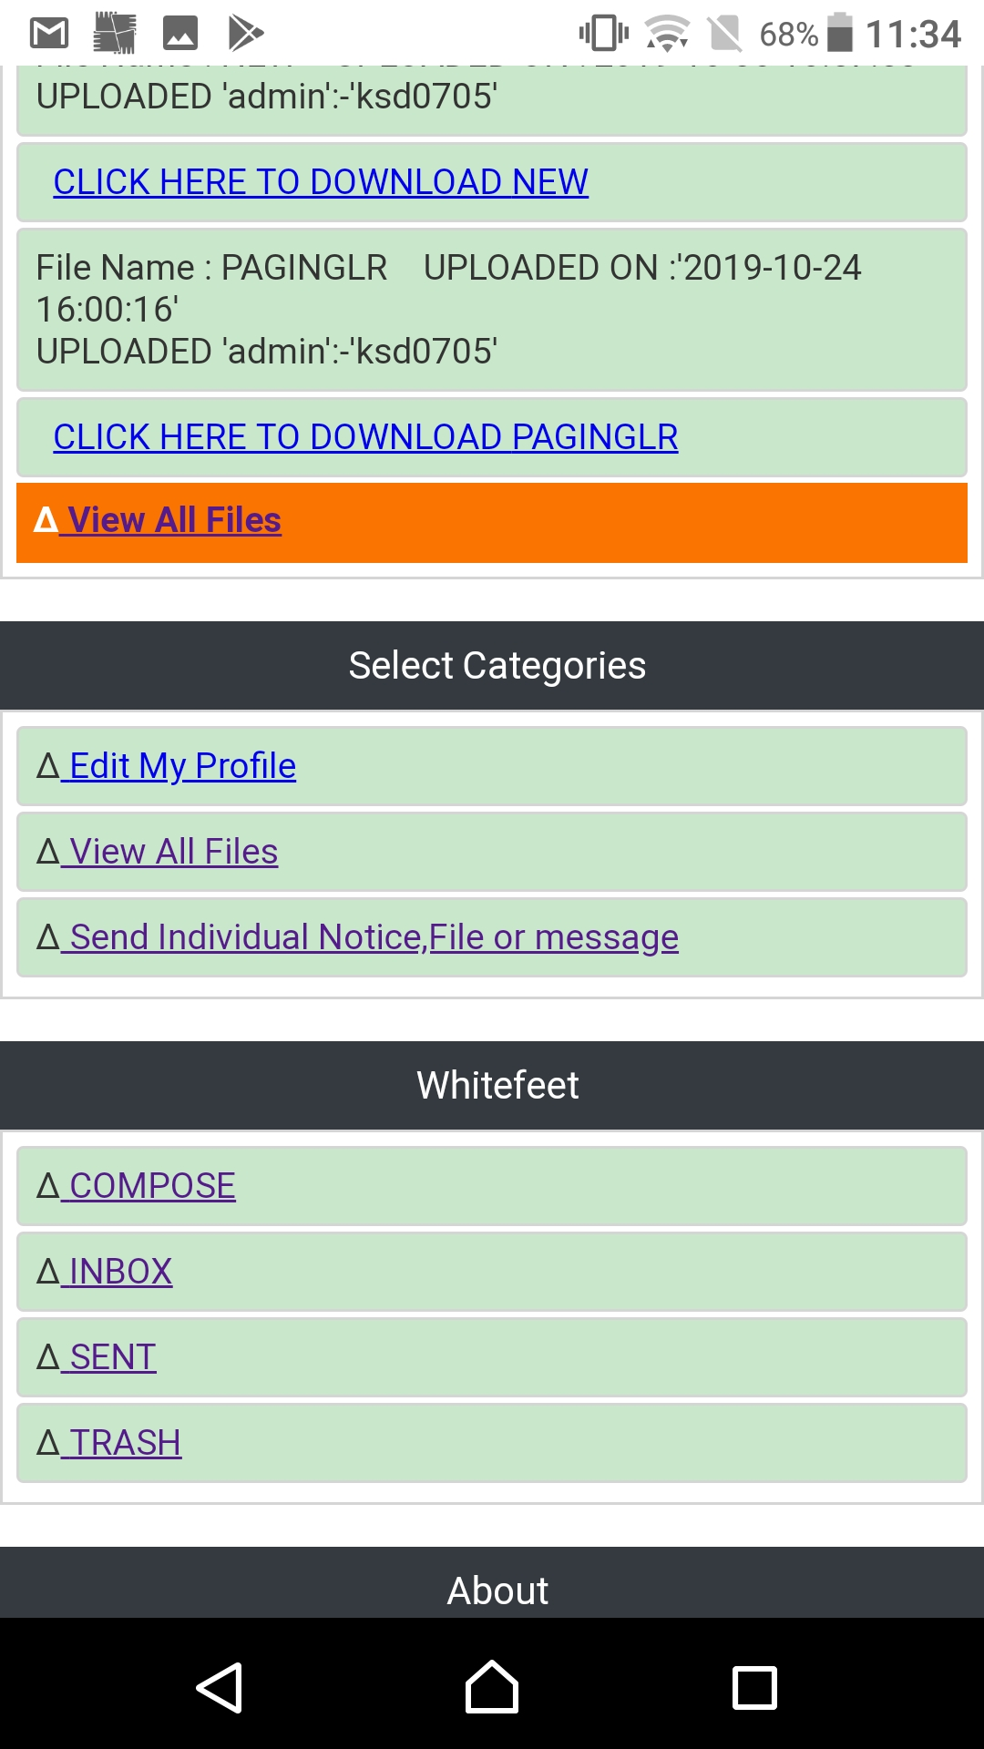

Slide 13
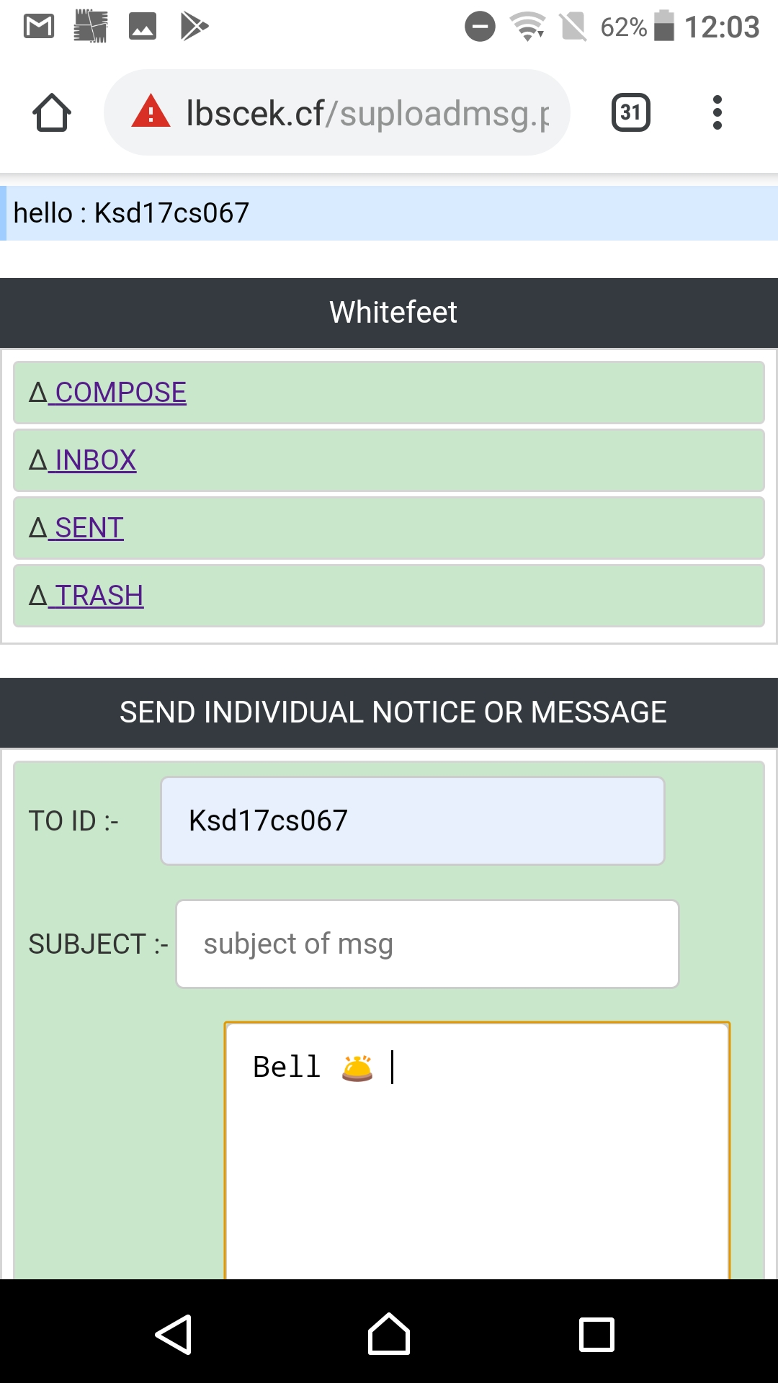

Slide 14
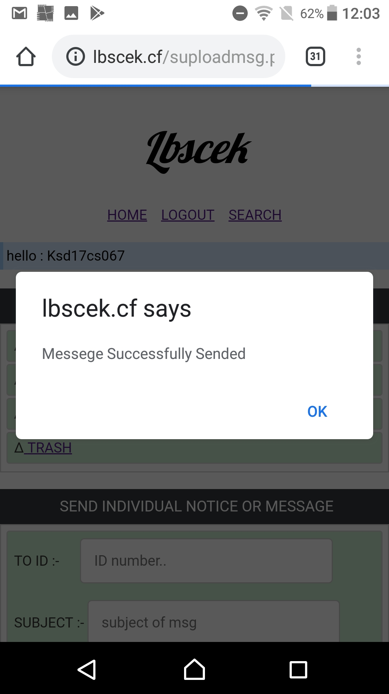

Slide 15
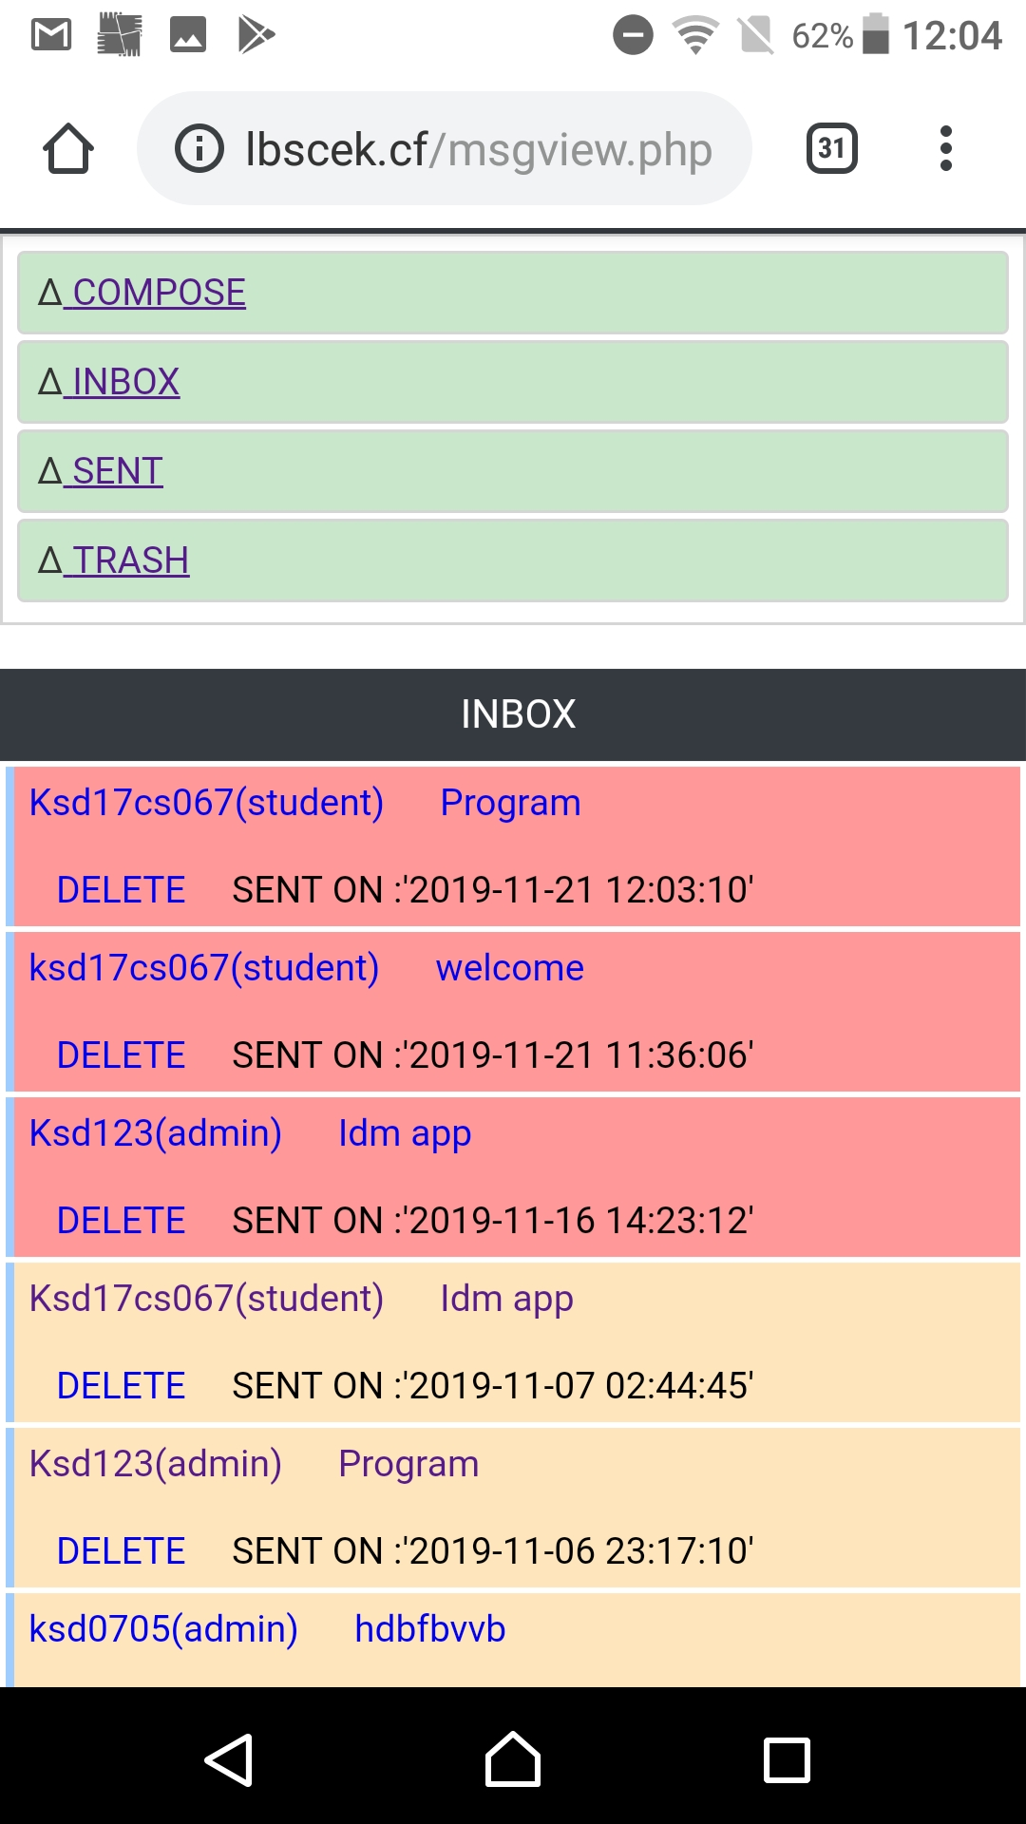

Slide 16
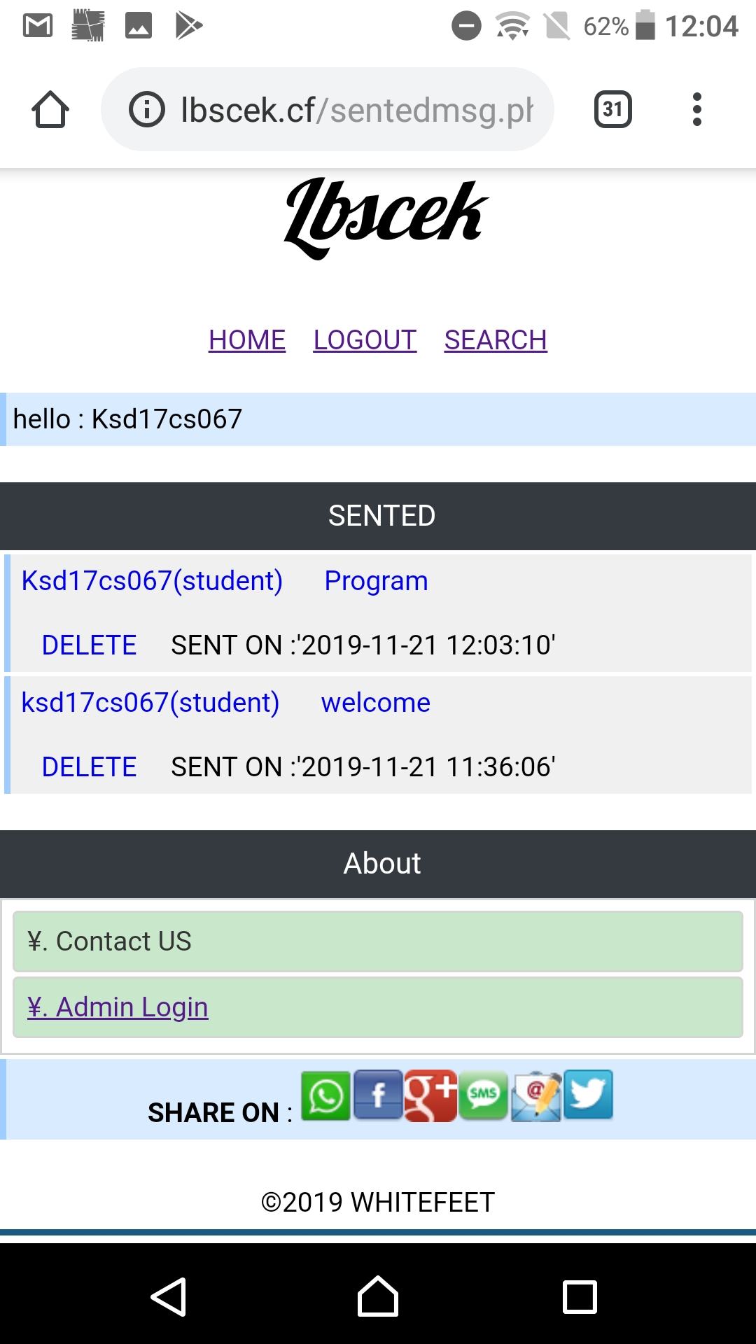

Slide 17
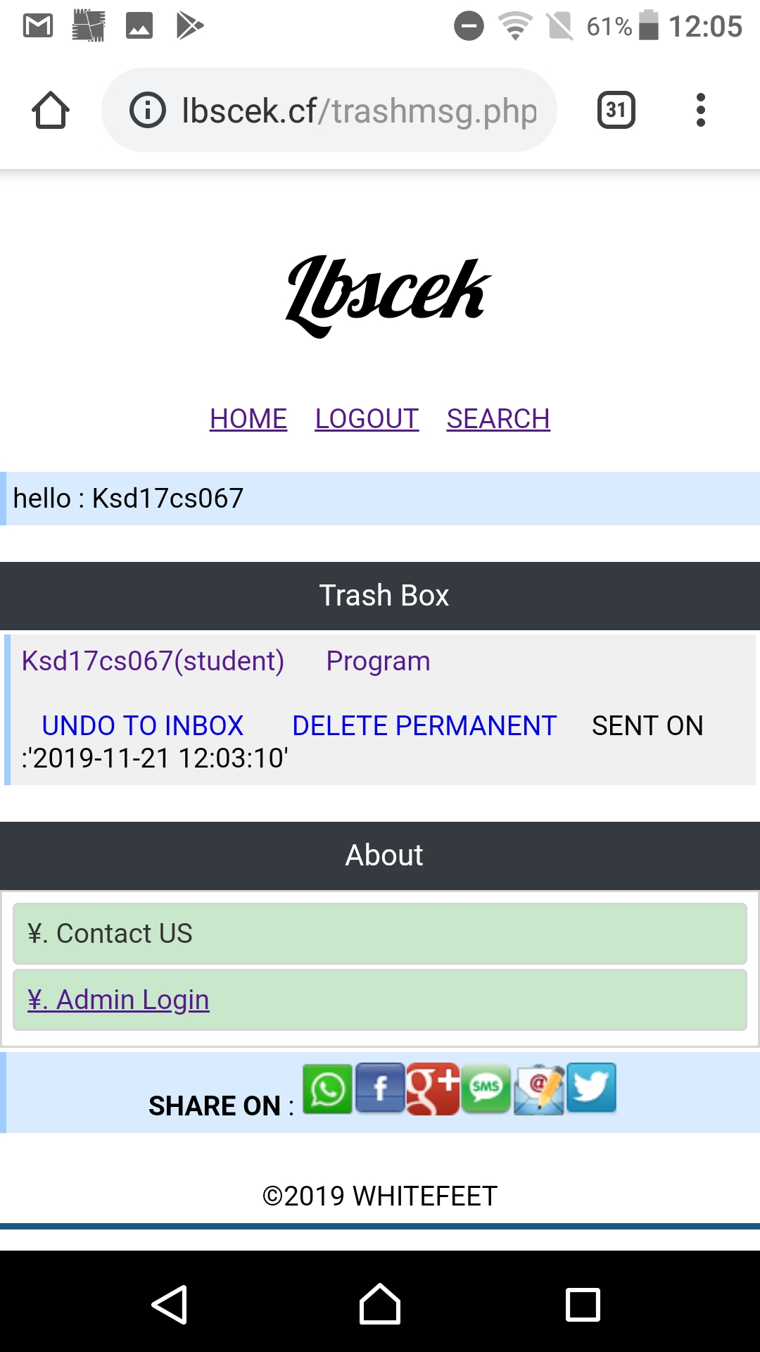

Slide 18
CONCLUSION
We would like to conclude our slide
THANK YOU

Slide 19
Group memebers
Mohammed Rafhath
Mohammed Arafath
Mohammed Rafeeq MA

