Slide 1
Introduction to Lex & Yacc tools

Slide 2
Lex
Lex is a program that generates lexical analyzer.
The lexical analyzer is a program that transforms an input stream into a sequence of tokens.
It reads the input stream and produces the source code as output through implementing the lexical analyzer in the C program.

Slide 3
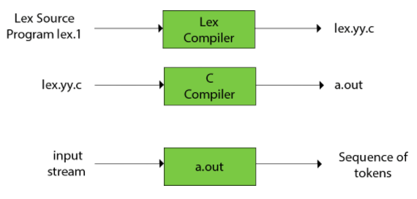
The function of Lex is as follows:
The Lex source program lex.l is written in the Lex language.
Then Lex compiler runs the lex.l program and produces a C program lex.yy.c.
Finally C compiler runs the lex.yy.c program and produces an object program a.out.
a.out is lexical analyzer that transforms an input stream into a sequence of tokens.

Slide 4
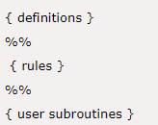
Lex file format
A Lex program is separated into three sections by %% delimiters. The format of Lex source is as follows:

Slide 5

Definition Section:
Definitions Section contains definitions and included code
In the definition section, text is enclosed in “%{ %}” brackets. Anything written in this brackets is copied directly to the file lex.yy.c

Slide 6
Definition Section:
Definitions are like macros and have the following form:
name translation
digit [0-9]
number {digit} {digit}*
Included code is all code included between %{ and %}
%{
float number; int count=0;
%}

Slide 7

Rules Section:
The rules section contains a series of rules in the form: pattern action
pattern must be unintended and action begin on the same line in {} brackets.
Actions are usually C-code lines that are copied verbatim to the the generated C-file
The rule section is enclosed in “%% %%”.

Slide 8
User Code Section
This section contain C statements and additional functions.
We can also compile these functions separately and load with the lexical analyzer.

Slide 9
How to run the program:
To run the program, it should be first saved with the extension .l .
Run the below commands on terminal in order to run the program file. Step 1: flex filename.l or lex filename.lex depending on the extension file is saved with Step 2: gcc lex.yy.c Step 3: ./a.out { for windows a.exe} Step 4: Provide the input to program in case it is required
Note: Press Ctrl+c or use some rule to stop taking inputs from the user

Slide 10
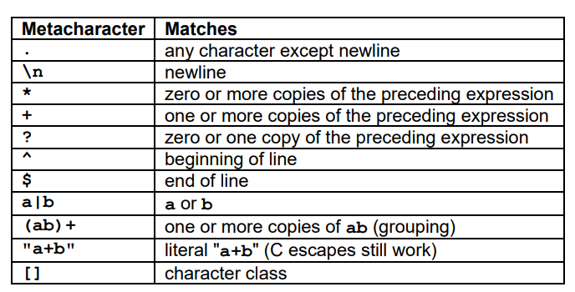
Lex is good at pattern matching.

Slide 11
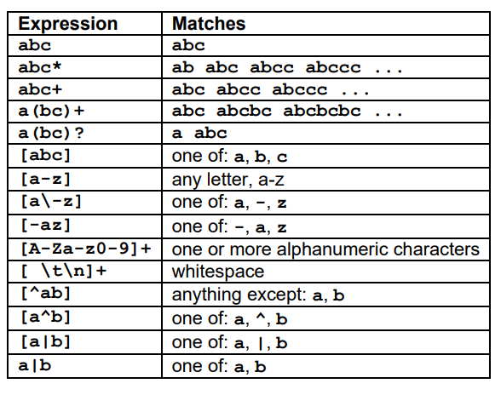
Pattern matching Examples

Slide 12
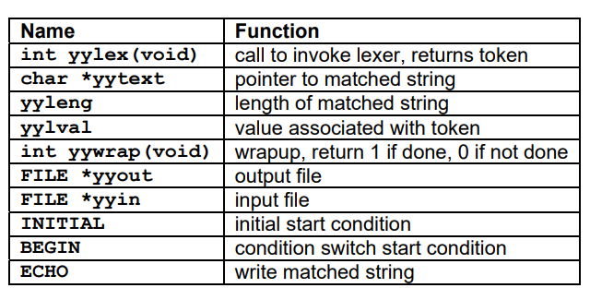
Lex Predefined Variables

Slide 13
Sample Program
Program to output the matched uppercase string.
%%
[A-Z]+ {ECHO; printf("\n");}
.|\n ;
%%
int yywrap(){}
int main(){yylex();}
Input:
dfghgTHIjhgdhghgRGD
Output:
THI
RGD

Slide 14
Programming Lex
To program LEX programs and Yacc programs you need to install two packages 1:Flex -to make the Lex program work 2.Bison -to make the yacc programs work

Slide 15
Installing Lex and Yacc in linux
To install,Open terminal and do the following... 1.To install Flex sudo apt-get upgrade sudo apt-get install flex 2.To install Lex sudo apt-get upgrade sudo apt-get install bison
https://stackoverflow.com/questions/3871425/how-to-install-lex-and-yacc-in-ubuntu

Slide 16
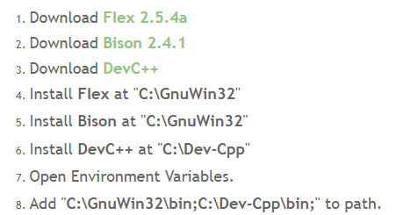
Installing Lex and Yacc in windows
https://stackoverflow.com/questions/5456011/how-to-compile-lex-yacc-files-on-windows

