Slide 1
Genetic Algorithms
Chapter 3

Slide 2
GA Quick Overview

Slide 3
Evolution in the real world
Each cell of a living thing contains chromosomes - strings of DNA
Each chromosome contains a set of genes - blocks of DNA
Each gene determines some aspect of the organism (like eye colour)
A collection of genes is sometimes called a genotype
A collection of aspects (like eye colour) is sometimes called a phenotype
Reproduction involves recombination of genes from parents and then small amounts of mutation (errors) in copying
The fitness of an organism is how much it can reproduce before it dies
Evolution based on “survival of the fittest”

Slide 4
GA Quick Overview
Developed: USA in the 1970’s
Early names: J. Holland, K. DeJong, D. Goldberg
Typically applied to:
  discrete optimization
Attributed features:
  not too fast
  good heuristic for combinatorial problems
Special Features:
  Traditionally emphasizes combining information from good parents (crossover)
  many variants, e.g., reproduction models, operators

Slide 5
Genetic algorithms
Holland’s original GA is now known as the simple genetic algorithm (SGA)
Other GAs use different:
  Representations
  Mutations
  Crossovers
  Selection mechanisms

Slide 6
SGA technical summary tableau
Representation | Binary strings
Recombination | N-point or uniform
Mutation | Bitwise bit-flipping with fixed probability
Parent selection | Fitness-Proportionate
Survivor selection | All children replace parents
Speciality | Emphasis on crossover

Slide 7
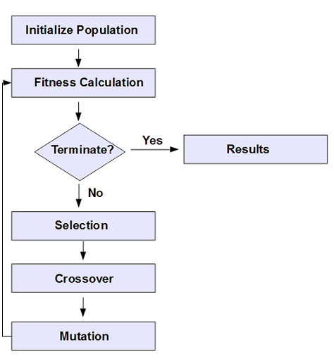
Genetic Algorithm

Slide 8
SGA reproduction cycle
Select parents for the mating pool
(size of mating pool = population size)
Shuffle the mating pool
For each consecutive pair apply crossover with probability p_{c} , otherwise copy parents
For each offspring apply mutation (bit-flip with probability p_{m} independently for each bit)
Replace the whole population with the resulting offspring

Slide 9
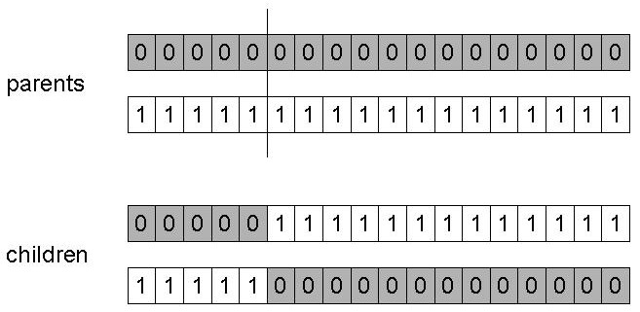
SGA operators: 1-point crossover
Choose a random point on the two parents
Split parents at this crossover point
Create children by exchanging tails
P_{c} typically in range (0.6, 0.9)

Slide 10
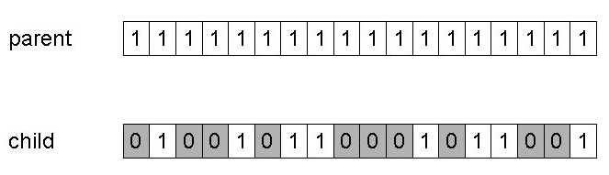
SGA operators: mutation
Alter each gene independently with a probability p_{m}
p_{m} is called the mutation rate
  Typically between 1/pop_size and 1/ chromosome_length

Slide 11
SGA operators: Selection
Main idea: better individuals get higher chance
  Chances proportional to fitness
  Implementation: roulette wheel technique
        Assign to each individual a part of the roulette wheel
        Spin the wheel n times to select n individuals
1/6 = 17%
B
fitness(A) = 3
A
C
fitness(B) = 1
3/6 = 50%
2/6 = 33%
fitness(C) = 2

Slide 12
Genetic Algorithm Example
Find linear equation for following points
(x, y) : {(1,5) (3, 9)}
[2 7][1 3]
Compute badness for [2 7]
Y = mx + c
(x, y) : {(1,5) (3, 9)}
[1 3][3 3]
[3 3][2 3]
Solution = Y = 2x + 3

Slide 13
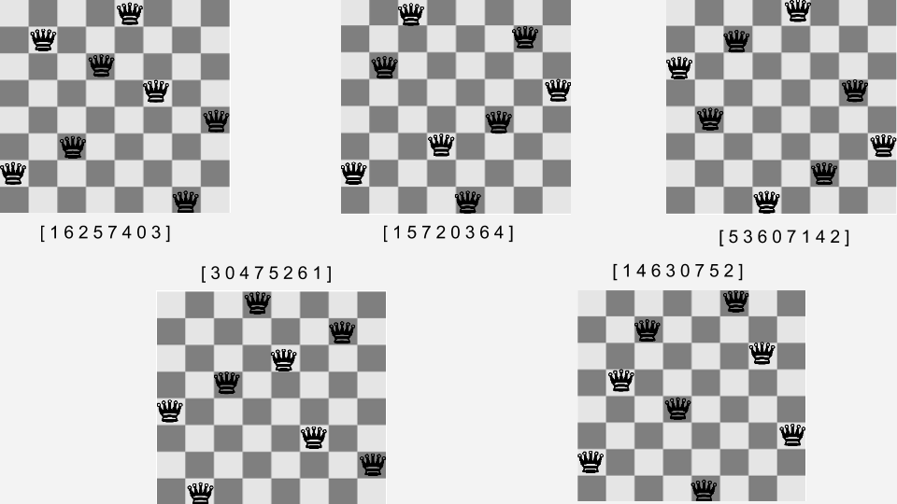
Genetic Algorithm Example
8 Queen Problem

Slide 14
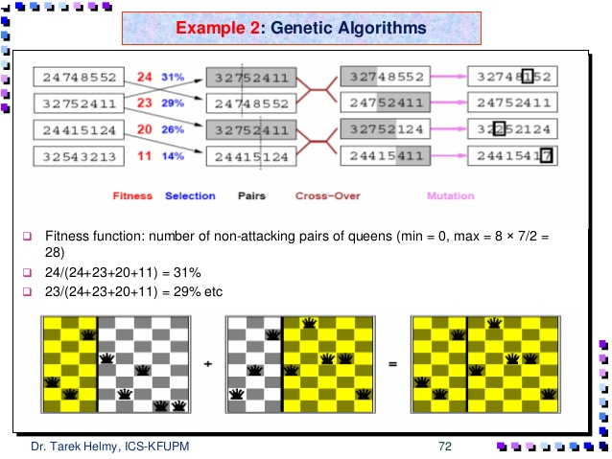
Genetic Algorithm Example
8 Queen Problem

Slide 15
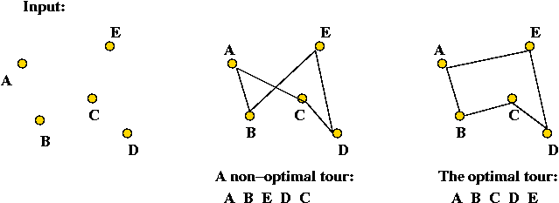
Genetic Algorithm Example
TSP
What about brute force technique?
N! – very huge search space

Slide 16
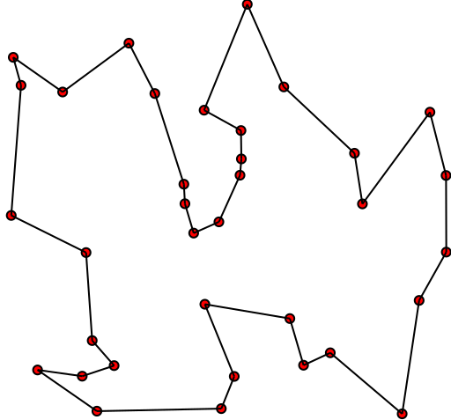
Genetic Algorithm Example
TSP

Slide 17
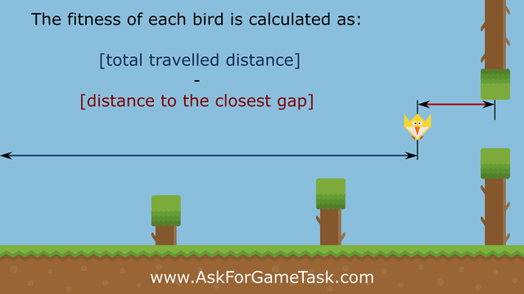
Genetic Algorithm Example
Flip Bird

Slide 18
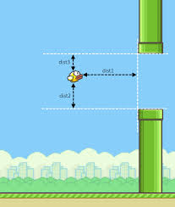
Genetic Algorithm Example
Flip Bird

Slide 19
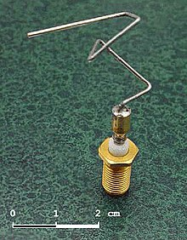

Genetic Algorithm Example
Team Selection
Antenna Design

Slide 20
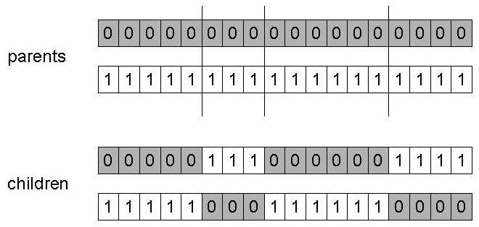
n-point crossover
Choose n random crossover points
Split along those points
Glue parts, alternating between parents
Generalisation of 1 point (still some positional bias)

Slide 21
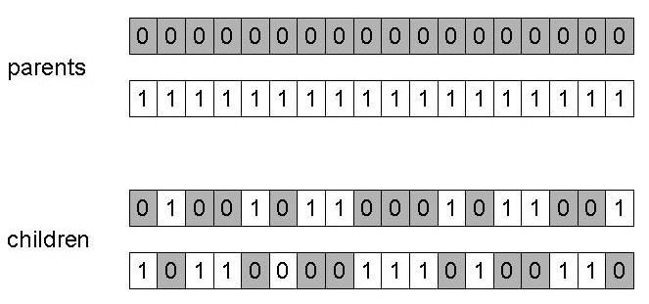
Uniform crossover
Assign 'heads' to one parent, 'tails' to the other
Flip a coin for each gene of the first child
Make an inverse copy of the gene for the second child
Inheritance is independent of position

Slide 22
Crossover OR mutation?
Decade long debate: which one is better / necessary / main-background
Answer (at least, rather wide agreement):
  it depends on the problem, but
  in general, it is good to have both
  both have another role
  mutation-only-EA is possible, xover-only-EA would not work

Slide 23
Crossover OR mutation? (cont’d)
Exploration: Discovering promising areas in the search space, i.e. gaining information on the problem
Exploitation: Optimising within a promising area, i.e. using information
There is co-operation AND competition between them
Crossover is explorative, it makes a big jump to an area somewhere “in between” two (parent) areas
Mutation is exploitative, it creates random small diversions, thereby staying near (in the area of ) the parent

Slide 24
Crossover OR mutation? (cont’d)
Only crossover can combine information from two parents
Only mutation can introduce new information (alleles)
Crossover does not change the allele frequencies of the population (thought experiment: 50% 0’s on first bit in the population, ?% after performing n crossovers)
To hit the optimum you often need a ‘lucky’ mutation

Slide 25
Other representations
Gray coding of integers (still binary chromosomes)
  Gray coding is a mapping that means that small changes in the genotype cause small changes in the phenotype (unlike binary coding). “Smoother” genotype-phenotype mapping makes life easier for the GA
Nowadays it is generally accepted that it is better to encode numerical variables directly as
Integers
Floating point variables

Slide 26
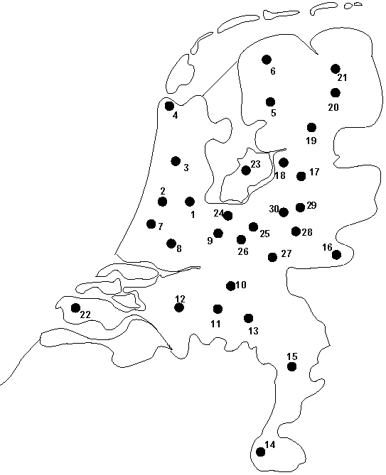
Permutation representation: TSP example
Problem:
  Given n cities
  Find a complete tour with minimal length
Encoding:
  Label the cities 1, 2, … , n
  One complete tour is one permutation (e.g. for n =4 [1,2,3,4], [3,4,2,1] are OK)
Search space is BIG:
for 30 cities there are 30! ≈ 10³² possible tours

Slide 27
Mutation operators for permutations
Normal mutation operators lead to inadmissible solutions
  e.g. bit-wise mutation : let gene i have value j
  changing to some other value k would mean that k occurred twice and j no longer occurred
Therefore must change at least two values
Mutation parameter now reflects the probability that some operator is applied once to the whole string, rather than individually in each position

Slide 28
Insert Mutation for permutations
Pick two allele values at random
Move the second to follow the first, shifting the rest along to accommodate
Note that this preserves most of the order and the adjacency information

Slide 29
Swap mutation for permutations
Pick two alleles at random and swap their positions
Preserves most of adjacency information (4 links broken), disrupts order more

Slide 30
Inversion mutation for permutations
Pick two alleles at random and then invert the substring between them.
Preserves most adjacency information (only breaks two links) but disruptive of order information

Slide 31
Scramble mutation for permutations
Pick a subset of genes at random
Randomly rearrange the alleles in those positions
(note subset does not have to be contiguous)

Slide 32
Crossover operators for permutations
“Normal” crossover operators will often lead to inadmissible solutions
Many specialised operators have been devised which focus on combining order or adjacency information from the two parents
1 2 3 4 5
1 2 3 2 1
5 4 3 2 1
5 4 3 4 5

Slide 33
Order 1 crossover
Idea is to preserve relative order that elements occur
Informal procedure:
  1. Choose an arbitrary part from the first parent
  2. Copy this part to the first child
  3. Copy the numbers that are not in the first part, to the first child:
    starting right from cut point of the copied part,
    using the order of the second parent
    and wrapping around at the end
  4. Analogous for the second child, with parent roles reversed

Slide 34
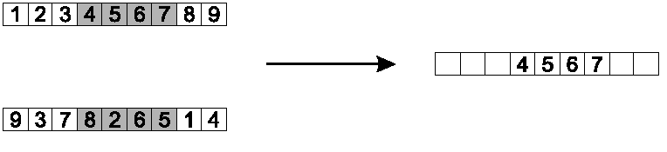
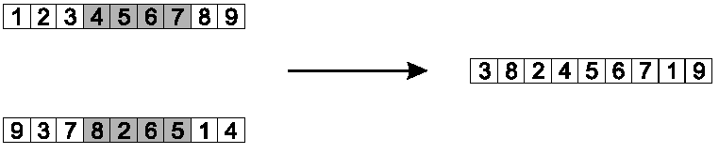
Order 1 crossover example
Copy randomly selected set from first parent
Copy rest from second parent in order 1,9,3,8,2

Slide 35
Partially Mapped Crossover (PMX)
Informal procedure for parents P1 and P2:
Choose random segment and copy it from P1
Starting from the first crossover point look for elements in that segment of P2 that have not been copied
For each of these i look in the offspring to see what element j has been copied in its place from P1
Place i into the position occupied j in P2, since we know that we will not be putting j there (as is already in offspring)
If the place occupied by j in P2 has already been filled in the offspring k, put i in the position occupied by k in P2
Having dealt with the elements from the crossover segment, the rest of the offspring can be filled from P2.
Second child is created analogously

Slide 36
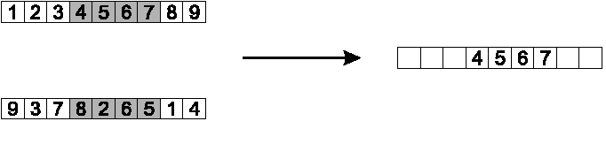
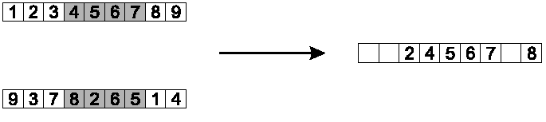
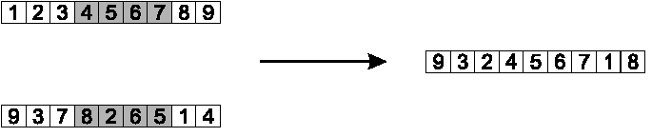
PMX example
Step 1
Step 2
Step 3

Slide 37
Cycle crossover
Basic idea:
Each allele comes from one parent together with its position.
Informal procedure:
1. Make a cycle of alleles from P1 in the following way.
  (a) Start with the first allele of P1.
  (b) Look at the allele at the same position in P2.
  (c) Go to the position with the same allele in P1.
  (d) Add this allele to the cycle.
  (e) Repeat step b through d until you arrive at the first allele of P1.
2. Put the alleles of the cycle in the first child on the positions they have in the first parent.
3. Take next cycle from second parent

Slide 38
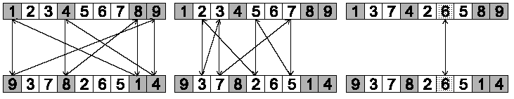
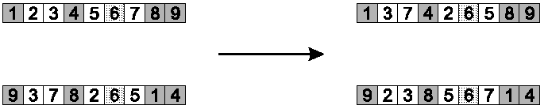
Cycle crossover example
Step 1: identify cycles
Step 2: copy alternate cycles into offspring

Slide 39
Cycle crossover example

Slide 40
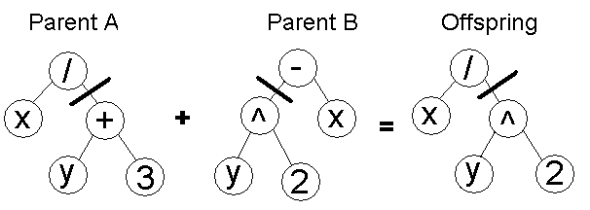
Genetic Programming
LISP: It is possible to evolve whole programs like this but only small ones. Large programs with complex functions present big problems

