Slide 1
Chapter 8: Deadlocks

Slide 2
Chapter 8: Deadlocks
System Model
Deadlock Characterization
Methods for Handling Deadlocks
Deadlock Prevention
Deadlock Avoidance
Deadlock Detection
Recovery from Deadlock

Slide 3
Chapter Objectives
To develop a description of deadlocks, which prevent sets of concurrent processes from completing their tasks
To present a number of different methods for preventing or avoiding deadlocks in a computer system

Slide 4
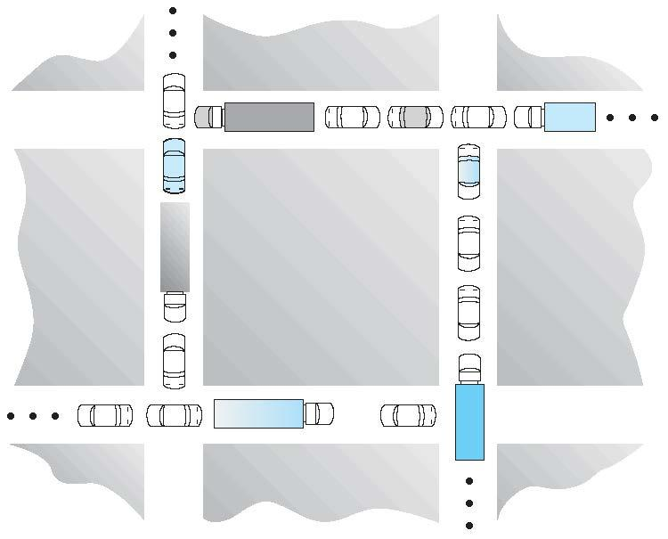
Deadlock Example

Slide 5
System Model
System consists of resources
Resource types R₁, R₂, . . ., R_{m}
CPU cycles, memory space, I/O devices
Each resource type R_{i} has W_{i} instances.
Each process utilizes a resource as follows:
request
use
release

Slide 6
Deadlock Example with Mutex locks
Two mutex locks are created in the following code
pthread_mutex_t first_mutex;
pthread_mutex_t second_mutex;
The two mutex locks are initialized in the following code
pthread_mutex_init (&first_mutex, NULL);
pthread_mutex_init(&second_mutex, NULL);
Two threads-- thread_one and thread_two are created, and both these threads have access to both mutex locks.

Slide 7
Deadlock Example with Mutex locks (Cont.)
/* thread one runs in this function */
void *do_work_one(void *param) {
pthread_mutex_lock(&first_mutex);
pthread_mutex_lock(&second_mutex);
/** * Do some work */ pthread_mutex_unlock(&second_mutex);
pthread_mutex_unlock(&first_mutex);
pthread_exit(0);
}
/* thread two runs in this function */
void *do_work_two(void *param) {
pthread_mutex_lock(&second_mutex);
pthread_mutex_lock(&first_mutex);
/** * Do some work */ pthread_mutex_unlock(&first_mutex);
pthread_mutex_unlock(&second_mutex);
pthread_exit(0);
}

Slide 8
Deadlock Characterization
Deadlock can arise if four conditions hold simultaneously.
Mutual exclusion: only one process at a time can use a resource
Hold and wait: a process holding at least one resource is waiting to acquire additional resources held by other processes
No preemption: a resource can be released only voluntarily by the process holding it, after that process has completed its task
Circular wait: there exists a set {P₀, P₁, …, P_{n}} of waiting processes such that P₀ is waiting for a resource that is held by P₁, P₁ is waiting for a resource that is held by P₂, …, P_{n–1} is waiting for a resource that is held by P_{n}, and P_{n} is waiting for a resource that is held by P₀.

Slide 9
Resource-Allocation Graph
A set of vertices V and a set of edges E.
V is partitioned into two types:
P = {P₁, P₂, …, P_{n}}, the set consisting of all the processes in the system
R = {R₁, R₂, …, R_{m}}, the set consisting of all resource types in the system
request edge – directed edge P_{i} → R_{j}
assignment edge – directed edge R_{j} → P_{i}

Slide 10



Resource-Allocation Graph (Cont.)
Process
Resource Type with 4 instances
P_{i} requests instance of R_{j}
P_{i} is holding an instance of R_{j}
P_{i}
R_{j}
P_{i}
R_{j}

Slide 11
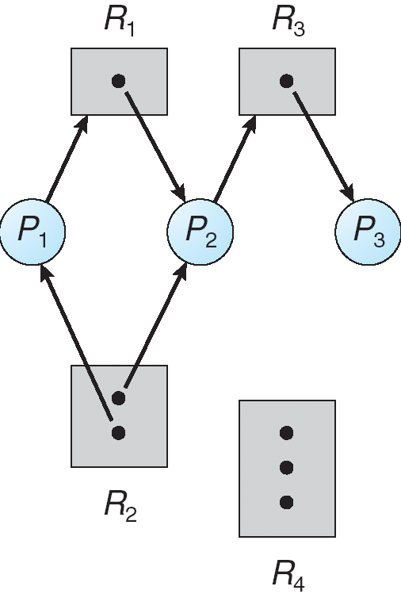
Example of a Resource Allocation Graph

Slide 12
Basic Facts
If graph contains no cycles ⇒ no deadlock
If graph contains a cycle ⇒
If only one instance per resource type, then deadlock exist
If several instances per resource type, then possibility of deadlock

Slide 13
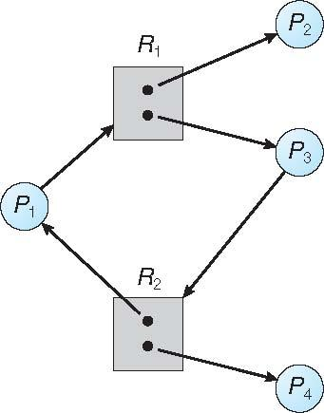
Resource Allocation Graph With a Cycle
Is there a deadlock?

Slide 14
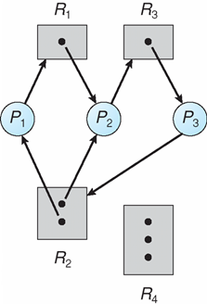
Resource Allocation Graph With a Cycle
Is there a deadlock?

Slide 15
Methods for Handling Deadlocks
Ensure that the system will never enter a deadlock state:
Deadlock prevention
Deadlock avoidance
Allow the system to enter a deadlock state and then recover
Ignore the problem and pretend that deadlocks never occur in the system; used by most operating systems, including UNIX

Slide 16
Deadlock Presentation
Ensure that at least one of the necessary condition for deadlocks does not hold. Can be accomplished restraining the ways request can be made
Mutual Exclusion – Must hold for non-sharable resources that can be accessed simultaneously by various processes. Therefore cannot be used for prevention.
Hold and Wait – must guarantee that whenever a process requests a resource, it does not hold any other resources
Require process to request and be allocated all its resources before it begins execution, or allow process to request resources only when the process has none allocated to it.
Low resource utilization; starvation possible

Slide 17
Deadlock Prevention (Cont.)
No Preemption – not practical for most systems
If a process that is holding some resources requests another resource that cannot be immediately allocated to it, then all resources currently being held are released
Preempted resources are added to the list of resources for which the process is waiting
Process will be restarted only when it can regain its old resources, as well as the new ones that it is requesting
Circular Wait – impose a total ordering of all resource types, and require that each process requests resources in an increasing order of enumeration. Can be used in practice.

Slide 18
Deadlock Example with Lock Ordering
Two bank transactions 1 and 2 execute concurrently.
Transaction 1 transfers $25 from account A to account B
Transaction 2 transfers $50 from account B to account A
Program
void transaction(Account from, Account to, double amount)
{
mutex lock1, lock2;
lock1 = get_lock(from);
lock2 = get_lock(to);
acquire(lock1);
acquire(lock2);
withdraw(from, amount);
deposit(to, amount);
release(lock2);
release(lock1);
}

Slide 19
Deadlock Avoidance
Ensure that the system will never enter a deadlock state
What is a trivial way of avoiding deadlocks?
Requires that the system to have some additional a priori information available on possible resource requests.
Simplest and most useful model requires that each process declare the maximum number of resources of each type that it may need
The deadlock-avoidance algorithm dynamically examines the resource-allocation state to ensure that there can never be a circular-wait condition
Resource-allocation state is defined by the number of available and allocated resources, and the maximum demands of the processes

Slide 20
Safe State
System is in safe state if there exists a sequence <P₁, P₂, …, P_{n}> of ALL the processes in the systems such that for each P_{i} the resources that P_{i} can still request can be satisfied by currently available resources + resources held by all the P_{j}, with j < i
That is:
If P_{i} resource needs are not immediately available, then P_{i} can wait until all processes P_{j} ( j < i ) have finished executing.
When they have finished executing they release all their resources and then P_{i} can obtain the needed resources, execute, return allocated resources, and terminate
When P_{i} terminates, P_{i +1} can obtain its needed resources, and so on

Slide 21
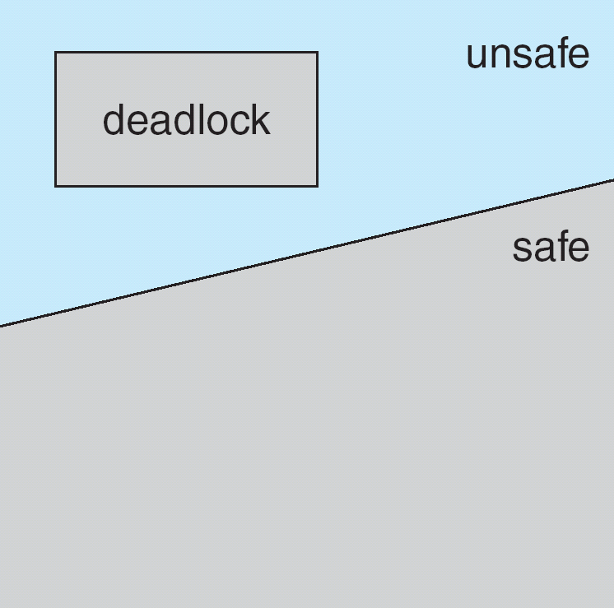
Basic Facts
If a system is in safe state ⇒ no deadlocks
If a system is in unsafe state ⇒ possibility of deadlock

Slide 22
Deadlock Avoidance Algorithms
Deadlock avoidance ⇒ ensure that a system will never enter an unsafe state.
Single instance of a resource type
Use a variant of the resource-allocation graph
Multiple instances of a resource type
Use the banker’s algorithm

Slide 23
Resource-Allocation Graph Scheme
Single instance of a resource type
Each process must a priori claim maximum resource use
Use a variant of the resource-allocation graph with claim edges.
Claim edge P_{i} → R_{j} indicated that process P_{j} may request resource R_{j}; represented by a dashed line
Claim edge converts to request edge when a process requests a resource
Request edge converted to an assignment edge when the resource is allocated to the process
When a resource is released by a process, assignment edge reconverts to a claim edge
Resources must be claimed a priori in the system
A cycle in the graph implies that the system is in unsafe state

Slide 24
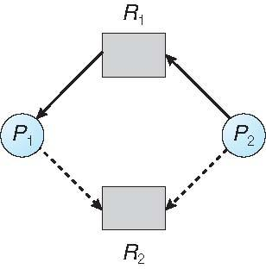
Resource-Allocation Graph with claim edges
P1 is holding resource R1 and has a claim on R2
P2 is requesting R1 and has a claim on R2
No cycle. So system is in a safe state.

Slide 25
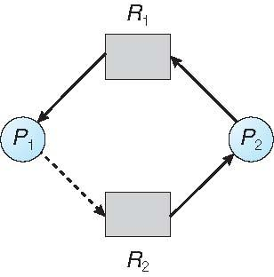
Example of a Resource Allocation Graph
The graph of slide 7.23 with a claim edge from P2 to R2 is changing to an assignment edge.
There is a cycle in the graph ➔ unsafe state.
Is there a deadlock?

Slide 26
Resource-Allocation Graph Algorithm
Suppose that process P_{i} requests a resource R_{j}
The request can be granted only if converting the request edge to an assignment edge does not result in the formation of a cycle in the resource allocation graph
Otherwise, the process must wait

Slide 27
Banker’s Algorithm
Multiple instances of a resource type
Each process must a priori claim maximum use
When a process requests a resource it may have to wait
When a process gets all its resources it must return them in a finite amount of time.
Think of an interest-free bank where:
A customer establishes a line of credit.
Borrows money in chunks that together never exceed the total line of credit.
Once it reaches the maximum, the customer must pay back in a finite amount of time.

Slide 28
Data Structures for the Banker’s Algorithm
Let n = number of processes, and m = number of resources types.
Available: Vector of length m.
If available [j] = k, then there are k instances of resource type R_{j} available
Max: n x m matrix.
If Max [i,j] = k, then process P_{i} may request at most k instances of resource type R_{j}
Allocation: n x m matrix.
If Allocation[i,j] = k then P_{i} is currently allocated k instances of R_{j}
Need: n x m matrix.
If Need[i,j] = k, then P_{i} may need at most k more instances of R_{j} to complete its task.
Need [i,j] = Max[i,j] – Allocation [i,j]

Slide 29
Safety Algorithm
1. Let Work and Finish be vectors of length m and n, respectively. Initialize:
Work = Available
Finish [i] = false for i = 0, 1, …, n- 1
2. Find an i such that both:
(a) Finish [i] = false
(b) Need_{i} ≤ Work
If no such i exists, go to step 4
3. Work = Work + Allocation_{i} Finish[i] = true go to step 2
4. If Finish [i] == true for all i, then the system is in a safe state. Otherwise, in an unsafe state.

Slide 30
Example of Safety Algorithm
5 processes -- P₀ ….. P₄;
3 resource types:
A (10 instances), B (5 instances), and C (7 instances)
Snapshot at time T₀:
Allocation Max Available
A B C A B C A B C
P₀ 0 1 0 7 5 3 3 3 2
P₁ 2 0 0 3 2 2
P₂ 3 0 2 9 0 2
P₃ 2 1 1 2 2 2
P₄ 0 0 2 4 3 3

Slide 31
Example of Safety Algorithm (Cont.)
The content of the matrix Need is defined to be Max – Allocation
Allocation Need Available
A B C A B C A B C
P₀ 0 1 0 7 4 3 3 3 2
P₁ 2 0 0 1 2 2
P₂ 3 0 2 6 0 0
P₃ 2 1 1 0 1 1
P₄ 0 0 2 4 3 1
The system is in a safe state since the sequence < P₁, P₃, P₄, P₂, P₀> satisfies safety criteria

Slide 32
Resource-Request Algorithm for Process P_{i}
Let Request_{i} [...] be the request vector for process P_{i}.
Request_{i} [j] = k. Process P_{i} wants k instances of resource type R_{j}
1. If Request_{i} ≤ Need_{i} go to step 2. Otherwise, raise error condition, since process has exceeded its maximum claim
2. If Request_{i} ≤ Available, go to step 3. Otherwise P_{i} must wait, since resources are not available
3. Pretend to allocate requested resources to P_{i} by modifying the state as follows:
Available = Available – Request_{i}
Allocation_{i} = Allocation_{i} + Request_{i}
Need_{i} = Need_{i} – Request_{i}
If safe ⇒ the resources are allocated to P_{i}
If unsafe ⇒ P_{i} must wait, and the old resource-allocation state is restored

Slide 33
Example of Banker’s Algorithm
5 processes P₀ through P₄;
3 resource types:
A (10 instances), B (5 instances), and C (7 instances)
Snapshot at time T₀:
Allocation Max Available
A B C A B C A B C
P₀ 0 1 0 7 5 3 3 3 2
P₁ 2 0 0 3 2 2
P₂ 3 0 2 9 0 2
P₃ 2 1 1 2 2 2
P₄ 0 0 2 4 3 3
We have shown that the system is in a safe state

Slide 34
Example: P₁ Request (1,0,2)
Check that Request ≤ Available (that is, (1,0,2) ≤ (3,3,2) ⇒ true
State of system after resources allocated to P₁
Allocation Need Available
A B C A B C A B C
P₀ 0 1 0 7 4 3 2 3 0
P₁ 3 0 2 0 2 0
P₂ 3 0 2 6 0 0
P₃ 2 1 1 0 1 1
P₄ 0 0 2 4 3 1
Executing safety algorithm shows that sequence < P₁, P₃, P₄, P₀, P₂> satisfies safety requirement
Given the above state -- can request for (3,3,0) by P₄ be granted?
Given the above state -- can request for (0,2,0) by P₀ be granted?

Slide 35
Methods for Handling Deadlocks: Detection
Allow system to enter deadlock state
Detection algorithm
Single instance of a resource type
Multiple instances of a resource type.
Recovery scheme

Slide 36
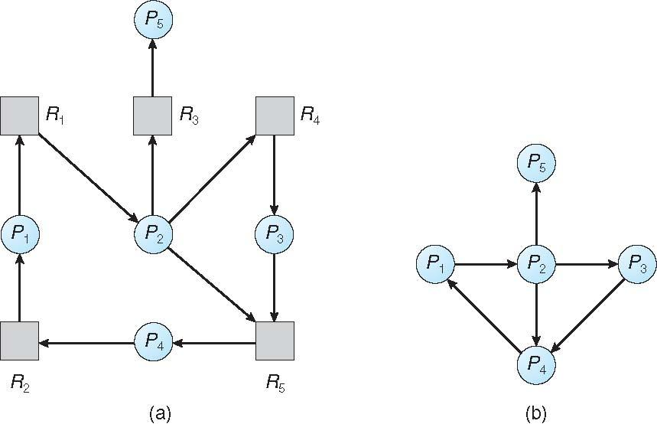
Single Instance of Each Resource Type
Maintain a wait-for graph
Nodes are processes
P_{i} → P_{j} if P_{i} is waiting for P_{j}
Converting a resource-allocation graph to a wait-for graph.
Resource-Allocation Graph
Corresponding wait-for graph

Slide 37
Detection Algorithm for Single Instance
Maintain a wait-for graph
Periodically invoke an algorithm that searches for a cycle in the graph. If there is a cycle, there exists a deadlock
An algorithm to detect a cycle in a graph requires an order of n² operations, where n is the number of vertices in the graph

Slide 38
Several Instances of a Resource Type
Let n = number of processes, and m = number of resources types.
Available: Vector of length m. If available [j] = k, then there are k instances of resource type R_{j} available
Allocation: n x m matrix. If Allocation[i,j] = k, then P_{i} is currently allocated k instances of R_{j}
Request: n x m matrix that indicates the current request of each process. If Request[i,j] = k, then process P_{i} is requesting k additional instances of resource type R_{j} .

Slide 39
Detection Algorithm
Let Work and Finish be vectors of length m and n, respectively Initialize:
1. Initialization
(a) Work = Available
(b) For i = 1,2, …, n, if Allocation_{i} ≠ 0, then Finish[i] = false; otherwise, Finish[i] = true
2. Find an index i such that both:
(a) Finish[i] == false
(b) Request_{i} ≤ Work
If no such i exists, go to step 4
3. Work = Work + Allocation_{i} Finish[i] = true go to step 2
4. If Finish[i] == false, for some i, 1 ≤ i ≤ n, then the system is in deadlock state. Moreover, if Finish[i] == false, then P_{i} is deadlocked

Slide 40
Example of Detection Algorithm
Five processes P₀ through P₄; three resource types A (7 instances), B (2 instances), and C (6 instances)
Snapshot at time T₀:
Allocation Request Available
A B C A B C A B C
P₀ 0 1 0 0 0 0 0 0 0
P₁ 2 0 0 2 0 2
P₂ 3 0 3 0 0 0
P₃ 2 1 1 1 0 0
P₄ 0 0 2 0 0 2
Sequence <P₀, P₂, P₃, P₁, P₄> will result in Finish[i] = true for all i

Slide 41
Example of Detection Algorithm (Cont.)
P₂ requests one additional instance of type C
Allocation Request Available
A B C A B C A B C
P₀ 0 1 0 0 0 0 0 0 0
P₁ 2 0 0 2 0 2
P₂ 3 0 3 0 0 1
P₃ 2 1 1 1 0 0
P₄ 0 0 2 0 0 2
State of system?
Can reclaim resources held by process P₀, but insufficient resources to fulfill other processes requests
Deadlock exists, consisting of processes P₁, P₂, P₃, and P₄

Slide 42
Detection-Algorithm Usage
If a deadlock is detected we must abort (rollback) some of the processes involved in the deadlock (see next slide)
Need to decide when, and how often, to invoke the dedalock detection algorithm, which depends on:
How often a deadlock is likely to occur?
How many processes will need to be rolled back?
one for each disjoint cycle
If detection algorithm is invoked arbitrarily, there may be many cycles in the resource graph and so we would not be able to tell which of the many deadlocked processes “caused” the deadlock.

Slide 43
Recovery from Deadlock: Process Termination
Abort all deadlocked processes
Abort one process at a time until the deadlock cycle is eliminated
In which order should we choose to abort?
Priority of the process
How long process has computed, and how much longer to completion
Resources the process has used
Resources process needs to complete
How many processes will need to be terminated
Is process interactive or batch?

Slide 44
Recovery from Deadlock: Resource Preemption
Selecting a victim – minimize cost
Rollback – return to some safe state, restart process for that state
Starvation – same process may always be picked as victim, include number of rollback in cost factor

Slide 45
End of Chapter 8

