Slide 1
Operating Systems

Slide 2
Agenda
What is an Operating System?
Batch Systems
Multiprogrammed Systems
Real -Time Systems
Typical Computer System Architecture
Computer System Operations
Interrupt Handling

Slide 3
What is an Operating System?
A program that acts as an intermediary between a user of a computer and the computer hardware.
Operating system goals:
Execute user programs and make solving user problems easier.
Make the computer system convenient to use.
Use the computer hardware in an efficient manner.

Slide 4
Computer System Components
1. Hardware – provides basic computing resources (CPU, memory, I/O devices).
2. Operating system – controls and coordinates the use of the hardware among the various application programs for the various users.
3. Applications programs – define the ways in which the system resources are used to solve the computing problems of the users (compilers, database systems, video games, business programs).
4. Users (people, machines, other computers).

Slide 5
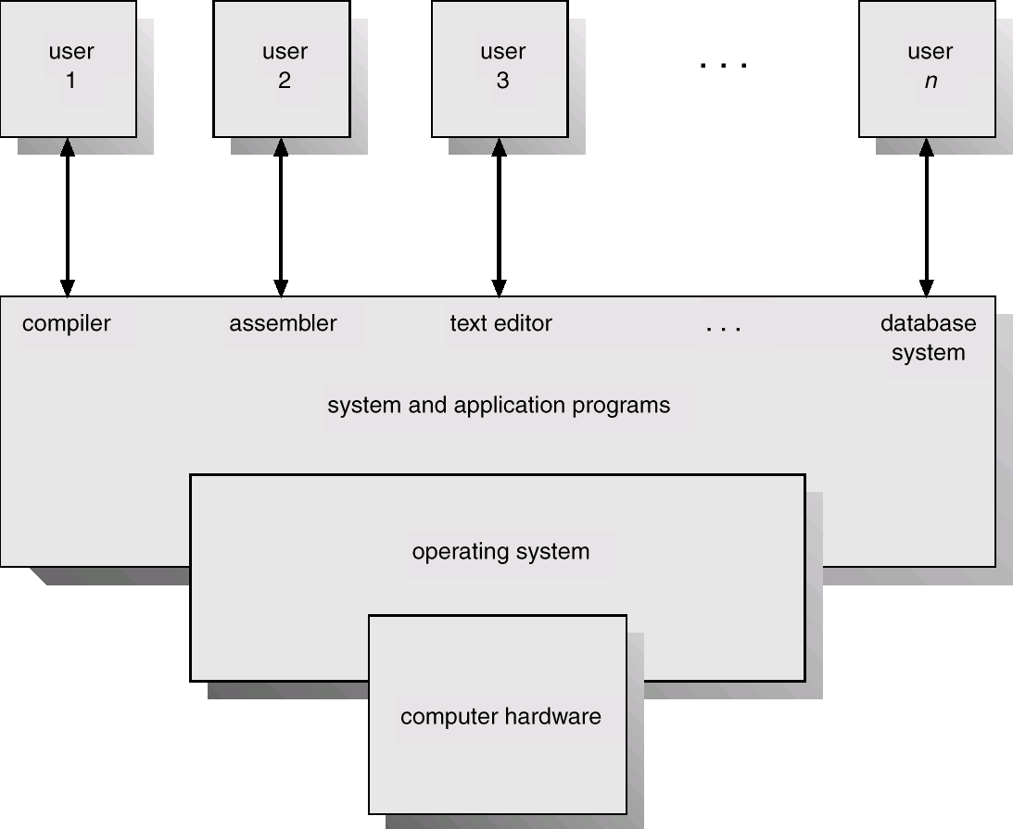
Abstract View of System Components

Slide 6
Operating System Definitions
Resource allocator – manages and allocates resources.
Control program – controls the execution of user programs and operations of I/O devices .
Kernel – the one program running at all times (all else being application programs).

Slide 7
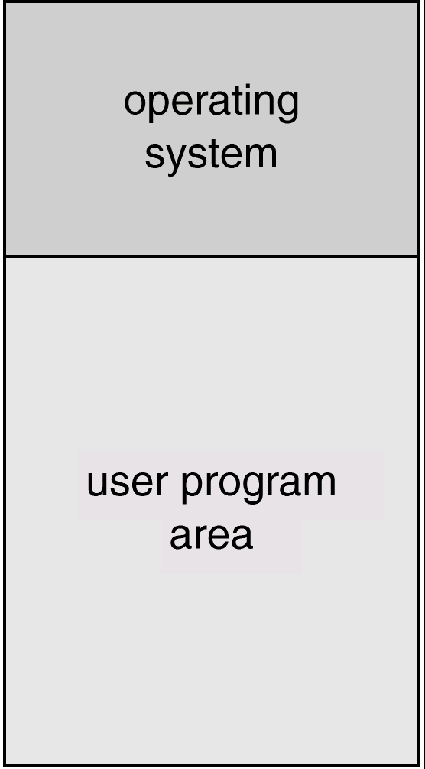
Memory Layout for a Simple Batch System

Slide 8
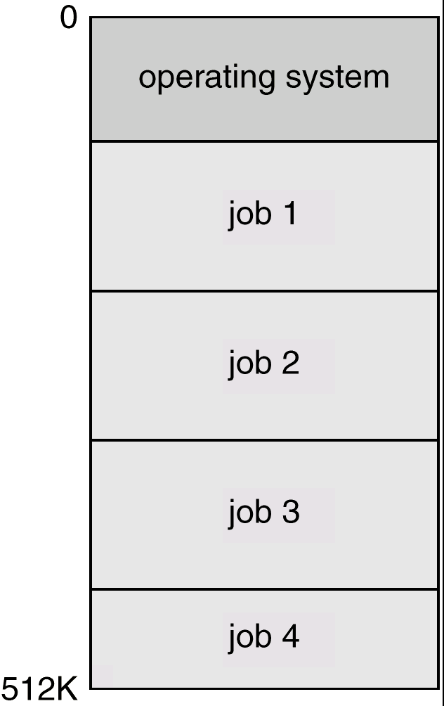
Multiprogrammed Batch Systems
Several jobs are kept in main memory at the same time, and the
CPU is multiplexed among them.

Slide 9
OS Features Needed for Multiprogramming
I/O routine supplied by the system.
Memory management – the system must allocate the memory to several jobs.
CPU scheduling – the system must choose among several jobs ready to run.
Allocation of devices.

Slide 10
Time-Sharing Systems–Interactive Computing
The CPU is multiplexed among several jobs that are kept in memory and on disk (the CPU is allocated to a job only if the job is in memory).
A job swapped in and out of memory to the disk.
On-line communication between the user and the system is provided; when the operating system finishes the execution of one command, it seeks the next “control statement” from the user’s keyboard.
On-line system must be available for users to access data and code.

Slide 11
Real-Time Systems
Often used as a control device in a dedicated application such as controlling scientific experiments, medical imaging systems, industrial control systems, and some display systems.
Well-defined fixed-time constraints.
Real-Time systems may be either hard or soft real-time.

Slide 12
Real-Time Systems (Cont.)
Hard real-time:
Secondary storage limited or absent, data stored in short term memory, or read-only memory (ROM)
Conflicts with time-sharing systems, not supported by general-purpose operating systems.
Soft real-time
Limited utility in industrial control of robotics
Useful in applications (multimedia, virtual reality) requiring advanced operating-system features.

Slide 13
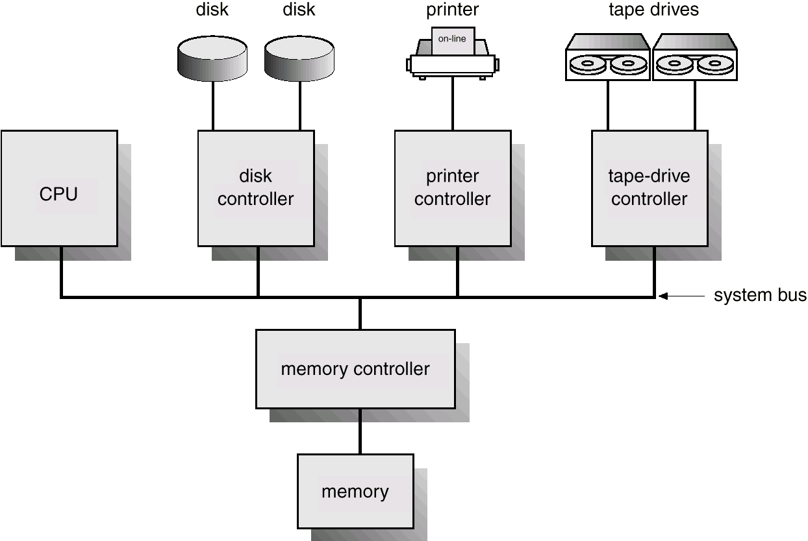
Computer-System Architecture

Slide 14
Computer-System Operation
I/O devices and the CPU can execute concurrently.
Each device controller is in charge of a particular device type.
Each device controller has a local buffer.
CPU moves data from/to main memory to/from local buffers
I/O is from the device to local buffer of controller.
Device controller informs CPU that it has finished its operation by causing an interrupt.

Slide 15
Common Functions of Interrupts
Interrupt transfers control to the interrupt service routine generally, through the interrupt vector, which contains the addresses of all the service routines.
Interrupt architecture must save the address of the interrupted instruction.
Incoming interrupts are disabled while another interrupt is being processed to prevent a lost interrupt.
A trap is a software-generated interrupt caused either by an error or a user request.
An operating system is interrupt driven.

