Slide 1
Chapter 9: Virtual Memory

Slide 2
Background
Code needs to be in memory to execute, but entire program rarely used
Error code, unusual routines, large data structures
Entire program code not needed at same time
Consider ability to execute partially-loaded program
Program no longer constrained by limits of physical memory
Each program takes less memory while running -> more programs run at the same time
Increased CPU utilization and throughput with no increase in response time or turnaround time
Less I/O needed to load or swap programs into memory -> each user program runs faster

Slide 3
Background (Cont.)
Virtual memory – separation of user logical memory from physical memory
Only part of the program needs to be in memory for execution
Logical address space can therefore be much larger than physical address space
Allows address spaces to be shared by several processes
Allows for more efficient process creation
More programs running concurrently
Less I/O needed to load or swap processes

Slide 4
Background (Cont.)
Virtual address space – logical view of how process is stored in memory
Usually start at address 0, contiguous addresses until end of space
Meanwhile, physical memory organized in page frames
MMU must map logical to physical
Virtual memory can be implemented via:
Demand paging
Demand segmentation

Slide 5
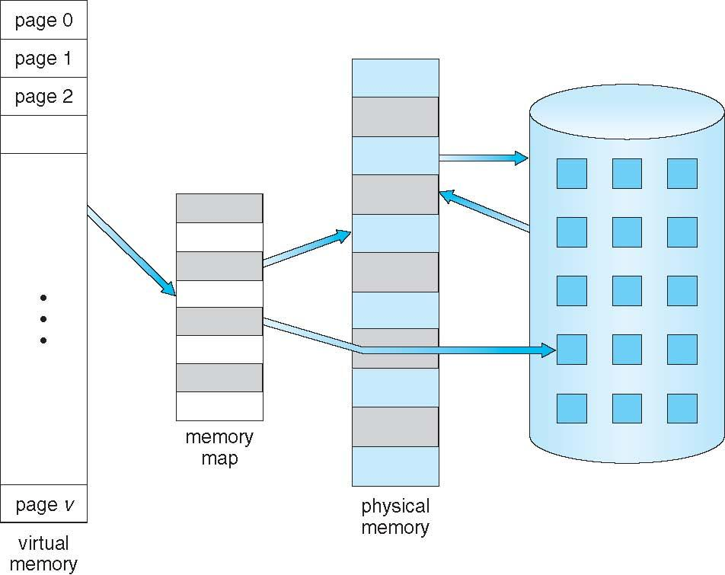
Virtual Memory That is Larger Than Physical Memory

Slide 6
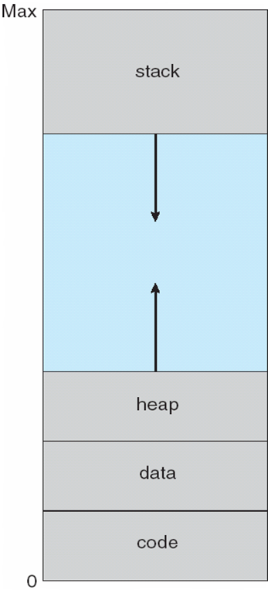
Virtual-address Space
Usually design logical address space for stack to start at Max logical address and grow “down” while heap grows “up”
Maximizes address space use
Unused address space between the two is hole
No physical memory needed until heap or stack grows to a given new page
Enables sparse address spaces with holes left for growth, dynamically linked libraries, etc
System libraries shared via mapping into virtual address space
Shared memory by mapping pages read-write into virtual address space
Pages can be shared during fork(), speeding process creation

Slide 7
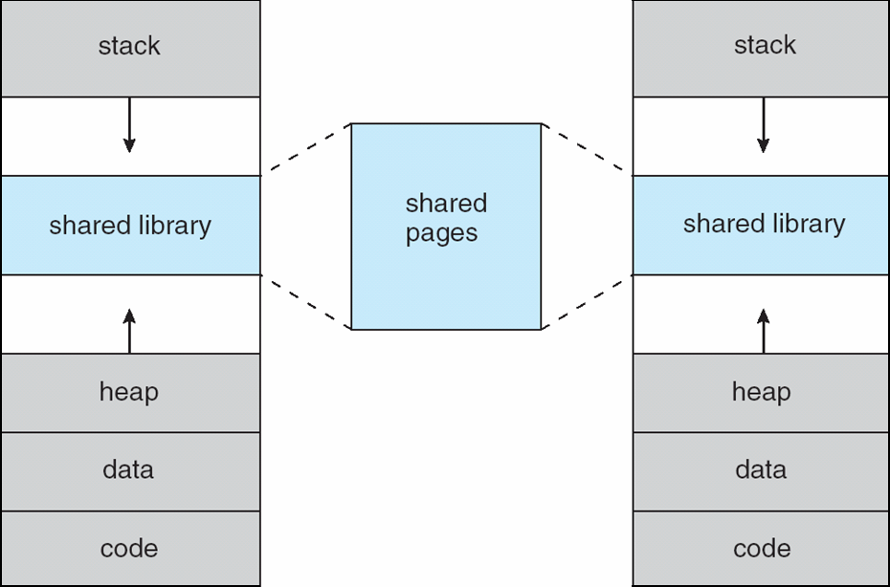
Shared Library Using Virtual Memory

Slide 8
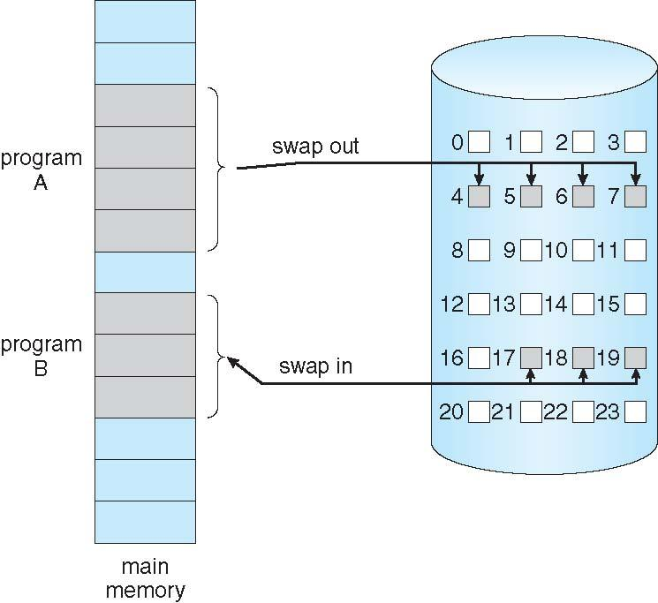
Demand Paging
Could bring entire process into memory at load time
Or bring a page into memory only when it is needed
Less I/O needed, no unnecessary I/O
Less memory needed
Faster response
More users
Similar to paging system with swapping (diagram on right)
Page is needed ⇒ reference to it
invalid reference ⇒ abort
not-in-memory ⇒ bring to memory
Lazy swapper – never swaps a page into memory unless page will be needed
Swapper that deals with pages is a pager

Slide 9
Basic Concepts
With swapping, pager guesses which pages will be used before swapping out again
Instead, pager brings in only those pages into memory
How to determine that set of pages?
Need new MMU functionality to implement demand paging
If pages needed are already memory resident
No difference from non demand-paging
If page needed and not memory resident
Need to detect and load the page into memory from storage
Without changing program behavior
Without programmer needing to change code

Slide 10
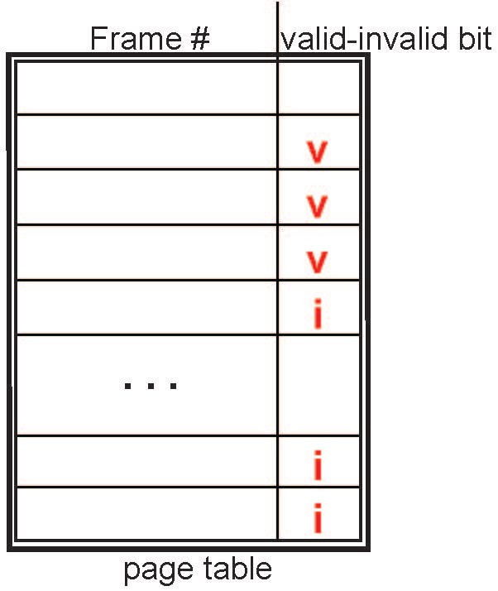
Valid-Invalid Bit
With each page table entry a valid–invalid bit is associated (v ⇒ in-memory – memory resident, i ⇒ not-in-memory)
Initially valid–invalid bit is set to i on all entries
Example of a page table snapshot:
During MMU address translation, if valid–invalid bit in page table entry is i ⇒ page fault

Slide 11
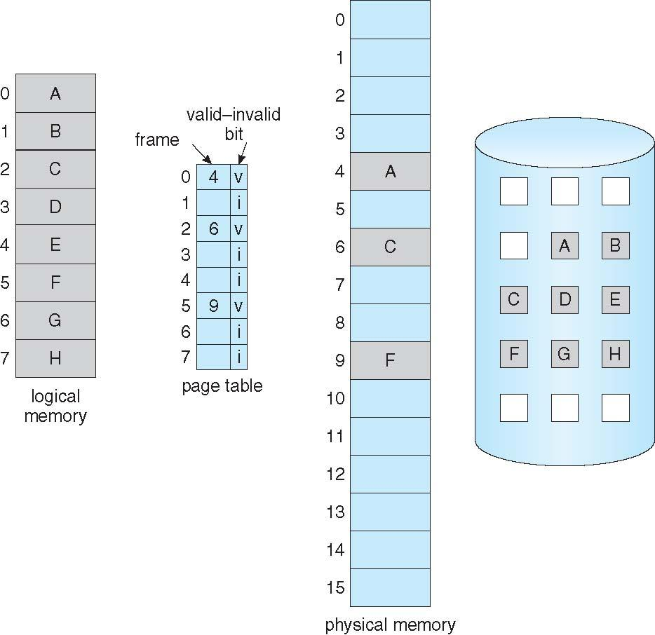
Page Table When Some Pages Are Not in Main Memory

Slide 12
Page Fault
If there is a reference to a page, first reference to that page will trap to operating system:
page fault
Operating system looks at another table to decide:
Invalid reference ⇒ abort
Just not in memory
Find free frame
Swap page into frame via scheduled disk operation
Reset tables to indicate page now in memory Set validation bit = v
Restart the instruction that caused the page fault

Slide 13
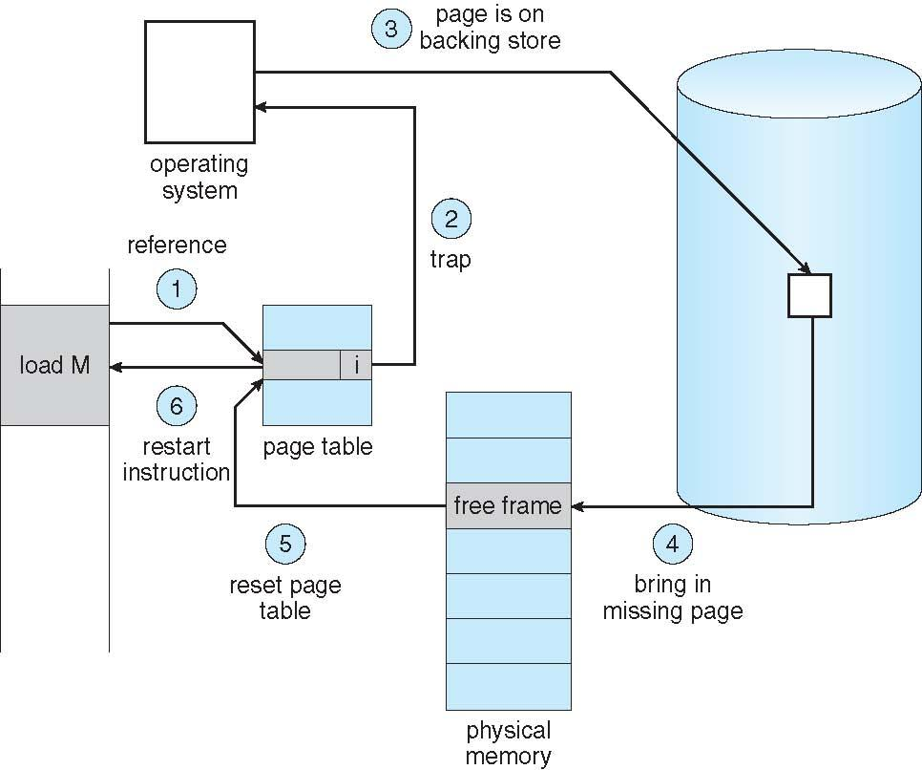
Steps in Handling a Page Fault

Slide 14
Aspects of Demand Paging
Extreme case – start process with no pages in memory
OS sets instruction pointer to first instruction of process, non-memory-resident -> page fault
And for every other process pages on first access
Pure demand paging
Actually, a given instruction could access multiple pages -> multiple page faults
Consider fetch and decode of instruction which adds 2 numbers from memory and stores result back to memory
Pain decreased because of locality of reference
Hardware support needed for demand paging
Page table with valid / invalid bit
Secondary memory (swap device with swap space)
Instruction restart

Slide 15
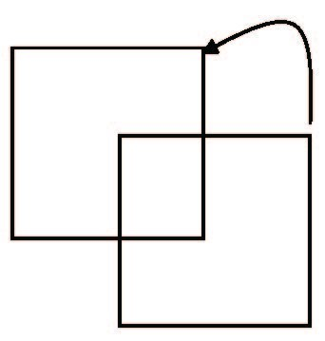
Instruction Restart
Consider an instruction that could access several different locations
block move
auto increment/decrement location
Restart the whole operation?
What if source and destination overlap?

Slide 16
Performance of Demand Paging
Stages in Demand Paging (worse case)
Trap to the operating system
Save the user registers and process state
Determine that the interrupt was a page fault
Check that the page reference was legal and determine the location of the page on the disk
Issue a read from the disk to a free frame:
Wait in a queue for this device until the read request is serviced
Wait for the device seek and/or latency time
Begin the transfer of the page to a free frame
While waiting, allocate the CPU to some other user
Receive an interrupt from the disk I/O subsystem (I/O completed)
Save the registers and process state for the other user
Determine that the interrupt was from the disk
Correct the page table and other tables to show page is now in memory
Wait for the CPU to be allocated to this process again
Restore the user registers, process state, and new page table, and then resume the interrupted instruction

Slide 17
Performance of Demand Paging (Cont.)
Three major activities
Service the interrupt – careful coding means just several hundred instructions needed
Read the page – lots of time
Restart the process – again just a small amount of time
Page Fault Rate 0 ≤ p ≤ 1
if p = 0 no page faults
if p = 1, every reference is a fault
Effective Access Time (EAT)
EAT = (1 – p) x memory access
+ p (page fault overhead
+ swap page out
+ swap page in )

Slide 18
Demand Paging Example
Memory access time = 200 nanoseconds
Average page-fault service time = 8 milliseconds
EAT = (1 – p) x 200 + p (8 milliseconds)
= (1 – p x 200 + p x 8,000,000
= 200 + p x 7,999,800
If one access out of 1,000 causes a page fault, then
EAT = 8.2 microseconds.
This is a slowdown by a factor of 40!!
If want performance degradation < 10 percent
220 > 200 + 7,999,800 x p 20 > 7,999,800 x p
p < .0000025
< one page fault in every 400,000 memory accesses

Slide 19
Demand Paging Optimizations
Swap space I/O faster than file system I/O even if on the same device
Swap allocated in larger chunks, less management needed than file system
Copy entire process image to swap space at process load time
Then page in and out of swap space
Used in older BSD Unix
Demand page in from program binary on disk, but discard rather than paging out when freeing frame
Used in Solaris and current BSD
Still need to write to swap space
Pages not associated with a file (like stack and heap) – anonymous memory
Pages modified in memory but not yet written back to the file system
Mobile systems
Typically don’t support swapping
Instead, demand page from file system and reclaim read-only pages (such as code)

Slide 20
Copy-on-Write
Copy-on-Write (COW) allows both parent and child processes to initially share the same pages in memory
If either process modifies a shared page, only then is the page copied
COW allows more efficient process creation as only modified pages are copied
In general, free pages are allocated from a pool of zero-fill-on-demand pages
Pool should always have free frames for fast demand page execution
Don’t want to have to free a frame as well as other processing on page fault
Why zero-out a page before allocating it?
vfork() variation on fork() system call has parent suspend and child using copy-on-write address space of parent
Designed to have child call exec()
Very efficient

Slide 21
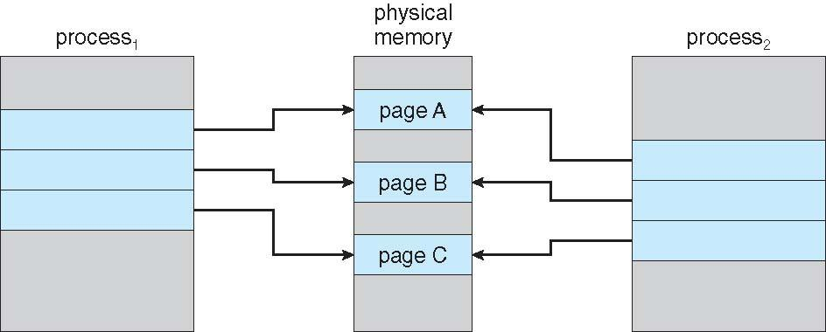
Before Process 1 Modifies Page C

Slide 22
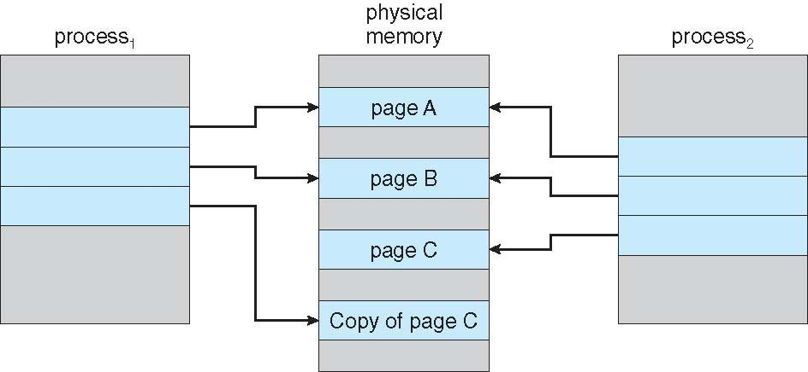
After Process 1 Modifies Page C

Slide 23
What Happens if There is no Free Frame?
Used up by process pages
Also in demand from the kernel, I/O buffers, etc
How much to allocate to each?
Page replacement – find some page in memory, but not really in use, page it out
Algorithm – terminate? swap out? replace the page?
Performance – want an algorithm which will result in minimum number of page faults
Same page may be brought into memory several times

Slide 24
Page Replacement
Prevent over-allocation of memory by modifying page-fault service routine to include page replacement
Use modify (dirty) bit to reduce overhead of page transfers – only modified pages are written to disk
Page replacement completes separation between logical memory and physical memory – large virtual memory can be provided on a smaller physical memory

Slide 25
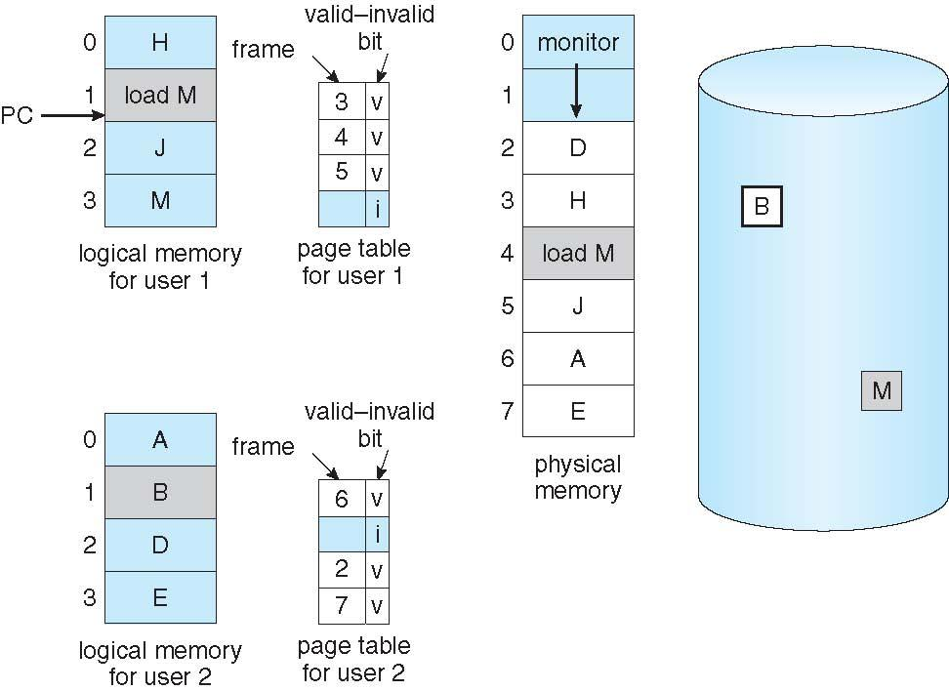
Need For Page Replacement

Slide 26
Basic Page Replacement
Find the location of the desired page on disk
Find a free frame: - If there is a free frame, use it - If there is no free frame, use a page replacement algorithm to select a victim frame - Write victim frame to disk if dirty
Bring the desired page into the (newly) free frame; update the page and frame tables
Continue the process by restarting the instruction that caused the trap
Note now potentially 2 page transfers for page fault – increasing EAT

Slide 27
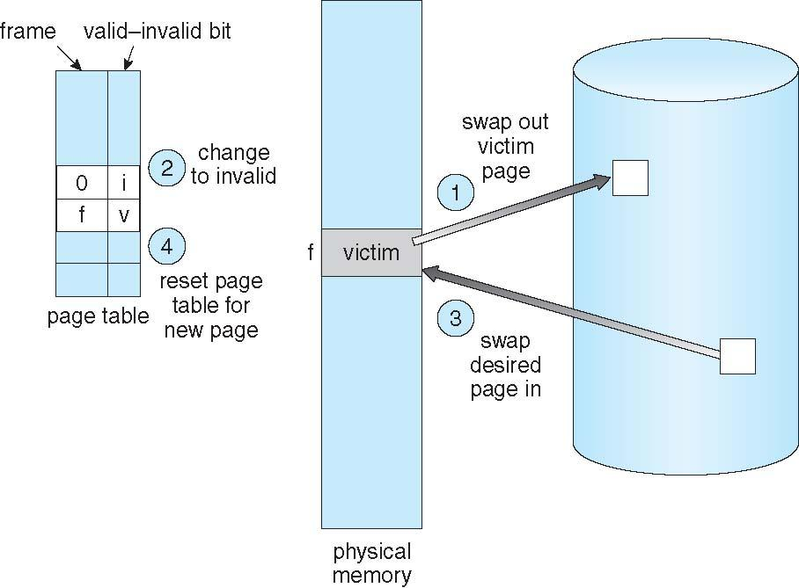
Page Replacement

Slide 28
Page and Frame Replacement Algorithms
Frame-allocation algorithm determines
How many frames to give each process
Which frames to replace
Page-replacement algorithm
Want lowest page-fault rate on both first access and re-access
Evaluate algorithm by running it on a particular string of memory references (reference string) and computing the number of page faults on that string
String is just page numbers, not full addresses
Repeated access to the same page does not cause a page fault
Results depend on number of frames available
In all our examples, the reference string of referenced page numbers is
7,0,1,2,0,3,0,4,2,3,0,3,0,3,2,1,2,0,1,7,0,1

Slide 29
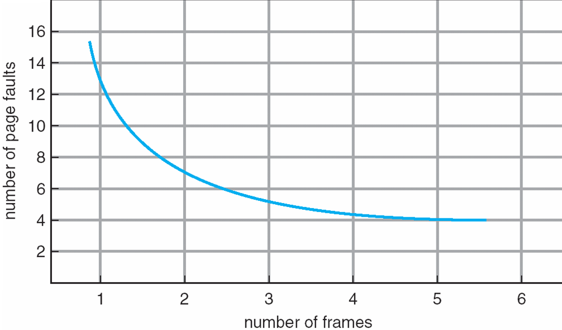
Graph of Page Faults Versus The Number of Frames

Slide 30
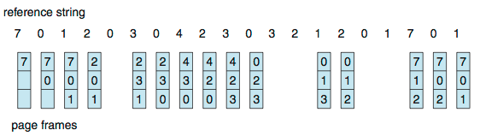
First-In-First-Out (FIFO) Algorithm
Reference string: 7,0,1,2,0,3,0,4,2,3,0,3,0,3,2,1,2,0,1,7,0,1
3 frames (3 pages can be in memory at a time per process)
Can vary by reference string: consider 1,2,3,4,1,2,5,1,2,3,4,5
Adding more frames can cause more page faults!
Belady’s Anomaly
How to track ages of pages?
Just use a FIFO queue
15 page faults

Slide 31
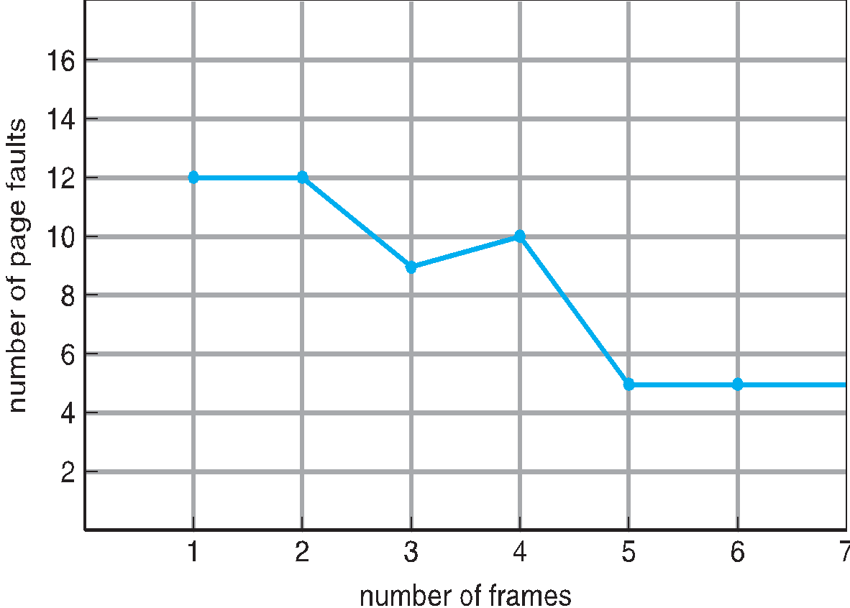
FIFO Illustrating Belady’s Anomaly

Slide 32
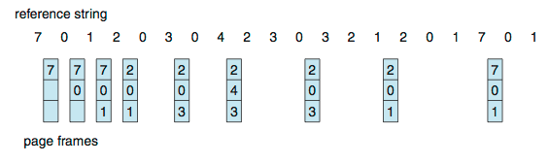
Optimal Algorithm
Replace page that will not be used for longest period of time
9 is optimal for the example
How do you know this?
Can’t read the future
Used for measuring how well your algorithm performs

Slide 33
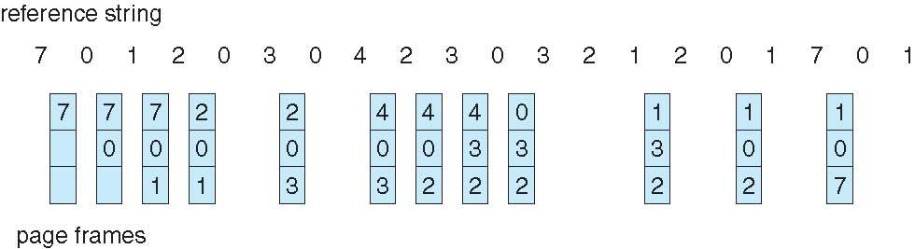
Least Recently Used (LRU) Algorithm
Use past knowledge rather than future
Replace page that has not been used in the most amount of time
Associate time of last use with each page
12 faults – better than FIFO but worse than OPT
Generally good algorithm and frequently used
But how to implement?

Slide 34
LRU Algorithm (Cont.)
Counter implementation
Every page entry has a counter; every time page is referenced through this entry, copy the clock into the counter
When a page needs to be changed, look at the counters to find smallest value
Search through table needed
Stack implementation
Keep a stack of page numbers in a double link form:
Page referenced:
move it to the top
requires 6 pointers to be changed
But each update more expensive
No search for replacement
LRU and OPT are cases of stack algorithms that don’t have Belady’s Anomaly

Slide 35
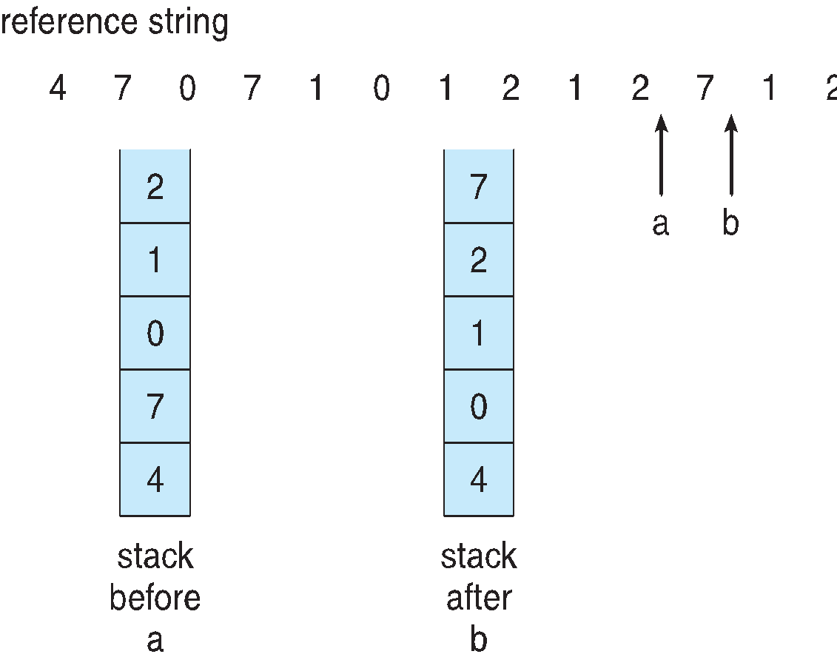
Use Of A Stack to Record Most Recent Page References

Slide 36
LRU Approximation Algorithms
LRU needs special hardware and still slow
Reference bit
With each page associate a bit, initially = 0
When page is referenced bit set to 1
Replace any with reference bit = 0 (if one exists)
We do not know the order, however
Second-chance algorithm
Generally FIFO, plus hardware-provided reference bit
Clock replacement
If page to be replaced has
Reference bit = 0 -> replace it
reference bit = 1 then:
set reference bit 0, leave page in memory
replace next page, subject to same rules

Slide 37
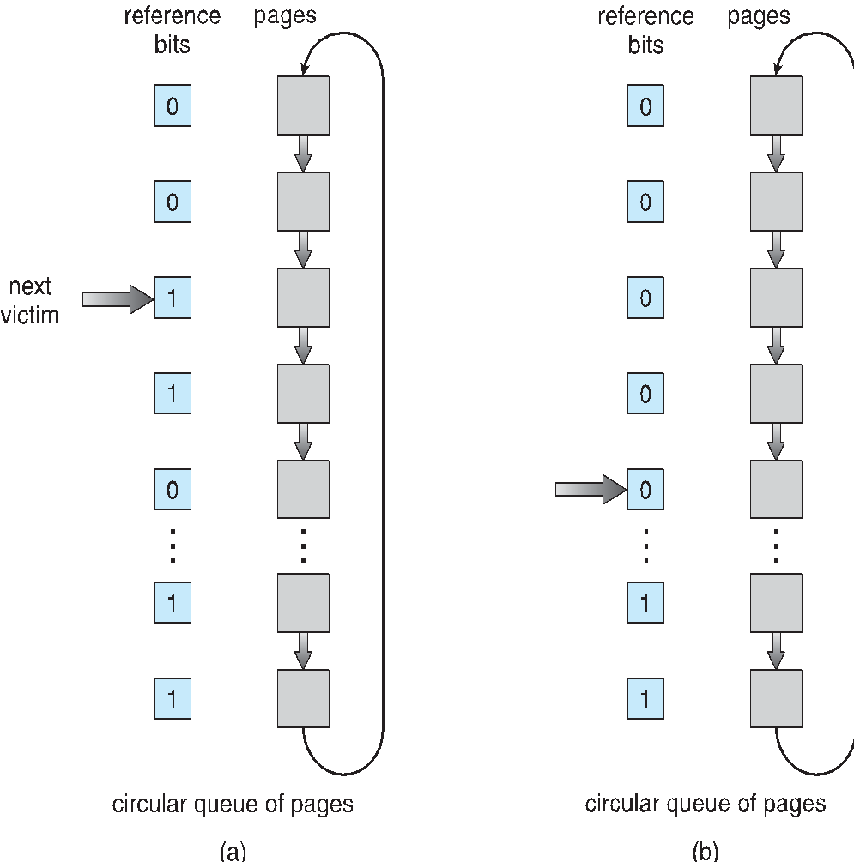
Second-Chance (clock) Page-Replacement Algorithm

Slide 38
Enhanced Second-Chance Algorithm
Improve algorithm by using reference bit and modify bit (if available) in concert
Take ordered pair (reference, modify)
(0, 0) neither recently used not modified – best page to replace
(0, 1) not recently used but modified – not quite as good, must write out before replacement
(1, 0) recently used but clean – probably will be used again soon
(1, 1) recently used and modified – probably will be used again soon and need to write out before replacement
When page replacement called for, use the clock scheme but use the four classes replace page in lowest non-empty class
Might need to search circular queue several times

Slide 39
Counting Algorithms
Keep a counter of the number of references that have been made to each page
Not common
Lease Frequently Used (LFU) Algorithm: replaces page with smallest count
Most Frequently Used (MFU) Algorithm: based on the argument that the page with the smallest count was probably just brought in and has yet to be used

Slide 40
Page-Buffering Algorithms
Keep a pool of free frames, always
Then frame available when needed, not found at fault time
Read page into free frame and select victim to evict and add to free pool
When convenient, evict victim
Possibly, keep list of modified pages
When backing store otherwise idle, write pages there and set to non-dirty
Possibly, keep free frame contents intact and note what is in them
If referenced again before reused, no need to load contents again from disk
Generally useful to reduce penalty if wrong victim frame selected

Slide 41
Applications and Page Replacement
All of these algorithms have OS guessing about future page access
Some applications have better knowledge – i.e. databases
Memory intensive applications can cause double buffering
OS keeps copy of page in memory as I/O buffer
Application keeps page in memory for its own work
Operating system can given direct access to the disk, getting out of the way of the applications
Raw disk mode
Bypasses buffering, locking, etc

Slide 42
Allocation of Frames
Each process needs minimum number of frames
Example: IBM 370 – 6 pages to handle SS MOVE instruction:
instruction is 6 bytes, might span 2 pages
2 pages to handle from
2 pages to handle to
Maximum of course is total frames in the system
Two major allocation schemes
fixed allocation
priority allocation
Many variations

Slide 43
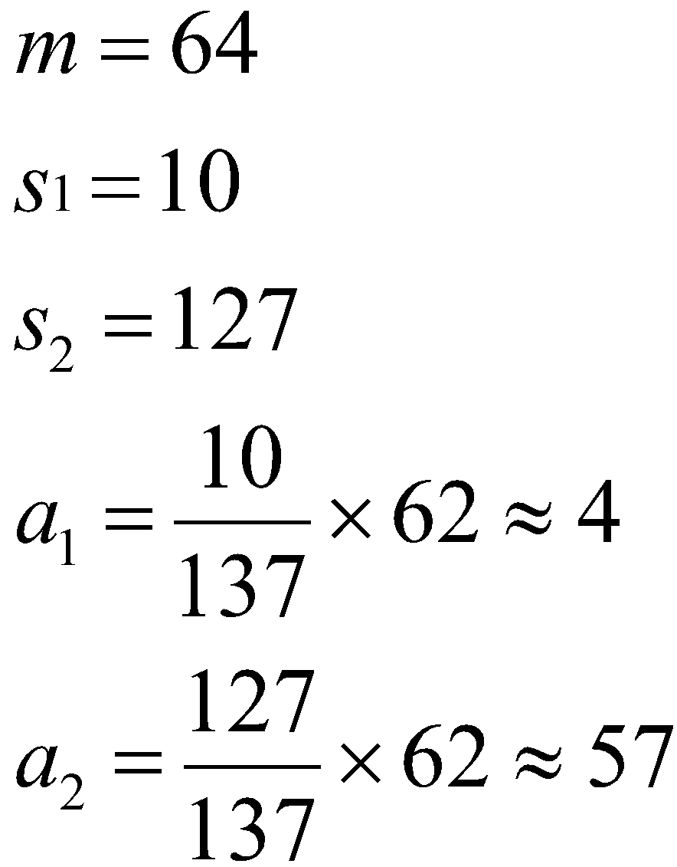
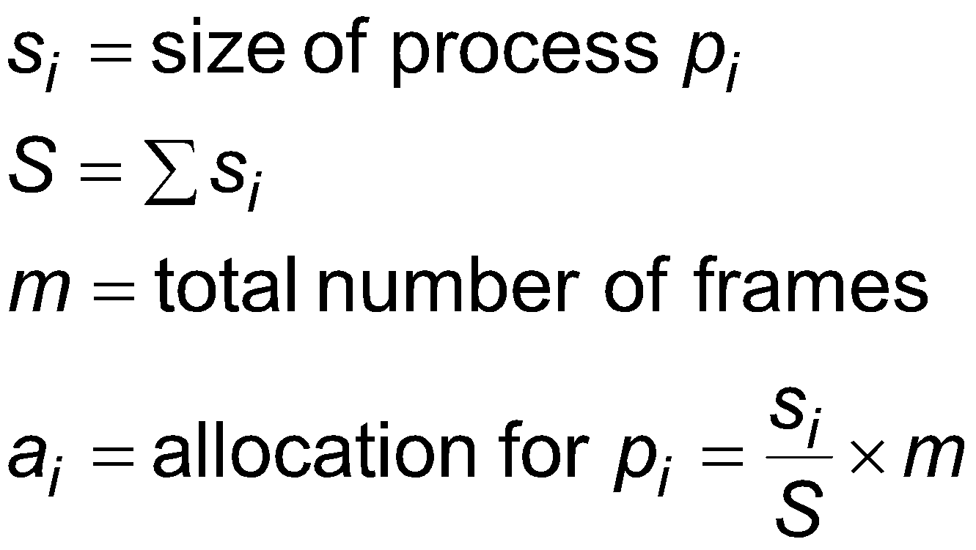
Fixed Allocation
Equal allocation – For example, if there are 100 frames (after allocating frames for the OS) and 5 processes, give each process 20 frames
Keep some as free frame buffer pool
Proportional allocation – Allocate according to the size of process
Dynamic as degree of multiprogramming, process sizes change

Slide 44
Priority Allocation
Use a proportional allocation scheme using priorities rather than size
If process P_{i} generates a page fault,
select for replacement one of its frames
select for replacement a frame from a process with lower priority number

Slide 45
Global vs. Local Allocation
Global replacement – process selects a replacement frame from the set of all frames; one process can take a frame from another
But then process execution time can vary greatly
But greater throughput so more common
Local replacement – each process selects from only its own set of allocated frames
More consistent per-process performance
But possibly underutilized memory

Slide 46
Thrashing
If a process does not have “enough” pages, the page-fault rate is very high
Page fault to get page
Replace existing frame
But quickly need replaced frame back
This leads to:
Low CPU utilization
Operating system thinking that it needs to increase the degree of multiprogramming
Another process added to the system
Thrashing ≡ a process is busy swapping pages in and out

Slide 47
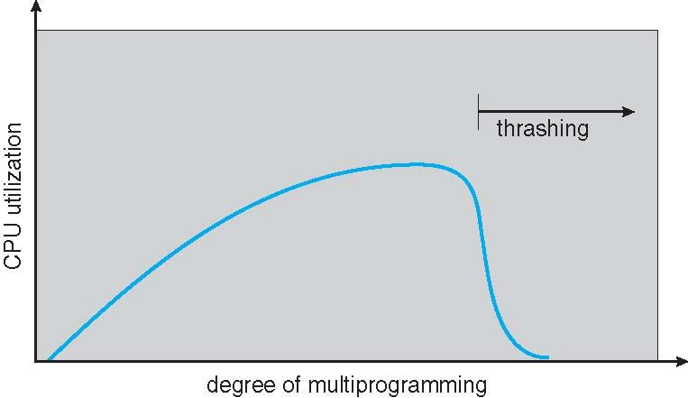
Thrashing (Cont.)

Slide 48
Demand Paging and Thrashing
Why does demand paging work? Locality model
Process migrates from one locality to another
Localities may overlap
Why does thrashing occur? Σ size of locality > total memory size
Limit effects by using local or priority page replacement

Slide 49
Memory-Mapped Files
Memory-mapped file I/O allows file I/O to be treated as routine memory access by mapping a disk block to a page in memory
A file is initially read using demand paging
A page-sized portion of the file is read from the file system into a physical page
Subsequent reads/writes to/from the file are treated as ordinary memory accesses
Simplifies and speeds file access by driving file I/O through memory rather than read() and write() system calls
Also allows several processes to map the same file allowing the pages in memory to be shared
But when does written data make it to disk?
Periodically and / or at file close() time
For example, when the pager scans for dirty pages

Slide 50
Memory-Mapped File Technique for all I/O
Some OSes uses memory mapped files for standard I/O
Process can explicitly request memory mapping a file via mmap() system call
Now file mapped into process address space
For standard I/O (open(), read(), write(), close()), mmap anyway
But map file into kernel address space
Process still does read() and write()
Copies data to and from kernel space and user space
Uses efficient memory management subsystem
Avoids needing separate subsystem
COW can be used for read/write non-shared pages
Memory mapped files can be used for shared memory (although again via separate system calls)

Slide 51
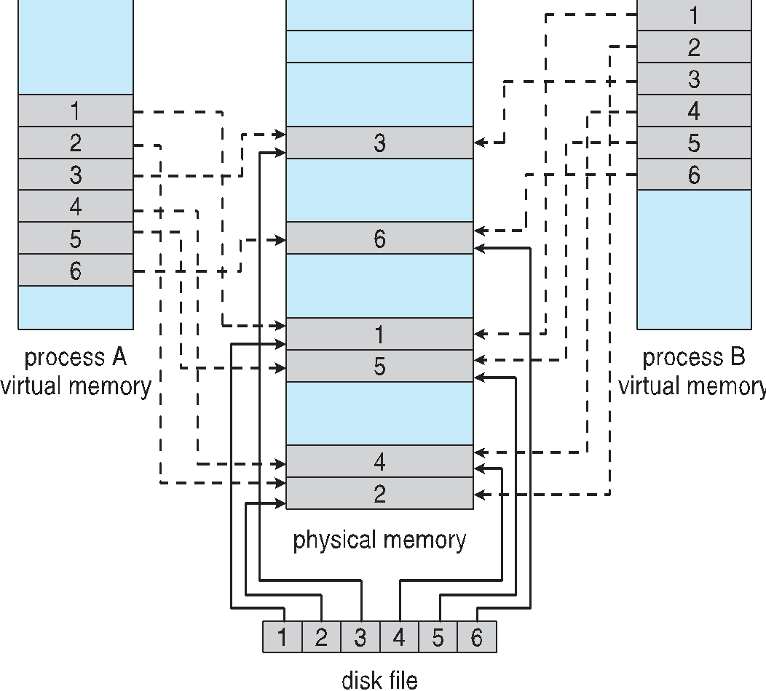
Memory Mapped Files

Slide 52
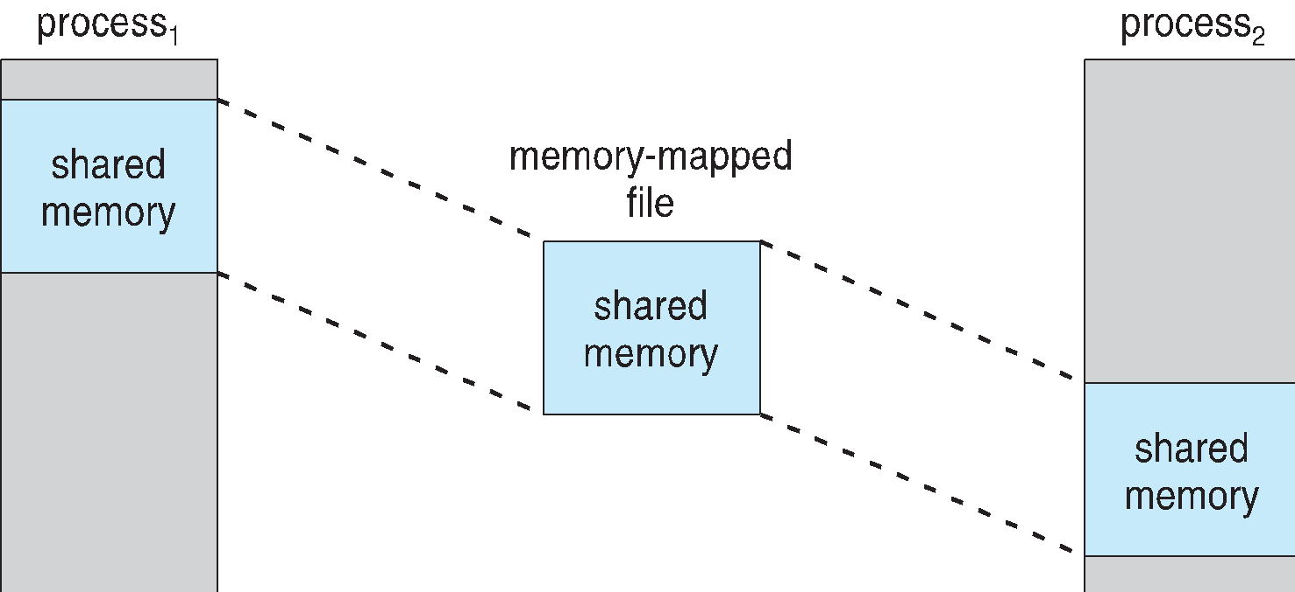
Shared Memory via Memory-Mapped I/O

Slide 53
Other Issues – Program Structure
Program structure
int[128,128] data;
Each row is stored in one page
Program 1
for (j = 0; j <128; j++) for (i = 0; i < 128; i++) data[i,j] = 0;
128 x 128 = 16,384 page faults
Program 2
for (i = 0; i < 128; i++) for (j = 0; j < 128; j++) data[i,j] = 0;
128 page faults

Slide 54
Kernel Memory Allocation
Buddy System:
Buddy system allows for partitions of different sizes i.e includes a mix of small and large partitions
the size of every chunk of memory(a partition) is a power of 2(we can write 2^{n})
Goal: to place every memory request in the smallest possible partition that will hold it, with just one condition that the partition must have a size that is equal to some power of 2

Slide 55
Kernel Memory Allocation
Algorithm:
To begin, the entire space available for allocation is treated as a single block of size 2^{U}
If a request of size s such that 2^{U} –1 < s 2^{U} is made, then the entire block is allocated
Otherwise, the block is split into two equal buddies of size 2^{U} –1 . If 2^{U} –2 < s 2^{U} –1 , then the request is allocated to one of the two buddies
This process continues until the smallest block greater than or equal to s is generated and allocated to the request
The buddy system maintains a list of unallocated blocks of each size 2 i
An unallocated block may be removed from the ( i + 1) list by splitting it in half to create two buddies of size 2 i in the i list
Whenever a pair of buddies on the i list both become unallocated, they are removed from that list and are merged into a single block on the ( i + 1) list

Slide 56
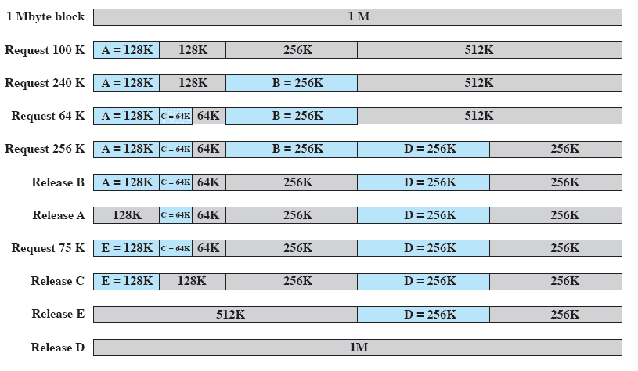
Example
Assume that you are provided 1-Mbyte initial block. Process A requests for 100 Kbytes. Then Process B, Process C and Process D request for 240 Kbytes, 64 Kbytes and 256 Kbytes, respectively. Then, Process B and Process A are released, respectively. Now, another process, Process D requests 75 Kbytes, and then Process C, Process E and Process D are released, respectively.

Slide 57
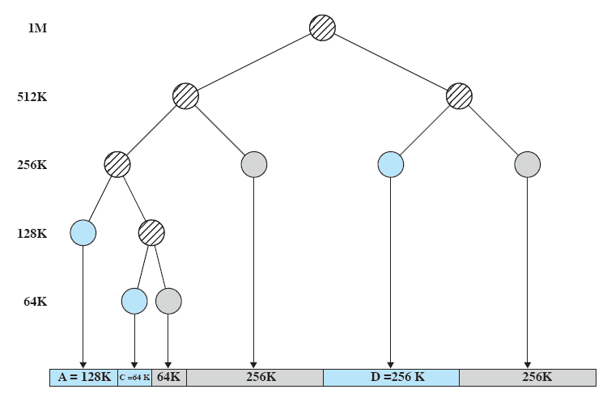
Tree Representation

