Slide 1
Leveraging Genre-Based Music Preferences to Assist Psychologists in Tailoring Mental Health Treatments : A Machine Learning Approach
Presented By Mohammad Mahbubur Rahman CE20001 Syed Mahir Faisal CE20005 Department of CSE, MBSTU | Supervised By Dr. Md. Sazzad Hossain Professor Department of CSE, MBSTU

Slide 2
Table of Contents
2
Introduction
Motivation
Related Works
Research Questions
Research Objectives
Methodology
Result and Discussion
Conclusion and Future Works
References
Leveraging Genre-Based Music Preferences to Assist Psychologists in Tailoring Mental Health Treatments : A Machine Learning Approach

Slide 3
INTRODUCTION
Mental health issues are widespread and need more personalized support.
Music impacts individuals’ emotional and psychological state but music therapy lacks personalization
Digital data can capture listening habits and mental health trends.
This study uses machine learning to predict genre-based psychological effects.
Leveraging Genre-Based Music Preferences to Assist Psychologists in Tailoring Mental Health Treatments : A Machine Learning Approach

Slide 4
Motivation
4
Mental health lacks consistent diagnostic standards
Music affects emotions differently across individuals
Daily music habits can reflect emotional well-being
Current music therapy is often too generalized
ML enables personalized, data-driven interventions
Leveraging Genre-Based Music Preferences to Assist Psychologists in Tailoring Mental Health Treatments : A Machine Learning Approach

Slide 5
Related Works
TITLE | AUTHORS | METHODS | SUMMARY | SCOPE
The Rhythm of the Mind: Exploring the Link Between Music Preferences and Mental Health Through Machine Learning[4] | Andrew T. Lian Yong Chen | ML Methods Logistic Regression Decision Tree Random Forest Stochastic Gradient Descent Classifier KNN Adaptive Boosting Bagging Classifier | Uses machine learning model to predict person’s mental health status from their playlist, combined with their demographic information | -Doesn’t consider any mental health issues -No focus on individuals’ music listening behavior
Unveiling the Connection: Music Preferences and Mental Health Through Machine Learning Analysis[3] | Karunya Thakeria Kritika Jain Khushi Sain Ritu Rani Arun Sharma Rajiv Sharma | ML Methods KNN Random Forest Support Vector Machine Decision Tree Logistic Regression | Did EDA of the demographic data, music listening habit and mental health status. Predicts mental health effects based on music preferences. | -Lack of focus on genre-based analysis -Incorporates favorite music with mental health issues, which increases biasness to one specific genre
Leveraging Genre-Based Music Preferences to Assist Psychologists in Tailoring Mental Health Treatments : A Machine Learning Approach

Slide 6
Related Works
TITLE | AUTHORS | METHODS | SUMMARY | SCOPE
TOWARDS EFFECTIVE MUSIC THERAPY FOR MENTAL HEALTH CARE USING MACHINE LEARNING TOOLS: HUMAN AFFECTIVE REASONING AND MUSIC GENRES[2] | Jessica Sharmin Rahman Tom Gedeon Sabrina Caldwell Richard Jones Zi Jin | ML/DL METHODS K-NN SVM Neural Network | Used Electrodermal activity,Blood Volume Pulse,Skin Temperature and pupil dilation to predict genre of music the participant’s listening to and his emotional state | -Mental health issues are not considered -Deprends on physiological signals which requires costly sensors
Twitter-MusicPD: melody of minds - navigating user-level data on multiple mental health disorders and music preferences[5] | Soroush Zamani Alavijeh Xingwei Yang Zeinab Noorian Amira Ghenai Fattane Zarrinkalam | ML/DL METHODS NLP Logistic regression | Analyzed 8.9 million tweets to explore correlations between users’ music preferences and self-reported mental health disorders | -Reliance on self-reported diagnostic keywords -Undercounting of actual music listeners -Personalized music recommendation is not included in this study
Leveraging Genre-Based Music Preferences to Assist Psychologists in Tailoring Mental Health Treatments : A Machine Learning Approach

Slide 7
Related Works
TITLE | AUTHORS | METHODS | SUMMARY | SCOPE
Exploring Relationship between music and mood through machine learning technique[6] | Shital Shankar Gujar Ali Yawar Reha | ML/DL METHODS SVM Random Forest | Analyzes the relationship between individuals’ emotional state based on musical attributes collected from different music | -Mental health issues are not considered while considering emotional state -Relationship between music and mental health in this case is generalized
Recommendation of Music Based on DASS-21 (Depression, Anxiety, Stress Scales) Using Fuzzy Clustering | Eunyoung Wang Hyeokmin Lee Kyunghee Do Moonhwan Lee Sungtaek Chung | ML/DL METHODS Fuzzy C means Clustering | Uses DASS‑21 scores and fuzzy clustering on ~39,000 responses to segment psychological states and recommend tailored music lists via a mobile app | -Weekly-only emotional measurement -Static weekly playlist (no real-time updates) -Potential questionnaire memorization by users
Leveraging Genre-Based Music Preferences to Assist Psychologists in Tailoring Mental Health Treatments : A Machine Learning Approach

Slide 8
Research Questions
Can mental health scores and genre-wise listening behavior predict the psychological effect of music genres?
How can these predictions support therapists and mental health platforms with actionable insights?
Can personalized music therapy be introduced in mental health treatments?
Leveraging Genre-Based Music Preferences to Assist Psychologists in Tailoring Mental Health Treatments : A Machine Learning Approach

Slide 9
Research Objectives
Collect and preprocess data on mental health scores and music listening frequency
Restructure data for genre-wise prediction of music’s psychological effect
Generate personalized genre-level predictions to assist mental health professionals
Leveraging Genre-Based Music Preferences to Assist Psychologists in Tailoring Mental Health Treatments : A Machine Learning Approach

Slide 10
Methodology
Leveraging Genre-Based Music Preferences to Assist Psychologists in Tailoring Mental Health Treatments : A Machine Learning Approach

Slide 11
Dataset Description
Contains 33 features
Frequency of listening to 16 different genres of music of individuals, their self-reported level of 4 different mental health issues and how music affects their mental health conditions (improve, worsen, no-effect) – these are some of the significant features.
Some other features are age, favorite genre, hours per day (listens to music), if they are instrumentalist or not etc. data are there as features.
Leveraging Genre-Based Music Preferences to Assist Psychologists in Tailoring Mental Health Treatments : A Machine Learning Approach

Slide 12
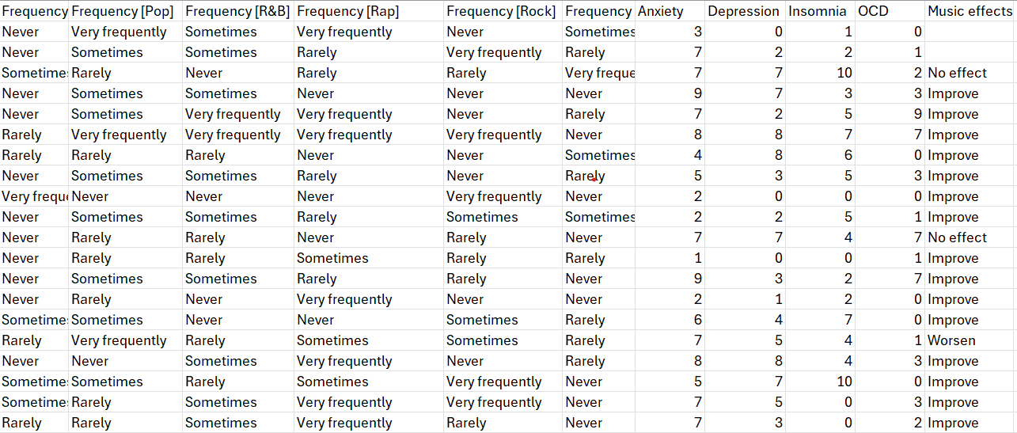
Dataset Demonstration
Leveraging Genre-Based Music Preferences to Assist Psychologists in Tailoring Mental Health Treatments : A Machine Learning Approach

Slide 13
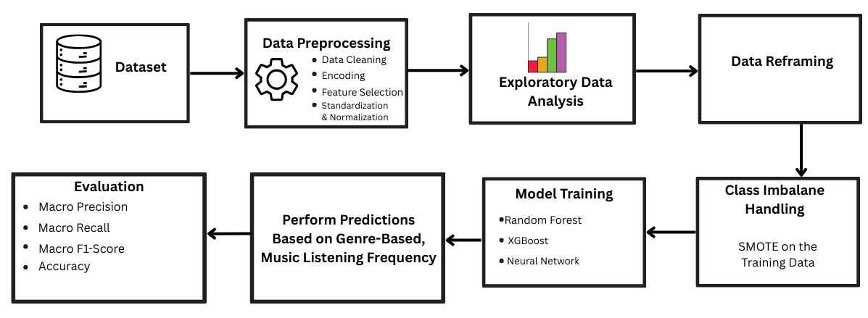
WORK-FLOW
Leveraging Genre-Based Music Preferences to Assist Psychologists in Tailoring Mental Health Treatments : A Machine Learning Approach

Slide 14
Data Preprocessing
Retained only columns relevant to mental health and music listening behavior
Ordinal encoding of genre-listening frequency: ’Never’: 0, ’Rarely’: 1, ’Sometimes’: 2, ’Very Frequently’: 3
One-hot encoding of categorical genre types
Label encoding of the target feature (“Music effects”) into numeric values for model training
Dropped irrelevant columns such as ’Timestamp’, ’Permissions’ etc.
Removed records containing null values
Leveraging Genre-Based Music Preferences to Assist Psychologists in Tailoring Mental Health Treatments : A Machine Learning Approach

Slide 15
Exploratory Data Analysis
Leveraging Genre-Based Music Preferences to Assist Psychologists in Tailoring Mental Health Treatments : A Machine Learning Approach

Slide 16
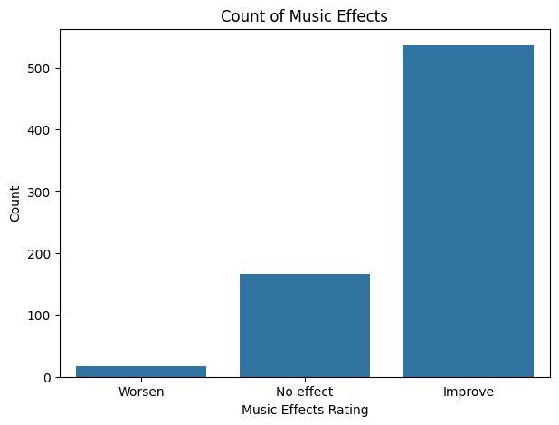
Musical Effect Distribution
-Improve: 536 participants
-No Effect: 166 participants
- Worsen: 17 participants
Leveraging Genre-Based Music Preferences to Assist Psychologists in Tailoring Mental Health Treatments : A Machine Learning Approach

Slide 17
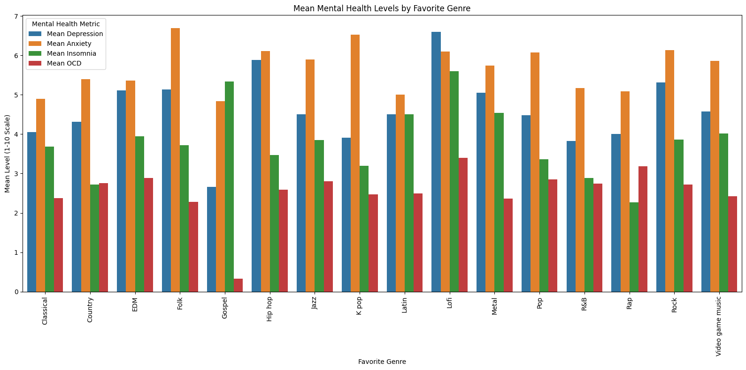
Mental Health Trends by Favorite Genre
Leveraging Genre-Based Music Preferences to Assist Psychologists in Tailoring Mental Health Treatments : A Machine Learning Approach

Slide 18
Insights
Metal, rock and lofi fans exhibit the highest levels across all metrics, suggesting a possible link to mental health challenges
Gospel listeners report the lowest levels, indicating a potential protective effect
Classical and country genres are associated with relatively lower levels, hinting at a calming influence
Leveraging Genre-Based Music Preferences to Assist Psychologists in Tailoring Mental Health Treatments : A Machine Learning Approach

Slide 19
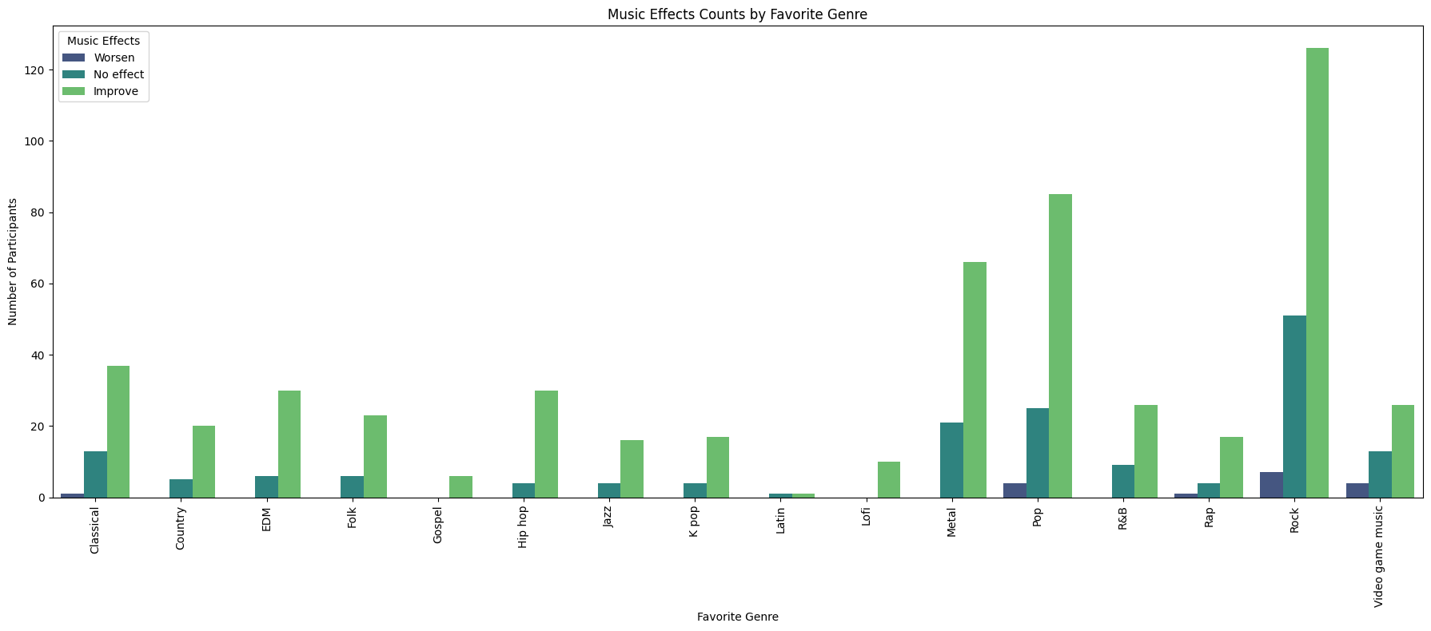
Genre-wise Impact on Perceived Music Effect
-Metal, Pop and Rock are associated with higher improve rating
-Metal and EDM showed more mixed effect
Leveraging Genre-Based Music Preferences to Assist Psychologists in Tailoring Mental Health Treatments : A Machine Learning Approach

Slide 20
Data Reframing
Transformed wide-format data into long-format structure
Expanded each participant into 16 genre-specific rows
Added 'Genre' and ordinally encoded 'Frequency' columns
Preserved mental health scores and 'Music effects' labels per row
Leveraging Genre-Based Music Preferences to Assist Psychologists in Tailoring Mental Health Treatments : A Machine Learning Approach

Slide 21
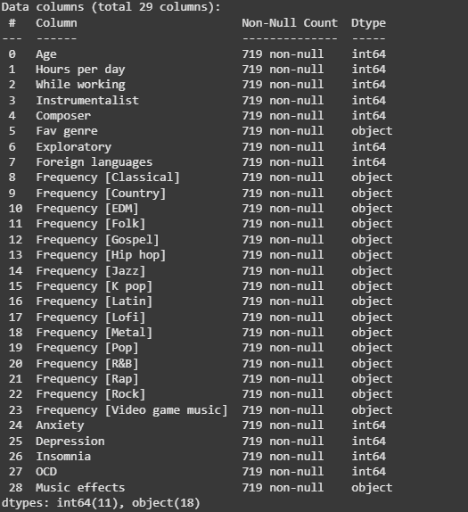
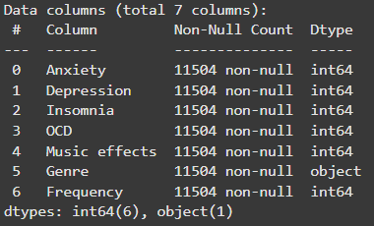
Before Data Reframing
After Data Reframing
Leveraging Genre-Based Music Preferences to Assist Psychologists in Tailoring Mental Health Treatments : A Machine Learning Approach

Slide 22
Class Imbalance Handling
-To mitigate, SMOTE[3][8] was employed during the training phase on training data
-It is a resampling method that generates synthetic data points for underrepresented classes by interpolating between existing minority class samples.
Leveraging Genre-Based Music Preferences to Assist Psychologists in Tailoring Mental Health Treatments : A Machine Learning Approach

Slide 23
Model Training
ML Models:
Random Forest (with 800 estimators or decision trees)
XGBoost
Neural Network (a five-layer feedforward neural network)
Input Features:
Frequency of listening to different genres of music
Mental health disorders’ ratings
Output Features:
Music effects (Music’s Impact)
Predicts music’s effect on individual with mental health issues based on genre-wise music listening frequency
Leveraging Genre-Based Music Preferences to Assist Psychologists in Tailoring Mental Health Treatments : A Machine Learning Approach

Slide 24
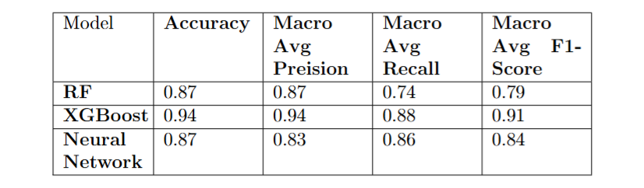
Result & Discussion
Leveraging Genre-Based Music Preferences to Assist Psychologists in Tailoring Mental Health Treatments : A Machine Learning Approach

Slide 25
Result & Discussion
Our system surpasses the previous study, done by Karunya et al.[3], achieving better accuracy (94%) and macro F1-score (91%).
This ensures our system’s effectiveness in personalized genre-based music suggestion in tailoring mental health treatments which is our key goal.
Leveraging Genre-Based Music Preferences to Assist Psychologists in Tailoring Mental Health Treatments : A Machine Learning Approach

Slide 26
Conclusion & Future Work
Our study went through a broad analysis of how people’s daily music listening habits of different genres can affect their mental health. Result of our work supports our goal of associating genre-based music preference and mental health issues.
Different demographic data, that relates to mental health, can be useful for building a more robust model
Expert Annotated Mental Health Ratings can create more robust dataset, allowing the model to work more effectively
Leveraging Genre-Based Music Preferences to Assist Psychologists in Tailoring Mental Health Treatments : A Machine Learning Approach

Slide 27
References
Lavinia Rebecchini, ”Music, mental health, and immunity,”, Brain Behavior & Immunity - Health, vol. 18, p. 100374, Oct. 2021, doi:10.1016/j.bbih.2021.100374
J. S. Rahman, T. Gedeon, S. Caldwell, R. Jones, and Z. Jin, “Towards effective music therapy for mental health care using machine learning tools: human affective reasoning and music genres,”, Journal of Artificial Intelligence and Soft Computing Research, vol. 11, no. 1, pp. 5–20, Dec. 2020, doi: 10.2478/jaiscr-2021-0001
Karunya Thakeria, Kritika Jain, Khushi Sain, Ritu Rani, Arun Sharma and Rajiv Sharma, “Unveiling the connection: music preferences and mental health through machine learning analysis,” IEEE Conference Publication — IEEE Xplore, Jan. 09, 2025, doi: 10.1109/ICAECT63952.2025.10958841
Andrew T. Lian and Yong Chen, “The Rhythm of the Mind: Exploring the link between music preferences and mental health through machine learning,” IEEE Conference Publication — IEEE Xplore, Dec. 15, 2024. doi:10.1109/BigData62323.2024.10825903
Leveraging Genre-Based Music Preferences to Assist Psychologists in Tailoring Mental Health Treatments : A Machine Learning Approach

Slide 28
References
S. Z. Alavijeh, X. Yang, Z. Noorian, A. Ghenai, and F. Zarrinkalam, “Twitter-MusicPD: melody of minds - navigating user-level data on multiple mental health disorders and music preferences,” EPJ Data Science, vol. 14, no. 1, Apr. 2025, doi:10.1140/epjds/s13688-025-00549-7
S. S. Gujar and A. Y. Reha, “Exploring relationship between music and mood through machine learning technique,”, in Proc. 2024 ACM Conf. on Multimedia (MM ’24), New York, NY, USA, 2024, pp. 1–5. doi: 10.1145/3647444.3647916
E. Wang, H. Lee, K. Do, M. Lee, and S. Chung, “Recommendation of music based onDASS-21 (Depression, Anxiety, Stress Scales) using fuzzy clustering,”, Electronics,vol. 12, no. 1, p. 168, Dec. 2022, doi: 10.3390/electronics12010168.
N. V. Chawla, K. W. Bowyer, L. O. Hall, and W. P. Kegelmeyer, “SMOTE: SyntheticMinority Over-sampling technique,” , Journal of Artificial Intelligence Research, vol.16, pp. 321–357, Jun. 2002, doi: 10.1613/jair.953.
Leveraging Genre-Based Music Preferences to Assist Psychologists in Tailoring Mental Health Treatments : A Machine Learning Approach

Slide 29
References
C. Rasgaitis, “Music & Mental Health Survey results,” Kaggle, Nov. 21, 2022. [Online]. Available:https://www.kaggle.com/datasets/catherinerasgaitis/mxmhsurvey-results
D. Marris, “Global Mental Health Statistics 2025: WHO uncovers crisis - Leal Mind,” Leal Mind, Jun. 18, 2025. https://lealmind.com/global-mental-health-statistics-2025/
Leveraging Genre-Based Music Preferences to Assist Psychologists in Tailoring Mental Health Treatments : A Machine Learning Approach

