Slide 1
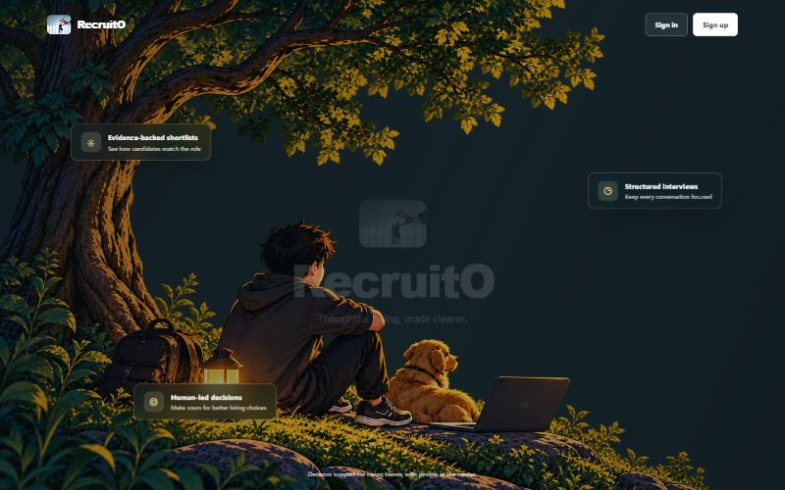
FINAL PROJECT PRESENTATION
RecruitO
An AI-Assisted Recruitment Platform
Evidence-backed hiring — from CV screening to live, analysed interviews.
Presented by Mahbubur Rahman Rafi
Notes:
Introduce yourself and RecruitO: an AI-assisted recruitment platform, built as a Dockerized web app with FastAPI, PostgreSQL and LangGraph/Gemini pipelines.

Slide 2
PROJECT OVERVIEW
What RecruitO is
RecruitO is a web-based recruitment platform that uses AI to automate the slow, repetitive parts of hiring. Managers post jobs, bulk-import CVs, and let the system screen, score and rank candidates — then run structured video interviews with live transcription and automated analysis, keeping humans in control of every decision.
Purpose
Cut manual CV screening and scheduling effort while keeping hiring fair and auditable.
Background
Teams receive hundreds of CVs; manual review is slow, inconsistent and hard to track.
Approach
AI pipelines (LangGraph + Gemini) assist, but the hiring manager makes the final call.
Notes:
One-line pitch: automate the busywork of hiring while keeping a human in the loop.

Slide 3
PROBLEM STATEMENT
Why hiring needs this
Traditional hiring is slow, inconsistent and hard to scale — especially the first screening pass.
High volume
Inconsistency
Slow scheduling
Lost insight
Hundreds of CVs per role take hours to read by hand.
Different reviewers score the same CV differently.
Coordinating interview times and interviewers is manual.
Interviews aren't captured or analysed in a consistent way.
Notes:
Frame the pain: volume, inconsistency, scheduling overhead, and no interview insight.

Slide 4
PROJECT OBJECTIVES
Goals and expected outcomes
1
Automate CV screening and ranking against each job's requirements.
Expected outcome
Faster, fairer shortlists and a repeatable, auditable hiring pipeline — with AI doing the reading and people making the decisions.
2
Keep scoring fair, explainable and evidence-backed (every point cites the CV).
3
Streamline interview scheduling with the hiring manager in control.
4
Enable cross-network video interviews with real-time transcription.
5
Analyse completed interviews to support the final hiring decision.
Notes:
Five concrete objectives; the outcome is faster, fairer, auditable hiring.

Slide 5
KEY FUNCTIONALITIES
What the system does
AI Job Descriptions
Bulk CV Import
AI CV Scoring & Ranking
Generates the JD and weighted (1-5) requirements from a short brief.
Any number of CVs, processed 10 at a time; auto-creates candidate profiles.
Graded 0-100 per requirement, with evidence quotes and a ranked list.
Manager-Driven Scheduling
Live Video Interviews
Analysis & Chatbots
Emails the manager when a CV scores above 65 to assign time + interviewer.
LiveKit video across networks with real-time AssemblyAI transcription.
Automated interview analysis plus role-aware candidate / manager assistants.
Notes:
Six headline features; emphasise bulk import, graded scoring, and the live interview with transcription.

Slide 6
WORKFLOW / PROCESS FLOW
How a hire flows end to end
1
Create job
2
Import CVs
3
Score & rank
Manager describes a role; AI drafts the JD + weighted requirements.
Bulk-upload CVs; each becomes a candidate profile automatically.
AI grades every CV 0-100 against the requirements, with evidence.
4
Notify (>65)
5
Interview
6
Analyse & decide
Strong candidates trigger an email to the manager to schedule.
Candidate + interviewer join a live video room with transcription.
AI analyses the interview; the manager makes the final call.
Notes:
Six steps: create job, import CVs, score & rank, notify manager, interview, analyse & decide.

Slide 7
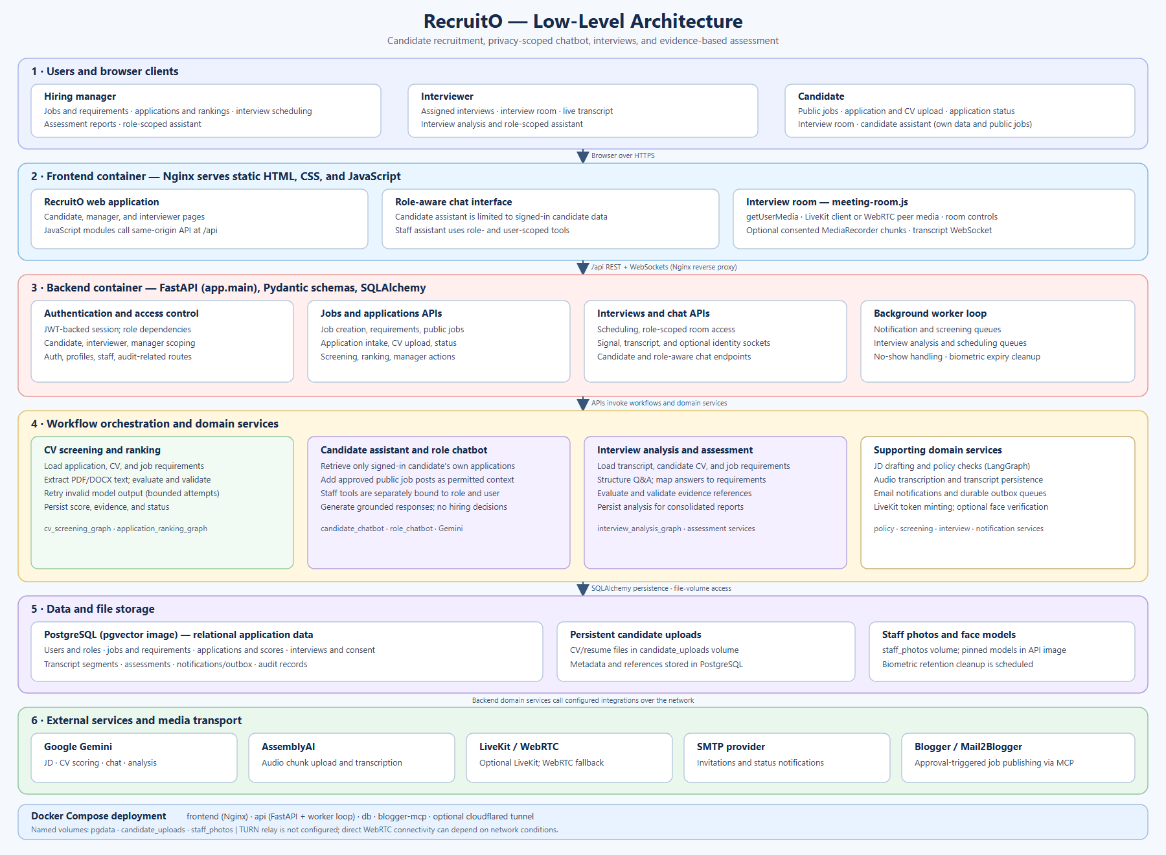
SYSTEM ARCHITECTURE
How the system fits together
Notes:
Walk the six layers top to bottom: users -> frontend (nginx) -> FastAPI backend + worker -> workflows & domain services -> data/file storage -> external services, all run by Docker Compose.

Slide 8
TECHNOLOGY STACK
Languages, frameworks and tools
Frontend
Backend
Database
• HTML, CSS, vanilla JavaScript
• WebRTC + LiveKit client
• Single-page interfaces
• Python + FastAPI (Uvicorn)
• Pydantic validation
• JWT auth, argon2 hashing
• PostgreSQL + pgvector
• SQLAlchemy ORM
• Alembic migrations
AI / ML
Infrastructure
Integrations
• LangGraph (StateGraph)
• Google Gemini models
• AssemblyAI speech-to-text
• Docker Compose
• nginx reverse proxy
• Cloudflare Tunnel
• LiveKit Cloud (video)
• Gmail SMTP (email)
• Blogger MCP (job posts)
Notes:
Group the stack: frontend, backend, database, AI, infrastructure, integrations.

Slide 9
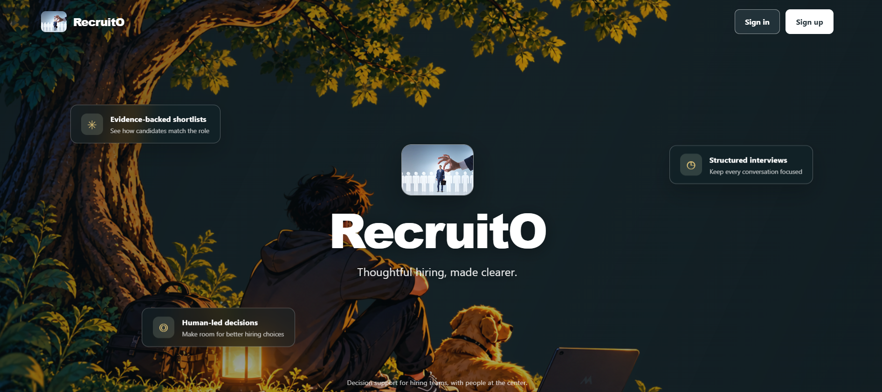
UI DEMONSTRATION
Landing page
On this screen
• Public entry point with sign in / sign up
• States the product promise: evidence-backed shortlists, structured interviews, human-led decisions
• Clean, focused first impression for candidates and hiring teams
Notes:
Open the live site here. Point out the three value props and the sign-in / sign-up entry.

Slide 10
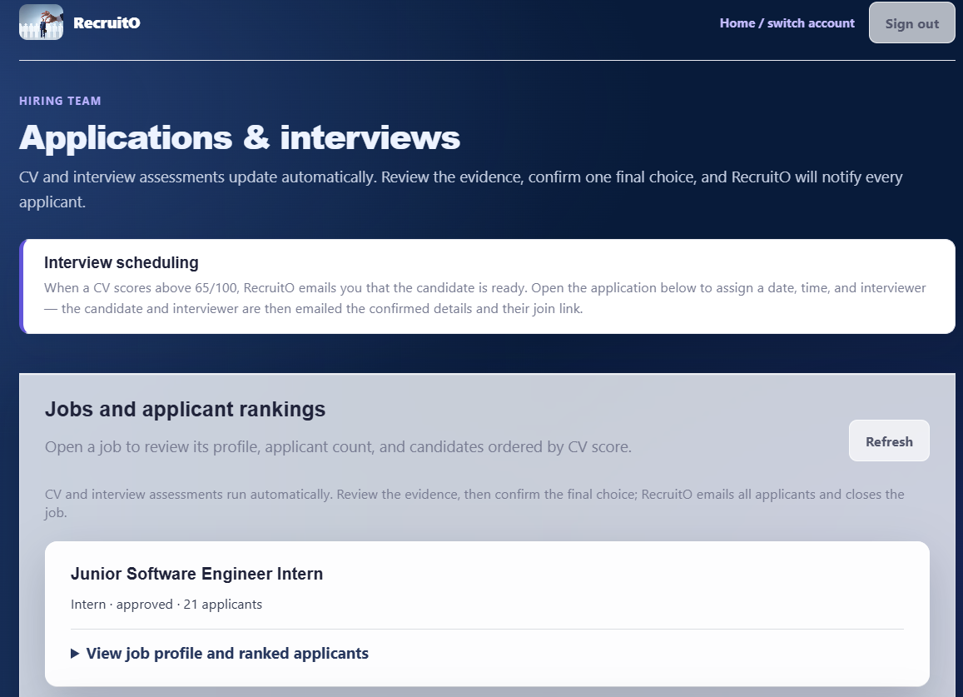
UI DEMONSTRATION
Applications & interview scheduling
On this screen
• Hiring manager's workspace: jobs with applicant counts and rankings
• Weighted scoring requirements (1-5) shown per job
• “Schedule & notify” assigns the date, time and interviewer
• CV and interview assessments update automatically
Notes:
Show the manager view: jobs, the scheduling banner, and the weighted requirements.

Slide 11
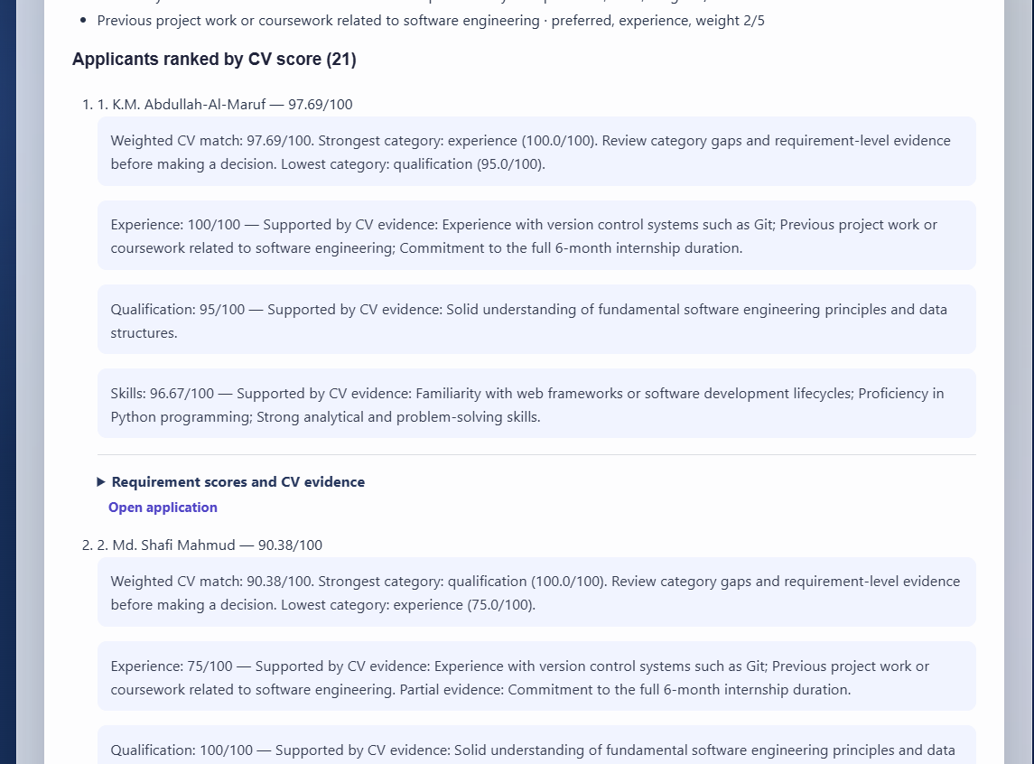
UI DEMONSTRATION
AI CV scores & ranked shortlist
On this screen
• Candidates ranked by CV score out of 100
• Per-requirement evidence: met / partial / gaps, with quotes from the CV
• Category breakdowns (skills, experience, qualification)
• Managers review the evidence, not just the number
Notes:
Scroll the ranked list; highlight the graded scores and the evidence quotes behind each one.

Slide 12
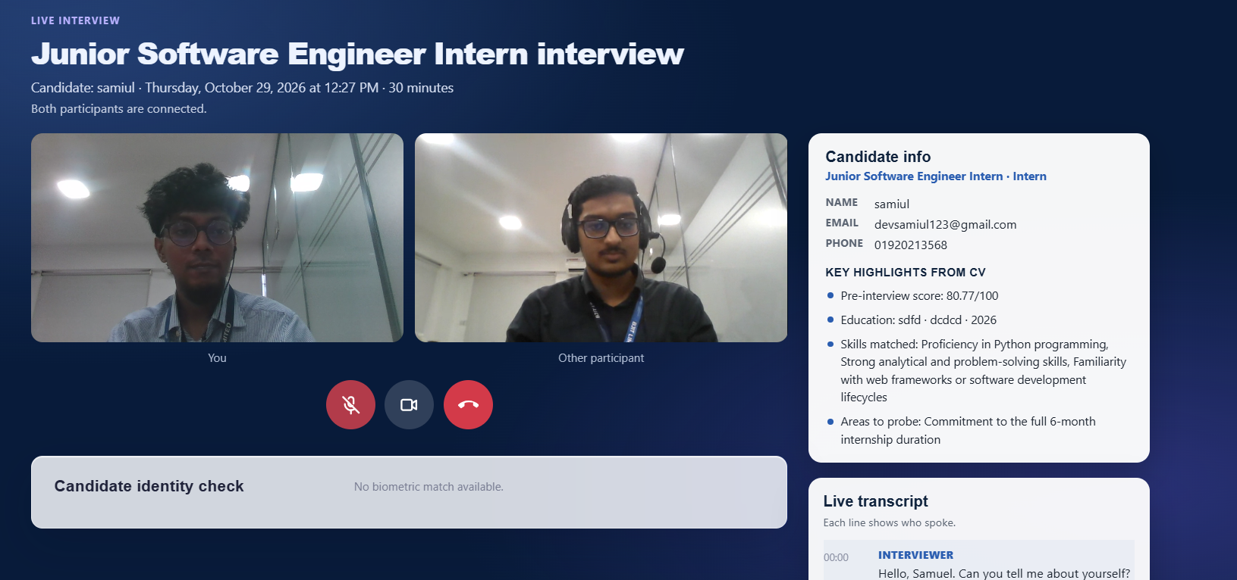
UI DEMONSTRATION
Live interview room (interviewer view)
On this screen
• LiveKit video with real-time transcription
• “Candidate info” panel shows CV highlights at a glance
• Live transcript labelled by speaker
• Icon controls for mute, camera and end call
• Candidates see only the call — not the transcript or notes
Notes:
Explain the interviewer sees candidate info + live transcript; the candidate sees only the video call.

Slide 13
CHALLENGES AND SOLUTIONS
What was hard, and how it was solved
CHALLENGE
SOLUTION
Unreliable live transcription
Transcode audio with ffmpeg and use AssemblyAI (English model) over a WebSocket stream.
Every CV scoring the same
Switched to graded 0-100 per-requirement scoring, weighted into the final score.
Large CV uploads failing
Raised the nginx upload limit and upload in batches of 10 with a progress bar.
Access without exposing my IP
Cloudflare Tunnel for public access; LiveKit Cloud relays the video.
Sessions expiring mid-task
Longer-lived JWT session plus automatic re-login on expiry.
Notes:
Narrate two or three in depth. Current status: all core modules implemented and integrated.

Slide 14
Q & A
Thank you — happy to demo the system and answer questions.
Current status
Future improvements
• All core modules implemented and integrated
• Running as a Dockerized stack
• Final end-to-end demo in progress
• Analytics / reporting dashboard
• Manager-editable requirement weights
• Deeper interview analytics
RecruitO · Mahbubur Rahman Rafi
Notes:
Invite questions and offer a live walkthrough. Be ready to discuss status, challenges and future work.

