Slide 1
Deep Learning for Twitter Emotion Extraction and Classification

Slide 2
Group Members
Istehad Ahmed Rafi 20200104077
Mahbub Roujen 20200104084
Sheikh Sadi 20200104085
Sayeed Ziarat Mahmud 20200104086

Slide 3
Introduction
Overview
Exploration of human emotions on Twitter
Utilizing CNN, Bi-LSTM, and BERT for emotion detection
Purpose
Understanding the complexities of emotions in social media
Implications on public opinion in critical events

Slide 4
Literature Review
Summary of Previous Research:
*EMOTEX:* Detecting Emotions in Twitter Messages (Hasan et al. [1])
- Innovative method using hashtags as labels for emotion categorization
- Automatic classification without human participation
*Twitter Sentiment Classification using Distant Supervision* (Go et al. [2])
- Utilized Twitter text and emoticons for sentiment classification
- Achieved an impressive 80% accuracy rate using SVM, Maximum Entropy, and Naive Bayes
*Using Youtube comments for text-based emotion recognition* (Yasamina et al. [3])
- Explored emotion detection in textual exchanges from YouTube comments
- Addressed challenges related to character writing style and language change

Slide 5
Literature Review
*Extraction of emotions from multilingual text using intelligent text processing* (Kumar et al. [4])
- Used multilingual text data based on linguistics and psychology
- Influenced the inclusion of GloVe embeddings in our research
*Predictability of user behavior in social media* (Darmon et al. [5])
- Explored representation modeling to predict social media user behavior
- Highlighted the presence of a small number of latent behavioral processing

Slide 6
Project Objective
Objective:
Recognition of emotions in texts on Twitter
Utilizing deep learning models: Bi-LSTM, CNN, and BERT
Emotions Targeted:
Joy, Surprise, Sadness, Anger, Love, Fear

Slide 7
Methodology
Convolutional Neural Network (CNN):
- Embedding Layer: GloVe 6B 300d
- Convolution Layer: Feature extraction
- Pooling Layer: Dimensionality reduction
- Dropout Layer: 0.1 dropout to prevent overfitting
- Fully Connected Layer: Output layer

Slide 8
Methodology
Bi-LSTM (Bidirectional Long Short-Term Memory):
Embedding Layer: GloVe 6B 300d
Pooling Layer: Average and Max pooling for dimensionality reduction
Dropout Layer: 0.1 dropout to prevent overfitting
Fully Connected Layer: Output layer

Slide 9
Methodology
BERT (Bidirectional Encoder Representations from Transformers)
Bidirectional contextual comprehension
Pre-trained weights for detailed emotion analysis on tweets

Slide 10
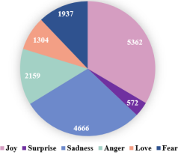
Experiments
Dataset:
Kaggle Twitter Emotion dataset

Slide 11
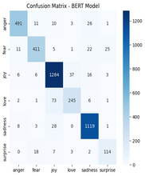
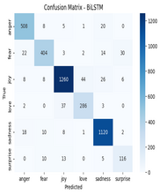
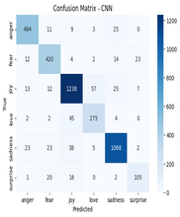
Experiments
Confusion Matrix:
CNN,
Bi-LSTM,
BERT models

Slide 12
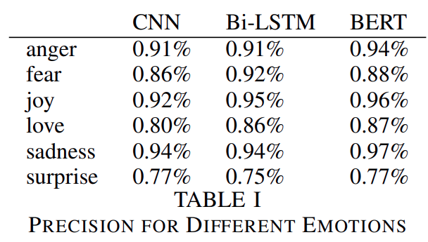
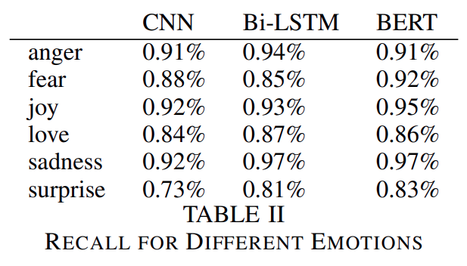
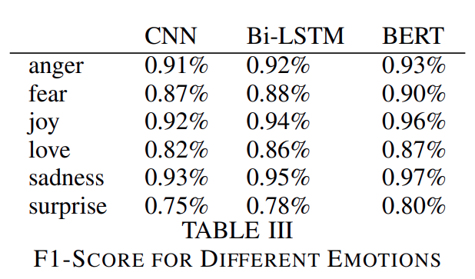
Results
Model Performance:
Comparative values for different emotions

Slide 13
Discussion
BERT Model:
Exceptional precision and comprehensive emotional understanding
Bi-LSTM:
Good performance, especially in identifying surprise, joy, and fear
CNN:
Competitive performance, strong at identifying specific patterns

Slide 14
Conclusion
All three models show potential for Twitter emotion classification
BERT excels in precision and understanding a wide range of emotions
Overall Accuracy
BERT (94%),
Bi-LSTM (92%),
CNN (90%)

Slide 15
Future Work
Hybrid models combining text and facial expressions
Exploration of emotions in different species
Real-time emotion recognition algorithms for social media

Slide 16
References
[1] M. Hasan, E. Rundensteiner, and E. Agu, ”Emotex: Detecting emotions in Twitter messages,” 2014.
[2] A. Go, R. Bhayani, and L. Huang, ”Twitter sentiment classification using distant supervision,” CS224N project report, Stanford, vol. 1, no. 12, p. 2009, 2009.
[3] V. K. Jain, S. Kumar, and S. L. Fernandes, ”Extraction of emotions from multilingual text using intelligent text processing and computational linguistics,” Journal of computational science, vol. 21, pp. 316–326,
2017.
[4] M. Hajar et al., ”Using youtube comments for text-based emotion recognition,” Procedia Computer Science, vol. 83, pp. 292–299, 2016.
[5] D. Darmon, J. Sylvester, M. Girvan, and W. Rand, ”Predictability of user behavior in social media: Bottom-up v. top-down modeling,” in 2013 International Conference on Social Computing, pp. 102–107, IEEE,
2013.
[6] CNN Description. https://en.wikipedia.org/wiki/ConvolutionalneuralnetworkcitenoteV aluevaN agornovLyakhovV aluev2020pp.232.
[7] Bi-LSTM Description. https://paperswithcode.com/method/bilstm.
[8] BERT Model. https://towardsdatascience.com/bert-explained-state-ofthe-art-language-model-for-nlp-f8b21a9b6270.

Slide 17


