Slide 1

Memory In Agents!
MD Rakibul Islam

Slide 2
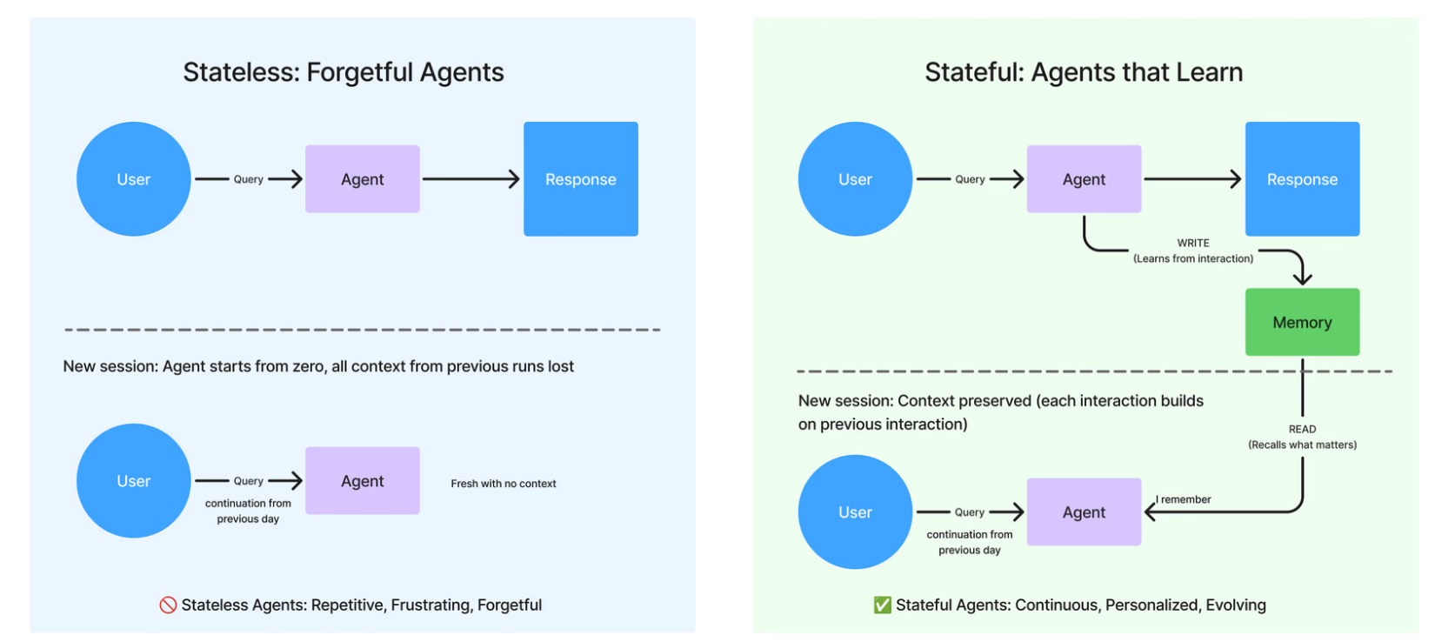

Slide 3
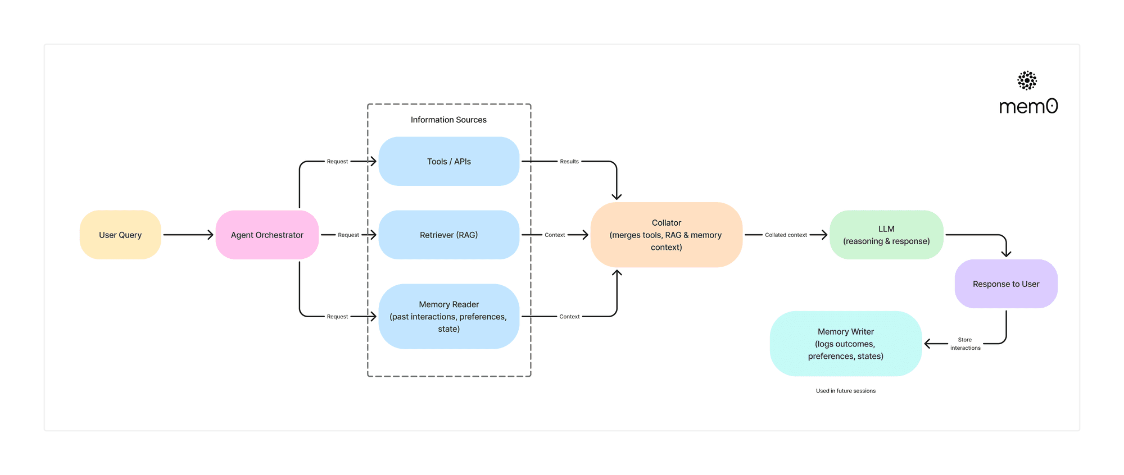

Slide 4
Reference links:
Memory in AI Agent : IBM
memory-in-agents-what-why-and-how

Slide 5
Thank you! Questions?

