Slide 1
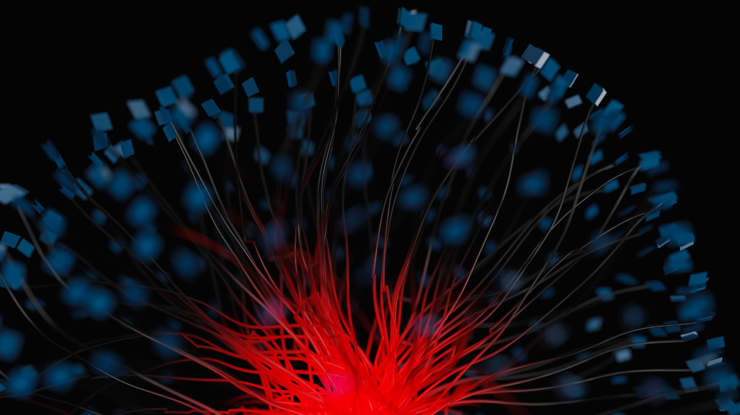
Technical explanation of Convolutional Neural Network
Architecture, Operations and Applications in computer vision tasks
Notes:
This presentation will provide a detailed technical explanation of Convolutional Neural Networks (CNNs), a type of neural network that is widely used in computer vision tasks. We will explore the architecture, operations, and applications of CNNs.

Slide 2
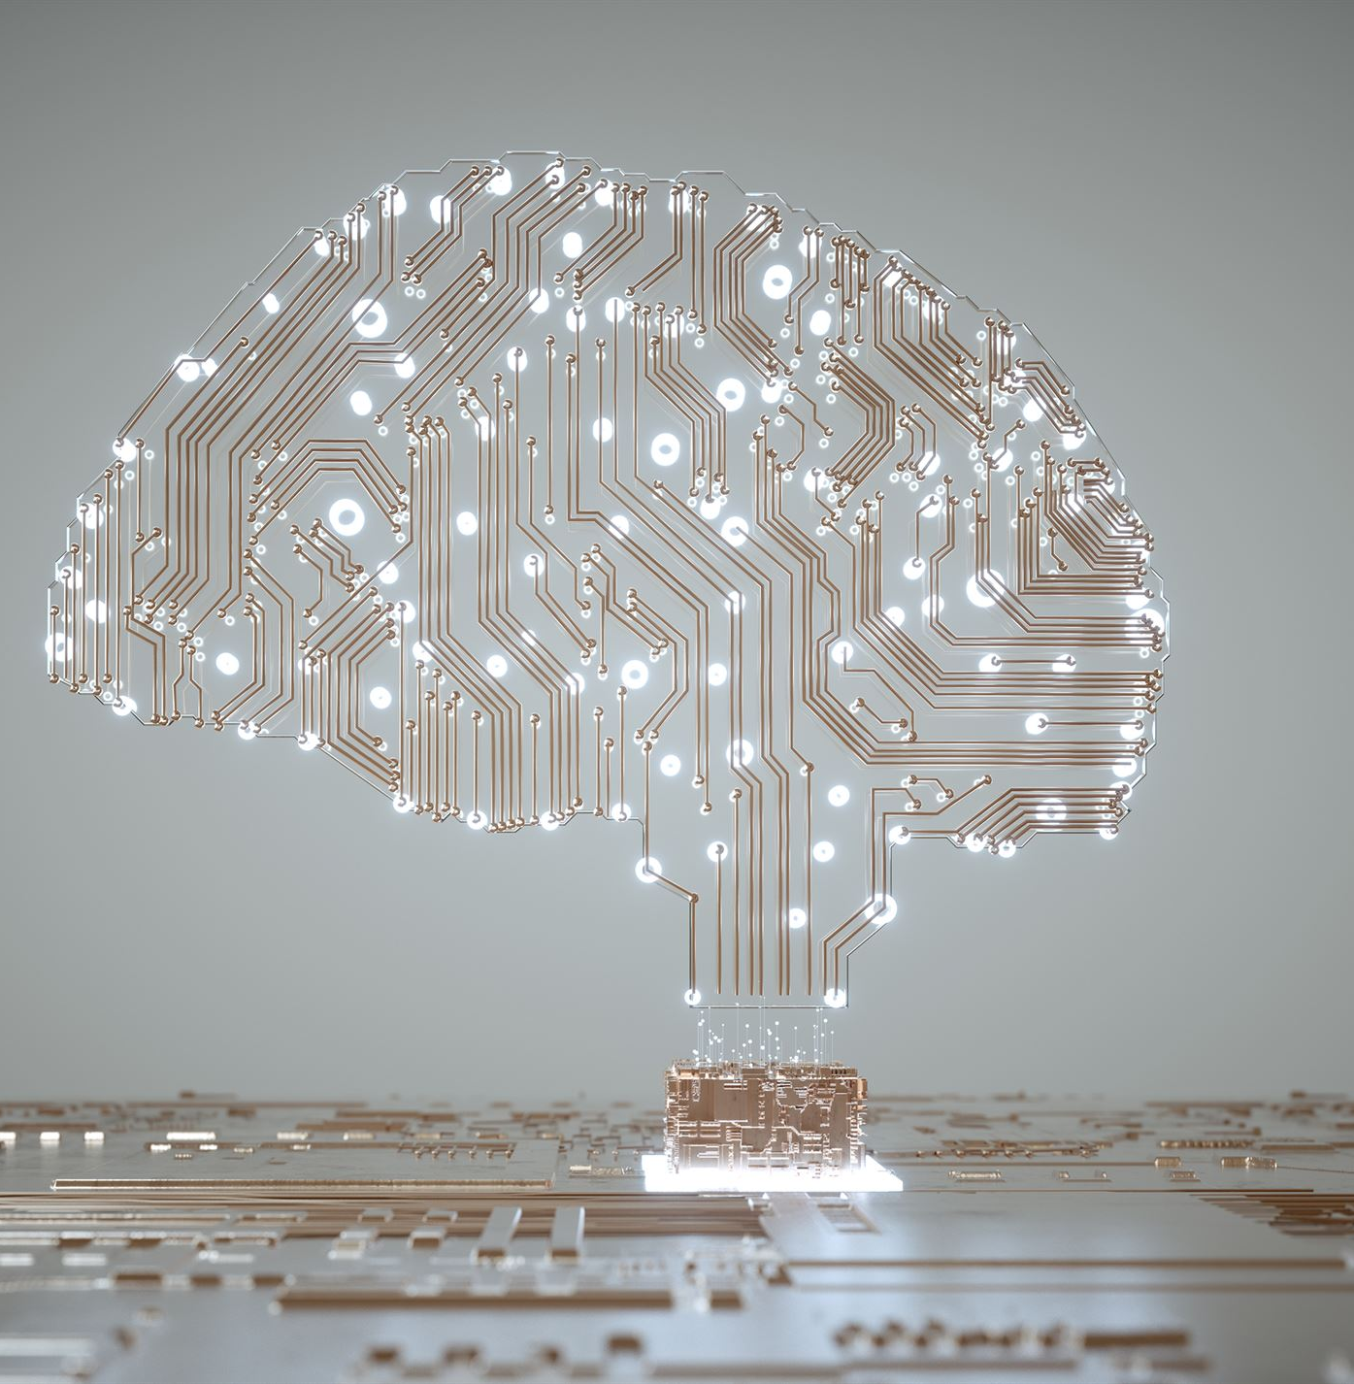
Presentation Overview
Introduction to Neural Networks
Neural networks are a set of algorithms that mimic the working of the human brain. They are used to process and analyze complex data and extract meaningful insights.
Convolutional Neural Networks
Convolutional Neural Networks (CNNs) are a type of neural network that are particularly useful for image recognition and analysis. They use a process called convolution to filter and analyze images.
Notes:
We will start by introducing the concept of neural networks and their workings. Then, we will delve into Convolutional Neural Networks, explaining their architecture, operations, and applications. Finally, we will explore some of the cutting-edge applications of CNNs.

Slide 3
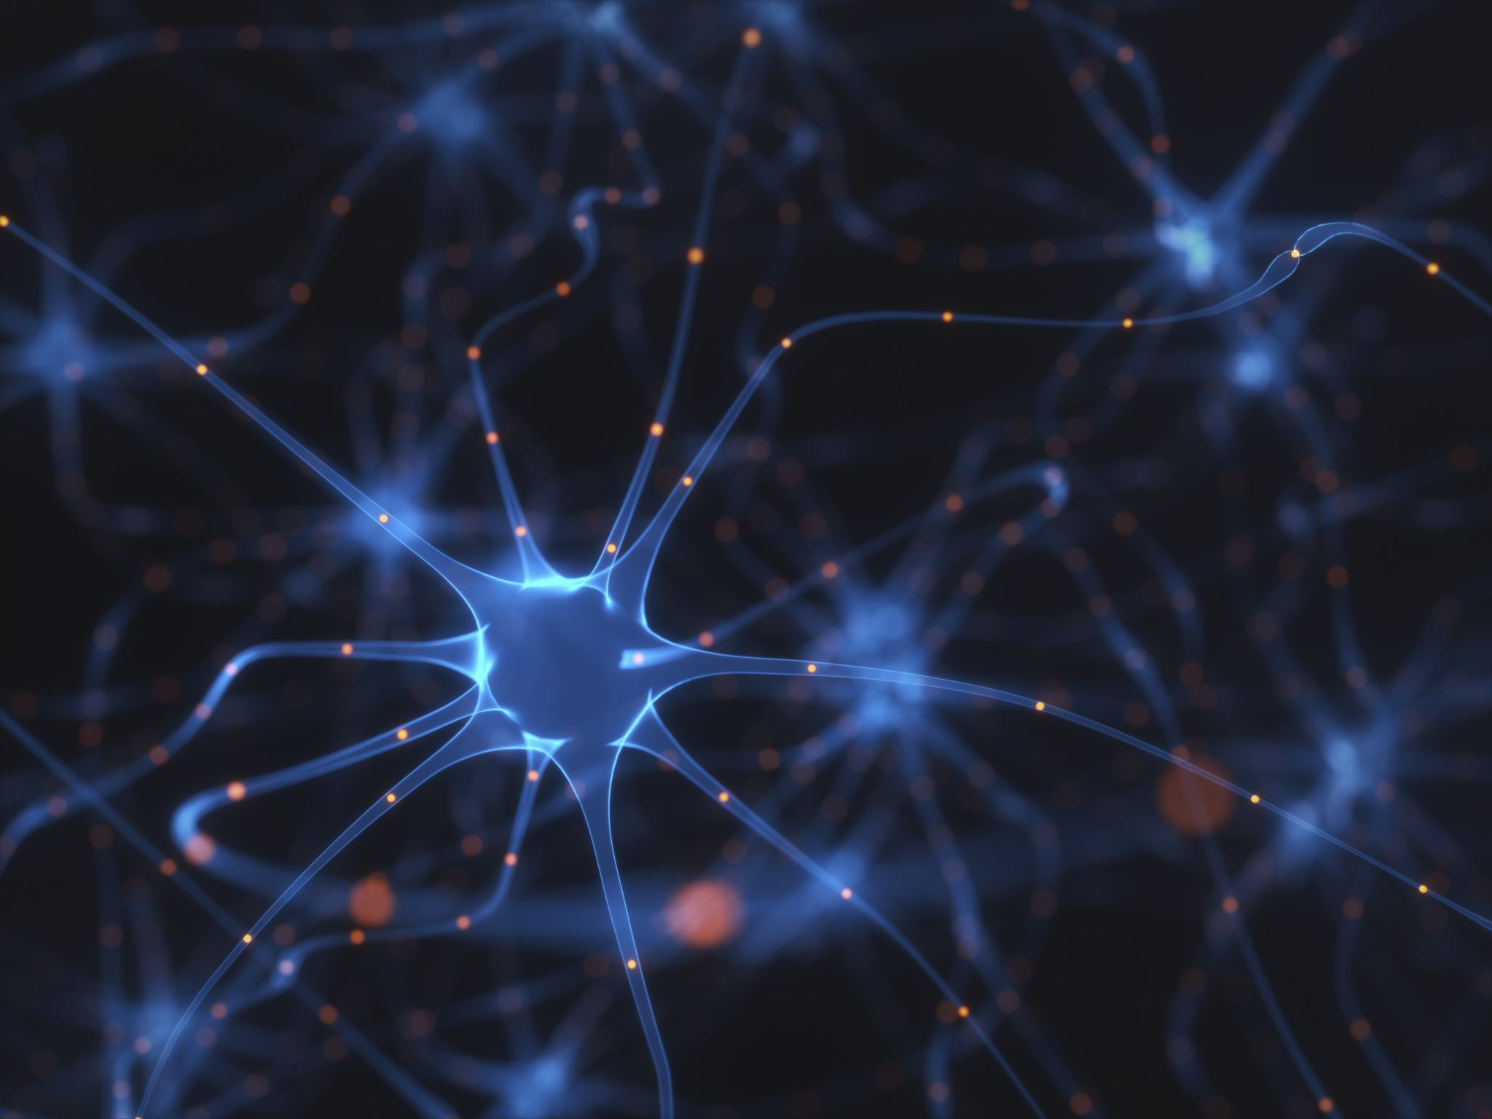
Introduction to Neural Networks
What are Neural Networks?
Neural networks are a type of machine learning algorithm designed to simulate the functioning of a human brain. They consist of interconnected units called artificial neurons that process information and perform calculations.
How do Neural Networks Work?
Neural networks learn from the data provided to them by adjusting the strengths of connections between neurons. They can be trained to recognize patterns and relationships in data and can be used for tasks such as image classification, speech recognition, and natural language processing.
Types of Neural Networks
There are several types of neural networks, including feedforward networks, convolutional networks, and recurrent networks. Each type has its own architecture and is suited for different types of tasks.
Notes:
Neural networks are a type of machine learning algorithm designed to simulate the functioning of a human brain. We will provide an overview of neural networks, how they work, and their different types.

Slide 4
What is a neural network?
A neural network is a set of algorithms that attempt to recognize patterns in data. It is composed of multiple layers of nodes, each layer of nodes performing specific computations.
Notes:
A neural network is a set of algorithms that attempt to recognize patterns in data. It is composed of multiple layers of nodes, each layer of nodes performing specific computations.

Slide 5
How does a neural network work?
Training Data
A neural network learns from a set of training data to identify patterns and make predictions on new data. The training data is used to adjust the weights of the connections between the nodes.
Identifying Patterns
The neural network attempts to identify patterns in the training data by adjusting the weights of the connections between the nodes. This process continues until the network can accurately predict patterns in new data.
Making Predictions
Once the neural network has been trained, it can be used to make predictions on new data. The network uses the patterns it has learned to predict the outcome of new data.
Notes:
A neural network works by learning from a set of training data. The network attempts to identify patterns in the data by adjusting the weights of the connections between the nodes. Once the network has been trained, it can be used to make predictions on new data.

Slide 6
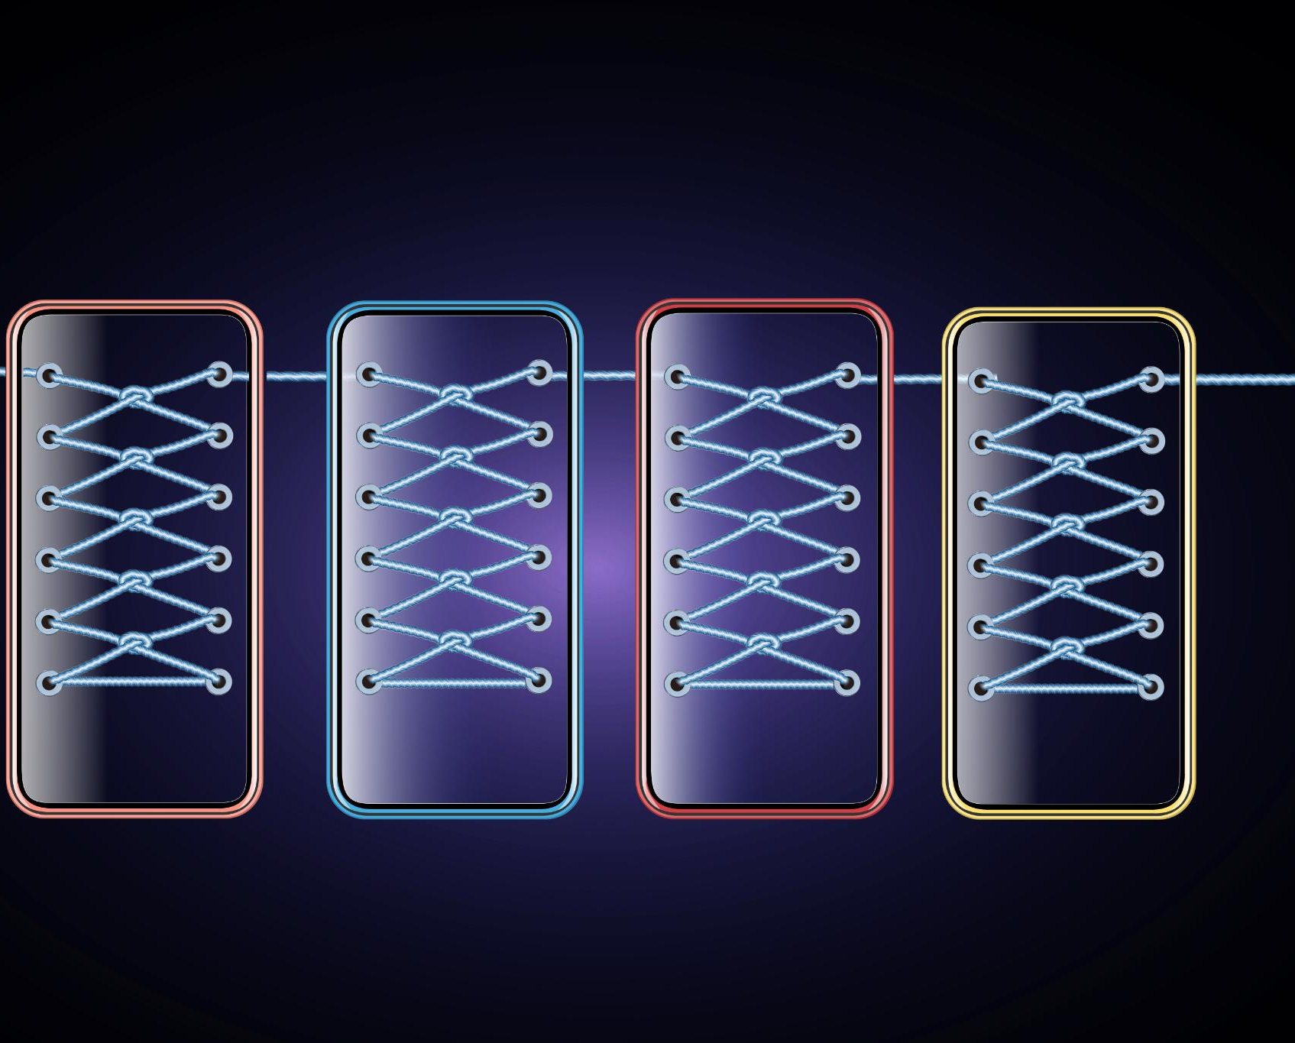
Understanding Convolutional Neural Networks
Convolutional Neural Networks
Convolutional Neural Networks are a type of neural network that is designed specifically for image classification tasks. They are composed of different layers, each with specific functionalities.
Convolutional Layers
Convolutional layers are the core building blocks of Convolutional Neural Networks. They extract features from input images by applying a set of learnable filters to the image pixels.
Pooling Layers
Pooling layers are used to reduce the dimensionality of the feature maps generated by convolutional layers. They help in making the learned features more robust to variations in the position of objects in the image.
ReLu Activation Function
The ReLu activation function is applied to the output of convolutional and pooling layers to introduce non-linearity in the learned features. It helps in improving the performance of the CNN by making it more expressive.
Notes:
Convolutional Neural Networks (CNNs) are a type of neural network that is specifically designed for image classification tasks. We will explore the architecture of CNNs, including their convolutional layers, pooling layers, and ReLu activation function.

Slide 7

Convolutional Layers
Convolutional layers in a CNN are responsible for detecting features in the input image, such as edges or patterns. They do this by using a set of filters that are convolved with the input image to produce a set of feature maps.
Notes:
Convolutional layers are the main building blocks of a CNN. They are responsible for detecting features in the input image, such as edges or patterns. Each convolutional layer consists of a set of filters that are convolved with the input image to produce a set of feature maps.

Slide 8

Pooling Layers
Downsampling Feature Maps
Pooling layers are used to downsample the feature maps produced by the convolutional layers. This reduces the spatial resolution of the feature maps, while retaining the important features.
Max Pooling
Max pooling is the most common type of pooling used in convolutional neural networks. In max pooling, the maximum value in each pooling window is retained.
Notes:
Pooling layers are used to downsample the feature maps produced by the convolutional layers. This reduces the spatial resolution of the feature maps, while retaining the important features. The most common type of pooling is max pooling, where the maximum value in each pooling window is retained.

Slide 9
ReLu Activation Function
The ReLu activation function is a non-linear function that is used in CNNs to improve the performance of the network by allowing it to learn more complex features. It is applied element-wise to the output of the convolutional and pooling layers.
Notes:
The ReLu activation function is used in CNNs to introduce non-linearity into the network. It is applied element-wise to the output of the convolutional and pooling layers. ReLu helps to improve the performance of the network by allowing it to learn more complex features.

Slide 10

Applications of Convolutional Neural Networks
Image Classification
CNNs are widely used in image classification tasks, such as identifying objects in images or recognizing faces in photographs.
Object Detection
Convolutional neural networks are used to detect objects in images and video streams. This can be used in self-driving cars, surveillance, and robotics.
Notes:
CNNs have a wide range of applications, from object detection to image classification. We will explore some of the most common applications of CNNs, including object detection and image classification.

Slide 11
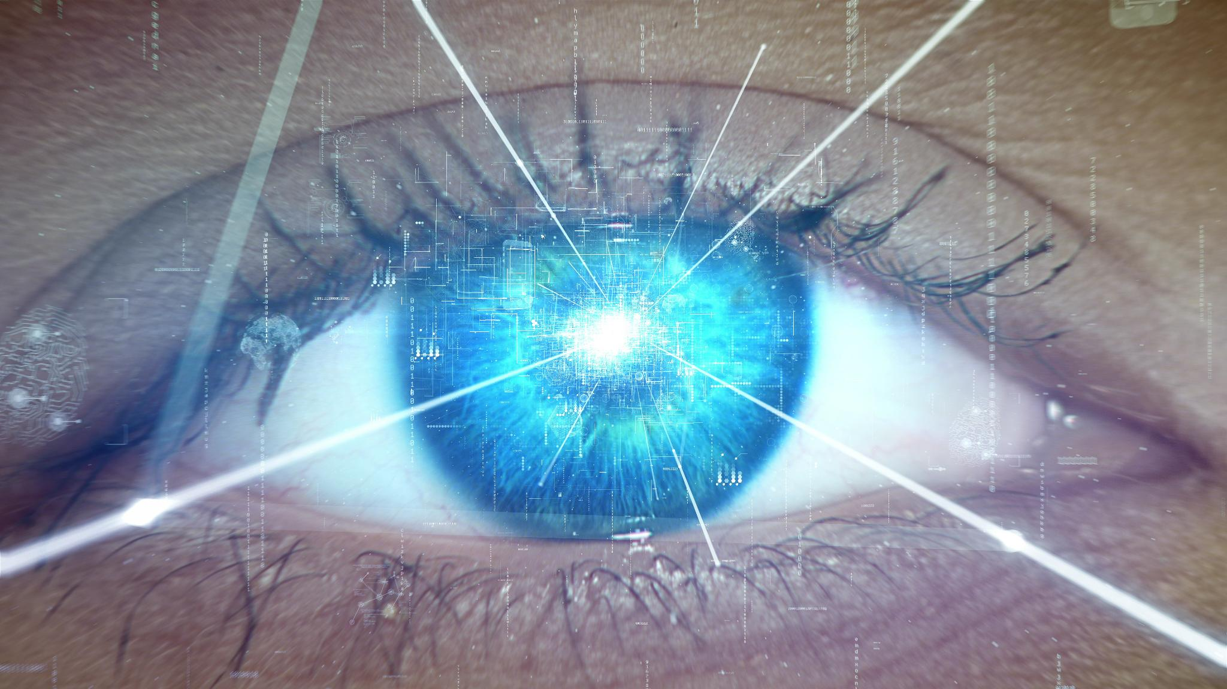
Object Detection
Object detection involves identifying and localizing objects in an image. CNNs are a popular and effective method for object detection, achieving state-of-the-art performance on many benchmark datasets.
Notes:
Object detection is the process of detecting and localizing objects in an image. CNNs are commonly used for object detection, and have achieved state-of-the-art performance on many benchmark datasets.

Slide 12
Image Classification
Convolutional Neural Networks (CNNs) are widely used for image classification tasks, as they can automatically learn features from raw image data and achieve impressive results on many benchmark datasets.
Notes:
Image classification is the process of categorizing an image into a set of predefined classes. CNNs are widely used for image classification tasks, and have achieved impressive results on many benchmark datasets.

Slide 13

Conclusion
Importance of CNNs in Computer Vision
CNNs are widely used in computer vision tasks and have achieved state-of-the-art performance on many benchmark datasets. They have a wide range of applications in fields such as image classification, object detection, and image segmentation.
Future of CNNs and Computer Vision
As the field of computer vision continues to evolve, CNNs will undoubtedly play an important role in shaping its future. They are expected to have a significant impact on fields such as autonomous driving, healthcare, and robotics.
Notes:
Convolutional Neural Networks are a powerful type of neural network that are widely used in computer vision tasks. They have achieved state-of-the-art performance on many benchmark datasets, and have a wide range of applications. As the field of computer vision continues to evolve, CNNs will undoubtedly play an important role in shaping its future.

