Slide 1
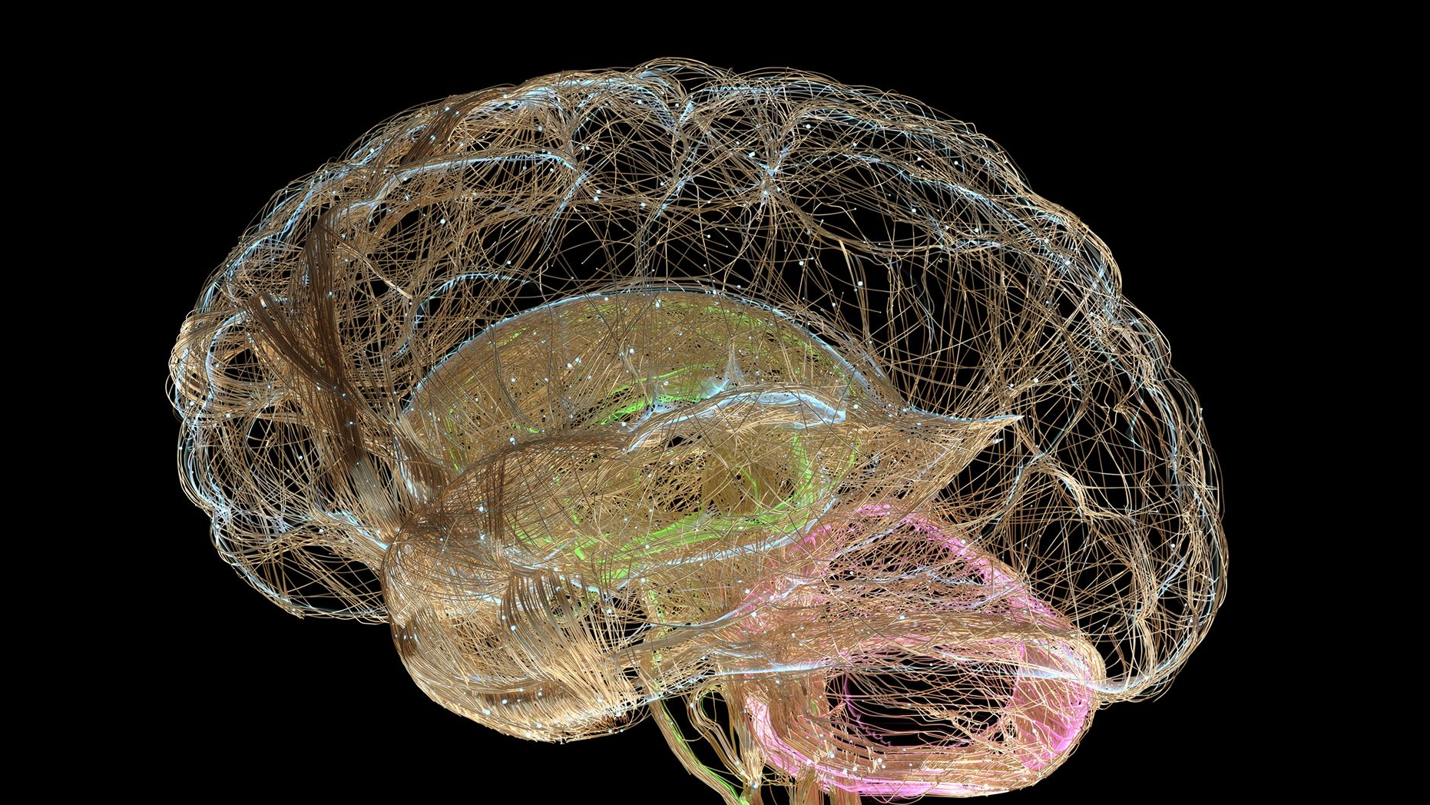
Introduction to Deep Learning
Exploring artificial neural networks for complex problem-solving
Notes:
Deep Learning is a subset of machine learning that uses artificial neural networks to model and solve complex problems. In this presentation, we will explore the fundamentals of deep learning, different types of deep learning, and how deep learning is being used to solve real-world problems.

Slide 2
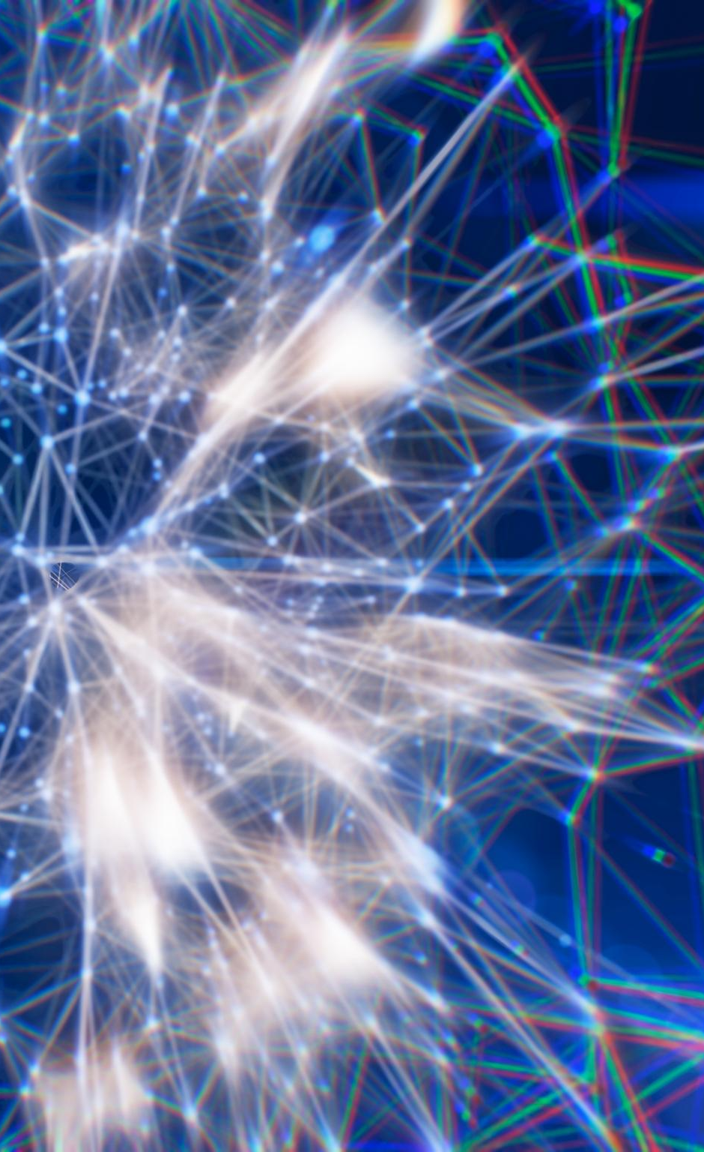
Presentation Overview
Fundamentals of Deep Learning
We will explore the basics of deep learning, including neural networks and backpropagation, and their applications in various fields.
Types of Deep Learning
We will cover different types of deep learning, including Convolutional Neural Networks (CNNs), Recurrent Neural Networks (RNNs), and Generative Adversarial Networks (GANs), and their applications in various fields.
Applications of Deep Learning
We will discuss various applications of deep learning, including computer vision, natural language processing, and recommendation systems, and their real-world implications.
Notes:
We will start by delving into the fundamentals of deep learning, including neural networks and backpropagation. Then, we will explore different types of deep learning, such as Convolutional Neural Networks (CNNs), Recurrent Neural Networks (RNNs), and Generative Adversarial Networks (GANs). Finally, we will discuss the various applications of deep learning, including computer vision, natural language processing, and recommendation systems.

Slide 3
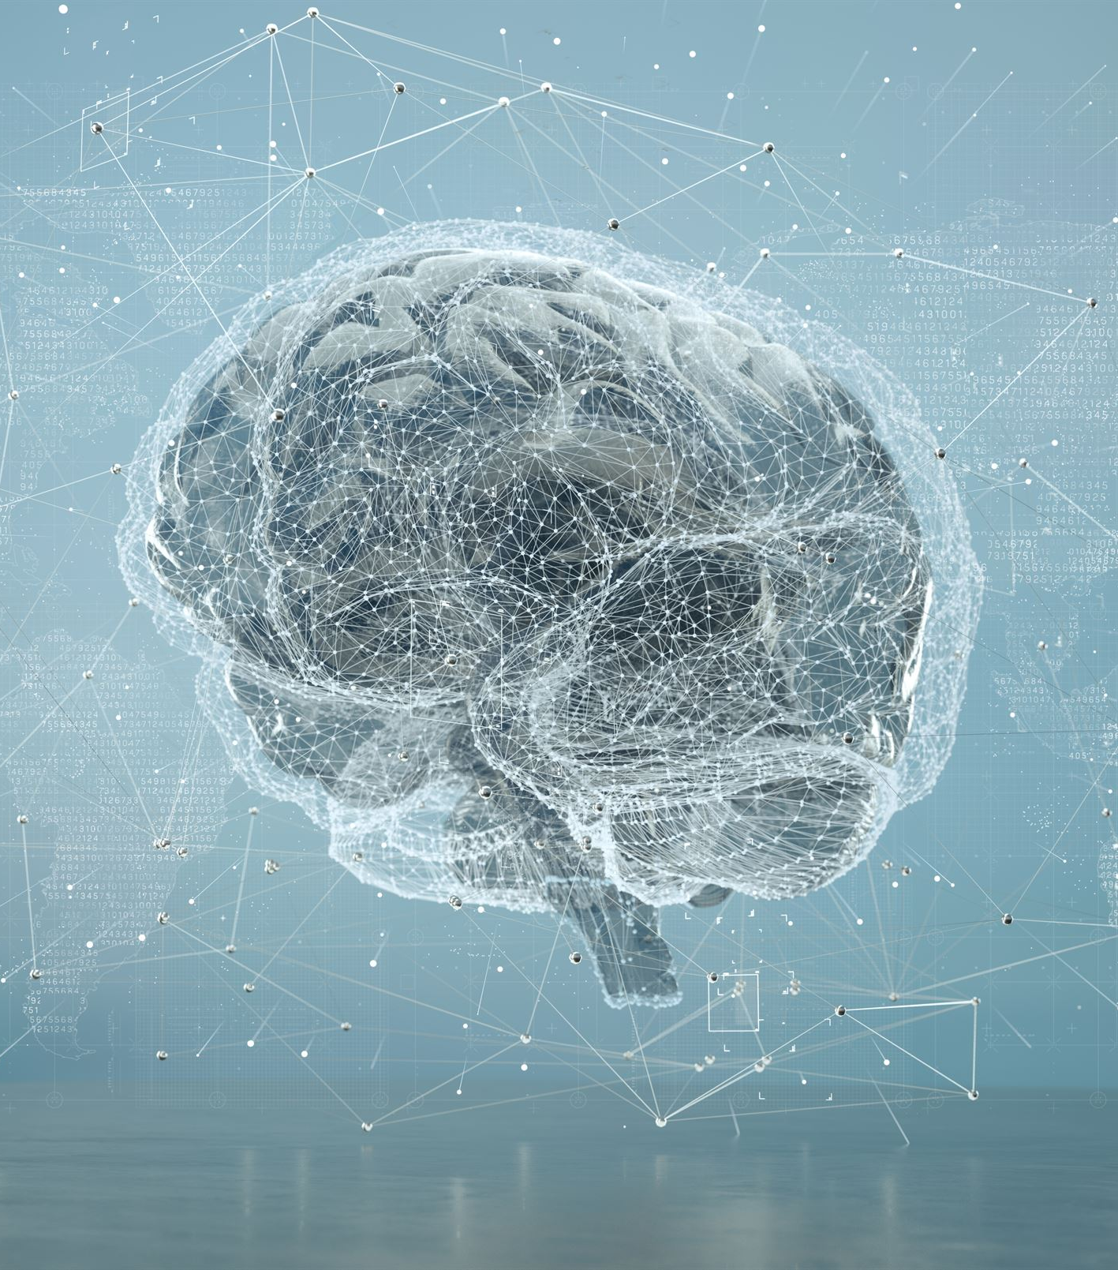
Fundamentals of Deep Learning
Neural Networks
Deep learning is based on artificial neural networks that are inspired by the structure and function of the human brain. We will explore the basics of neural networks and their applications in deep learning.
Backpropagation
Backpropagation is a process used to train neural networks in deep learning. We will explore how backpropagation works and its importance in deep learning.
Notes:
Deep Learning is based on artificial neural networks that are inspired by the structure and function of the human brain. We will explore the basics of neural networks, the process of backpropagation, and how deep learning is different from traditional machine learning.

Slide 4
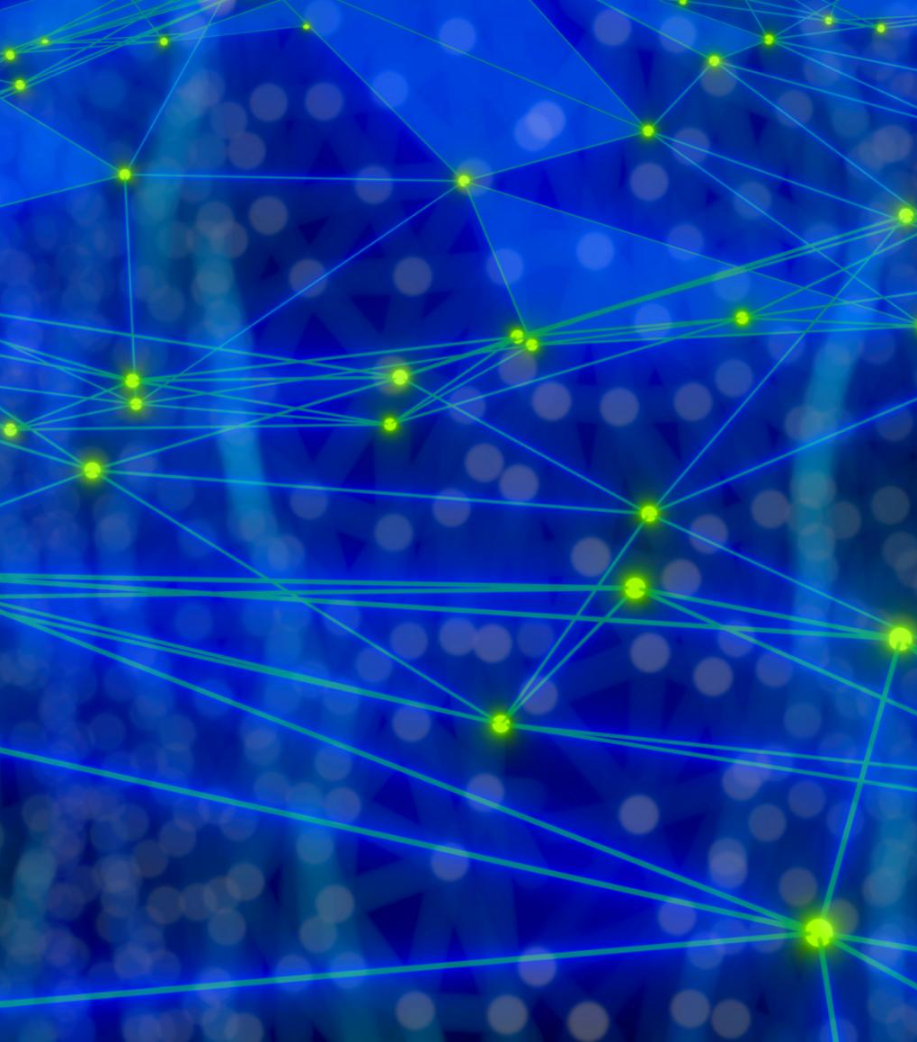
What is Deep Learning?
Definition of Deep Learning
Deep Learning is a subset of machine learning that uses neural networks to model and solve complex problems.
Applications of Deep Learning
Deep Learning has led to breakthroughs in areas such as computer vision, natural language processing, and speech recognition.
Notes:
Deep Learning is a subset of machine learning that uses neural networks to model and solve complex problems. It has led to breakthroughs in areas such as computer vision, natural language processing, and speech recognition.

Slide 5
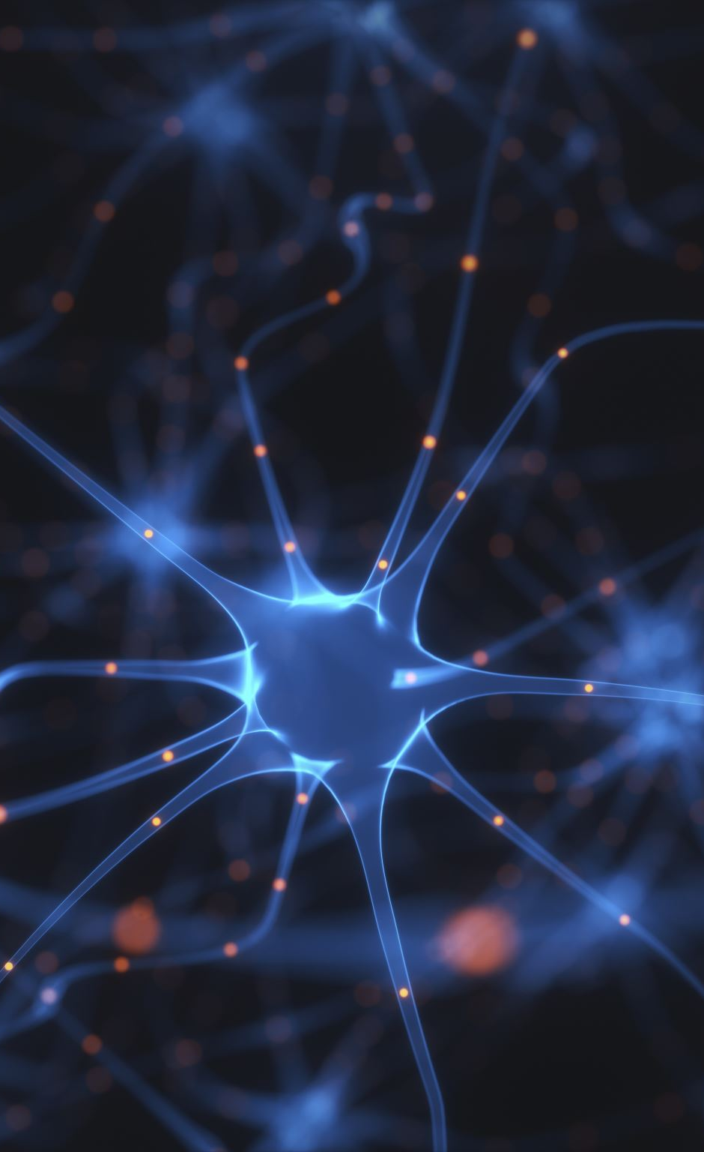
Neural Networks
Basics of Neural Networks
Neural networks are the basic building blocks of deep learning algorithms. They are composed of interconnected layers of neurons that can learn to recognize patterns in data, making them useful in image and speech recognition, and natural language processing.
Components of Neural Networks
Neural networks consist of several interconnected layers of neurons that perform different functions, including input layers, hidden layers, and output layers. Each layer processes the data and feeds it forward to the next layer until the desired output is obtained.
Notes:
Neural networks are the building blocks of deep learning. They are composed of layers of interconnected neurons that can learn to recognize patterns in data. We will explore the basics of how neural networks work and their different components.

Slide 6
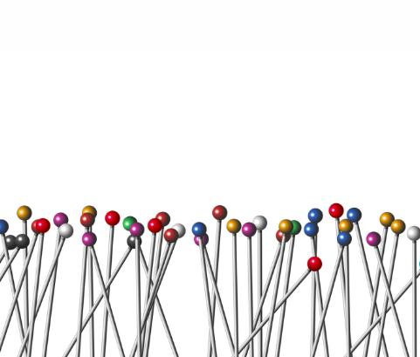
Backpropagation
Backpropagation is a process of adjusting the weights of connections in a neural network to improve its performance. It is a fundamental algorithm used in training deep learning models.
Notes:
Backpropagation is the process of training a neural network by adjusting the weights of its connections. We will explore how backpropagation works and how it is used to train deep learning models.

Slide 7
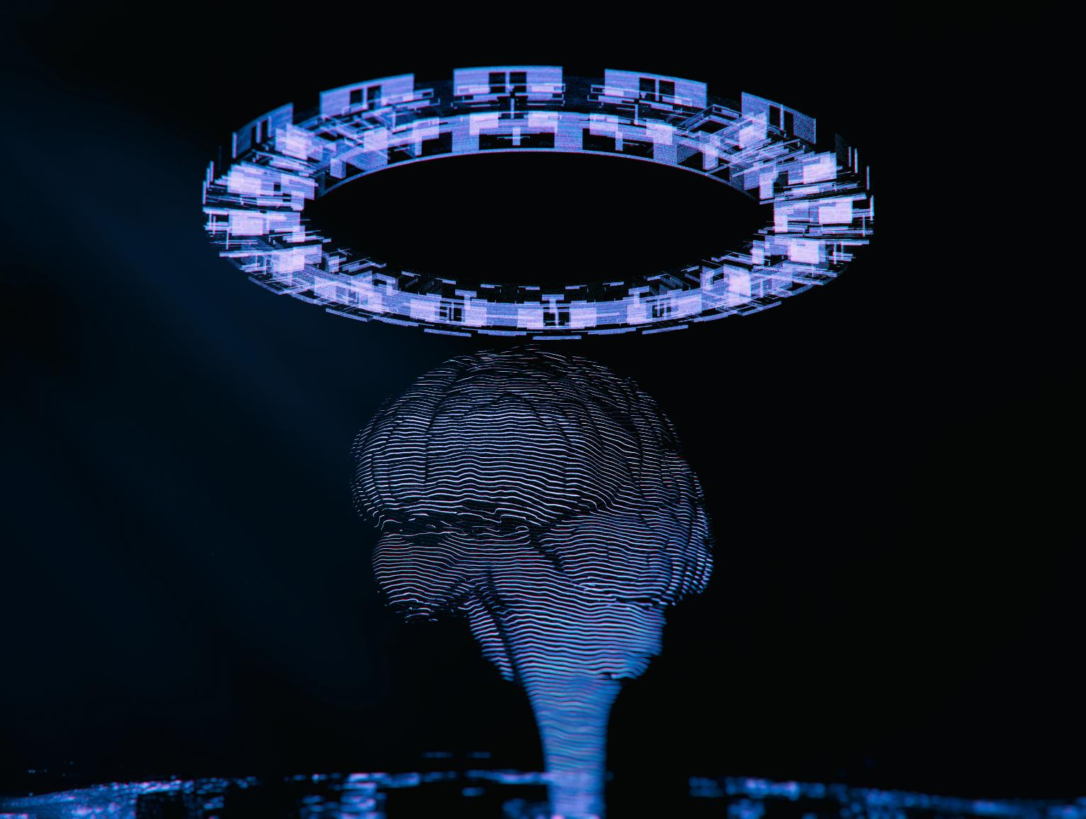
Types of Deep Learning
Convolutional Neural Networks (CNNs)
Convolutional Neural Networks (CNNs) are used for image recognition and classification tasks. CNNs are designed to recognize visual patterns in large datasets and are commonly used in computer vision applications.
Recurrent Neural Networks (RNNs)
Recurrent Neural Networks (RNNs) are used for sequential data processing tasks. RNNs are designed to recognize patterns in sequential data and are commonly used in natural language processing and speech recognition applications.
Generative Adversarial Networks (GANs)
Generative Adversarial Networks (GANs) are used for generating new data based on existing data. GANs are designed to generate new data that is similar to the existing data and are commonly used in image and video generation applications.
Notes:
There are several types of deep learning, each with its own strengths and weaknesses. We will explore Convolutional Neural Networks (CNNs), Recurrent Neural Networks (RNNs), and Generative Adversarial Networks (GANs).

Slide 8
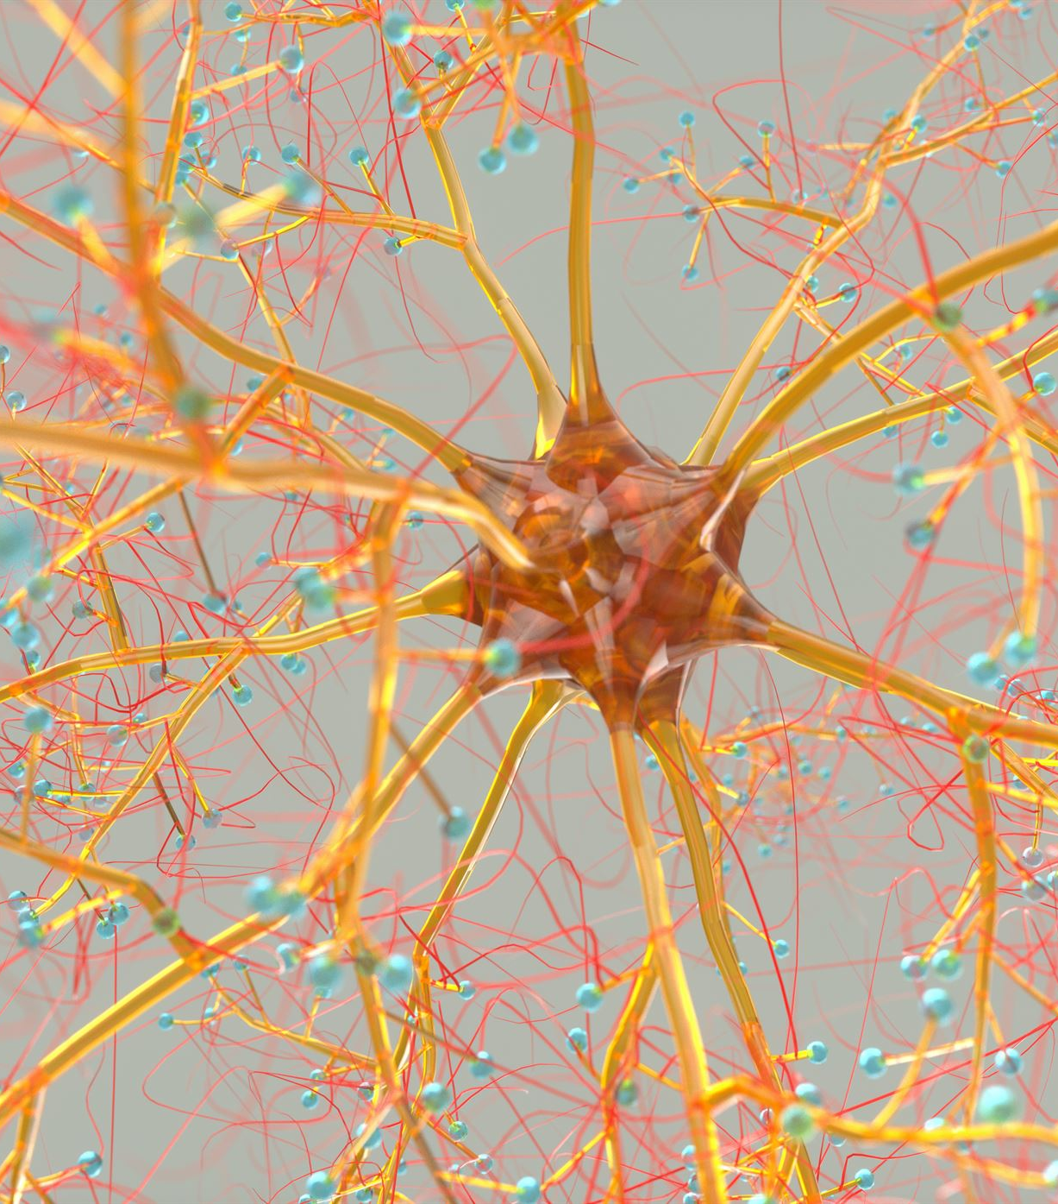
Convolutional Neural Networks (CNNs)
Computer Vision Tasks
CNNs are commonly used in computer vision tasks, such as image and video recognition. They are capable of recognizing visual patterns in data and are often used in applications such as facial recognition, object detection, and autonomous vehicles.
Visual Pattern Recognition
CNNs are designed to recognize visual patterns in data. They use convolutional layers to automatically learn features from images, making them ideal for tasks that involve complex visual patterns.
Notes:
CNNs are commonly used in computer vision tasks, such as image and video recognition. They are designed to recognize visual patterns in data and are often used in applications such as facial recognition and autonomous vehicles.

Slide 9
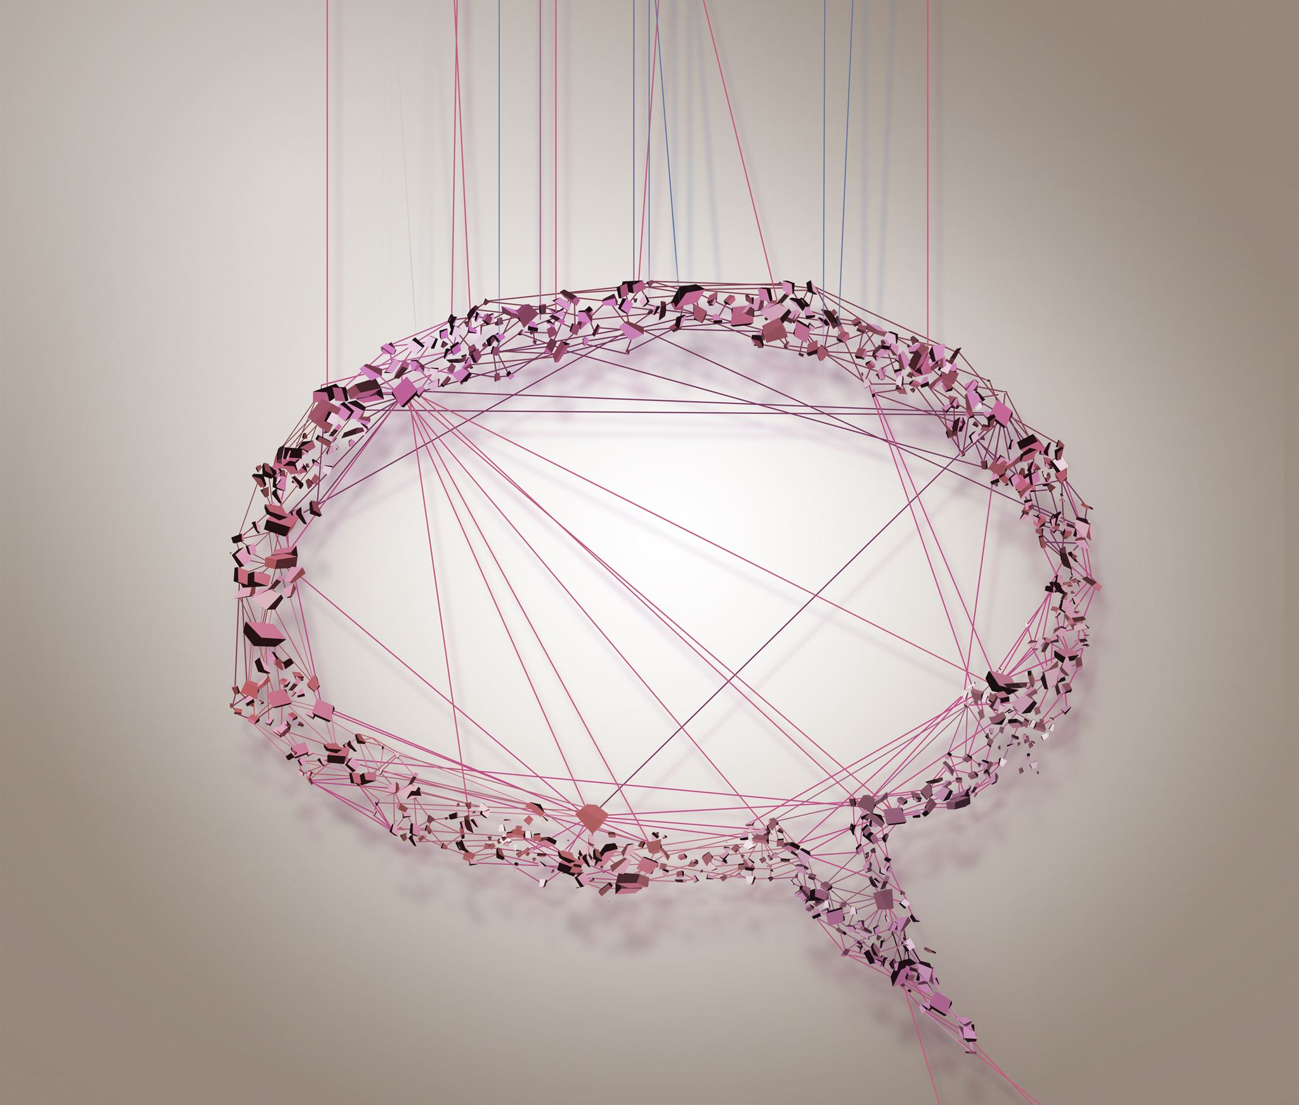
Recurrent Neural Networks (RNNs)
RNNs are specially designed for sequence learning tasks, such as natural language processing and speech recognition. They are used to recognize patterns in sequence data and can be used to generate text or speech.
Notes:
RNNs are used for sequence learning tasks, such as natural language processing and speech recognition. They are designed to recognize patterns in sequential data and can be used to generate text or speech.

Slide 10
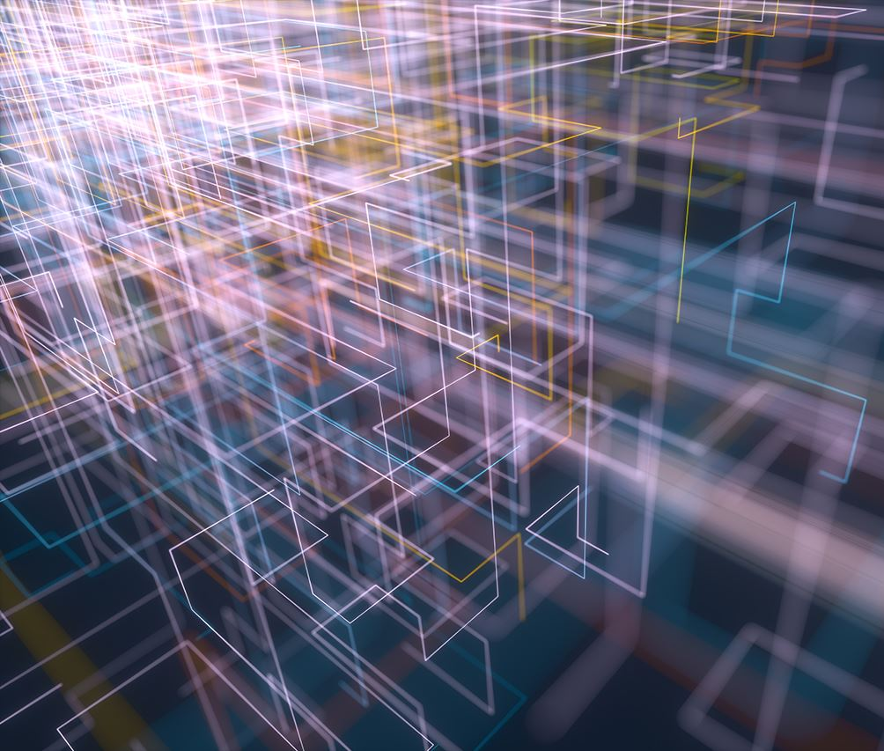
Generative Adversarial Networks (GANs)
GANs are a type of neural network used for generative modeling tasks, such as image and video generation, that can produce realistic data using unsupervised learning.
Notes:
GANs are used for generative modeling tasks, such as image and video generation. They are composed of two neural networks, a generator and a discriminator, that work together to generate realistic data.

Slide 11
Applications of Deep Learning
Computer Vision
Deep learning is being used to develop computer vision systems that can recognize and identify objects, people, and scenes in images and videos. This has many applications in fields like healthcare, transportation, and security.
Natural Language Processing
Deep learning is being used to develop natural language processing systems that can understand and process human language. This has many applications in fields like customer service, language translation, and voice recognition.
Recommendation Systems
Deep learning is being used to develop recommendation systems that can provide personalized recommendations for products, services, and content. This has many applications in fields like e-commerce, entertainment, and education.
Notes:
Deep learning is being used to solve a wide range of real-world problems. We will explore some of the most exciting applications of deep learning, including computer vision, natural language processing, and recommendation systems.

Slide 12
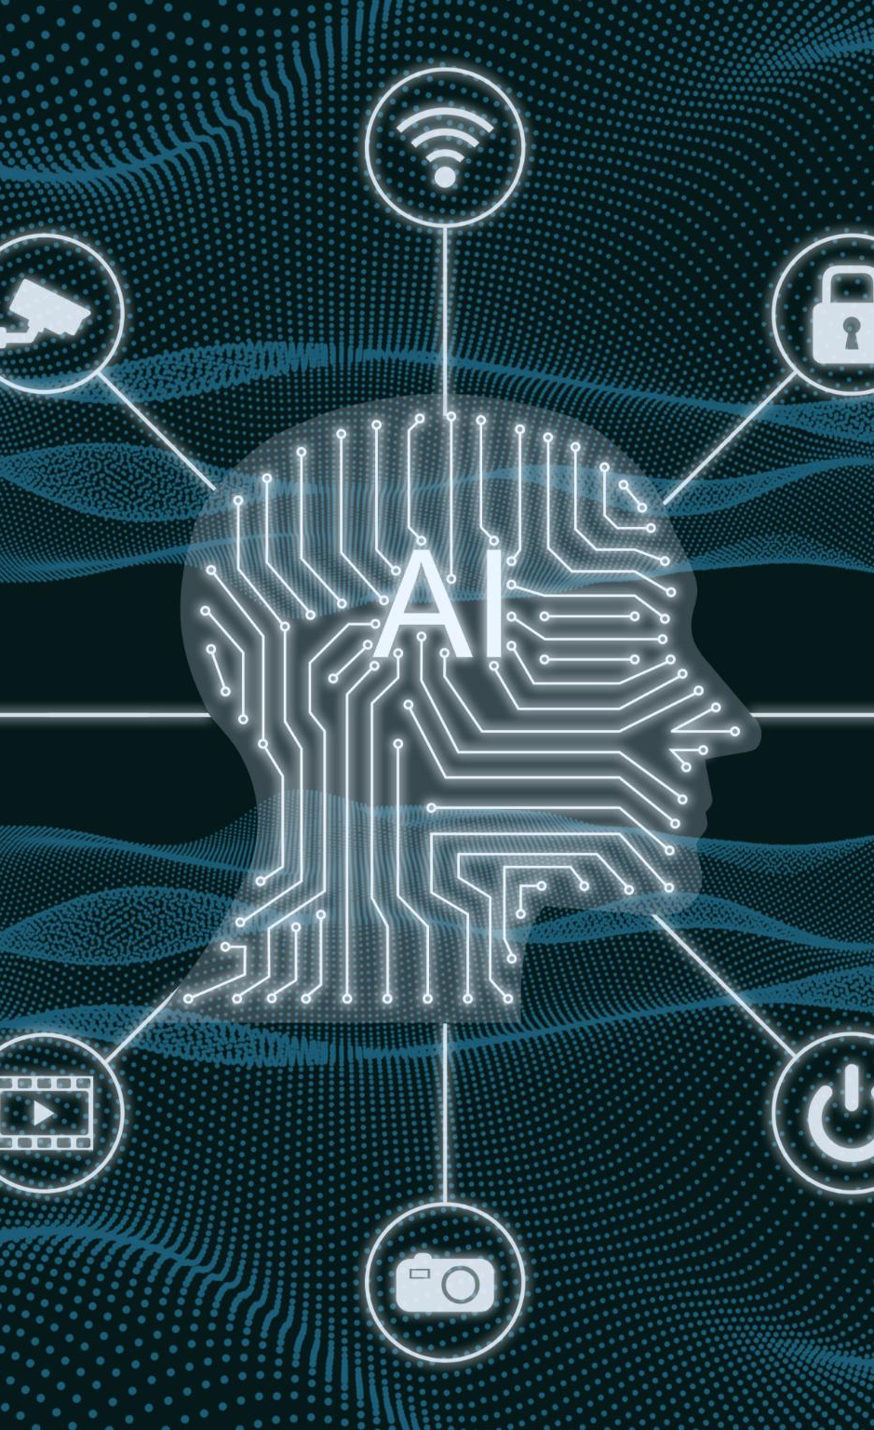
Computer Vision
Object Recognition
Deep learning is being used to improve object recognition in computer vision, making it easier to identify and classify objects in images and video.
Facial Recognition
Deep learning is being used to improve facial recognition in computer vision, making it easier to identify and verify individuals based on facial features.
Autonomous Vehicles
Deep learning is being used to improve the perception and decision-making capabilities of autonomous vehicles, allowing them to navigate and interact with the environment more safely and efficiently.
Notes:
Deep learning is being used to improve computer vision tasks, such as object recognition, facial recognition, and autonomous vehicles. We will explore some of the most exciting applications of deep learning in computer vision.

Slide 13
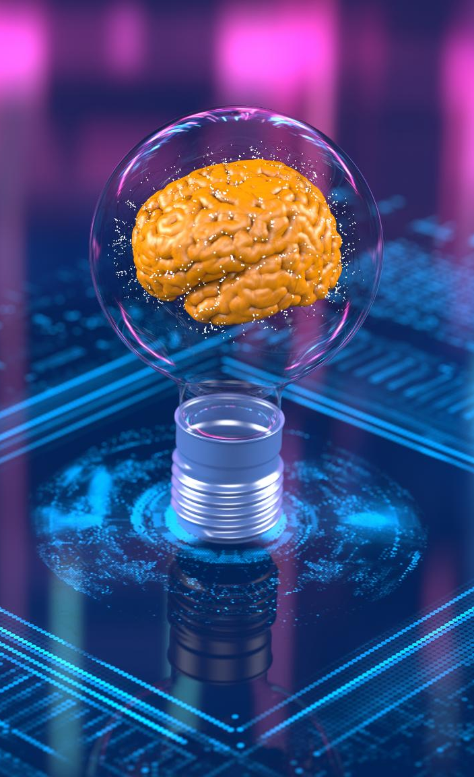
Natural Language Processing (NLP)
Machine Translation
Deep learning has revolutionized machine translation by enabling models to learn from large amounts of parallel text data, resulting in more accurate translations across different languages.
Sentiment Analysis
Deep learning models have been shown to be effective in sentiment analysis by learning from large amounts of labeled data, enabling more accurate detection of positive, negative, or neutral sentiment in text data.
Speech Recognition
Deep learning has enabled significant advances in speech recognition, enabling more accurate transcription of speech data and facilitating the development of voice-enabled applications and devices.
Notes:
Deep learning is being used to improve natural language processing tasks, such as machine translation, sentiment analysis, and speech recognition. We will explore some of the most exciting applications of deep learning in NLP.

Slide 14
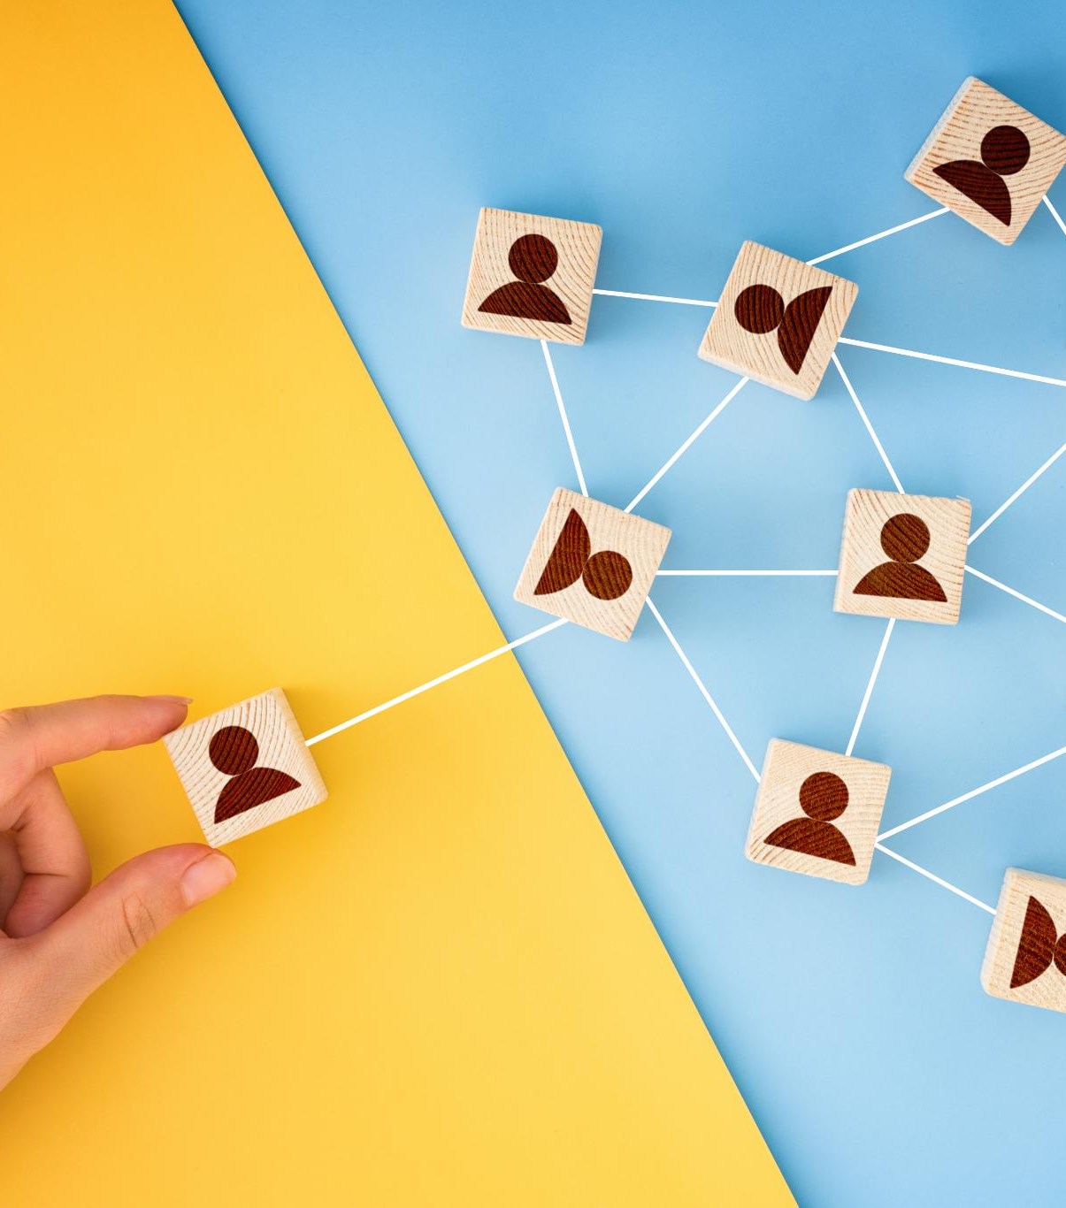
Recommendation Systems
Deep Learning for Recommendation Systems
Deep learning is being used to improve the accuracy and effectiveness of recommendation systems, which are widely used in e-commerce and media industries to personalize user experience.
Personalization of Recommendations
Personalization is a key aspect of modern recommendation systems, enabling companies to tailor their recommendations to individual users based on their preferences, interests and behavior.
Notes:
Deep learning is being used to improve recommendation systems, such as those used by Netflix and Amazon. We will explore how deep learning is being used to personalize recommendations and improve user engagement.

Slide 15
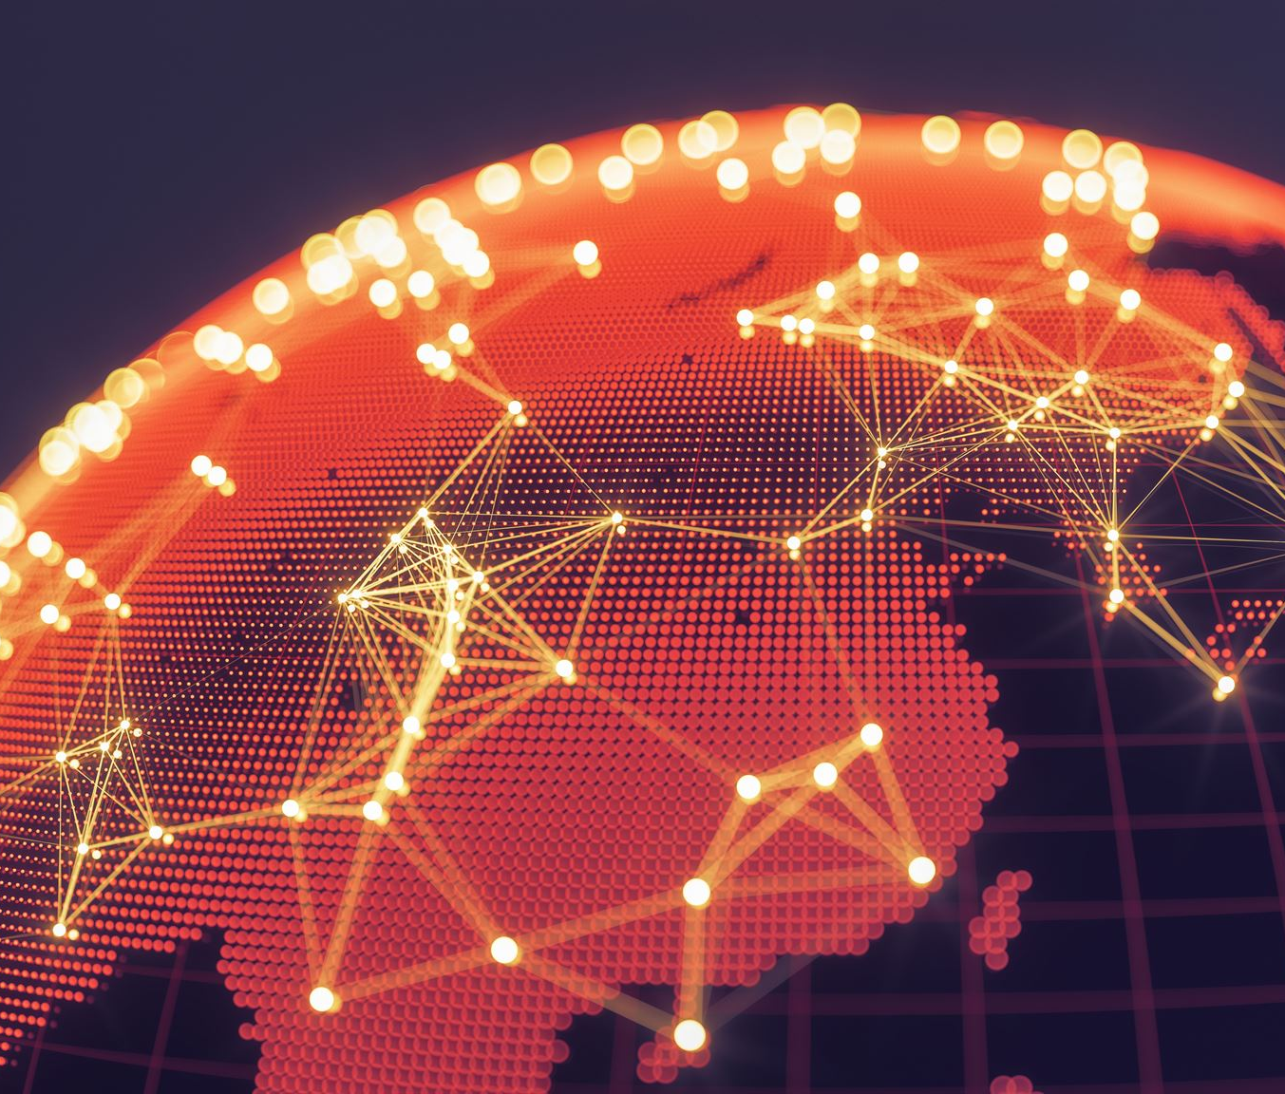
Conclusion
Deep learning is revolutionizing many industries, including healthcare, finance, and transportation. It has the potential to transform the world as we know it.
Notes:
Deep learning is a rapidly evolving field that is revolutionizing many industries. It has the potential to transform everything from healthcare to finance to transportation. By understanding the fundamentals of deep learning, different types of deep learning, and its applications, we can better appreciate the impact it is having on our world.

