Slide 1

Understanding the Four Building Blocks of Large Language Models (LLMs)
An exploration of key components in LLMs
Notes:
AI-generated content may be incorrect. Large Language Models (LLMs) have revolutionized natural language processing. In this presentation, we will explore the four building blocks of LLMs and how they contribute to the success of these models.

Slide 2
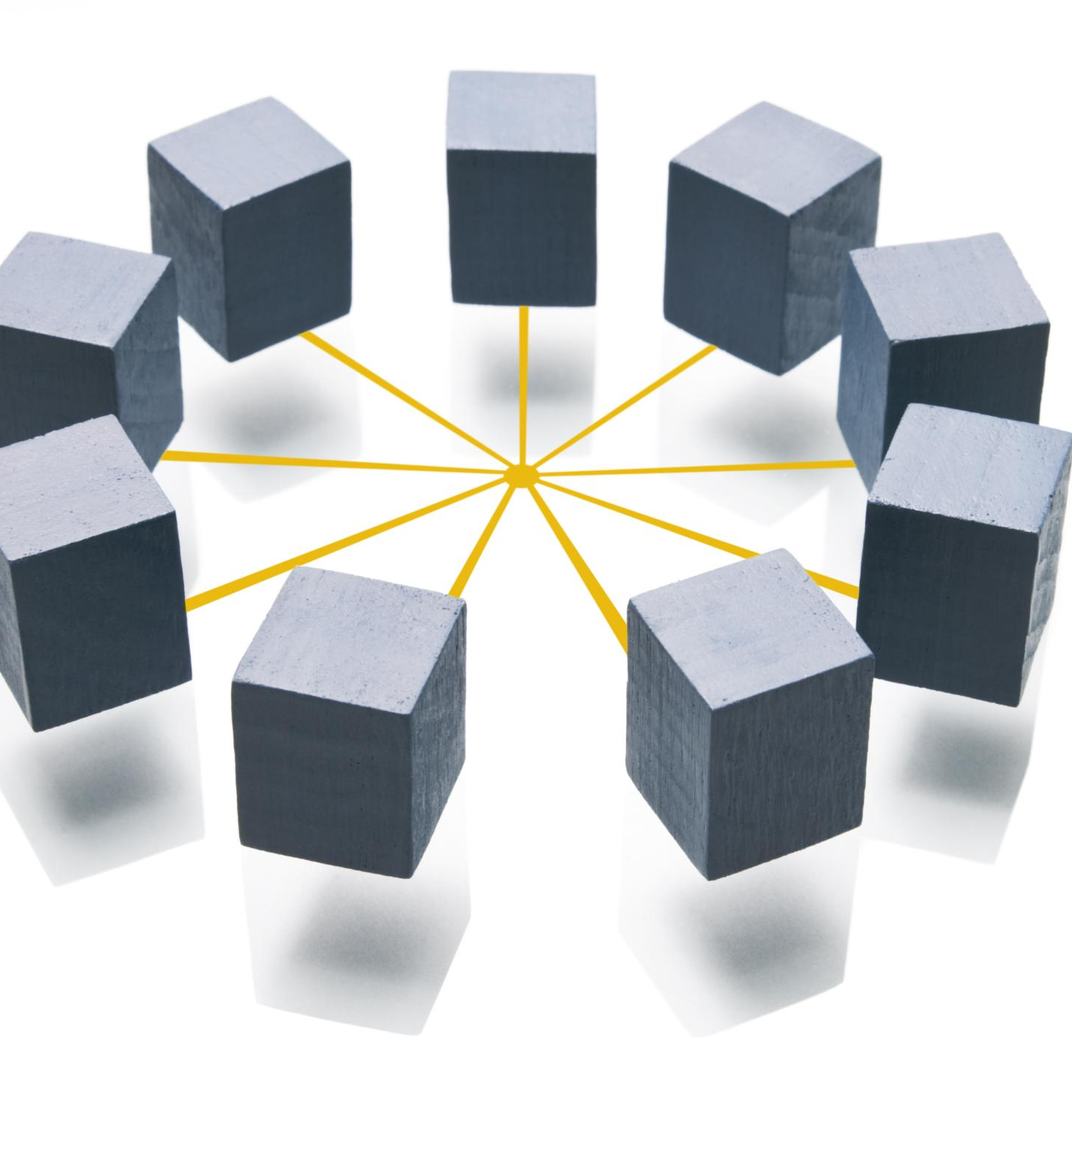
Outline
Transformers: The Architecture Behind LLMs
Parameters: The Learning Components
Tokens: The Fundamental Units of Text
Context Length: Managing Input Sequences
Notes:
We will start by delving into the architecture of LLMs, with a focus on Transformers and the attention mechanism. Then, we will discuss the importance of parameters and how they impact model performance. After that, we will explore tokens and tokenization, and their impact on model efficiency. Finally, we will examine the role of context length in managing input sequences.

Slide 3
Transformers: The Architecture Behind LLMs
Notes:
Transformers are a key building block of LLMs, enabling their ability to process large amounts of text and generate coherent, context-specific responses. The attention mechanism, which is used by transformers, allows models to focus on important aspects of the input text.

Slide 4
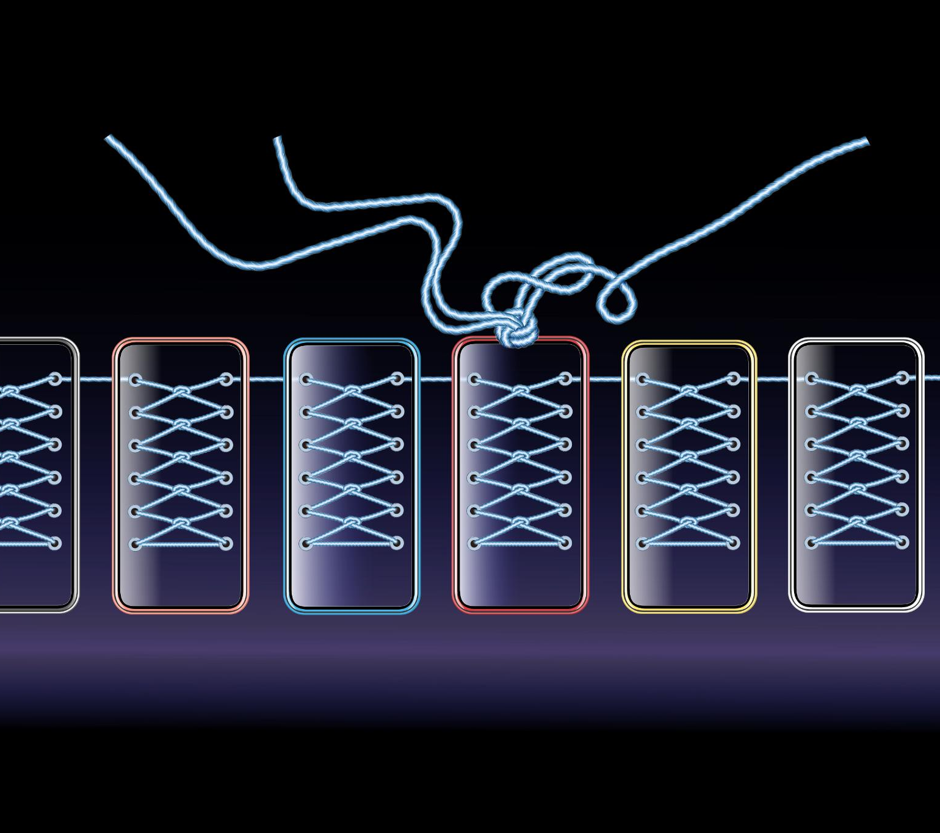
Introduction to Transformers
Transformers are a type of neural network architecture that process sequential data, such as text, using a self-attention mechanism. They were introduced in 2017 by Vaswani et al. and have since become the backbone of many state-of-the-art LLMs.
Notes:
Transformers are neural network architectures that process sequential data, such as text, and are based on the self-attention mechanism. They were introduced in 2017 by Vaswani et al. and have since become the backbone of many state-of-the-art LLMs.

Slide 5

The Attention Mechanism
What is the Attention Mechanism?
The attention mechanism is a way for LLMs to selectively focus on certain parts of the input text, assigning weights based on the relevance of each part.
Advantages of the Attention Mechanism
This mechanism has the advantage of allowing the model to selectively use context from the input text, rather than relying on a fixed-length context window.
Notes:
The attention mechanism is a way for LLMs to selectively focus on certain parts of the input text, assigning weights based on the relevance of each part. This mechanism has the advantage of allowing the model to selectively use context from the input text, rather than relying on a fixed-length context window.

Slide 6

Benefits over Previous Architectures
Handling Long-Range Dependencies
Transformers are better at handling long-range dependencies in input text due to their self-attention mechanism which allows them to process all words in the input sequence simultaneously.
Parallel Processing of Input Text
Transformers can process input text in parallel which makes them faster than recurrent neural networks (RNNs) that process input text sequentially.
Notes:
Transformers have several advantages over previous neural network architectures for processing text, such as recurrent neural networks (RNNs) and convolutional neural networks (CNNs). For example, Transformers are better at handling long-range dependencies and can process input text in parallel.

Slide 7
Parameters: The Learning Components
Notes:
Parameters are a key component of LLMs, and are learned during the training process. They influence model performance, and can be fine-tuned to improve the accuracy of the model.

Slide 8

Definition and Role of Parameters
Definition of Parameters
Parameters are variables in machine learning that are learned during the training process and used to make predictions on new input. They can be fine-tuned to improve accuracy.
Role of Parameters in LLMs
Parameters play a crucial role in the performance of LLMs, influencing the quality of the output produced. Fine-tuning of parameters is an important aspect of LLMs.
Notes:
Parameters are the variables that are learned during the training process, and are used to make predictions on new input. They play a crucial role in the performance of LLMs, and can be fine-tuned to improve the model's accuracy.

Slide 9

How Parameters Influence Model Performance
Tweaking the values of parameters can lead to improved model performance by fine-tuning the model to better fit the training data, resulting in better accuracy on the test data.
Notes:
The choice of parameters can have a significant impact on the accuracy of the model. By tweaking the values of these parameters, we can fine-tune the model to better fit the training data, leading to improved performance on the test data.

Slide 10

Training and Fine-Tuning Parameters
Training and fine-tuning parameters is an iterative process that repeatedly adjusts the values of the parameters to improve the performance of the model.
Notes:
Training and fine-tuning parameters is an iterative process that involves adjusting the values of the parameters to improve the performance of the model. This process requires a lot of computing power and data, but can lead to significant improvements in the accuracy of the model.

Slide 11
Tokens: The Fundamental Units of Text
Notes:
Tokens are the basic building blocks of text that are used by LLMs to generate responses. Understanding tokenization and the different types of tokens is important for optimizing the efficiency of LLMs.

Slide 12

What Are Tokens and Tokenization
Tokens are individual units of text that are used by language learning models to process input text. Tokenization is the process of dividing text into tokens, and is a crucial step in language learning models.
Notes:
Tokens are individual units of text that are used by LLMs to process input text. Tokenization is the process of dividing text into tokens, and is a crucial step in LLMs.

Slide 13
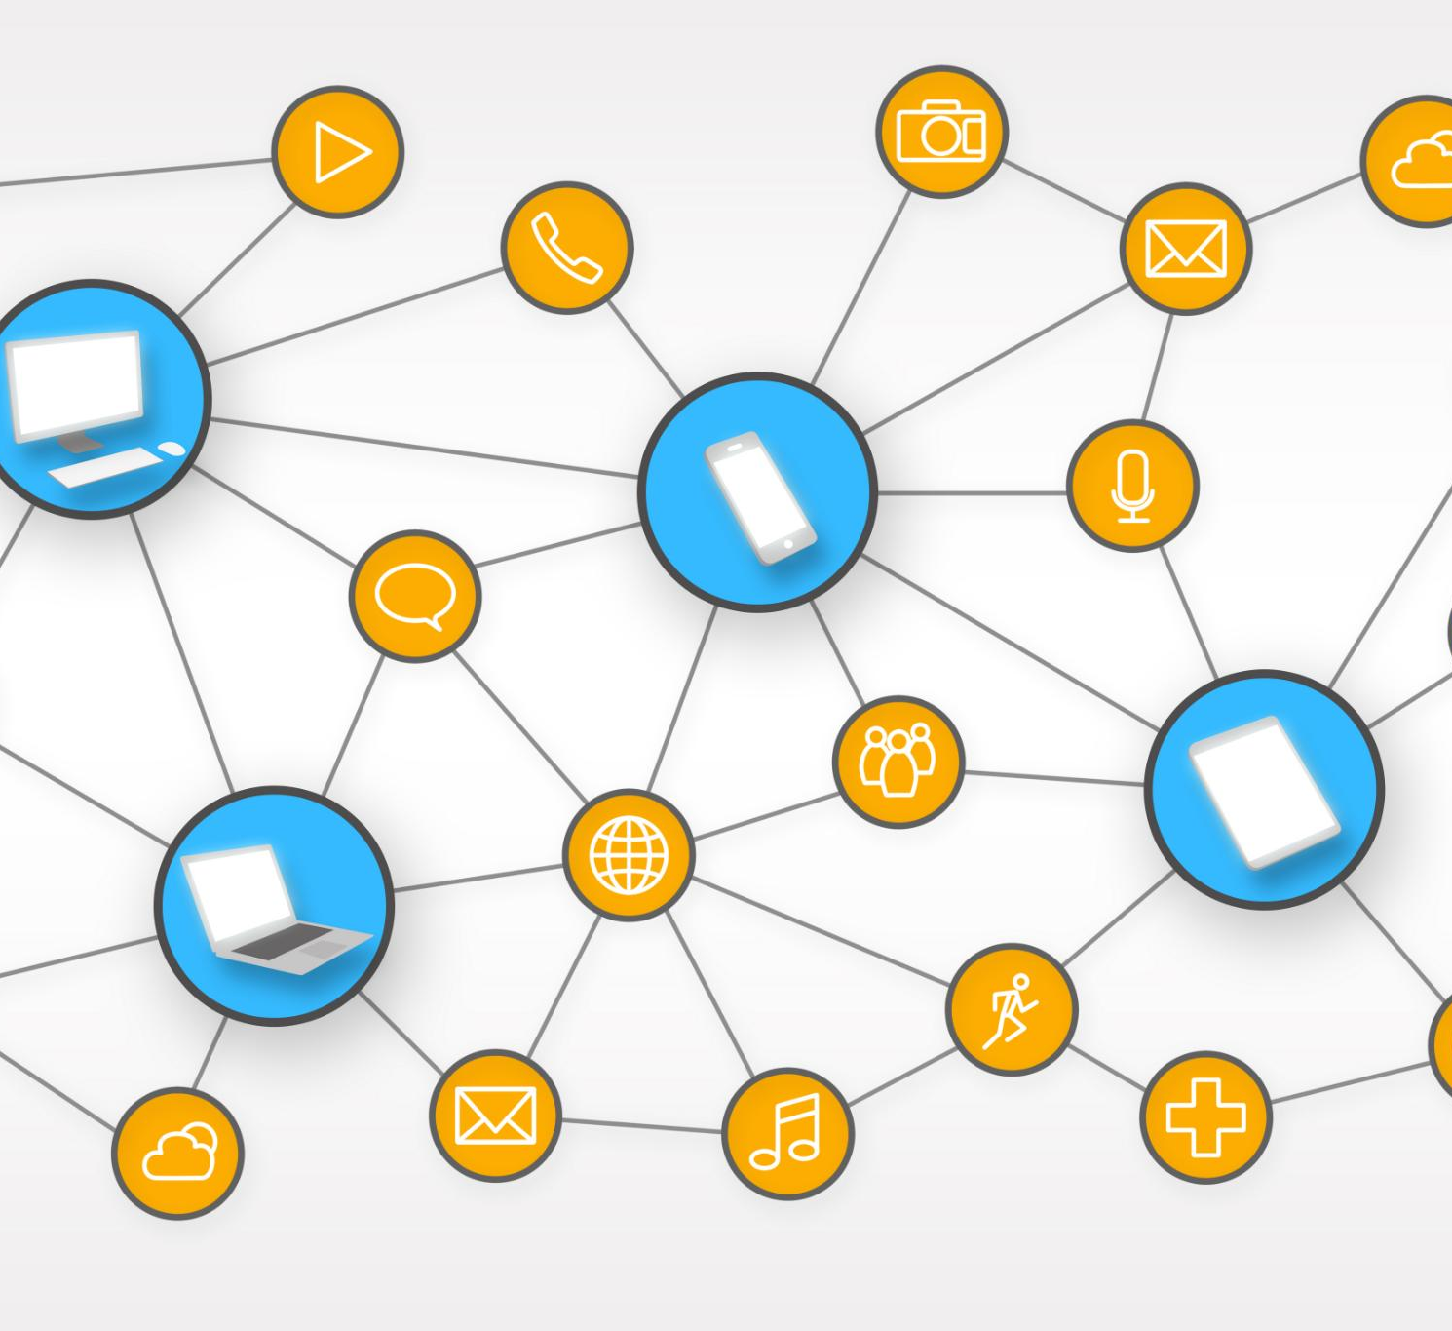
Types of Tokenization Methods
Word-Level Tokenization
Word-level tokenization is a type of tokenization method used in LLMs that splits text into individual words. This method is useful for preserving the meaning of words and is often used in natural language processing.
Subword-Level Tokenization
Subword-level tokenization is a type of tokenization method used in LLMs that splits text into smaller subword units. This method is useful for handling out-of-vocabulary words and is often used in models with limited vocabulary size.
Character-Level Tokenization
Character-level tokenization is a type of tokenization method used in LLMs that splits text into individual characters. This method is useful for handling rare or unusual words and is often used in models with very limited vocabulary size.
Notes:
There are several types of tokenization methods used in LLMs, including word-level tokenization, subword-level tokenization, and character-level tokenization. Each method has its own advantages and disadvantages.

Slide 14

Impact of Tokens on Model Efficiency
The choice of tokenization method can have a significant impact on the efficiency of LLMs, in terms of both memory usage and processing time. Choosing the right tokenization method is important for optimizing the performance of LLMs.
Notes:
The choice of tokenization method can have a significant impact on the efficiency of LLMs, in terms of both memory usage and processing time. Choosing the right tokenization method is important for optimizing the performance of LLMs.

Slide 15
Context Length: Managing Input Sequences
Notes:
The length of the input text that LLMs can process is an important consideration, as it can impact the model's accuracy and efficiency. Understanding context length and how to manage input sequences is crucial for optimizing the performance of LLMs.

Slide 16

Understanding Context Length
Context Length Definition
Context length refers to the number of tokens that LLMs can process at one time. It is an important parameter in language modeling and affects the accuracy of the model.
Impact of Longer Context Lengths
Longer context lengths can lead to better accuracy in LLMs, as they can capture more nuanced relationships between words. However, this can also increase memory usage and processing time, making it important to balance accuracy with computational resources.
Notes:
Context length refers to the number of tokens that LLMs can process at one time. Longer context lengths can lead to better accuracy, but can also increase memory usage and processing time.

Slide 17

Effects of Context Length on Model Performance
Impact of Context Length on Accuracy
Context length has a significant impact on the accuracy of LLMs. Longer context lengths can lead to better accuracy because the model has more contextual information to work with.
Impact of Context Length on Resource Usage
Longer context lengths can also increase memory usage and processing time, which can be problematic for large models or datasets. It is important to choose a context length that balances accuracy and resource usage.
Notes:
The choice of context length can have a significant impact on the accuracy of LLMs. Longer context lengths can lead to better accuracy, but can also increase memory usage and processing time. Choosing the right context length is important for optimizing the performance of LLMs.

Slide 18

Strategies for Handling Long Context
Several strategies exist for handling long context in LLMs, such as hierarchical models or dividing the input text into smaller chunks. Choosing the right strategy is important for optimizing the efficiency and accuracy of LLMs.
Notes:
There are several strategies for handling long context in LLMs, such as using hierarchical models or dividing the input text into smaller chunks. Choosing the right strategy is important for optimizing the efficiency and accuracy of LLMs.

