Slide 1
Homework in Seminar of Applied Statistics
Analyses of the Data Set «German Credits»

Slide 2
Content
Introduction to the Problem
Exploratory Data Analysis
Modelling
Classification Tree
Random Forest
Neural Network
Conclusion/Findings

Slide 3
I Introduction to the Problem
Estimating the Credit Rating of a Credit Applicant
Data Set: German Credit Data
Explanatory Data Analysis and Variable Selection
Modelling by applying the following methods
Classification Tree
Random Forest Method
Neural Networks

Slide 4
IIa Exploratory Data Analysis: Qualitative Variables
Crosstabling the qualitative covariates
Signification Criteria: p-Value Pearson’ Chi^2-Test
Finding significant relationships to Credit Rating for most of the qualitative covariates!
Eliminating the following covariates at this step:
FURNITURE
RETRAINING
MALE_DIV
MALE_MAR_WID
GUARANTOR
PRESENT_RESIDENT
NUM_CREDITS
NUM_DEPENDENTS
TELEPHONE
Notes:
In the codelist 6 variables were defined as numeric. Anyhow since 3 of these 6 were mostly ordinal variables with 4 or few categories, I decided to classify this 3 aswell as qualitative instead of quantitative vars.
So at the end only 3 covariates remained which I consider as real continuous covariates

Slide 5
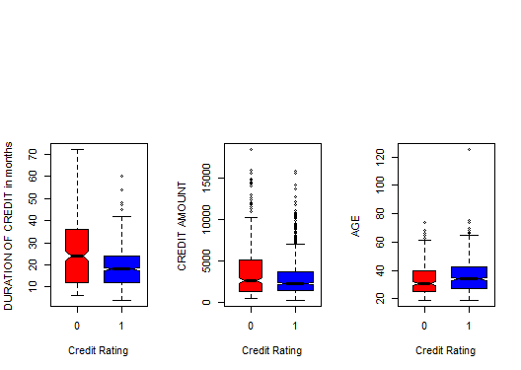
IIb Exploratory Data Analysis: Quantitative Variables
Boxplots of the quantitative Covariates
Notes:
Logically the Variance, the red boxes are for all 3 plots larger due to the fact that we have a much smaller number of bad credit ratings
In the codelist 6 variables were defined as numeric. Anyhow since 3 of these 6 were mostly ordinal variables with 4 or few categories, I decided to classify this 3 aswell as qualitative instead of quantitative vars.
So at the end only 3 covariates remained which I consider as real continuous covariates

Slide 6
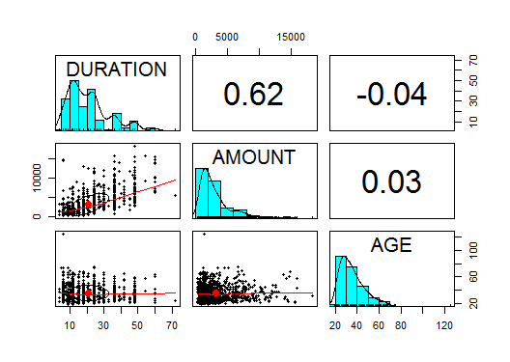
IIb Exploratory Data Analysis: Quantitative Variables
Correlations between the quantitative Covariates
Notes:
Selected by graphical and computational Tools
In the codelist 6 variables were defined as numeric. Anyhow since 3 of these 6 were mostly ordinal variables with 4 or few categories, I decided to classify this 3 aswell as qualitative instead of quantitative vars.
So at the end only 3 covariates remained which I consider as real continuous covariates

Slide 7
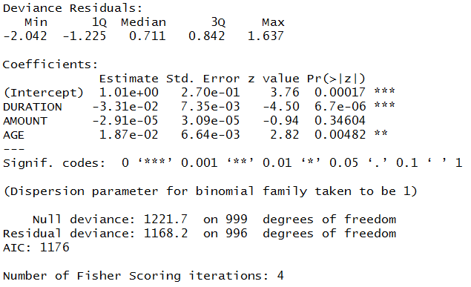
IIb Exploratory Data Analysis: Quantitative Variables
Logistic Regression Model (remaining 3 quantitative variables)
Notes:
Selected by graphical and computational Tools
In the codelist 6 variables were defined as numeric. Anyhow since 3 of these 6 were mostly ordinal variables with 4 or few categories, I decided to classify this 3 aswell as qualitative instead of quantitative vars.
So at the end only 3 covariates remained which I consider as real continuous covariates

Slide 8
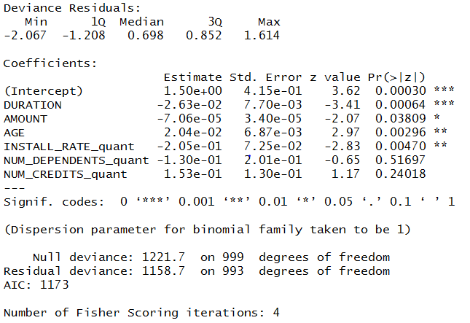
IIb Exploratory Data Analysis: Quantitative Variables
Logistic Regression Model (all original quantitative variables)
Notes:
Selected by graphical and computational Tools
In the codelist 6 variables were defined as numeric. Anyhow since 3 of these 6 were mostly ordinal variables with 4 or few categories, I decided to classify this 3 aswell as qualitative instead of quantitative vars.
So at the end only 3 covariates remained which I consider as real continuous covariates

Slide 9
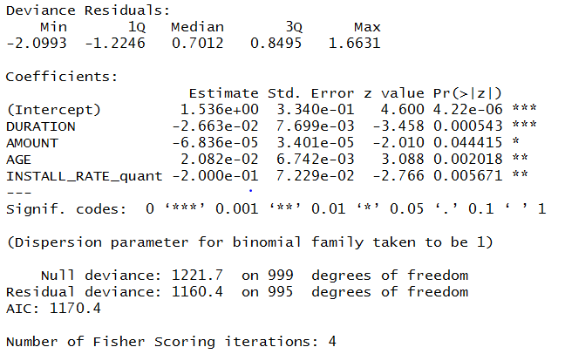
IIb Exploratory Data Analysis: Quantitative Variables
Logistic Regression Model (4 quantitative variables)
Notes:
Selected by graphical and computational Tools
In the codelist 6 variables were defined as numeric. Anyhow since 3 of these 6 were mostly ordinal variables with 4 or few categories, I decided to classify this 3 aswell as qualitative instead of quantitative vars.
So at the end only 3 covariates remained which I consider as real continuous covariates

Slide 10
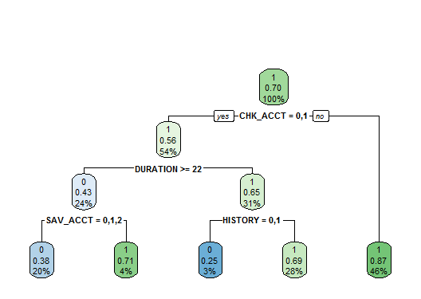
IIIa Modelling: Classification Tree

Slide 11
IIIa Modelling: Classification Tree
Notes:
Selected by graphical and computational Tools
In the codelist 6 variables were defined as numeric. Anyhow since 3 of these 6 were mostly ordinal variables with 4 or few categories, I decided to classify this 3 aswell as qualitative instead of quantitative vars.
So at the end only 3 covariates remained which I consider as real continuous covariates

Slide 12
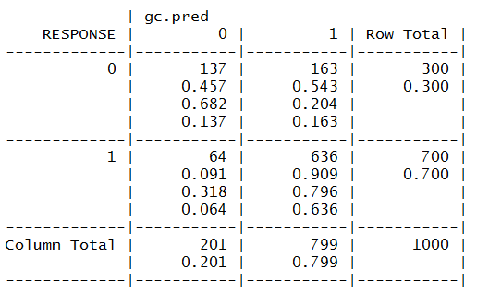
IIIa Modelling: Classification Tree Prediction Performance
True negative rate: 137/300 -> 45,7%
True positive rate: 636/700 -> 90,9%
-> Conclusion: CT Tree, besides its instability, is very good at which person got a good credit rating, but it’s not very good at predicting which one got a bad rating.
Notes:
So we can very well distinguish true positives and false negatives

Slide 13
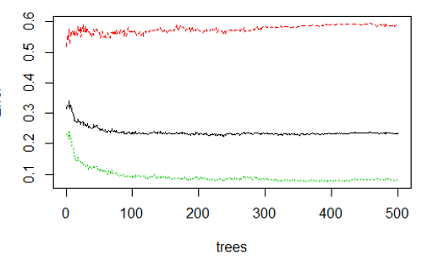
IIIb Modelling: Random Forest
Error rate in Dependance of the number of trees
Notes:
Error Rate in Dependance of the Number of trees
After around 30 trees the error keeps stable

Slide 14
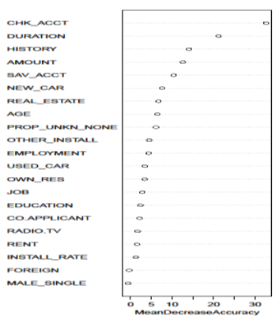
IIIb Modelling: Random Forest
Most important Variables
Notes:
The Random Forest supports our findings from the Classification Tree quite well. We can see that the same variables are important
We can see by the left graph, that MeanDecrease Accuracy is forced mainly by the 3 dominant Variables in the CT model, CHK_ACCT, DURATION, and History. Again CHK_ACCT points out to be the most influential coviariate as it was before in the Classification tree as it represented the first node.
CHK-ACCT, DURATION, HISTORY, AMOUNT, SAVE_ACCT
By the right graph we can see that Age and the employment affects the RESPONSE variable as well. So the RF weights the importance of these two variables a bit higher, otherwise for the classification the used Car variable was quite important. But for both model the core variables, CHEK ACC, DURATION, HISTORY AMOUNT and SAVE ACCOUNT stays the same, giving us robustness or both models and evidence that these are the most important variables to explain credit rating of a person.

Slide 15

III Modelling: Random Forest Prediction Performance
Similar Prediction Quality as the Classification Tree (besides that RT is more stable)
Performing slightly better in terms of true positive rate than the Classification Tree and slightly worse in terms of true negative rate
True negative rate: 137/300 -> 41,3% (CT: 45,7%)
True positive rate: 636/700 -> 91,9% (CT: 90,9%)

Slide 16
IV Conclusion
Most important and robust Variables according to both models Classification Tree and Random Forest:
CHK_ACCT (most important Variable!)
Further: DURATION, HISTORY, AMOUNT, SAVE_ACCT
Further important only in Classification Tree: USED_CAR
Further important only in Random Forest: AGE, EMPLOYMENT
Both Models are good in prediction if an applicant has a good credit rating
Not very precise in predicting applicants having a bad credit rating
Conclusion: One should emphasize especially on the Checking account status and one can further emphasize on variables like Credit Duration, Credit History, Credit Amount as well as on the purpose (Used_Car) and socio-economic variables as AGE and EMPLOYMENT in order to rate a Persons Credibility
Be aware of predicting bad rated applicants -> True negative rate of only 41%!
Notes:
So one should really emphasize on these few variables to find out if someone has a good credit rating or not
I think these 3 variables chk_accdt duration and history suit quite well the intuitive theoretical assumptions about the impact on the credit rating of a Person

