Slide 1
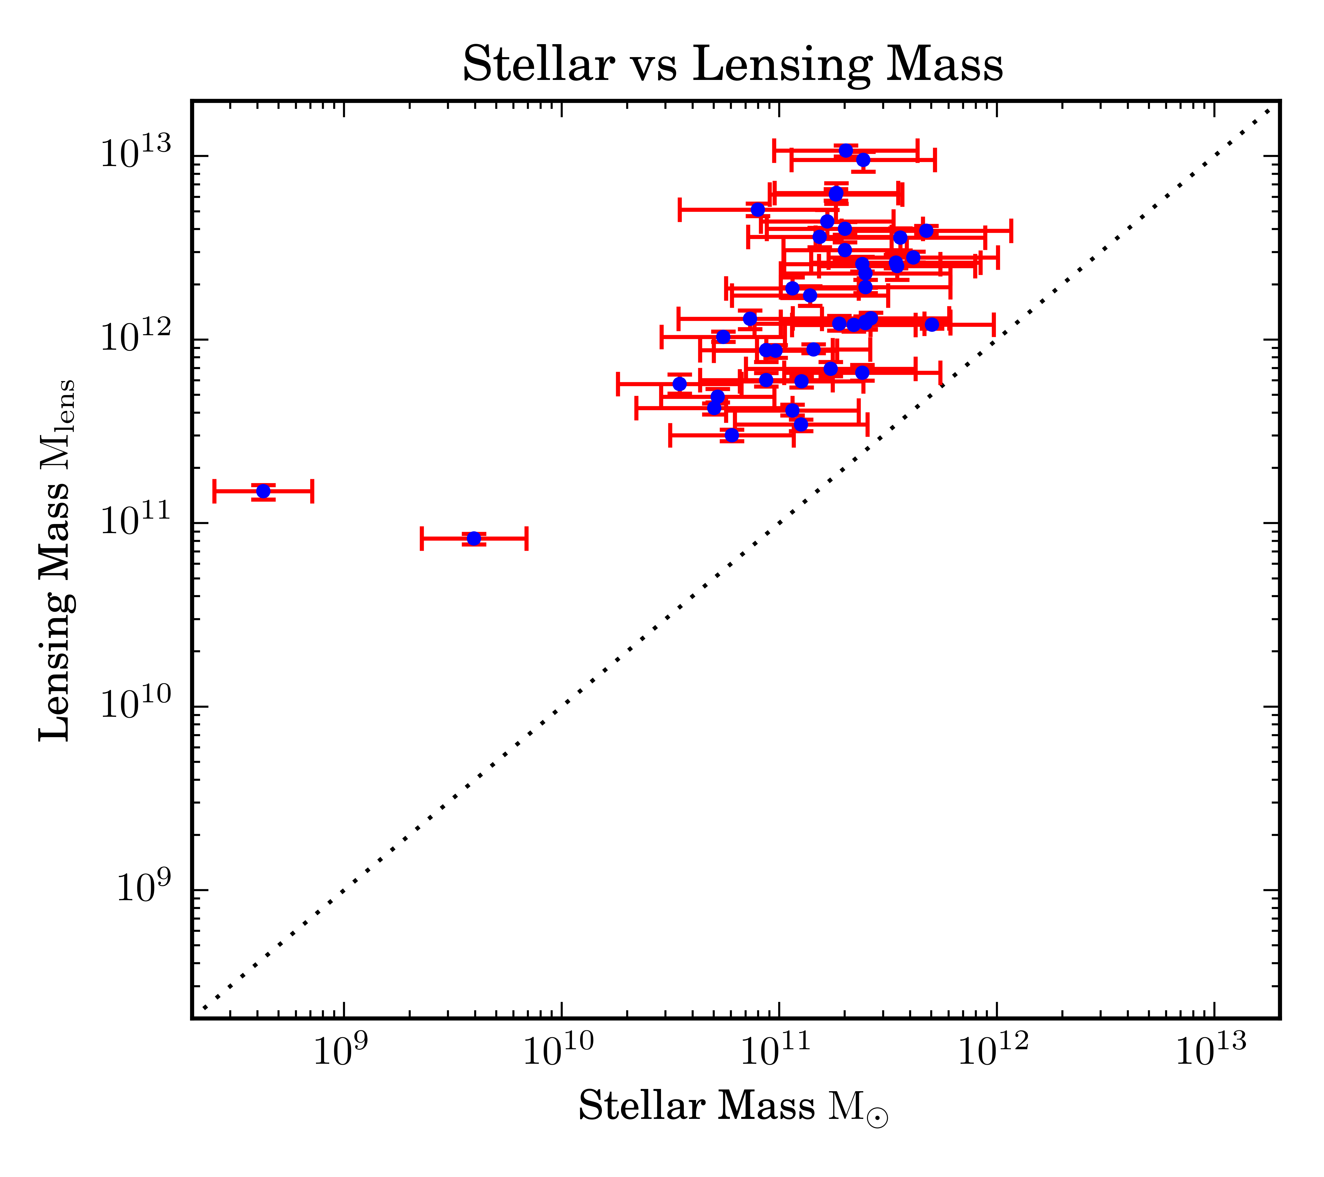
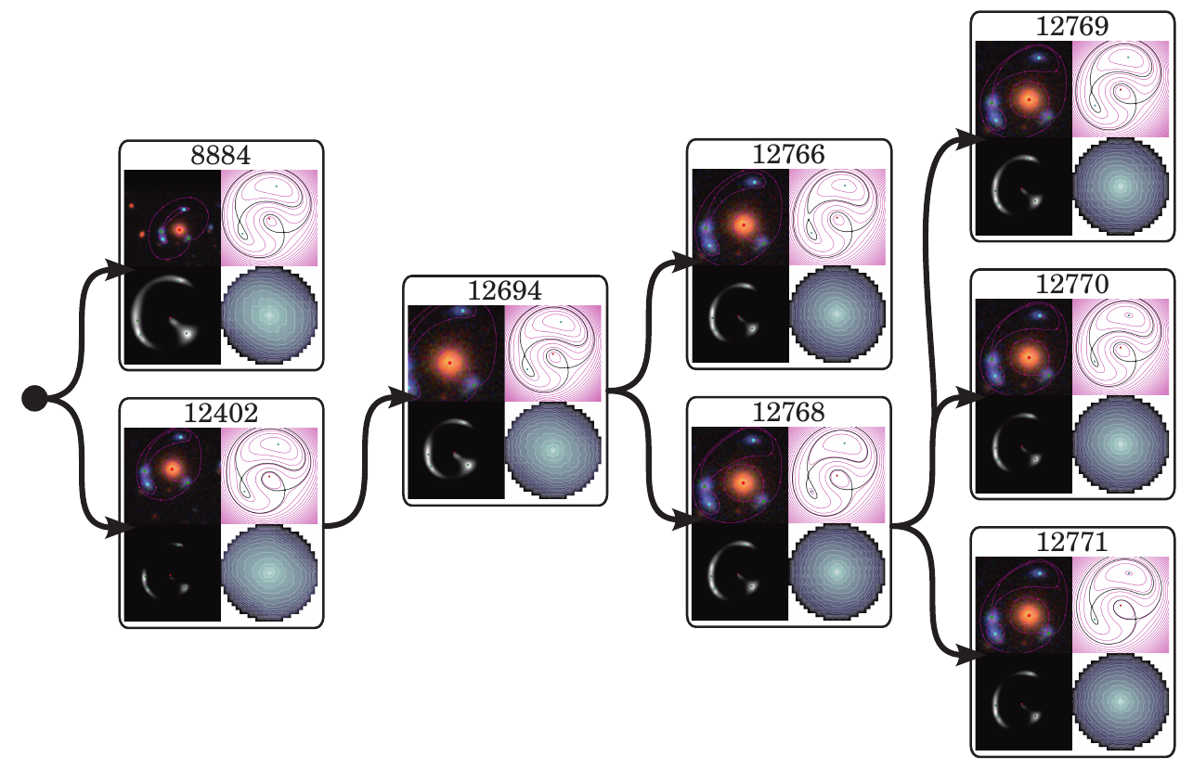
Lensing Galaxies in the CHFTLS
R. Küng et al.
SpaceWarps
  Citizen Science project identifying strong gravitational lenses
  First run: 59 new candidate lenses
SpaghettiLens
  Web based lens modelling
  Intuitive usage: sketch arrival time surface, direct visual feedback
Collaborative Modelling
  Volunteers create and revise models
  Leads to a tree of models
Preliminary Results
  Stellar mass faction of order 20 percent

