Slide 1
Medicine Shop Management System
Submitted By:
Rafi Md. Hasib 2016-3-60-064 Rezoanul Islam 2017-2-60-129 Raihan Muhammad Karmol Ruhani 2017-2-60-143
Submitted To: Dr. Mohammad Salah Uddin Assistant Professor, CSE Department East West University, Dhaka

Slide 2
Problem Description
> Searching medicine is time consuming
> A complexity with updated prices and products
> Product Storage is always complex
> Manual invoices
> Customer relation is quite impossible

Slide 3
Proposed Solution
> A time efficient and user friendly search where it shows rack number , product id
> Always up to date with prices and alternative products
> Products storage system made easy by adding storage file to our application
> Sufficient way to manage customer relation as we keep track of every customer
> Notify low stock for the medicines
> Notify about outdated medicine before 6 months of expire date of medicine
> Sales and purchase details storing
> Transaction details generation

Slide 4
Requirement Analysis
> Pharmacist can search medicines where the rack number is shown and describe the category such as tablets , syrups,capsules
> Pharmacist can search customers
> Pharmacist can sell medicines
> Pharmacist can generate invoice by selling products where total bill is shown by calculating per piece

Slide 5
Requirement Analysis
> Admin can add medicines to inventory
> Admin can edit medicines details
>Admin can add/delete pharmacist
> Admin can add/delete customer details
> Admin can view sales and transaction report of a certain period
> Admin can check out the low stock products
> Admin also can check out the soon to expire products

Slide 6
Feasibility study
We used html for creating web structure
Css for presenting
Javascript for programming
Mysql for database
PHP to connect and to run the scripts
A better way to maintain customer relation by storing customer details
A system where admins can view sales report and generate employee report
Search system made easier to to be less time consuming
Admin can keep track of low stock of product where they can take necessary step to minimize the issue
This application can store medicine by category tablet , syrup , capsule

Slide 7
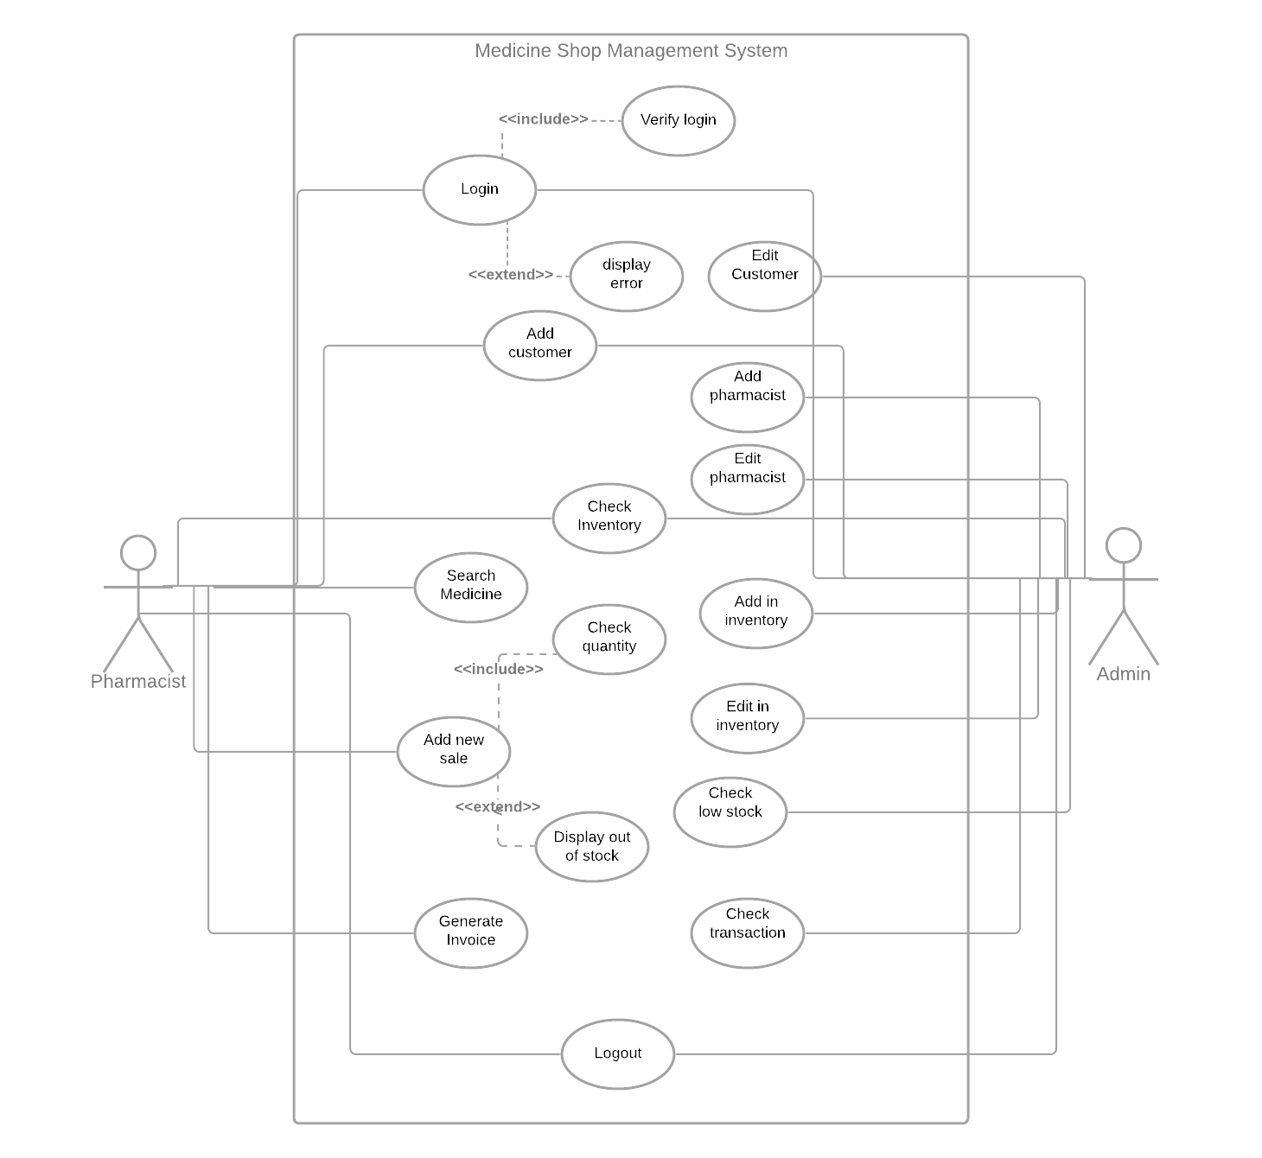
Use Case Diagram

Slide 8
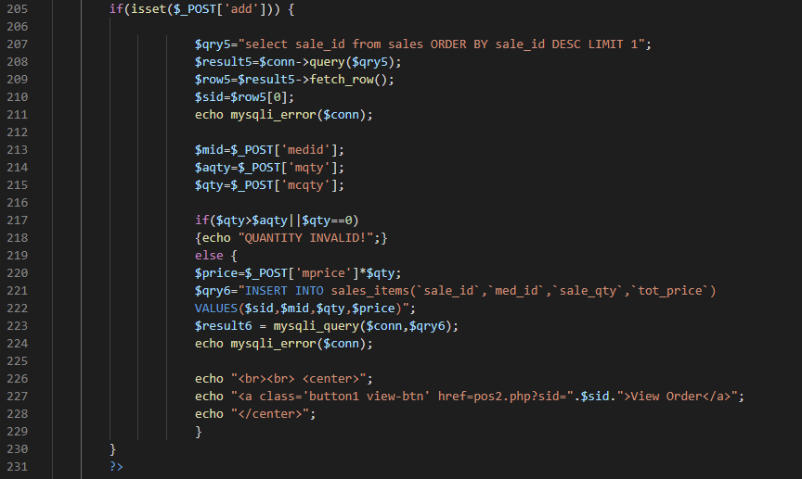
Test Case diagram (sale a product as Pharmacist)

Slide 9
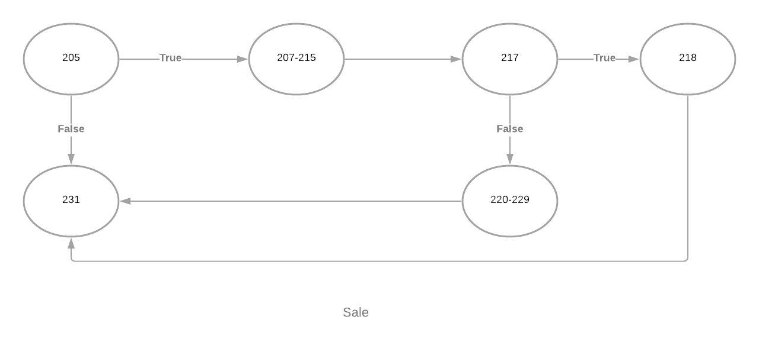
Control Flow Diagram for sale:

Slide 10
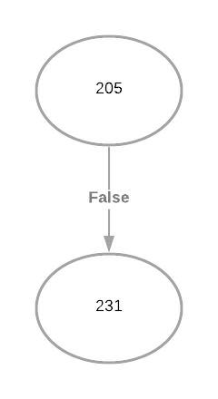
White box testing (all path coverage)
Isset ($_post {“add”} = False
$ qty = 10
$ aqty = 20

Slide 11
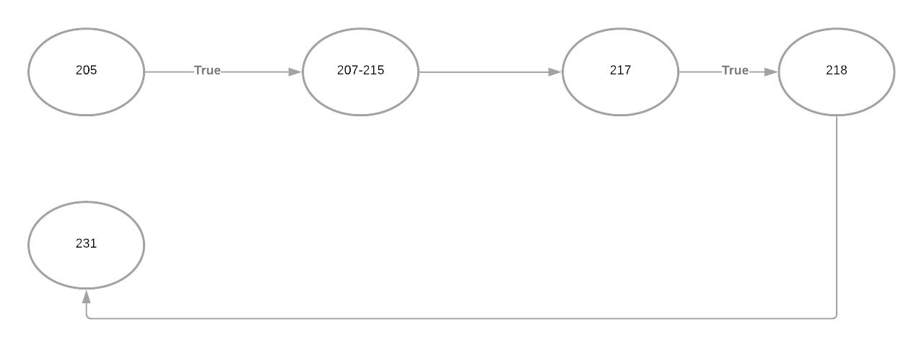
Isset ($_post {“add”} = True
$ qty = 0
$ aqty = 10

Slide 12
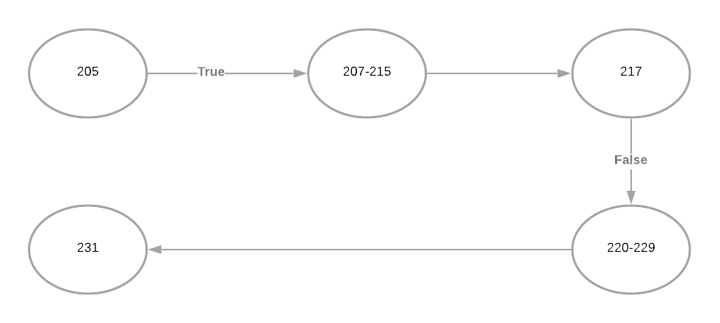
Isset ($_post [“add”] )= False
$ qty = 20
$ aqty = 30

Slide 13
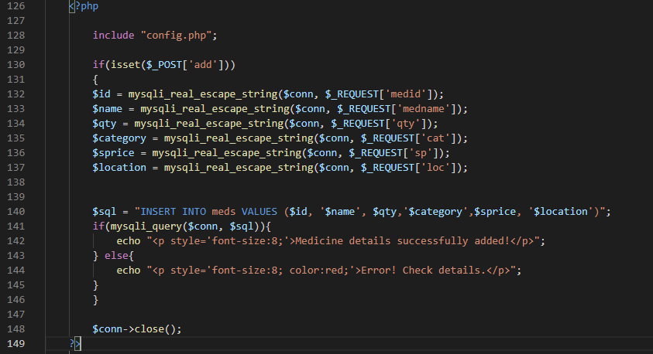
Test case diagram (add a medicine as Admin)

Slide 14
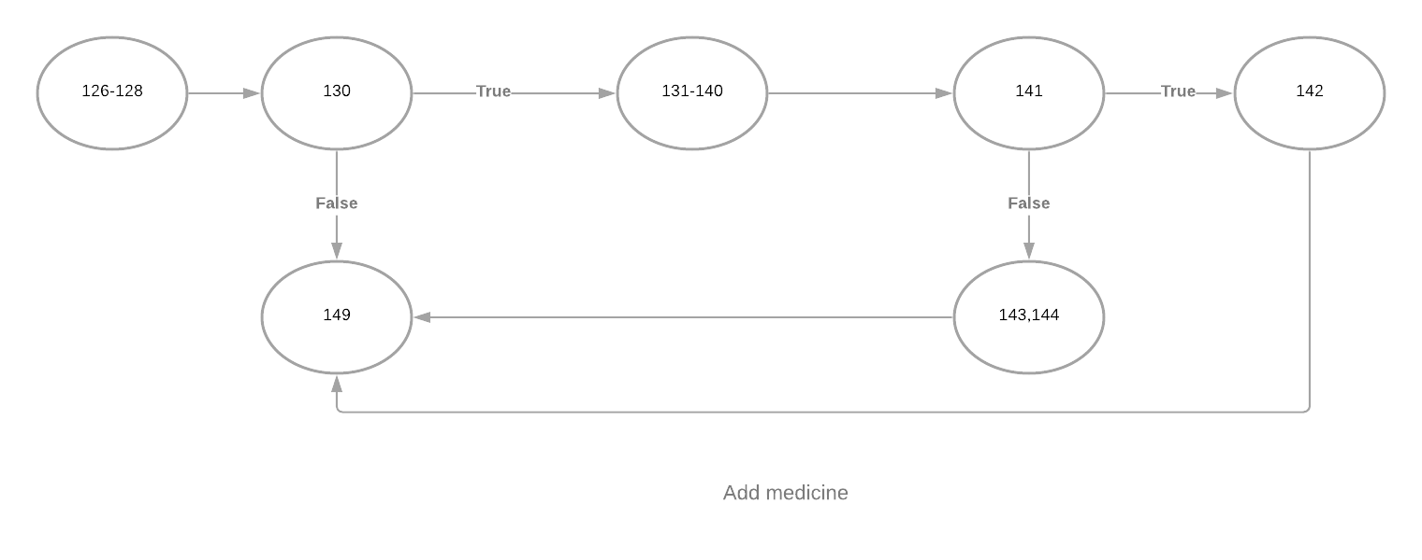
Control Flow Diagram for add a medicine to inventory

Slide 15
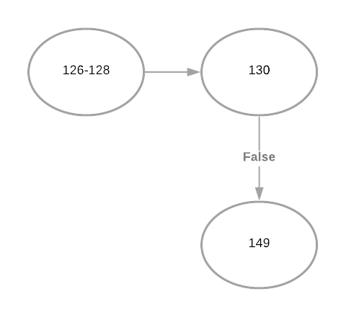
Isset ($_post['add'] = False
mysqli_query($conn,$sql) = True
White box testing (all path coverage)

Slide 16
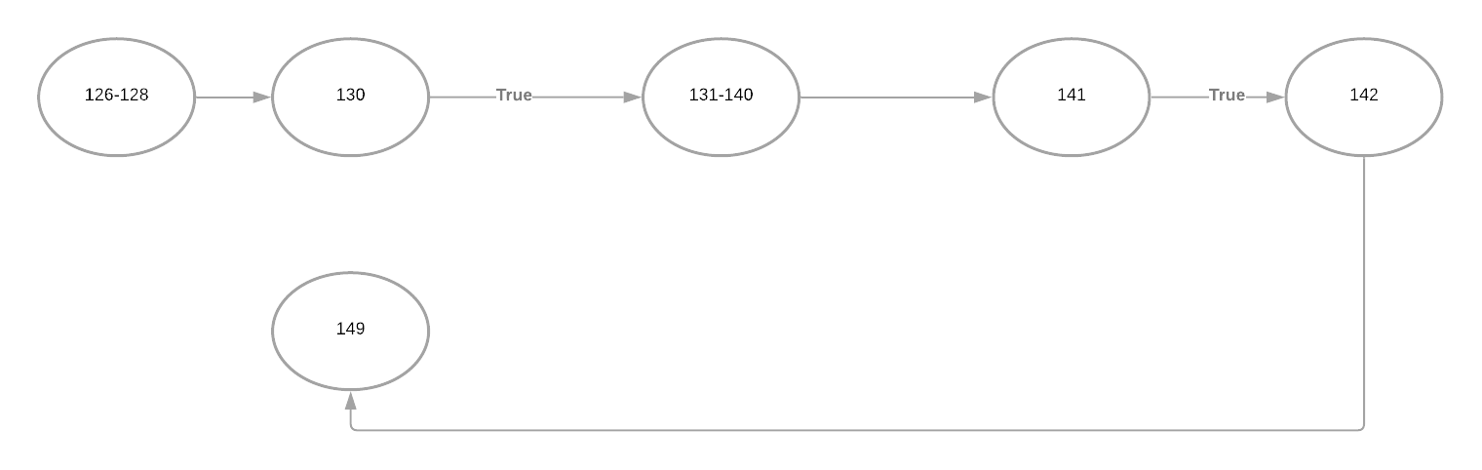
isset($_post['add'] = True
mysqli_query($conn,$sql) = True

Slide 17
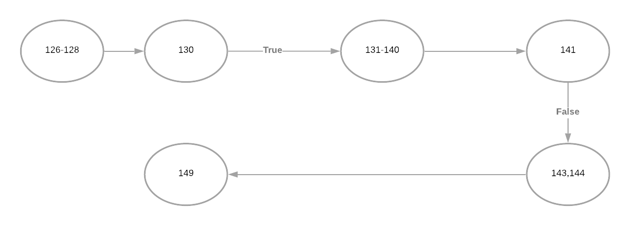
isset($_post['add'] = True
mysqli_query($conn,$sql) = False

Slide 18
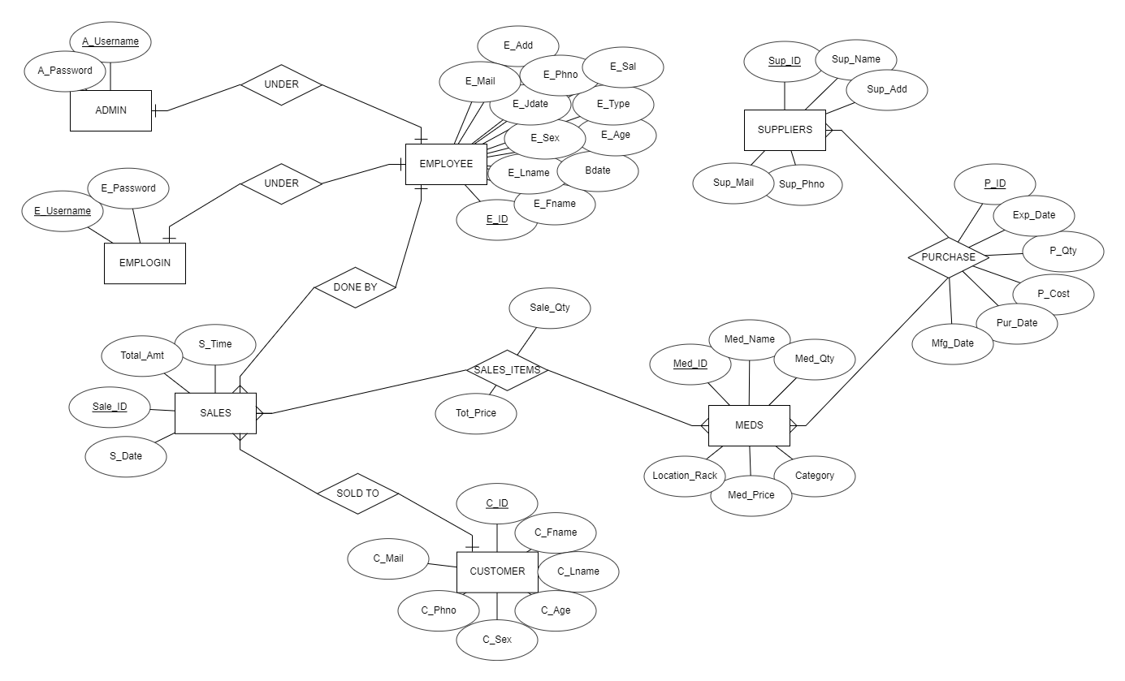
ER Diagram :

Slide 19
Thank You!

