Slide 1
Smart POS Software System
Complete Inventory, Purchase, Sales &
Return Management Solution
Notes:
This template can be used as a starter file to give updates for project milestones.
Sections
Right-click on a slide to add sections. Sections can help to organize your slides or facilitate collaboration between multiple authors.
Notes
Use the Notes section for delivery notes or to provide additional details for the audience. View these notes in Presentation View during your presentation.
Keep in mind the font size (important for accessibility, visibility, videotaping, and online production)
Coordinated colors
Pay particular attention to the graphs, charts, and text boxes.
Consider that attendees will print in black and white or grayscale. Run a test print to make sure your colors work when printed in pure black and white and grayscale.
Graphics, tables, and graphs
Keep it simple: If possible, use consistent, non-distracting styles and colors.
Label all graphs and tables.

Slide 2
It scholarship Consultant.
Md Moshaidul Islam
WDPF.IsDB-BISEW It scholarship Email: moshaidul@gmail.com
Supervisor & Coordinator.
Instructor: Farhana Akter Lucky WDPF.IsDB-BISEW It scholarship Email: farhanawdpf@gmail.com
Developed By.
Name : Rafia Akter
Trainee ID: 1288607 Batch: WDPF/NCLC-M/65/01 Email: rafiaakterbonna@gmail.com

Slide 3
Application
August 05, 2025 The Consultant WDPF, IDB-BISEW IDB Bhaban Sher-e-Bangla Nagar, Dhaka Subject: Project Proposal Letter for POS Management System
Dear Sir,
Thank you for giving me the opportunity to develop a real-life project based on our core course, Web Development with PHP and MySQL (WDPF). I am pleased to inform you that I have decided to work on a project titled "POS (Point of Sale) Management System", which is essential for modern businesses such as retail shops, pharmacies, and departmental stores.
This system will include modules for product management, stock control, purchase and sales, customer/vendor tracking, return handling, and reporting, offering a complete solution for small to mid-size businesses. I have studied its structure and requirements thoroughly and have prepared a detailed proposal for your kind consideration.
I hope you will kindly approve my proposed project and allow me to apply my technical knowledge and creativity to complete it successfully.
Sincerely, Rafia Akter Trainee ID: 1288607 Batch: WDPF/NCLC-M/65/01

Slide 4
Index of the project
Project Background and Objective ---------------------------------5
Software Features and Scope ----------------------------------- 6
FLOWCHART------------------------------------------------------7
ERD Diagram ------------------------------------------------------8
List of Report-------------------------------------------------------9
Project Demo View------------------------------------------------10
Project Dashboard ------------------------------------------------11
Project Demo Invoice---------------------------------------------12
Example of Invoice Report---------------------------------------13
Milestone/Timeline ----------------------------------------------14
Information Source & Reference--------------------------------15
Use Tools and Technol------------------------------------------- 16
Implementation Cost--------------------------------------------- 17

Slide 5
Objective :
To design and develop a Point of Sale (POS) Management System that simplifies and automates business operations such as sales, purchases, stock control, returns, and reporting using PHP and MySQL.
Purpose :
To provide an easy-to-use platform for managing daily transactions in shops or stores
To ensure accurate and real-time stock tracking for all products
To record customer and vendor activities for better business insights
To automate invoice generation and return processing
To generate daily, weekly, and monthly sales/purchase reports
To reduce manual errors and improve operational efficiency
To apply web development skills in a real-life business application

Slide 6
Software Features
Audit information system.
Flexible purchase and sales report.
Flexible dues calculation.
Product price life cycle report.
Sales analysis report.
Current stock and assets report of the shop
Online report system.
Repots with graphical view.
communicate by text and calling one to another user.
Auto backup Database.
Safe from Hacker and third parties.
Different login system
Controlling Access to perform specific task.
Control product by type, category and manufacture base.
Product Expired date notification.
Stock Management system.
Lot Base Product Stock.
FIFO and LIFO Sales system.
Multiple unit of measurement base sales.
Product price and discount system.
Tax control system.

Slide 7
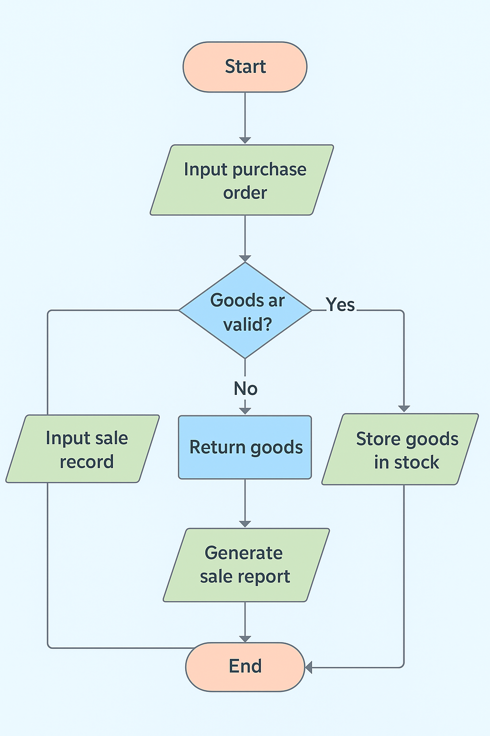
Smart POS Software System Flowchart

Slide 8
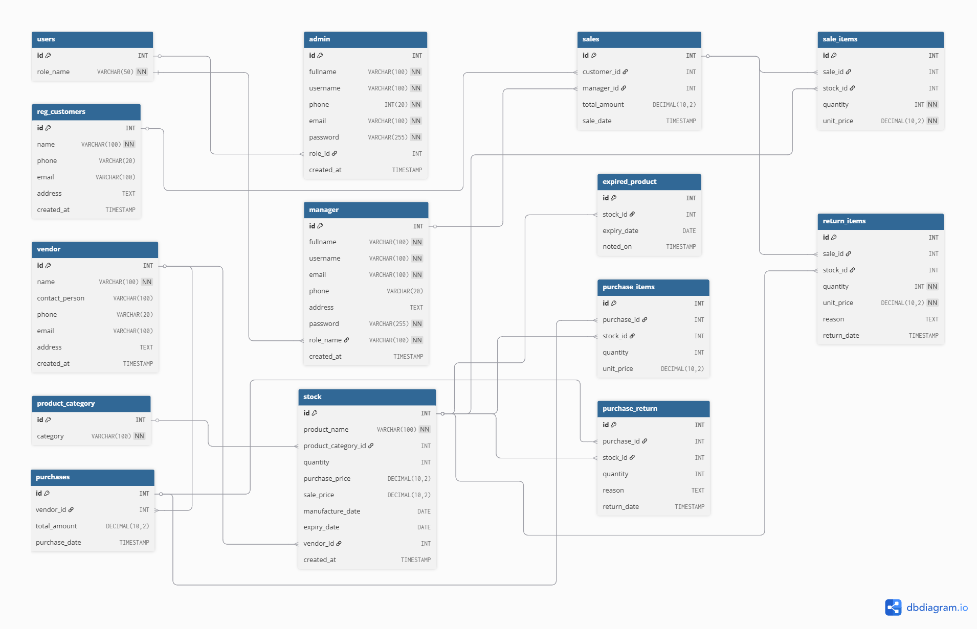
Smart POS Software System

Slide 9
List Of Reports
Designation Report
Employee Report
Product Type Report
Product Category Report
Purchase Report
Stock Report
Wastage Report
Expired Date Report
Sales Report
Profit and Benefit
Order Report
Received Report
User Report
Audit Report
Menu Form
Password Form

Slide 10
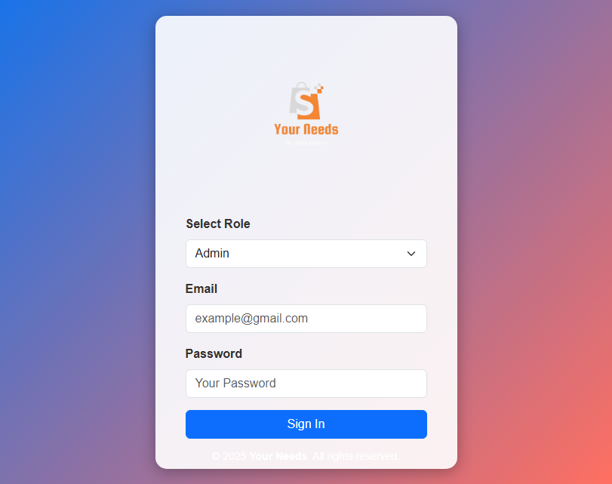
LOGIN PAGE :

Slide 11
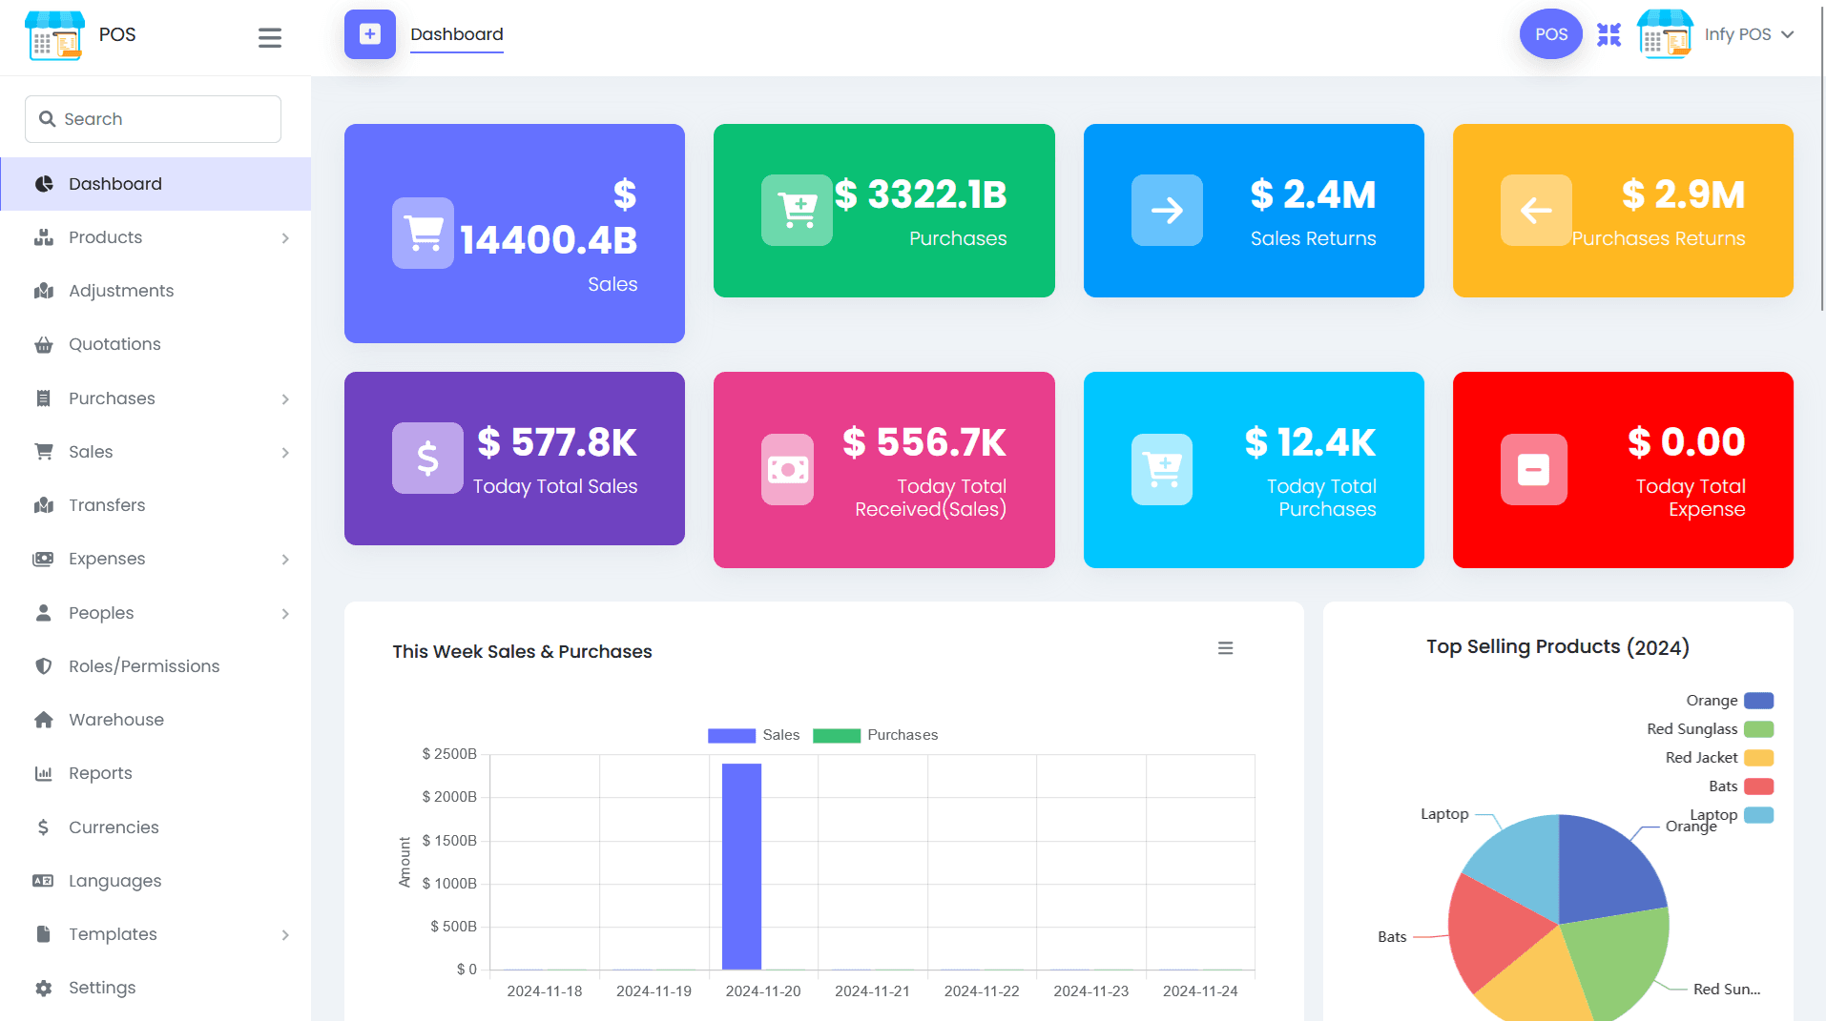
DASHBOARD DESIGN :

Slide 12
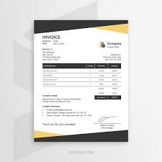
Sales Invoice :

Slide 13
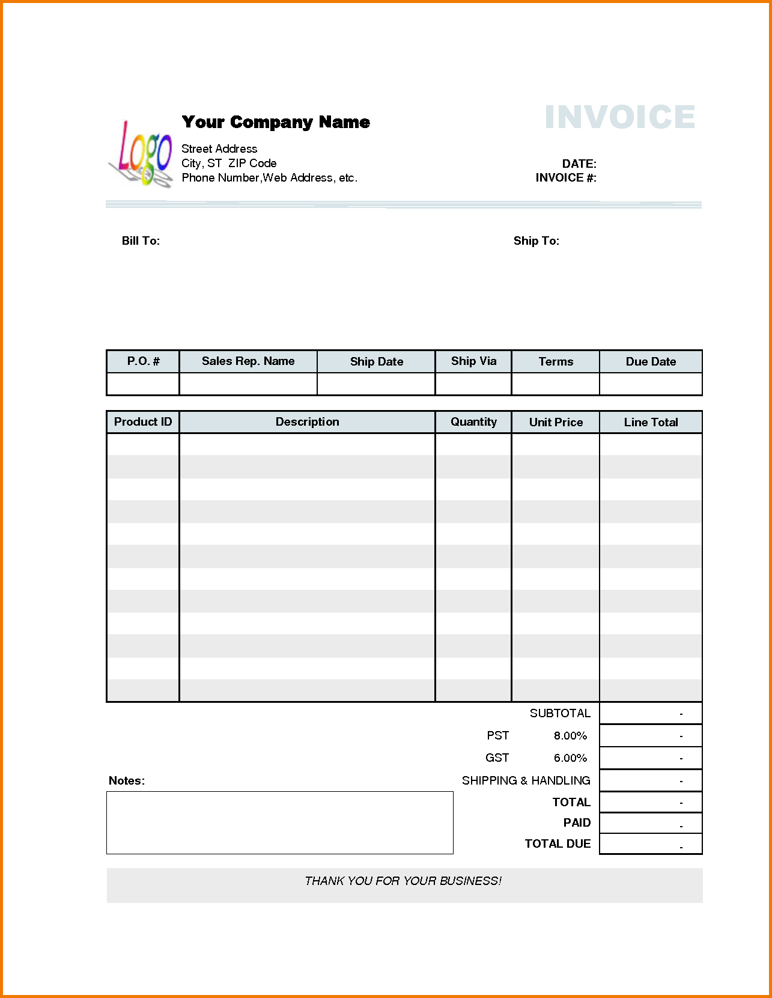
Example of Invoice Report

Slide 14
Milestone/Timeline
Milestone | Description | Duration | Day Range
📌 Planning & ERD Design | Requirements, feature list, ERD | 5 days | Day 1 – Day 5
🏗️ Database Setup | Tables, views, stored procedures, triggers | 6 days | Day 6 – Day 11
💻 Backend Development | PHP CRUD for core modules | 8 days | Day 12 – Day 19
🎨 Admin Panel Integration | AdminLTE setup, includes, role-based access | 6 days | Day 20 – Day 25
🛒 POS Functional Modules | Sales, purchase, return, invoices | 8 days | Day 26 – Day 33
📊 Reports & Dashboard | Reports, analytics, low stock, expiry alerts | 5 days | Day 34 – Day 38
🧪 Testing & Debugging | Functional & UI testing, bug fixing | 5 days | Day 39 – Day 43
🎓 Final Demo & Submission | Documentation, PPT, live demo | 5 days | Day 44 – Day 48

Slide 15
Information Source & Reference
PHP.Net
MySql.com
Vcampus
W3School
Income Tax Authority
Audit Information
Supply chain management
Stock Management
Bar Council
Ministry of Law
Wikipedia
Legal Aid

Slide 16
Use Of Tools And Technology
This is a web_based software and can be run either offline or online or both systems. It is based on frontend and backend system.
Frontend | Html 5, CSS3, Bootstrap, JavaScript
Back end | PHP, MYSQL
Server Software Configuration
Operating System | Windows 7 and higher
Language | PHP
Database | MYSQL

Slide 17
Implementation Cost
The implementation will cover the following areas:
Analysis of Super Shop management system.
Core coding of the application.
Database designing.
Frontend design.
Developing the business and database logic.
Module level unit testing.
Bug fixing and final release including server setup

Slide 18
Thanks For Watching

