Slide 1
POS MANAGEMENT SYSTEM
For Retails,
Department Store
WELCOME TO
MY
PROJECT PROPOSAL
Notes:
This template can be used as a starter file to give updates for project milestones.
Sections
Right-click on a slide to add sections. Sections can help to organize your slides or facilitate collaboration between multiple authors.
Notes
Use the Notes section for delivery notes or to provide additional details for the audience. View these notes in Presentation View during your presentation.
Keep in mind the font size (important for accessibility, visibility, videotaping, and online production)
Coordinated colors
Pay particular attention to the graphs, charts, and text boxes.
Consider that attendees will print in black and white or grayscale. Run a test print to make sure your colors work when printed in pure black and white and grayscale.
Graphics, tables, and graphs
Keep it simple: If possible, use consistent, non-distracting styles and colors.
Label all graphs and tables.

Slide 2
it scholarship Consultant.
Md Moshaidul Islam
WDPF.idb-bisew it scholarship Email: moshaidul@gmail.com
idul@gmail.com
Supervisor & Coordinator.
Instructor: Farhana Akter Lucky WDPF.idb-bisew it scholarship Email: farhanawdpf@gmail.com
Developed By.
Name : Rafia Akter
Trainee ID: 1288607 Batch: WDPF/NCLC-M/62/01 Email: rafiaakterbonna@gmail.com

Slide 3
Application
Jan 05, 2025, The Consultant WDPF, IDB-BISEW IDB Bhaban Sher-e-Bangla Nagar, Dhaka. Subject: Project proposal letter for POS Management System Dear Sir, Thank you for offering me a great opportunity to make a real-life project based on our core course that is Web Development with PHP and MySQL(PWAD). In this respect, I would like to inform you that I have decided to make a project on library Management System, which is most importance for every office communities. I have studied about the various aspects of this system and make a proposal accordingly which is enclosed herewith for your kind perusal. So, I think you will finally Approved the project and help to utilize my creativity. Sincerely, Rafia Akter, Trainee ID:1288607 Batch: PWAD/NCLC-M/62/01

Slide 4
Index of the project
Project Background and Objective ---------------------------------5
Software Features and Scope ----------------------------------- 6
FLOWCHART------------------------------------------------------7
ERD Diagram ------------------------------------------------------8
List of Report-------------------------------------------------------9
Project Demo View------------------------------------------------10
Project Dashboard ------------------------------------------------11
Project Demo Invoice---------------------------------------------12
Example of Invoice Report---------------------------------------13
Milestone/Timeline ----------------------------------------------14
Information Source & Reference--------------------------------15
Use Tools and Technol------------------------------------------- 16
Implementation Cost--------------------------------------------- 17

Slide 5
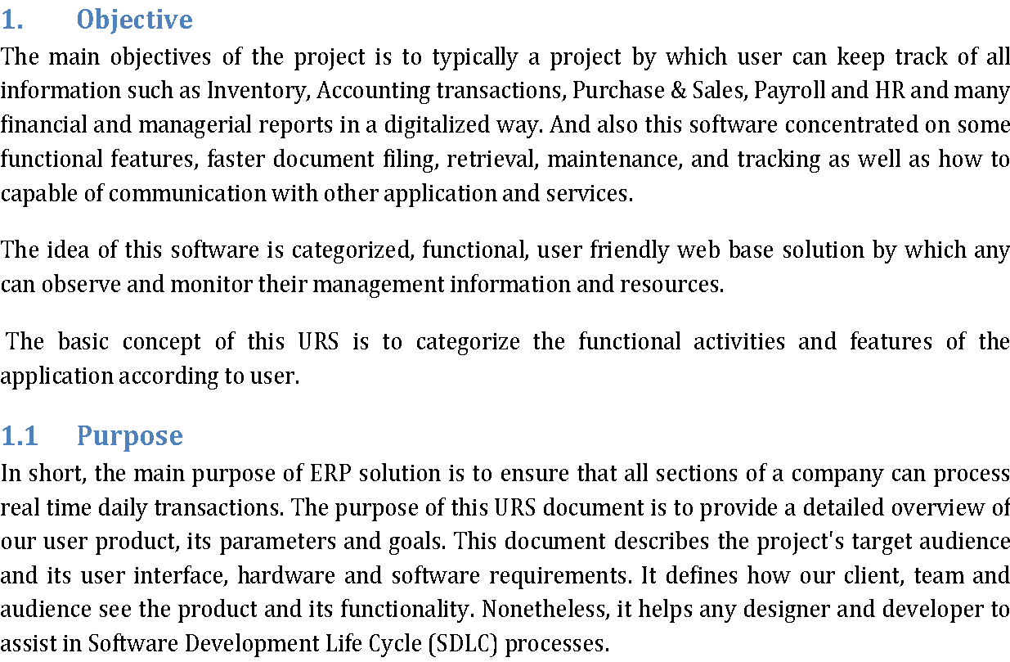

Slide 6
Software Features
Audit information system.
Flexible purchase and sales report.
Flexible dues calculation.
Product price life cycle report.
Sales analysis report.
Current stock and assets report of the shop
Online report system.
Repots with graphical view.
communicate by text and calling one to another user.
Auto backup Database.
Safe from Hacker and third parties.
Different login system
Controlling Access to perform specific task.
Control product by type, category and manufacture base.
Product Expired date notification.
Stock Management system.
Lot Base Product Stock.
FIFO and LIFO Sales system.
Multiple unit of measurement base sales.
Product price and discount system.
Tax control system.

Slide 7
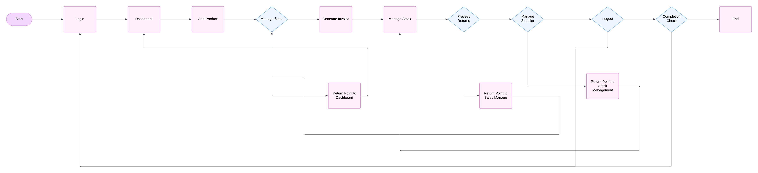
POS management System flow chart

Slide 8
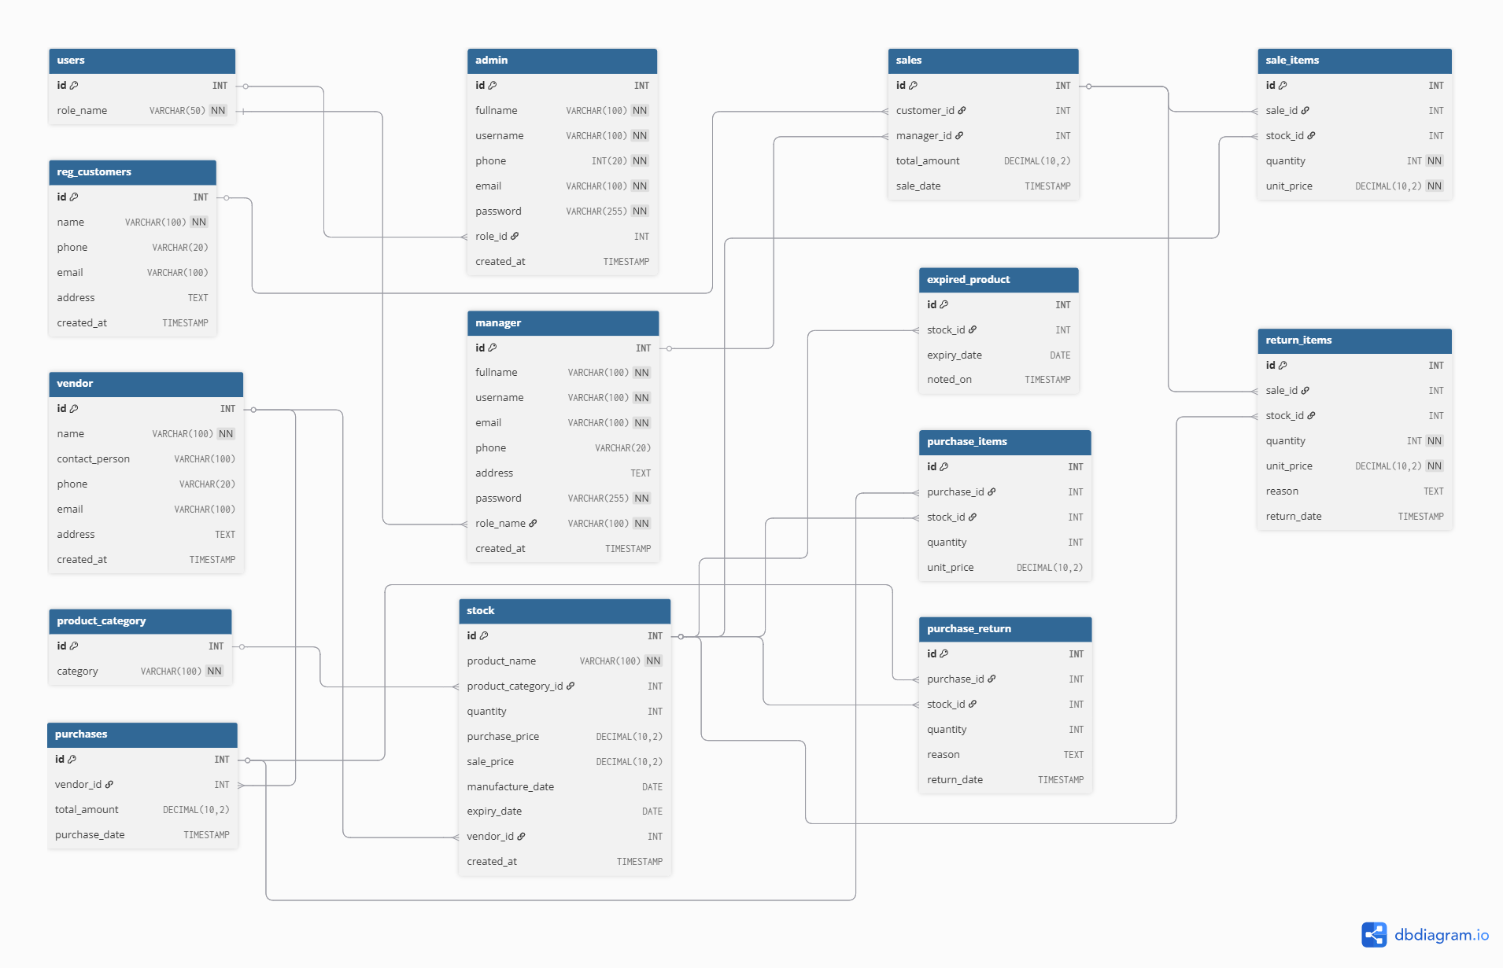
ERD – Pos Management system -

Slide 9
List Of Reports
Designation Report
Employee Report
Product Type Report
Product Category Report
Purchase Report
Stock Report
Wastage Report
Expired Date Report
Sales Report
Profit and Benefit
Order Report
Received Report
User Report
Audit Report
Menu Form
Password Form

Slide 10
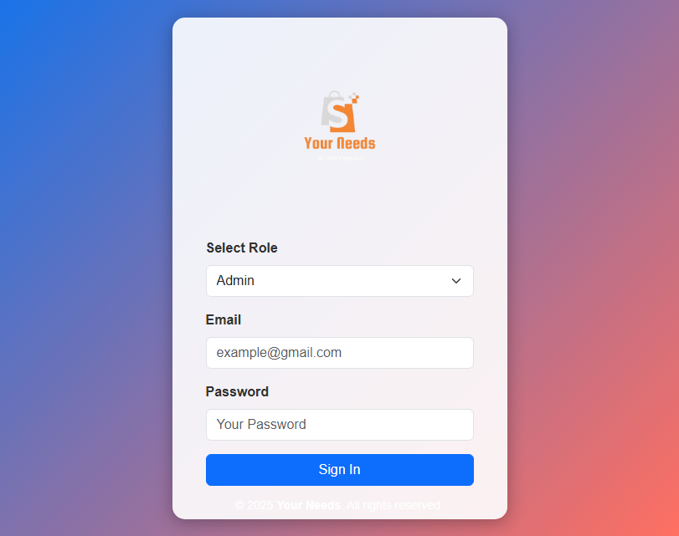
LOGIN PAGE :

Slide 11
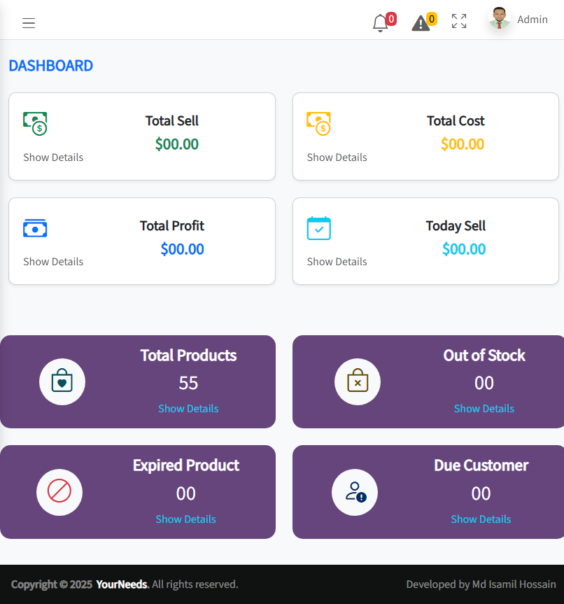
DASHBOARD DESIGN :

Slide 12
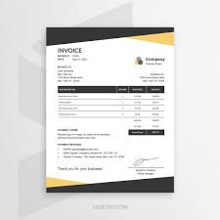
Sales Invoice :

Slide 13
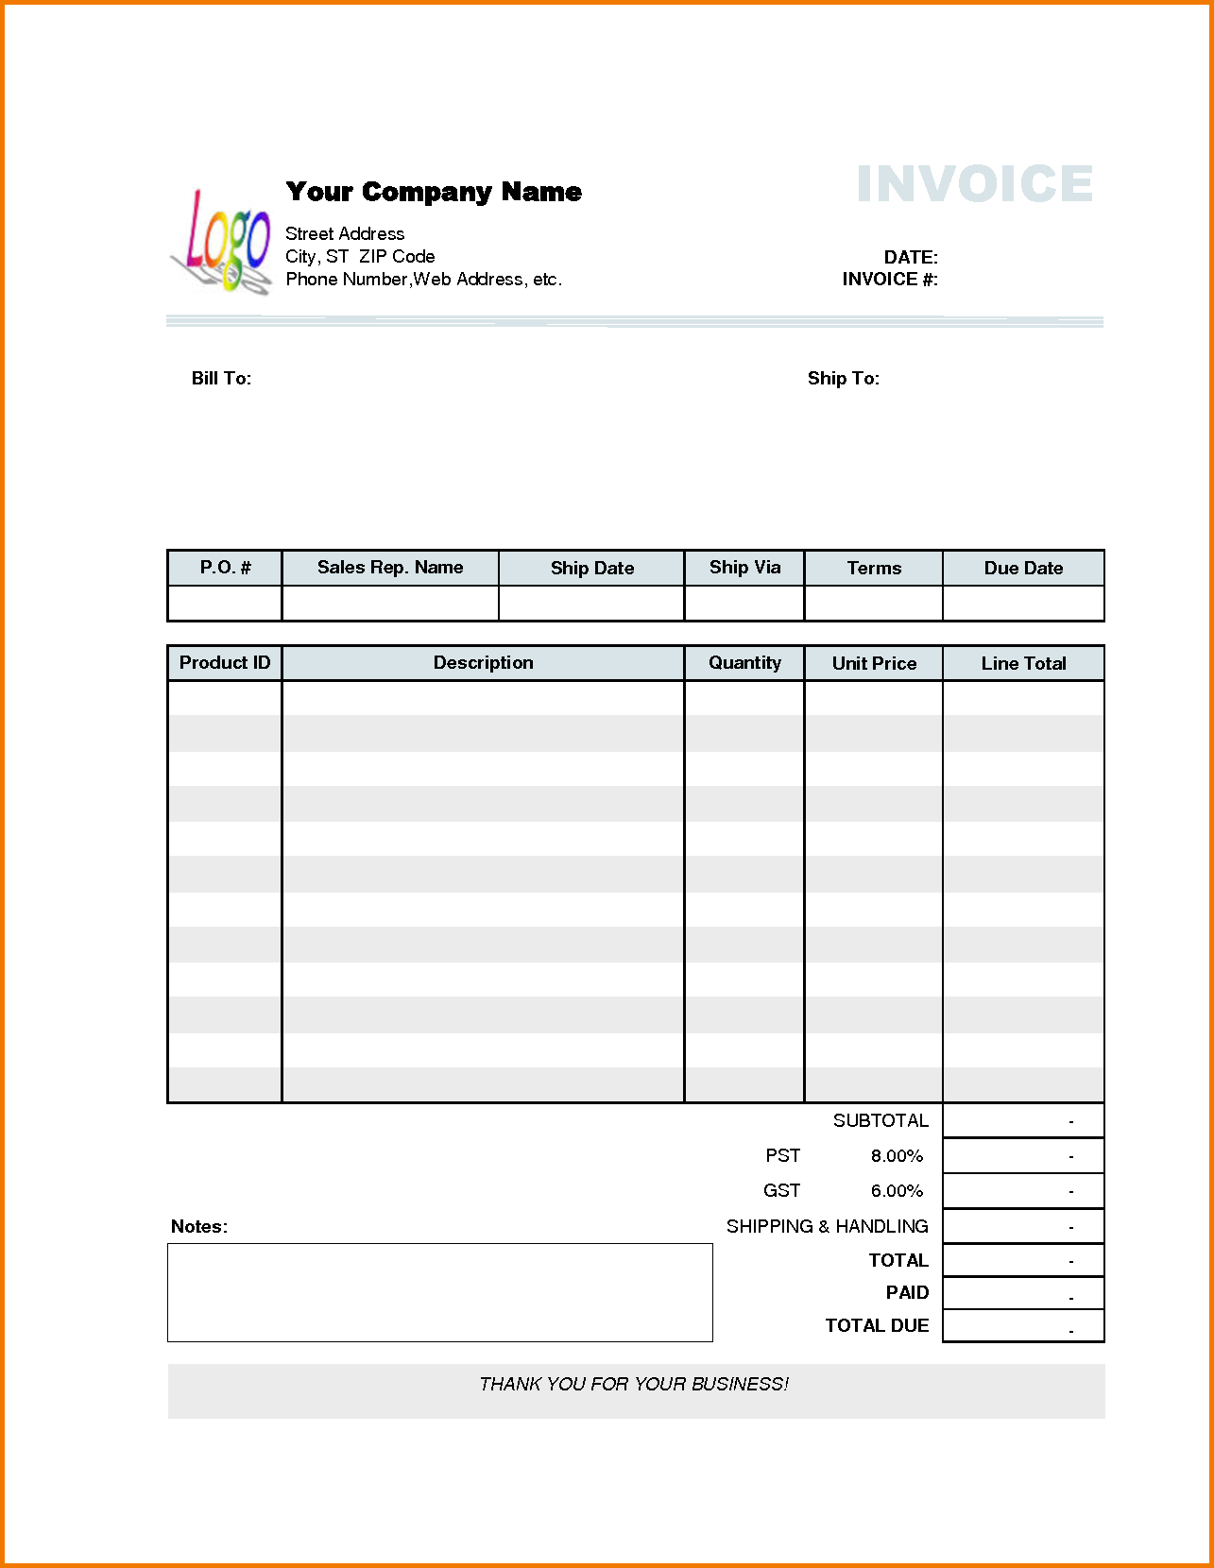
Example of Invoice Report

Slide 14
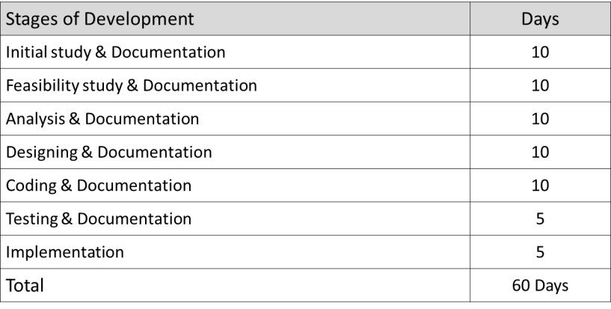
Milestone/Timeline

Slide 15
Information Source & Reference
PHP.Net
MySql.com
Vcampus
W3School
Income Tax Authority
Audit Information
Supply chain management
Stock Management
Bar Council
Ministry of Law
Wikipedia
Legal Aid

Slide 16
Use Of Tools And Technology
This is a web based software and can be run either offline or online or both systems. It is based on frontend and backend system.
Frontend | Html 5, CSS3, Bootstrap, JavaScript
Back end | PHP, MYSQL
Server Software Configuration
Operating System | Windows 7 and higher
Language | PHP
Database | MYSQL

Slide 17
Implementation Cost
The implementation will cover the following areas:
Analysis of Super Shop management system.
Core coding of the application.
Database designing.
Frontend design.
Developing the business and database logic.
Module level unit testing.
Bug fixing and final release including server setup

Slide 18
Thanks For Watching

