Slide 1
Component/Unit Testing
Software Testing Process

Slide 2
Unit testing
The most ‘micro’ scale of testing.
Tests done on particular functions or code modules.
Requires knowledge of the internal program design and code.
Done by Programmers (not by testers).

Slide 3
Unit testing
Objectives | To test the function of a program or unit of code such as a program or module To test internal logic To verify internal design To test path & conditions coverage To test exception conditions & error handling
When | After modules are coded
Input | Internal Application Design Test Plan Unit Test Schedule
Output | Unit defect log Test Report

Slide 4
Who | Developer
Methods | White Box testing techniques Test Coverage techniques
Tools | Debug Re-structure Code Analyzers Path/statement coverage tools
Education | Testing Methodology Effective use of tools

Slide 5
INTEGRATION Testing
Software Testing Process

Slide 6
Integration Testing
Continuous testing of an application as and when a new functionality is added.
Application’s functionality aspects are required to be independent enough to work separately before completion of development.
Focus on interfaces
Might be interface problem although components work when tested in isolation
Might be possible to perform new tests

Slide 7
Integration Testing
Testing of combined parts of an application to determine their functional correctness.
‘Parts’ can be
code modules
individual applications
client/server applications on a network.

Slide 8
Integration Testing Types
Strategies
Bottom-up, start from bottom and add one at a time
Top-down, start from top and add one at a time
Big-bang, everything at once
Functional, order based on execution

Slide 9
Integration Testing
Objectives | To technically verify proper interfacing between modules, and within sub-systems
When | After modules are unit tested
Input | Internal & External Application Design Test Plan Integration Test Schedule
Output | Integration Test Defect log & Report

Slide 10
Who | Tester
Methods | White and Black Box techniques Problem / Configuration Management
Tools | Debug Re-structure Code Analyzers
Education | Testing Methodology Effective use of tools

Slide 11
SYSTEM Testing
Software Testing Process

Slide 12
System Testing
Testing of groups of components integrated to create a system or sub-system;
The responsibility of an independent testing team;
Tests are based on a system specification.

Slide 13
System Testing
Functional testing
Test end to end functionality
Requirement focus
Test cases derived from specification
Use-case focus
Test selection based on user profile

Slide 14
System Testing
Non-functional testing
Quality attributes
Performance, can the system handle required throughput?
Reliability, obtain confidence that system is reliable
Timeliness, testing whether the individual tasks meet their specified deadlines
etc.

Slide 15
System Testing
Objectives | To verify that the system components perform control functions To perform inter-system test To demonstrate that the system performs both functionally and operationally as specified To perform appropriate types of tests relating to Transaction Flow, Installation, Reliability, Regression etc.
When | After Integration Testing
Input | Detailed Requirements & External Application Design Test Plan System Test Schedule
Output | System Test Report

Slide 16
Who | Tester
Methods | Black box/white box Problem / Configuration Management
Tools | RFT(Rational Functional Tester Wtir Selenium Test complete
Education | Testing Methodology Effective use of tools

Slide 17
ACCEPTANCE Testing
Software Testing Process

Slide 18
Acceptance Testing
User (or customer) involved
Environment as close to field use as possible
Focus on:
Building confidence
Compliance with defined acceptance criteria in the contract

Slide 19
Acceptance Testing
Objectives | To verify that the system meets the user requirements
When | After System Testing
Input | Business Needs & Detailed Requirements Master Test Plan User Acceptance Test Plan
Output | User Acceptance Test report

Slide 20
Who | Users / End Users
Methods | Black Box techniques Problem / Configuration Management
Tools | Compare, keystroke capture & playback, regression testing
Education | Testing Methodology Effective use of tools Product knowledge Business Release Strategy

Slide 21
REGRESSION Testing
Software Testing Process

Slide 22
Re-Test and Regression Testing
Conducted after a change
Re-test aims to verify whether a fault is removed
Re-run the test that revealed the fault
Regression test aims to verify whether new faults are introduced
How can we test modified or newly inserted programs?
Ignore old test suites and make new ones from the scratch or
Reuse old test suites and reduce the number of new test suites as many as possible
Should preferably be automated

Slide 23
Who | System Testers
Methods | White and Black Box techniques Problem / Configuration Management
Tools | Recommended set of tools for system and integrations testing
Education | Testing Methodology Effective use of tools

Slide 24
AN Overview on software quality & TESTING III
CSE
Department of
Computer
Science
&
Engineering
CSC445/CSE451 Software Engineering
CSC/SEN545: Software Engineering Concepts
Lecture 10

Slide 25
TESTING METHODOLOGIES AND TYPES

Slide 26
Testing methodologies **Black box testing
**White box testing

Slide 27
Black box testing
No knowledge of internal design or code required.
Tests are based on requirements and functionality
White box testing
Knowledge of the internal program design and code required.
Tests are based on coverage of code statements,branches,paths,conditions.

Slide 28
Black Box - testing technique
Incorrect or missing functions
Interface errors
Errors in data structures or external database access
Performance errors
Initialization and termination errors

Slide 29
Black box / Functional testing
Based on requirements and functionality
Not based on any knowledge of internal
design or code
Covers all combined parts of a system
Tests are data driven

Slide 30
White box testing / Structural testing
Based on knowledge of internal logic of an
application's code
Based on coverage of code statements,
branches, paths, conditions
Tests are logic driven

Slide 31
White Box - testing technique
All independent paths within a module have been exercised at least once
Exercise all logical decisions on their true and false sides
Execute all loops at their boundaries and within their operational bounds
Exercise internal data structures to ensure their validity

Slide 32
Some other White Box Techniques
Statement Coverage – execute all statements at least once
Decision Coverage – execute each decision direction at least once
Condition Coverage – execute each decision with all possible outcomes at least once
Decision / Condition coverage – execute all possible combinations of condition outcomes in each decision.
Multiple condition Coverage – Invokes each point of entry at least once.
Examples ……

Slide 33
Testing Level to Strategy Mapping
Testing Levels/ Techniques | White Box | Black Box
Unit Testing | X
Integration Testing | X
System Testing |  | X
Acceptance Testing |  | X

Slide 34
What Must be Included?
Introduction
Goal
Scope
Test Spec
Test Plan
Unit Test
Integration Test
System Test
Acceptance Test
(If in scope)
Test Procedure

Slide 35
The Test Plan
The Test Plan
who
what
when
where
how

Slide 36
Test Plan Considerations
What are the critical or most complex modules?
make sure they get integration tested first
probably deserve white-box attention
Where have you had problems in the past?
Third-Party delivered components?
What training is required?
conducting formal reviews
use of testing tools
defect report logging

Slide 37
Test Plan Contents (IEEE 829 format-tailored )
Introduction
Test Items
Features to be Tested
Features not to be Tested
Approach
Item Pass/Fail Criteria
Suspension Criteria and Resumption Requirements
Test Deliverables
Environmental Needs
Staffing and Training Needs
Responsibilities
Schedule
Planning Risks and Contingencies
Approvals
Glossary
http://en.wikipedia.org/wiki/Test_Plan

Slide 38
Test Plan Specification Major Items
Introduction
Project Name
Project Lead
Project Manager
Test Manager
Test Project Task
Test case design
Test personal(Only for manual tests)
Documentation Review
Project Overview
Defect tracking and reporting system

Slide 39
Test Plan Specification Major Items
2. Testing Outline
Item to be tested
Item Not to be tested
Standards/Reference material
Test Environment
System Requirements
Hardware Interface Requirements
Software Interface Requirements
Communication Interface Requirements

Slide 40
Test Plan Specification Major Items
E. Test Environment/System Requirements
Hardware Interface Requirements
Software Interface Requirements
Communication Interface Requirements
ID # | Hardware Component | Requirement | Reference / Location
 | DMZ Server (for Public Interface / Web Server) | 2 CPU, 4 GB Memory
2. | Internal Box (Service API, DB & Others) | 2 CPU, 4GB Memory, 300 GB storage
ID # | Software Component | Requirement | Reference / Location
 | Java Development Kit (JDK) | JDK 1.7
2. | Database Server | MySQL 5.5
3. | Web Server | Glassfish 3.1
ID # | Communication Requirement
 | Windows Internet Explorer for Admin GUI

Slide 41
Test Plan Specification Major Items
3 . Testing Scope
Unit , Functional , Integration , Performance , Load etc
4. Test Schedule and Resources
Major Avidities Schedule
Activities | Start Date | End Date | Responsible | Deliverables
Ensure Test Environment | - | 15/05/2012 | Kazi Mahmudul Hasan | Test Server
Test plan | 10/04/2012 | 12/04/2012 | Mohammad Salim Morshed | Test Plan
Test Cases Design | 12/04/2012 | 09/05/2012 | Mohammad Salim Morshed | Test Cases
Identify Additional testers | - | 14/04/2012 | Kazi Mahmudul Hasan / Mohammad Salim Morshed
Testing Conducted (1st cycle + 2nd cycle + system testing + bug fixing of all cycle ) | 15/05/2012 | 30/07/2012 | 1.Mohammad Salim Morshed 2.Sohel Barua | Test Report

Slide 42
Test Plan Specification Major Items
5. Test Phases and Completion Criteria
Before testing any features / module developers will must finish unit testing
Integration, system, load testing will be done for the features of every delivered testable components in each first cycle testing.
Any blocker issue for a feature will be taken care of immediately before testing the next one.
The testing of the modules will be completed when the defects are fixed and re-tested.
The severity of found defects will be assessed and the priorities on resolving them will be set by collaborating with the developer(s), project managers and the system analyst on this.
The criteria that must be fulfilled before each cycle of testing can be considered are:
The Blocker, Critical, Major issues and Minor issues will be fixed.
The Known issues (if any) will be listed and notified to clients in release notes.

Slide 43
Test Plan Specification Major Items
5. Issues and Risks
Identify issues that have yet to be decided as of this draft of the plan. Note these as risks to the schedule, scope, or quality of the test effort.
Identify other risks that may have an impact on the success of the plan.
Some Example of Risk and Issues
The feedback (issue fixing/not fixing) from developers on Test and defect report needs to be well communicated. If not, testing schedule may be hampered.
Bug fixing and retesting part needs to be very interactive and well communicated among developers and testers. Otherwise there is risk to ensure bug density minimization.
If planned/allocated resources are not available the functional test, retest and regression test may hamper.

Slide 44
Test Case
What is Test Case
Test case is set of activities with expected and actual results executed in sequence to validate the feature of an application. Test case is the document and is designed by the tester based on the SRS document and Use case document.
Why we write test cases?
The basic objective of writing test cases is to validate the testing coverage of the application. If you are working in any CMMi company then you will strictly follow test cases standards. So writing test cases brings some sort of standardization and minimizes the ad-hoc approach in testing.

Slide 45
Test Case -How to write test cases?
First understand the requirements & while writing test cases do not assume any requirements by your own.
Prior to design the test cases figure out all features of application.
Ensure that test case should cover all functionality mention in requirement document.
Avoid repetition of test cases which help to get exact scope of testing.
Generic test cases should be collected & combine together in test suite, which helps to minimize the effort of writing standard common test cases every time
Testing Priority should be assign to each test case. Select the Test case priority depending upon how important the test case is for that Feature, component or the product.
While writing test cases Keep in mind all your test cases should be simple and easy to understand. Don’t write explanations like essays. Be to the point.
Keep in mind input data for test cases is very important part in testing, your test cases should validate range of input data. Also check how system behaves in the normal & abnormal conditions.
Every test case may or may not have defect linked but each defect should have test case linked.

Slide 46
Test Case
What should be format of test case?
The test case template may vary from company to company, but the standard test case format should have the following components:
Test case id – (Unique Identifier)
Test case Title – (Short description of test case & should be effective to convey the test case)
Pre-condition/Test data – (Any pre-requisite required to execute the test case)
Test Steps – (Actual step to be followed or executed)
Excepted Result – (Result which is expected as a normal behavior)
Actual result – (Result which we actually get after we execute the test step)
Test Case Status(Pass/Fail)
Data used/input data
Comments – (Additional Comments or any note required to while executing test case or special note to tester which need to be consider)

Slide 47
What is a defect?
Defect Management
A defect is any non-fulfilment of a product requirement related to an intended or specified use. (All non-fulfilment found by internal reviewer, external reviewer and customer).
Testing activities & Reviewing activities are called “Quality Control activities” (QC activities)
Reviewing activities include: Document review ; code review; other review, acceptance review.
Testing activities include: Unit test, integration test, System test, Other test ,Acceptance test.
Defect can be also known as Bug

Slide 48
What should be done after a defect is found?
Defect Management
The defect is logged into Defect management tool ( Menual excel or automated tool ).
The defect needs to be communicated and assigned to developers that can fix it.
After the defect is resolved, fixes should be re-tested, and determinations made regarding requirements for regression testing to check that fixes didn’t create defects elsewhere.

Slide 49
What is defect management
Defect Management
It is journey of a defect cycle, which a defect goes through during its lifetime and got managed . It varies from organization to organization and also from project to project as it is governed by the software testing process and also depends upon the tools used .
Some Defect Management tools
Bugzilla
JIRA
DMS
Rational Quality Manager(RQM)
Rational Clear Quest (RCQ)
http://www.aptest.com/bugtrack.html
http://www.softwaretestinghelp.com/popular-bug-tracking-software/

Slide 50
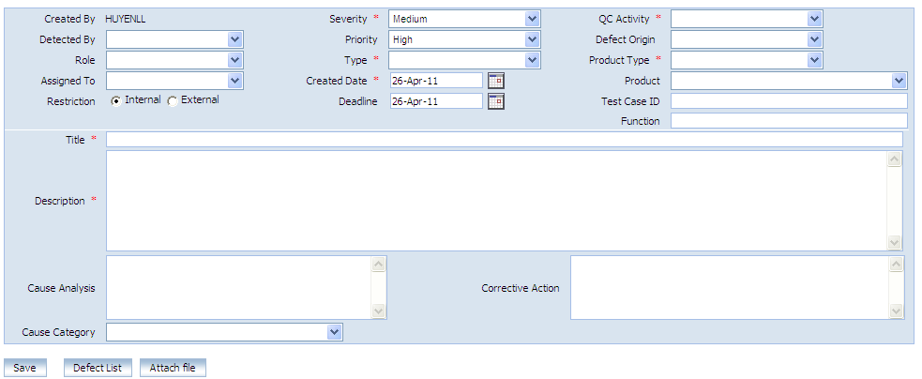
Defect information
Defect Management
The defect information includes Severity, Type, Description…. as below image

Slide 51
What is defect Life cycle
Defect Management
Defect life cycle is a cycle which a defect goes through during its lifetime. It starts when defect is found and ends when a defect is closed, after ensuring it’s not reproduced. Defect life cycle is related to the bug found during testing.
The bug has different states in the Life Cycle. The Life cycle of the bug can be shown diagrammatically as follows

Slide 52
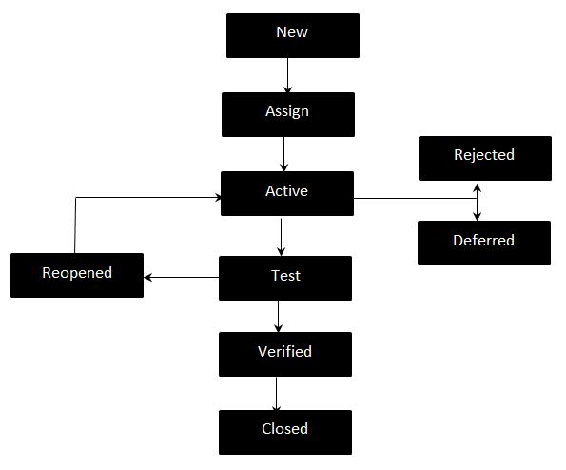
Defect Management
.
The bug has different states in the Life Cycle. The Life cycle of the bug can be shown diagrammatically as follows

Slide 53
Defect Management
.Defect Life Cycle States:
New - Potential defect that is raised and yet to be validated.
Assigned - Assigned against a development team to address it but not yet resolved.
Active - The Defect is being addressed by the developer and investigation is under progress. At this stage there are two possible outcomes; - Deferred or Rejected.
Test - The Defect is fixed and ready for testing.
Verified - The Defect that is retested and the test has been verified by QC.
Closed - The final state of the defect that can be closed after the QC retesting or can be closed if the defect is duplicate or considered as NOT a defect.
Reopened - When the defect is NOT fixed, QC reopens/reactivates the defect.
Deferred - When a defect cannot be addressed in that particular cycle it is deferred to future release.
Rejected - A defect can be rejected for any of the 3 reasons; - duplicate defect, NOT a Defect, Non Reproducible

Slide 54
Testing Types

Slide 55
Functional testing
Black box type testing geared to functional requirements of an application.
Done by testers.
System testing
Black box type testing that is based on overall requirements specifications; covering all combined parts of the system.
End-to-end testing
Similar to system testing; involves testing of a complete application environment in a situation that mimics real-world use.

Slide 56
Sanity testing
Initial effort to determine if a new software version is performing well enough to accept it for a major testing effort.
Regression testing
Re-testing after fixes or modifications of the software or its environment.

Slide 57
Acceptance testing
Final testing based on specifications of the end-user or customer
Load testing
Testing an application under heavy loads.
Eg. Testing of a web site under a range of loads to determine, when the system response time degraded or fails.

Slide 58
Stress Testing
Testing under unusually heavy loads, heavy repetition of certain actions or inputs, input of large numerical values, large complex queries to a database etc.
Term often used interchangeably with ‘load’ and ‘performance’ testing.
Performance testing
Testing how well an application complies to performance requirements.

Slide 59
Install/uninstall testing
Testing of full, partial or upgrade install/uninstall process.
Recovery testing
Testing how well a system recovers from crashes, HW failures or other problems.
Compatibility testing
Testing how well software performs in a particular HW/SW/OS/NW environment.

Slide 60
Alpha testing
Testing done when development is nearing
completion; minor design changes may still be made as a result of such testing.
Beta-testing
Testing when development and testing are essentially completed and final bugs and problems need to be found before release.

