Slide 1
Database Management CSE303

Slide 2
Student Performance monitoring system Group-4
Group Members
Misbahur Rashid – 1721911
Rafid Al Ahsan – 1722006
Md.Musfiqur Rahaman – 1721684
Sadia Afroz Alma - 1730407
Md.Sakimuzzaman – 1721527
Puja Bhowmik – 1730791
Elan Md Taseen - 1831050

Slide 3
Introduction
The Student Performance Monitoring System (SPMS) focuses on performance monitoring of student’s continuous assessment and examination scores in order to predict their final achievement status upon graduation.
The main goal of this project is to find the systemic problems and limitation we have in our current system in few areas and how can we improve it. The aim of our project is to design, build and deliver a developed software that we believe will help universities everywhere to promote a more productive and effective way of evaluating students. The faculties can input the COs for each of their students so that the system can map the COs to PLO accordingly. We also analyze individual processes that take place under the current system of monitoring student performance and the concerns and problems with those process from start to finish.

Slide 4
Project analysis slide 2
Database Management
Rich Picture
ERD & Relational Schema
Project
Six Element Analysis
Normalization
Process Diagram
Data Dictionary

Slide 5
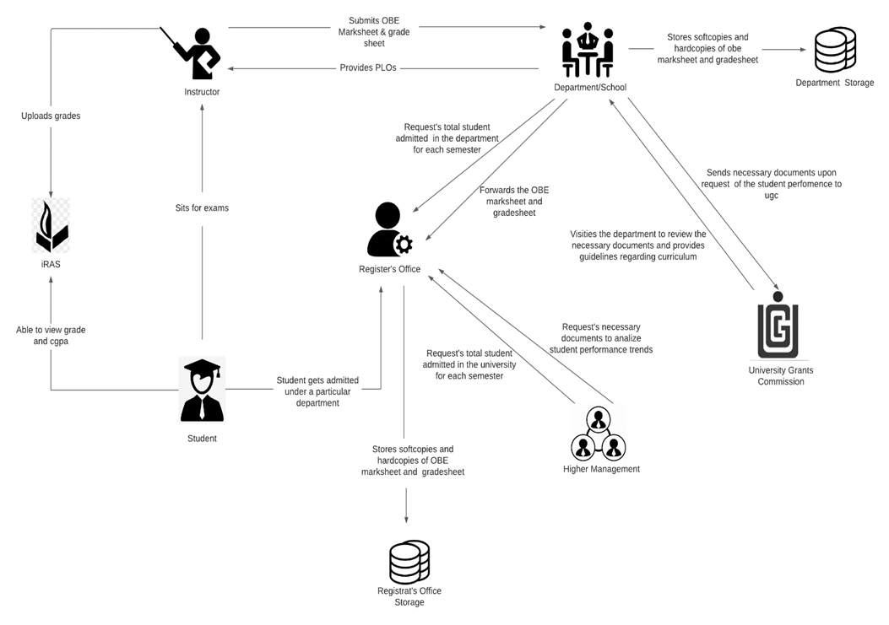
RICH PICTURE(AS-IS)

Slide 6
SIX ELEMENT(AS-IS)
Student sits for exam
Student are able to view grades, cgpa and download transcript
Instructors uploads grades to iras
Instructors produce OBE marksheet and grades sheet and submits it to the department
Map Course Outcomes (COs) to Program Learning Outcomes(PLOs)
Student gets admitted under a particular department
Request for review and change of grades
View Records OBE Marksheets and Course Assessment Reports

Slide 7
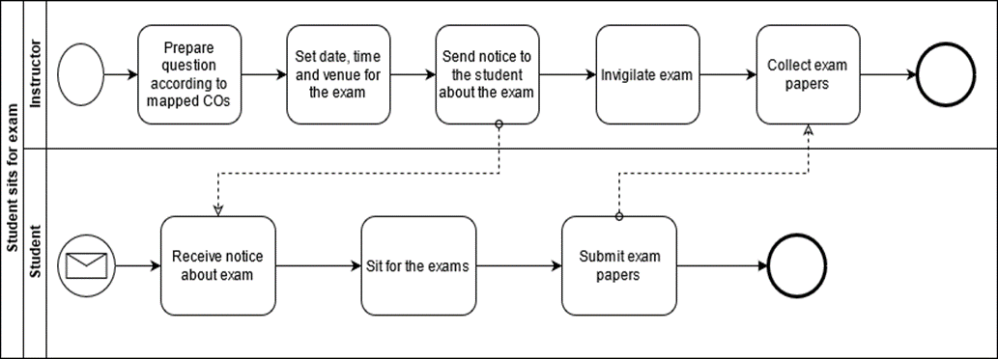
PROCESS DIAGRAM(AS-IS)
FIGURE 2.1 Process Diagram for Student Sits for exam

Slide 8
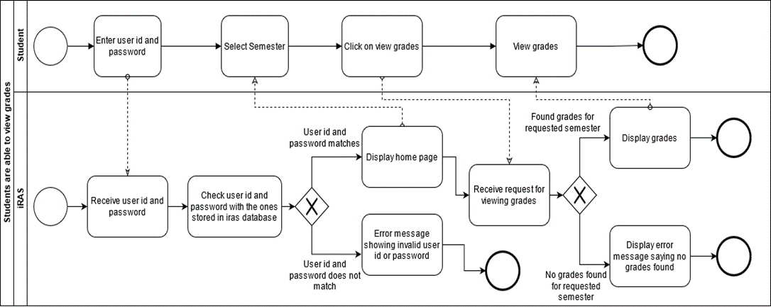
FIGURE 2.2 Process Diagram for Student are able to view grades and CGPA

Slide 9
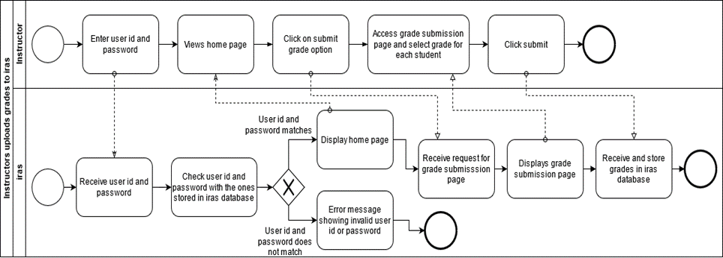
FIGURE 2.3 Process Diagram for Instructor uploading grade to iras

Slide 10
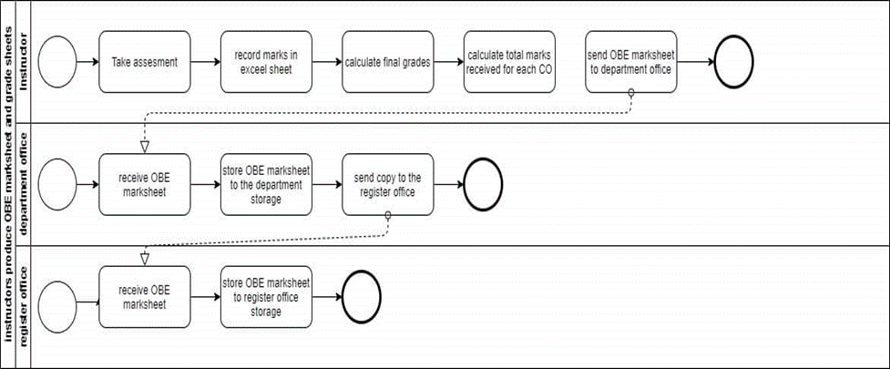
FIGURE 2.4 Process Diagram for Instructor produces OBE marksheet

Slide 11
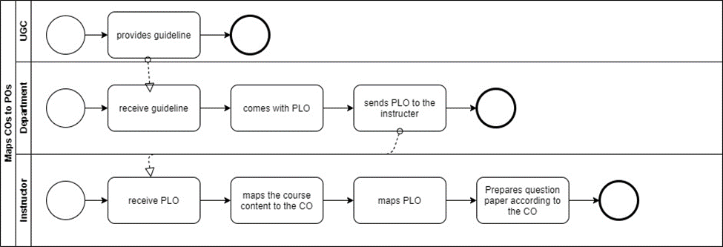
FIGURE 2.5 Process Diagram for Map COs and POs

Slide 12
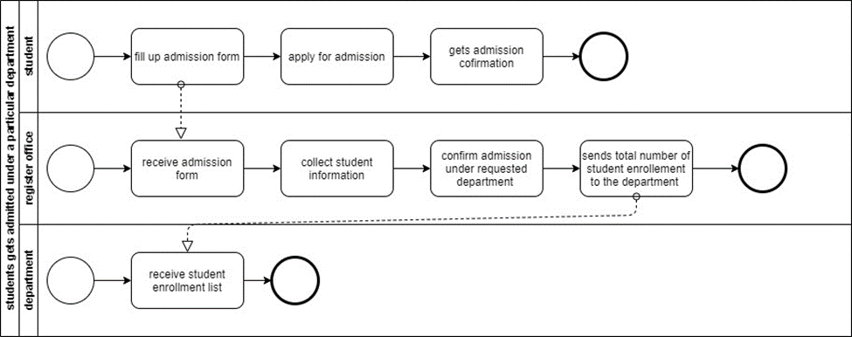
FIGURE 2.6 Process Diagram for Student gets admitted under particular department

Slide 13
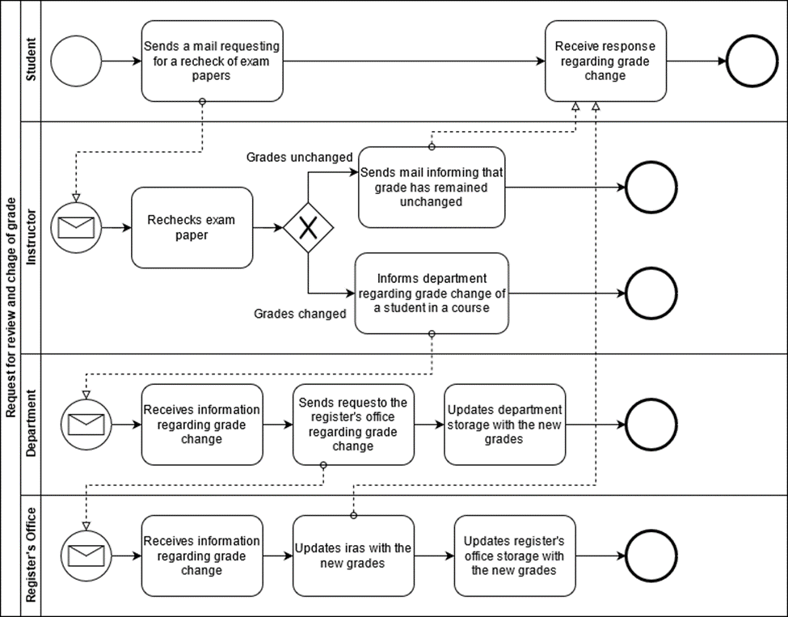
FIGURE 2.7 Process Diagram for request for review and change of grades

Slide 14
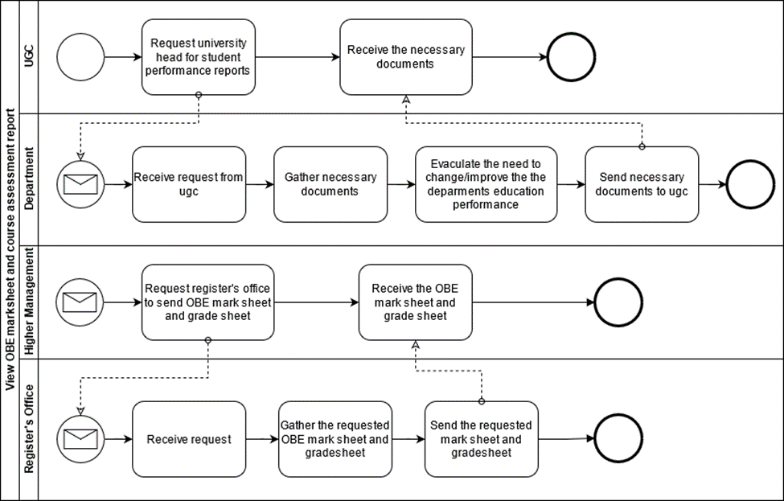
FIGURE 2.8 Process Diagram for view obe marksheet and course assessment report

Slide 15
Problem Analysis
Preparing a Course Assessment
Higher Management Viewing Individual Instructor Performance
Instructor viewing the CGPA and change the grade
Higher management and Instructor viewing OBE mark sheet and grade sheet
Students will be able to get grades from Department instead of Instructor
Higher Management & Instructor Uploading & Viewing PLOs/CO
Student viewing PLO & CO
UGC approves curriculum based on PLO and CO

Slide 16
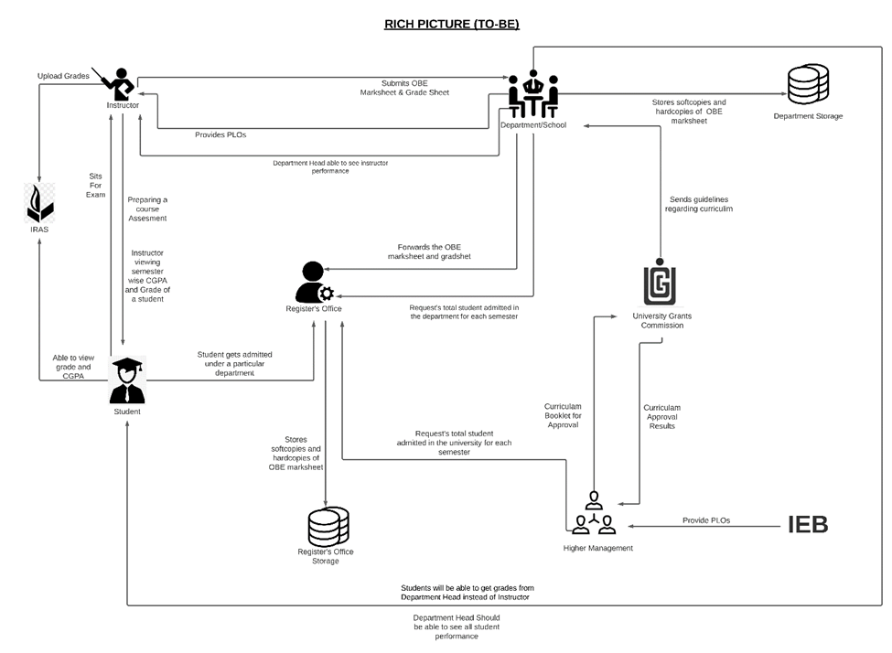
RICH PICTURE (TO-BE)

Slide 17
SIX ELEMENT (TO-BE)
Preparing Course Assessment of Instructor
Instructor Able to see the result of another courses of a Student
Students will be able to get grades from Department instead
UGC approves curriculum based on PLO and CO
Department Head able to see all instructor Performance
Higher Management and Instructor viewing OBE mark sheets and grade sheet
Instructor viewing CGPA and change the grade
Student viewing PLO & CO

Slide 18
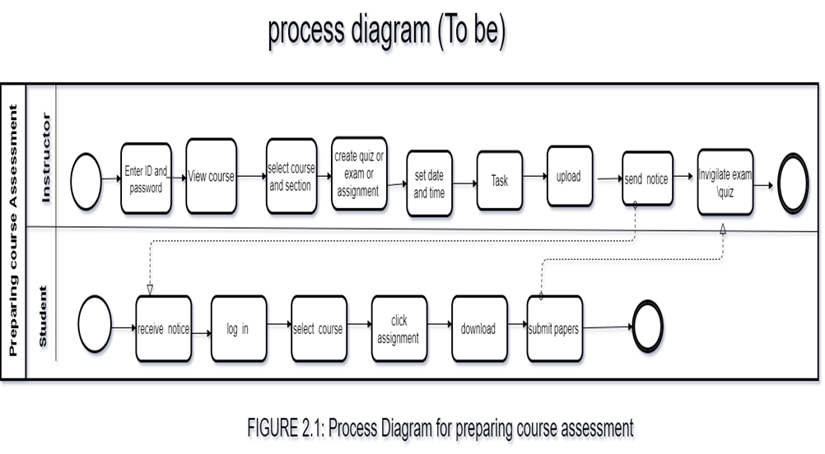
PROCESS DIAGRAM (TO-BE)

Slide 19
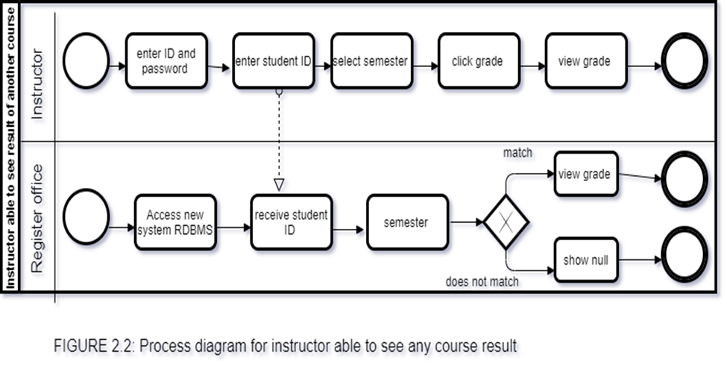

Slide 20
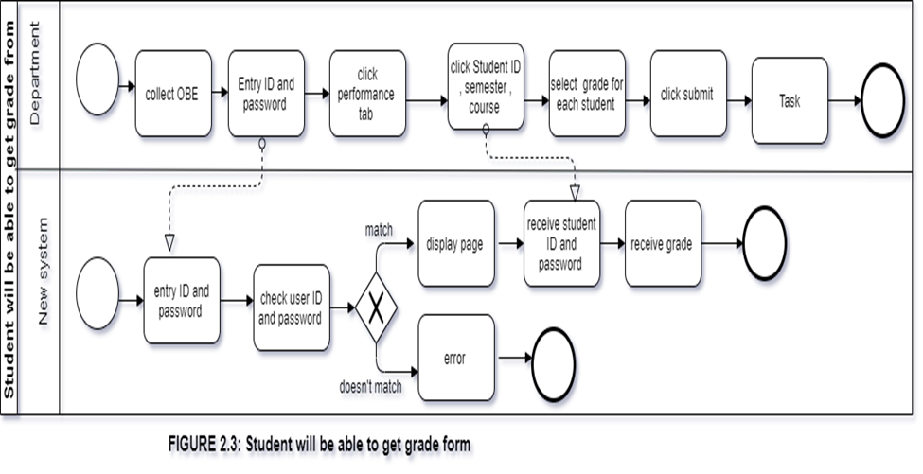

Slide 21
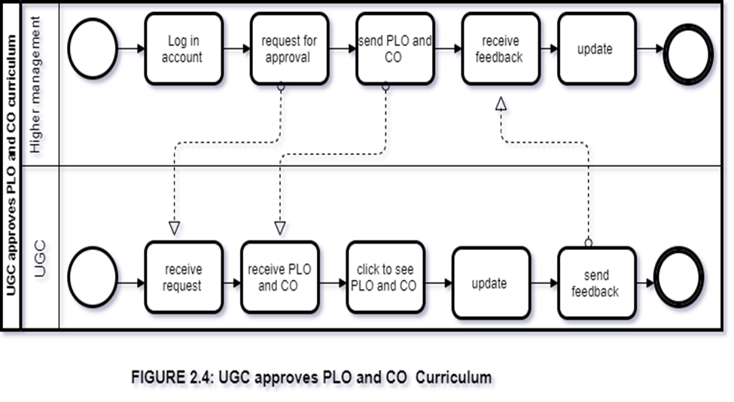

Slide 22
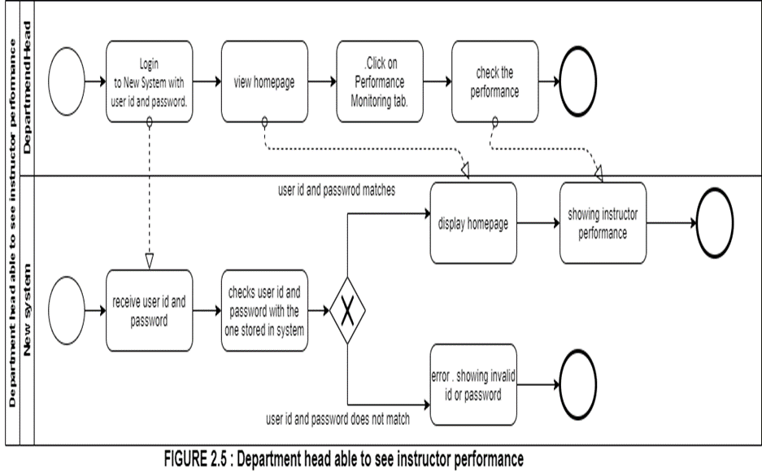

Slide 23
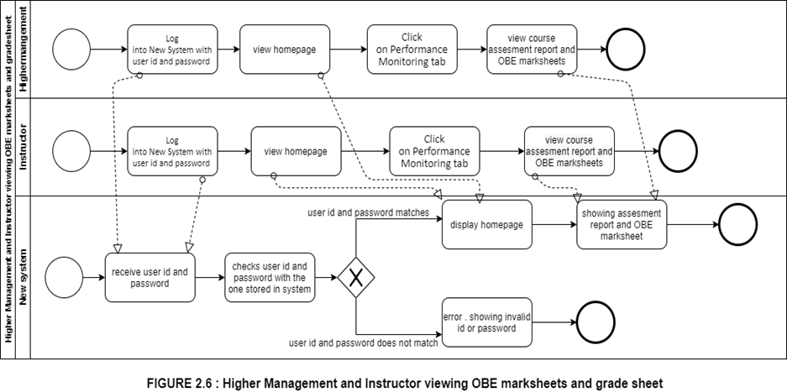

Slide 24
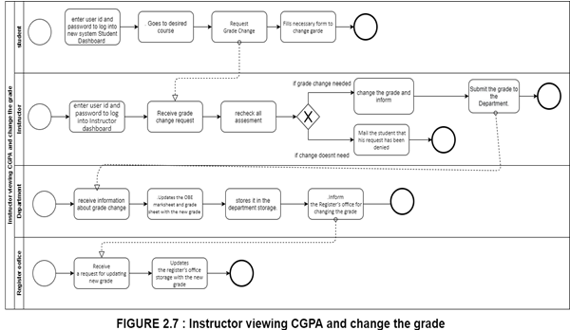

Slide 25
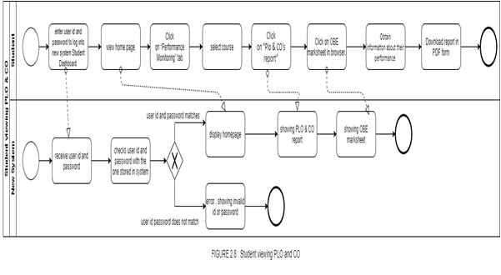
FIGURE 2.8 Student viewing PLO &CO

Slide 26
BUSINESS RULE
1) A student may register under one or more programs. A program many have multiple students.
2) A department may have multiple programs. A program must be exactly under one department.
3) A school may have multiple departments. A department must be exactly under one school.
4) A department may have multiple instructors. An instructor must be exactly under one department.
5) A department must have exactly one head.
6) A school must have exactly one dean.
7) A program may have multiple PLOs. A PLO many be under multiple programs.
8) An instructor may teach multiple courses. A course must have exactly one instructor.
9) A course may have multiple sections. A section must be under exactly one course.
10) A student may tale multiple assessments. A particular assessment must be taken exactly by one student.
11) A section may have multiple assessments. An assessment must have one exact section.

Slide 27
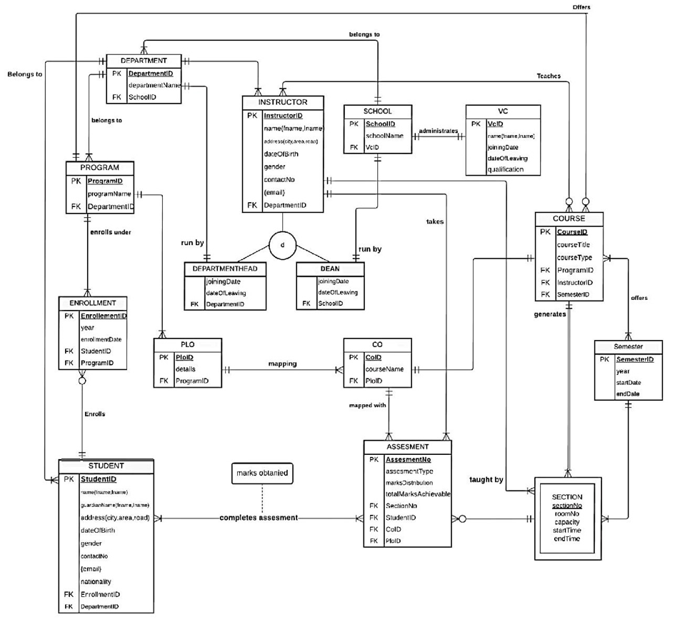
ENTITY RELATIONSHIP DIAGRAM

Slide 28
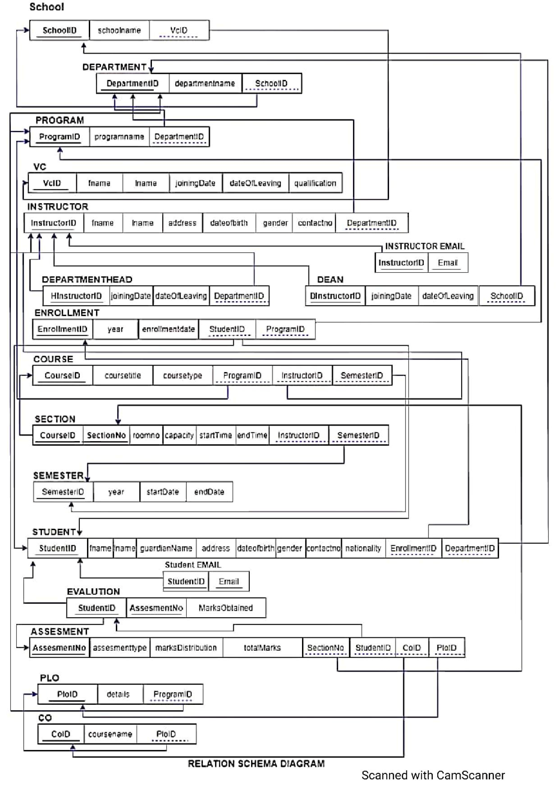
ENTITY RELATIONSHIP DIAGRAM TO RELATIONAL SCHEMA

Slide 29
NORMALIZATION
School | SchoolID | s1 | Enrollment | enrollemntID | n1
 |  |  |  | year | n2
 | School name | s2 |  | Enrollment date | n3
 | VCID | v1 |  | studentID | t1
 |  |  |  | ProgramID | p1
VC | vcID | v1 | student | studentID | t1
 | Fname | v2 |  | fname | t2
 | Iname | v3 |  | iname | t3
 | Joining datew | v4 |  | City | t4
 | Leaving date | v5 |  | Road | t5
 | Qualification | v6 |  | Area | t6
Department | departmentID | d1 |  | Date of birth | t7
 | Departmentname | d2 |  | Gender | t8
 |  |  |  | Contact no | t9
 | schoolID | S1 |  | Nationality | t10
program | programID | p1 |  | enrollmentID | n1
 | Program name | p2 |  | departmentID | d1
 | departmentID | d1 | Assessment | Assessment ID | a1
Instructor | InstructorID | i1 |  | Assessment type | a2
 | fname | i2 |  | Marks distribution | a3
 | Iname | i3 |  | sectionNO | e1
 | City | i4 |  | studentID | t1
 | Area | i5 |  | COID | o1
 | Road | i6 |  | PLOID | l1
 | Date of birth | i7 |  | Student complete assessment | a4
 | Gender | i8 |  | Student marks obtained | a5
 | Contact no (gmail) | i9 | Course | courseID | c1
 | DepartmentID | d1 |  | Course title | c2
Department Head | departrmentheadID | h1 |  | Course type | c3
 | qualification | h2 |  | programID | p1
 | Joining date | h3 |  | InstructorID | i1
 | Date of leaving | h4 |  | semesterID | r1
Dean | deanID | x1 | Section | sectionNO | e1
 | Annual salary | x2 |  | courseID | c1
 | Joining date | x3 |  | Room no | e2
 | Date of leaving | x4 |  | capacity | e3
 |  |  |  | Start time | e4
 |  |  |  | End time | e5

Slide 30
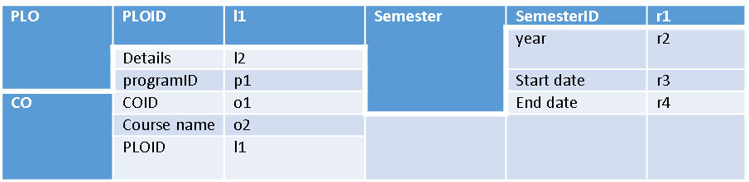

Slide 32
1NF
Arrange all the relationship. There are multiple attribute and there are no repeating groups.
2NF
Remove all the partial dependence. There are no composite keys present this step is not required.

Slide 33
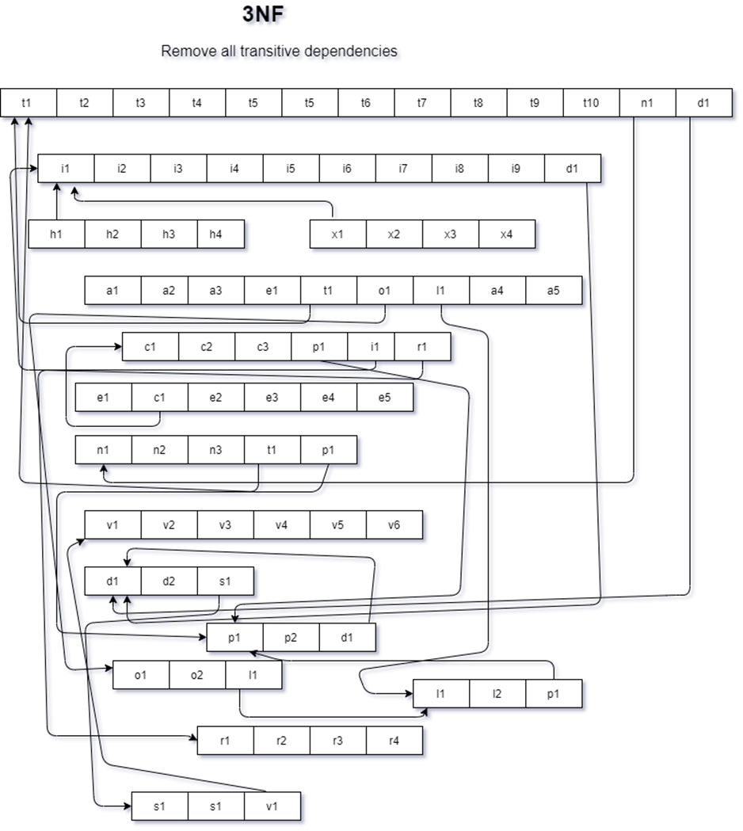
3NF
BCNF
No non-key attribute can identify can primary key or part key. So all relationship is in BCNF

Slide 34
DATA DICTIONARY
VC_T
Name | DataType | Size | Remark
nvcid | Number | 7 | This is the Primary Key for VC. Example: “19*****”
cname | Text |  | This is the name of vc Example: “md khan”
djoiningDate | DateTime |  | This contains the date when vc took charge of his role
dleavingDate | DateTime |  | This contains the date when vc discharged from his role
cqualification | Text |  | This contains the qualification of vc Example “ PHD , BSC”

Slide 35
Name | DataType | Size | Remark
cdepartmentid | Text |  | This is the Primary Key of the Department. Example: “EEE”
cdepartmentname | Text |  | This is the name of the Department. Example: “Computer Science and Engineering”
cschoolid | Text |  | This is the Foreign Key of the table School. Example: “SETS”
Department_T

Slide 36
Student_T
Name | DataType | Size | Remark
nstudentid | Number |  | This is the Primary Key for the Student. Example: “1800001”
cname | Text |  | This is the name of the Student. Example: “Muhammad Akib”
cguardianname | Text |  | This is the name of the guardian. Example: “Muhammad karim”
caddress | Text |  | This is the address of the Student. Example: “House 270, Road 6, Block C, Bashundhara, Dhaka, Bangladesh
ddateofbirth | Datetime | “dd/mm/yy” | This the Date of Birth of the Student. Example: “01-01-2000”
cgender | Text |  | This is the gender of the Student. Example: “M”
ncontactno | Number |  | This is the phone number of the Student. Example: “0191211141”
cemail | Text |  | This is the email address of the Faculty. Example: “mahady@iub.edu.bd”
cnationality | Text |  | This contains nationality of the student Example: “Bangladeshi”
ndepartmentid | Number |  | This is the Foreign Key from the Department table. Example: “CSE

Slide 37
Instructor_T
Name | DataType | Size | Remark
ninstructorID | Number |  | This is the Primary Key for Faculty. Example: “1501*** “
cname | Text |  | This is the first name of the instructor. Example : “ Abdur Rahim”
caddress | Text |  | This is the address of the instructor. Example: “House 1, Road 1, Sector 1, Uttara, Dhaka, Bangladesh
ddateofbirth | DateTime | DD-MM-Y YYY | This the Date of Birth of the instructor. Example: “01-01-1993”
cgender | Text |  | This is the gender of the instructor . Example: “F”
ncontactno | Number |  | This is the phone number of the instructor. Example: “01910101010”
cemail | Text |  | This is the email address of the instructor. Example: “rakib@iub.edu.bd”
cdepartmendid | Text |  | This is the Foreign Key from the Department table. Example: “CSE

Slide 38
Departmenthead_T
Name | DataType | Size | Remark
djoiningDate | DateTime |  | This contains the date when a vc took charge of his role
dleavingDate | DateTime |  | This contains the date when a vc discharged from his role
cdepartmentID | Text |  | This is the Foreign Key from the Department table. Example: “CSE
Dean_T
Name | DataType | Size | Remark
djoiningDate | DateTime |  | This contains the date when a vc took charge of his role
dleavingDate | DateTime |  | This contains the date when a vc discharged from his role

Slide 39
PLO_T
PLO_T
Name | DataType | Size | Remark
cploid | Text | 5 | This is the primary key for Program Learning Outcome. Example: “PLO1”
cdetails | Text |  | This is the details of the Program Learning Outcome. Example: “An ability to select and apply the knowledge, techniques, skills, and modern tools of the computer science and engineering discipline”
cporgramid | Text |  | This is the foreign key from Program table Example: ”B.Sc”.
cschoolid | Text |  | This is the Foreign Key of the table School. Example: “SETS”

Slide 40
CO_T
Name | DataType | Size | Remark
ccoid | Text | 5 | This is the Primary Key for Course Outcome. Example: “CO1”
ccoursename | Text |  | This is the name of the course Example: “Database management system”
cploid | Text |  | This is the foreign key from the Program Learning Outcome table. Example: “PLO1”

Slide 41
Enrollement_T
Name | DataType | Size | Remark
nenrollmentid | Number |  | This is the Primary Key for Enrollment
dyear | Datetime |  | This is the year of Enrollment Example: “2017”
cenrollmntdate | DateTime | DD-MM-Y YYY | This contains the date of the enrollment. Example : 30/01/2021
nstudentid | Number |  | This is the Foreign key from the Student Table. Example: “1800001”
cprogramid | Text |  | This is the Foreign Key from Program table Example: ”B.Sc”.

Slide 42
Program_T
Name | DataType | Size | Remark
cprogramid | Number |  | This is the Primary Key for program. Example : “BSC”
cprogramname | Text |  | This is the name of the program . Example : “Bachelor of Science”
cdepartmentid | Text |  | This is the Foreign Key from the Department table. Example: “CSE”

Slide 43
Course_T
Name | DataType | Size | Remark
ncourseid | Text |  | This is the Primary Key for the Course. Example: “CSE203”
ccoursetitle | Text |  | This is the name of the Course. Example: ”Data Structure”
ccoursetype | Text |  | This is the type of the Course. Example: “Core”
cprogramid | Text |  | This is the Foreign Key from Program table Example: ”B.Sc”.
cinstructorid |  |  | This is the Foreign Key from instructor table. Example :”1810000”
csemesterID |  |  | This is the Foreign Key from semester table.

Slide 44
Section_T
Name | DataType | Size | Remark
nsectionID | Number |  | This is the Primary Key for Section Example :”1001"
nsectionno | Number |  | This is the section number. Example: “4”
croomno | Text |  | This is the room number . Example : “B7107”
ccapacity | Text |  | This is the foreign key from the Course table. Example: “CSE203”
dstarttime | Datetime |  | This contains the time when a class start .Example : 3 pm
dendtime | Datetime |  | This contains the time when a class end. Example :4.30 pm

Slide 45
Assesment_T
Name | DataType | Size | Remark
nassesmentno | Number |  | This is the Primary Key for assessment . Example : “1”
cassesmenttype | Text |  | This is the type of assessment . Example : “Assignment ,Viva”
cmarksdistribution | Text |  | This contains the marks distribution
Ctotalmarksachievable | Text |  | This contains how much mark a student can achieve in total . Example : “100”
nsectionid | Number |  | This is the foreign key from section table Example” 1001”
nstudentid | Number |  | This is the foreign key from student table Example : “1810000”
ccoid | Text |  | This is the foreign key from the Program Learning Outcome table. Example: “CO1”

Slide 46
Semester_T
Name | DataType | Size | Remark
nSemesterid | Text |  | This is the Primary Key for semester
year | DateTime |  | This contains the year of that semester. Example:” 2021”
startdate | DateTime |  | This is the starting date of the semester. Example: “15.02.21”
enddate | DateTime |  | This is the ending date of the semester. Example: “10.05.21”

Slide 47
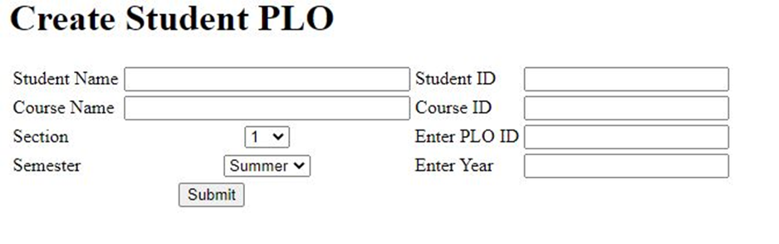
INPUT FORMS

Slide 48
<html>
<body>
<form action="script.php" method="POST">
<table border="0">
<h1>Create Student PLO</h1>
<div class="plo">
<tr>
<td>Student Name</td>
<td align="center"><input type="text" name="studentName" size="30"/></td>
<td>Student ID</td>
<td align="center"><input type="text" name="studentId" size="20"/></td>
</tr>
<tr>
<td>Course Name</td>
<td align="center"><input type="text" name="courseName" size="30"/></td>
<td>Course ID</td>
<td align="center"><input type="text" name="courseId" size="20"/></td>
</tr>
<tr>
<td>Section</td>
<td align="center"><select type="select" name="sectionNumber">
<option value="Section-1">1</option>
<option value="Section-2">2</option>
<option value="Section-3">3</option>
<option value="Section-4">4</option>
<option value="Section-5">5</option>
<option value="Section-6">6</option>
<option value="Section-7">7</option>
<option value="Section-8">8</option>
<option value="Section-9">9</option>
<option value="Section-10">10</option>
<option value="Section-11">11</option>
<option value="Section-12">12</option>
<td>Enter PLO ID</td>
<td align="center"><input type="text" name="coursePloId" size="20"/></td>
</td>
<tr>
<td>Semester</td>
<td align="center"><select type="semester" name="semestername">
<option value="semester-1">Summer</option>
<option value="semester-2">Spring</option>
<option value="semester-3">Autumn</option>
<td>Enter Year</td>
<td align="center"><input type="text" name="year" size="20"/></td>
</td>
</tr>
</tr>
<tr>
<td colspan="2" align="center"><input type="submit" value="Submit"</td>
</tr>
</table>
</div>
</form>
</body>
</html>

Slide 49
THANK YOU

