Slide 1
Automated Floodgate control and Flood Detection
Student ID :
1405013
1405015

Slide 2
Brief Project Description :
Detection of water level using water level sensors
Controlling floodgate depending on water level
Use of alarm when water level reaches danger point
Calculating increase or decrease rate of water level
Use of GPS to make a central detection system for issuing warning

Slide 3
Input of our system
Water Level
Longitude and latitude from GPS

Slide 4

Output of our system
Display water level on LCD monitor
Trigger alarm if water level reaches danger point
GPS locations

Slide 5

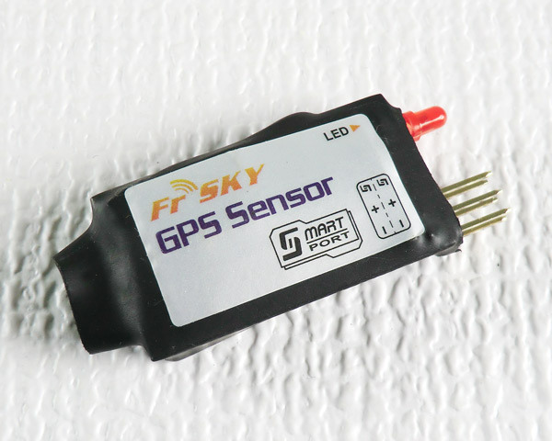
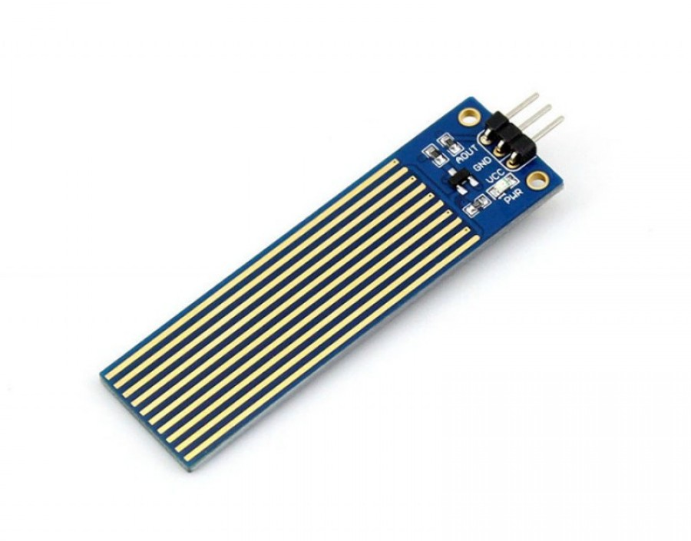
List of sensors
Liquid Level /Pressure / Sonar (Sensor)
GPS

Slide 6
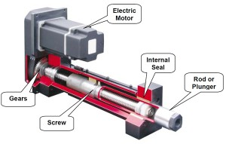
List of Actuators
Floodgate (Electric)

Slide 7
Outcome of our project
Low cost flood detection system
Automated floodgate control
GPS can be used to develop a central system which will allow efficient dam management.

Slide 8
Thank You

