Slide 1
Graph Algorithm Implementation
&
Visualization
Presented By
Ibne Bin Rafid
Exam Roll: 60919
Supervised By
Kishan Kumar Ganguly
Assistant Professor
IIT, DU
1

Slide 2
# Project Overview
The project on Graph
Algorithm Implementation
and Visualization aims to develop a comprehensive software solution that enables users to explore and understand various graph algorithms
2

Slide 3
# Project Overview
Depth First Search (DFS)
Breadth-First Search (BFS)
Dijkstra's algorithm
Bellman Ford algorithm
Johnson's algorithm
Prim's algorithm
Kruskal's algorithm
Fleury’s algorithm
Tarjan's algorithm
VF2 algorithm
3

Slide 4
# DFS & BFS algorithms are used for graph traversal
# Dijkstra’s, Bellman Ford, Johnson’s
& A* algorithms are used for finding the shortest paths in graph
# Prims & Kruskals algorithm are used
for finding minimum spanning tree
# Tarjan's algorithm finds strongly
connected components in a directed graph
4

Slide 5
# Fleury's algorithm finds
an Eulerian circuit or path in
a graph, which visits each
edge exactly once
# VF2 algorithm determines
whether two graphs are isomorphic,
meaning they have the same
structure but may have different
labels on nodes and edges
5

Slide 6
# Features
6

Slide 7
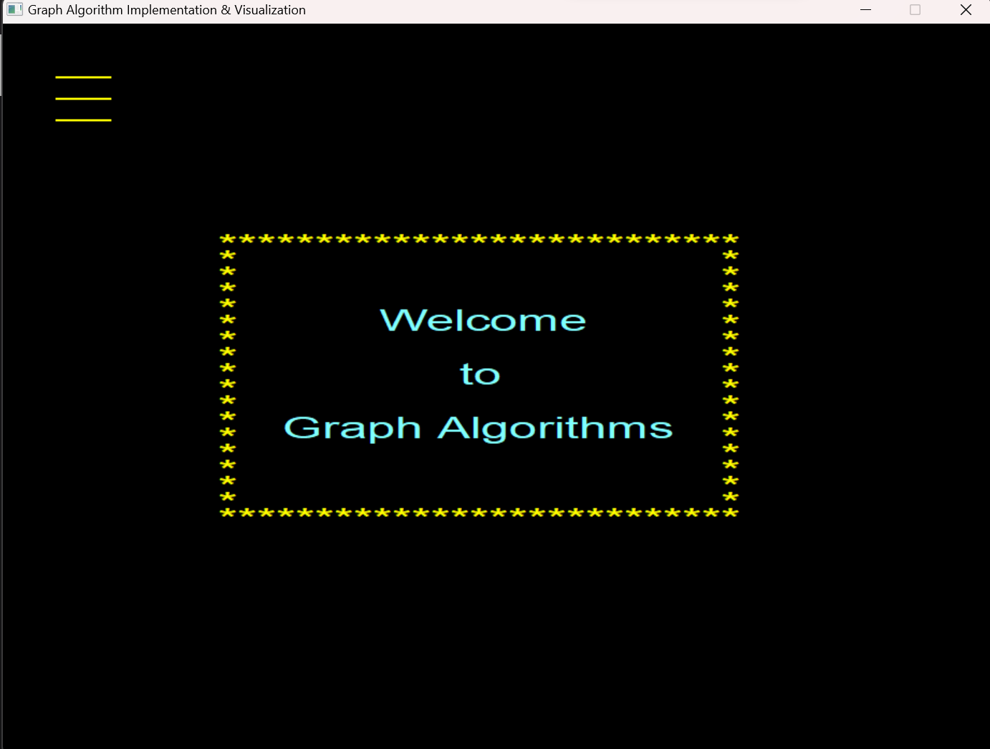
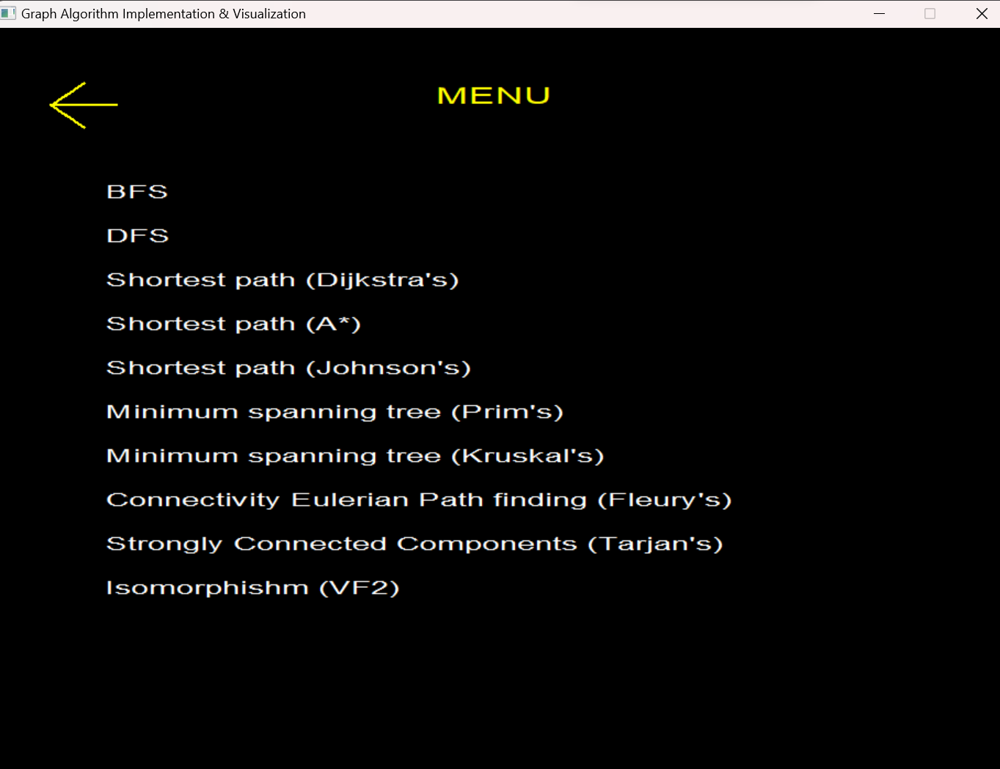
User-friendly interface to create and
interact
7

Slide 8
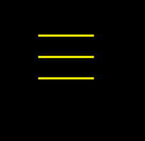
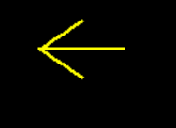
Buttons that will help a lot !
This is Menu button that will take user
to the graph algorithm names window
This Previous window button that will take user to the previous window
8

Slide 9
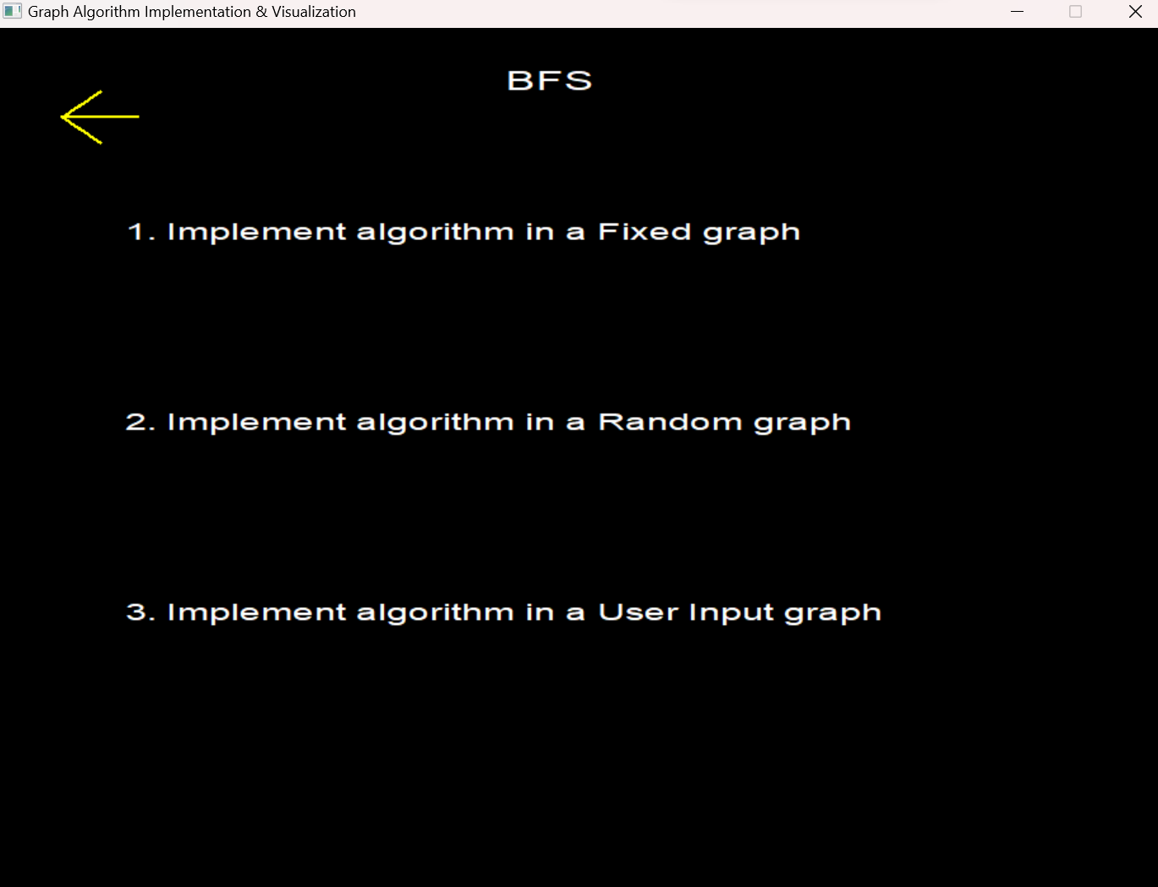
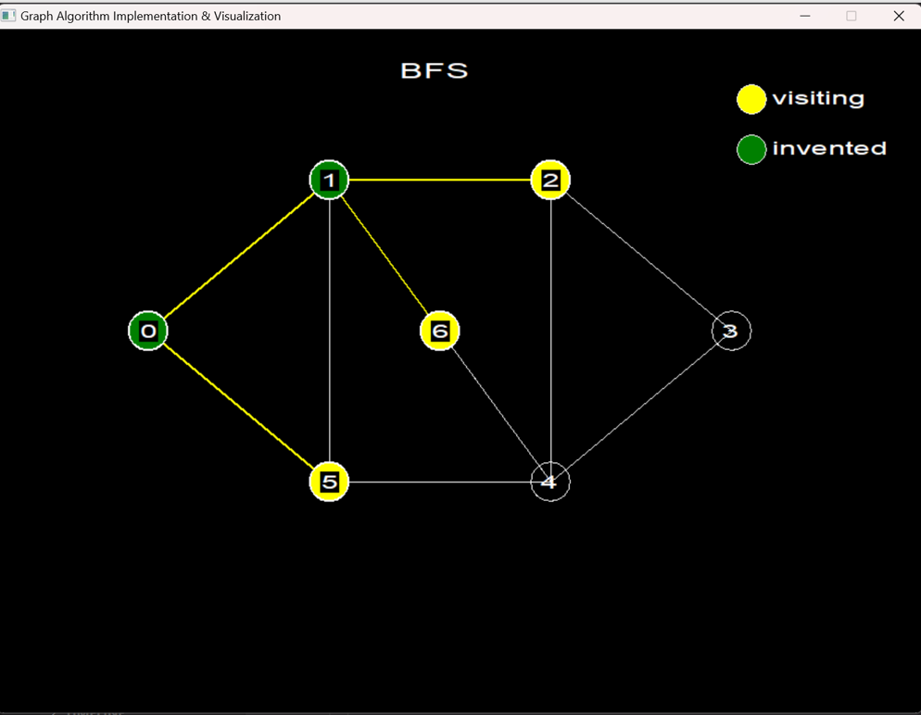
Clicking on the names will start the visualization process
9

Slide 10
# Tools & Technologies
10

Slide 11





11

Slide 12
# Challenges
12

Slide 13
The implementation of graph algorithms presented several challenges, including:
Developing an understandable visualization system using graphical window to enhance user understanding
Understanding the intricacies of each algorithm and their underlying concepts
Handling different graphs in a single graphical window
Improving the correctness of the visualization in the graphical window
13

Slide 14
THANK
YOU
Github : SPL_1 github link
14

