Slide 1
Graph Algorithm Implementation
&
Visualization
Presented by
Ibne Bin Rafid
BSSE 13,
Roll: 1330
Supervised by
Kishan Kumar Ganguly
Assistant Professor,
IIT, DU

Slide 2
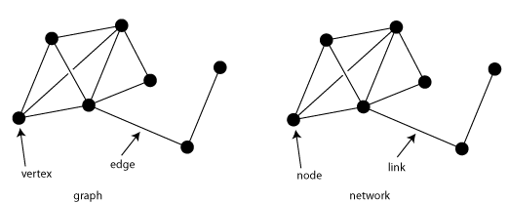
Project Overview
Graphs are used to represent relationships between data, and graph algorithms are used to analyze and manipulate these relationships.

Slide 3
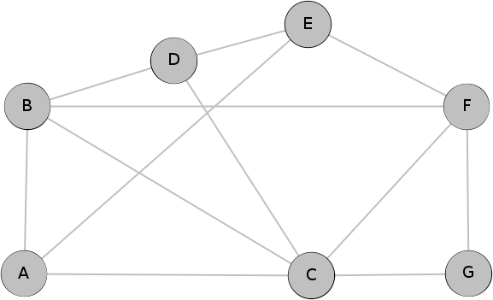
Project Overview
Graph algorithms are crucial for modeling and analyzing complex relationships and connections, widely used in various fields for solving problems such as shortest path, network patterns, optimizing flow, and recommendation. They are efficient and scalable for processing large-scale data.

Slide 4
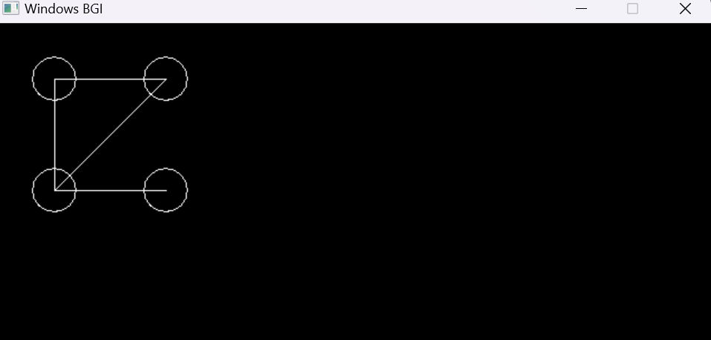
Project Overview
The goal of this project is to implement various graph algorithms and visualize their workings in a graphical window.

Slide 5
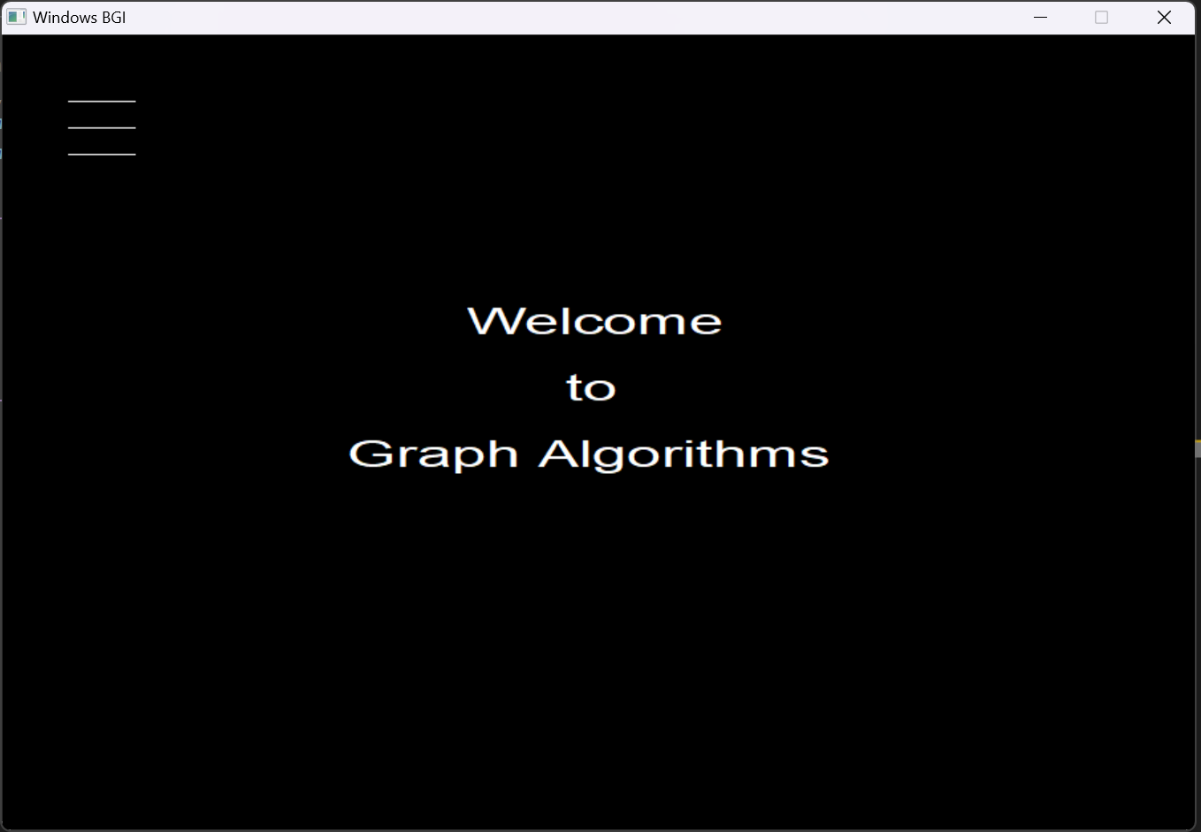
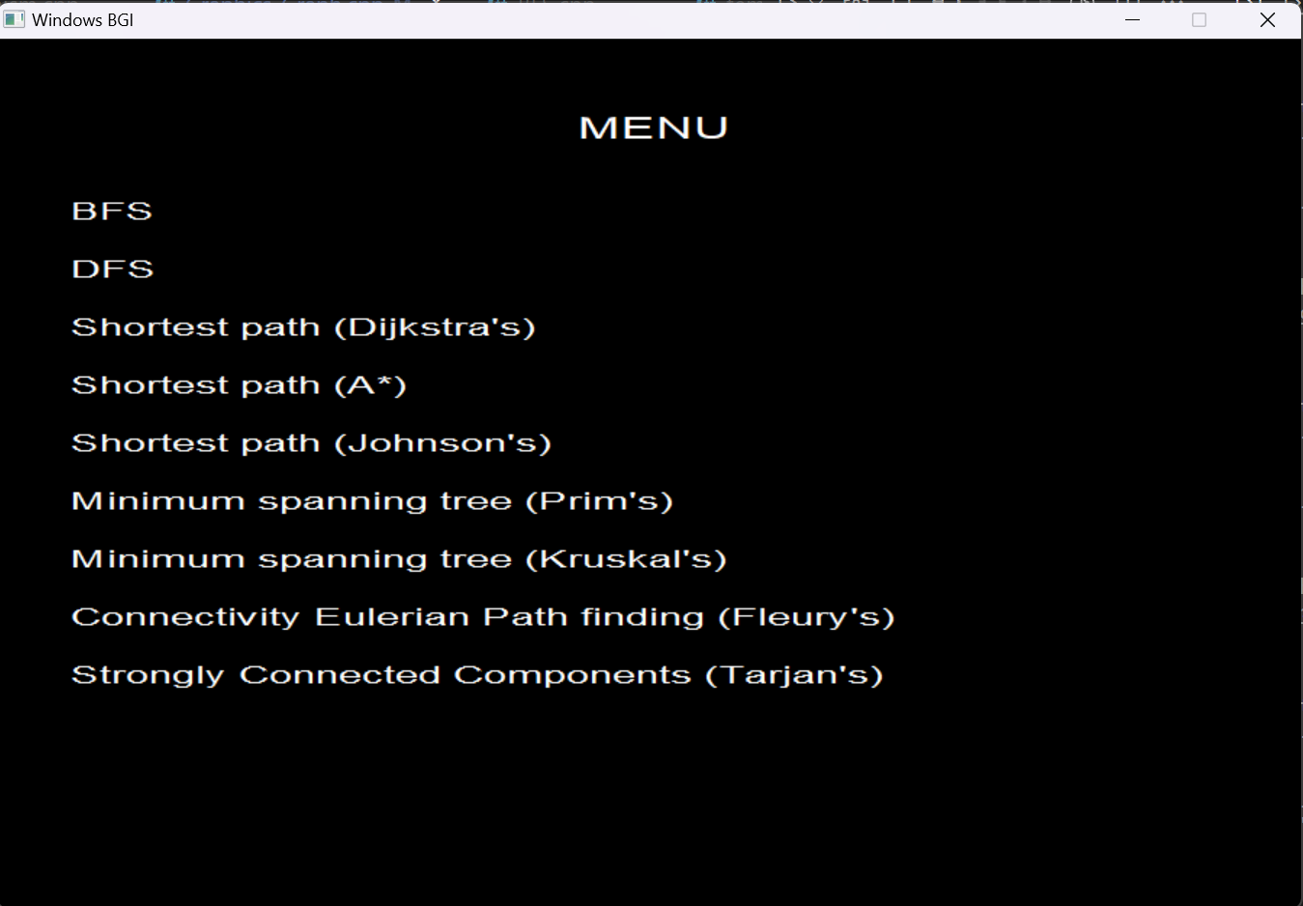
Features
User-friendly interface to create and interact with the graph
and visualize the algorithms.

Slide 6
Features
Graph representation: Represent the graph using an adjacency matrix or adjacency list.
Graph creation: Allow the user to create a graph randomly or by adding vertices and edges.
Breadth-First Search (BFS): Implement the BFS algorithm to traverse a graph and visualize the process.
Depth-First Search (DFS): Implement the DFS algorithm to traverse a graph and visualize the process.

Slide 7
Features
5. Shortest Path algorithms: Implement algorithms like Dijkstra’s algorithm or A* algorithm or Johnsons’s algorithm to find the shortest path between two vertices in a graph.
Minimum Spanning Tree algorithms: Implement algorithms like Kruskal's or Prim's algorithm to find the minimum spanning tree of a graph.
Strongly Connected Components: Implement Tarjan’s algorithm to find strongly connected components in a directed graph.

Slide 8
Features
Connectivity: Implement eulerian path finding algorithm like Fleury’s algorithm to check connectivity.
Graph Isomorphism: Checking of two wheter they are isomorphic or not using VF2 algorithm.

Slide 9
Features
User can go back to previous window from its current window and can implement different algorithms in the same graph.
User can understand a graph algorithm more deeply seeing its visualization.

Slide 10





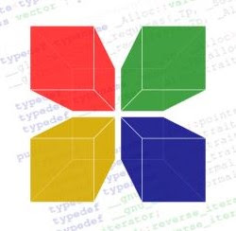

Tools & Technologies

Slide 11
Overview
task that I have already completed
User input graph creation
Random graph creation
BFS algorithm
DFS algorithm
Shortest path finding (A* algorithm)
Graph isomorphism (VF2 algorithm)
Basic output interface creation

Slide 12
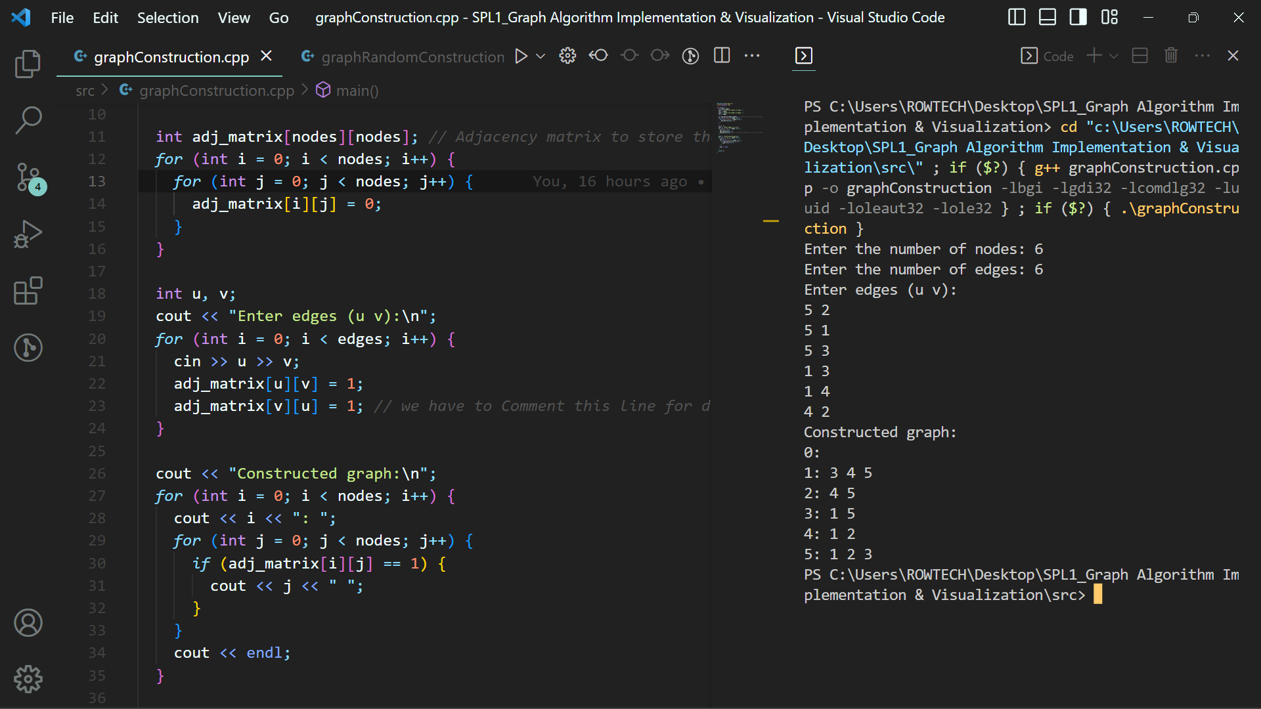
Overview
task that I have already completed
User input graph creation : graph code

Slide 13
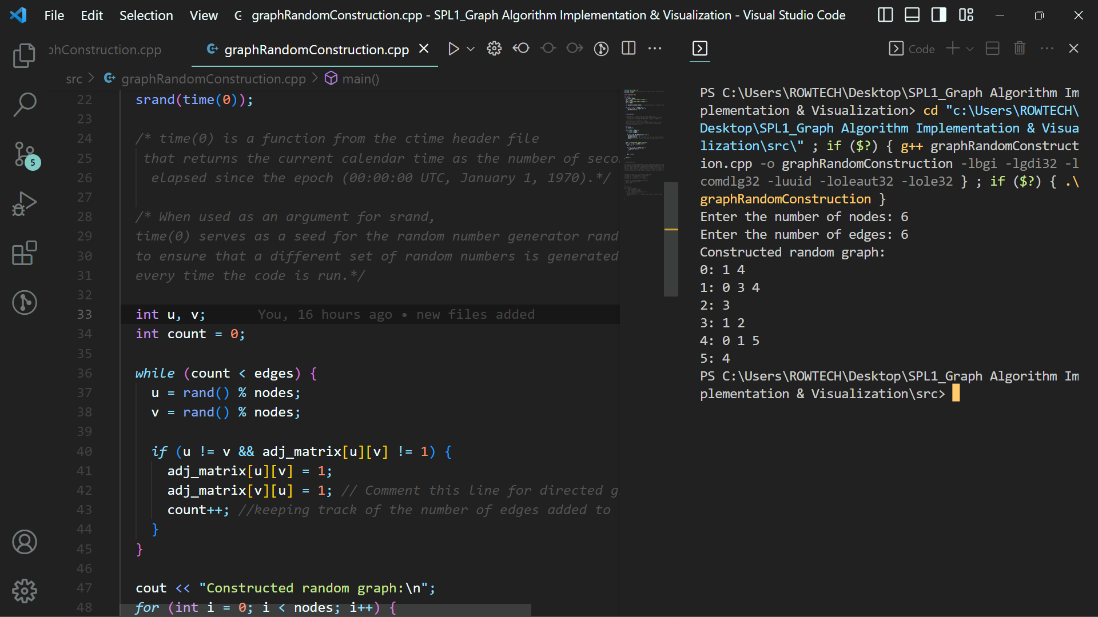
Overview
task that I have already completed
Random graph creation : graph code

Slide 14
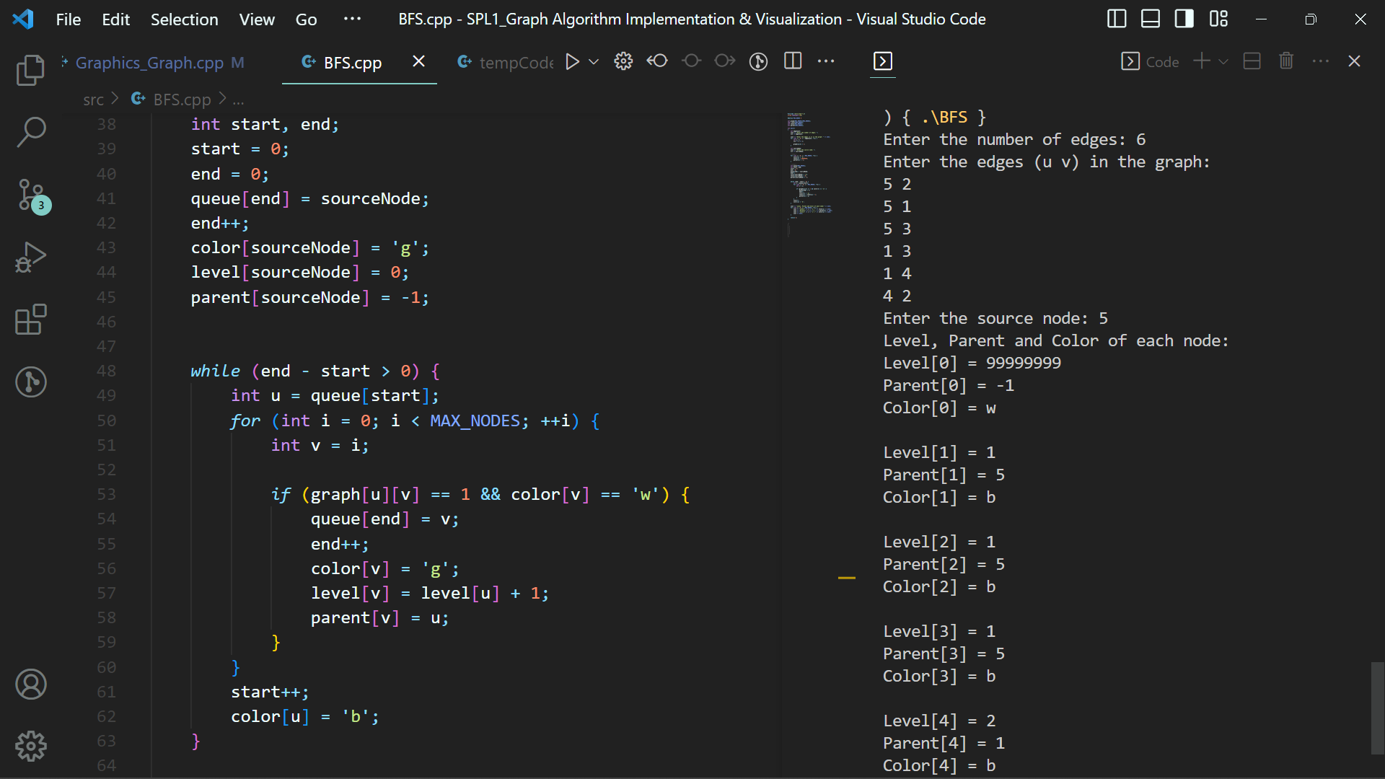
Overview
task that I have already completed
BFS : BFS code

Slide 15
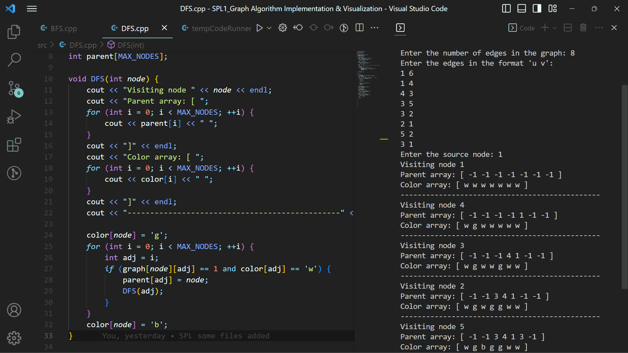
Overview
task that I have already completed
DFS : DFS code

Slide 16
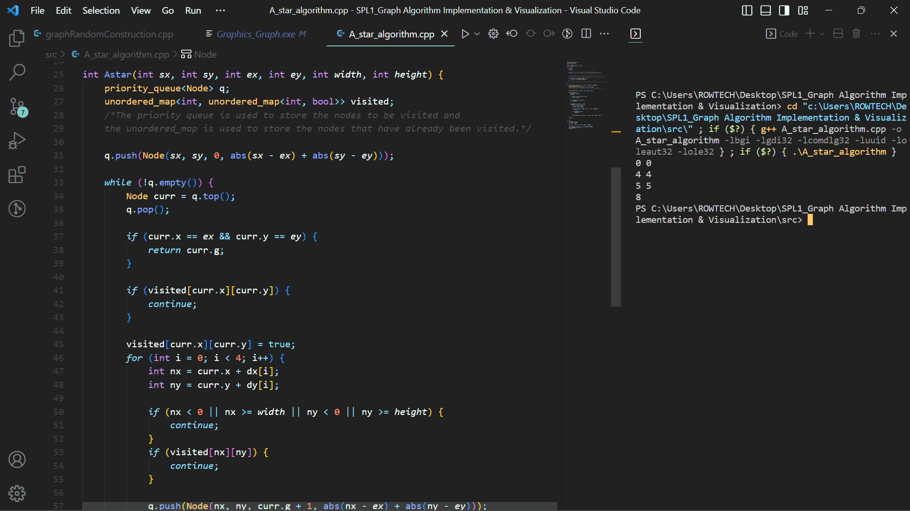
Overview
task that I have already completed
Shortest path : A* algorithm code

Slide 17
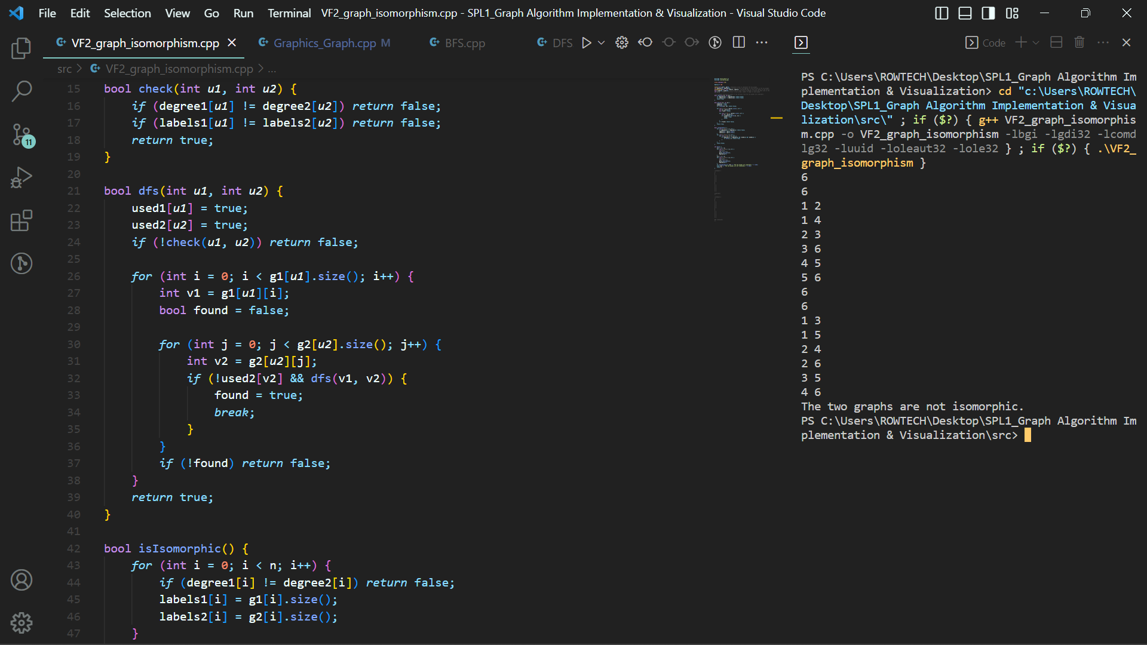
Overview
task that I have already completed
Graph Isomorphism : VF2 algorithm code

Slide 18
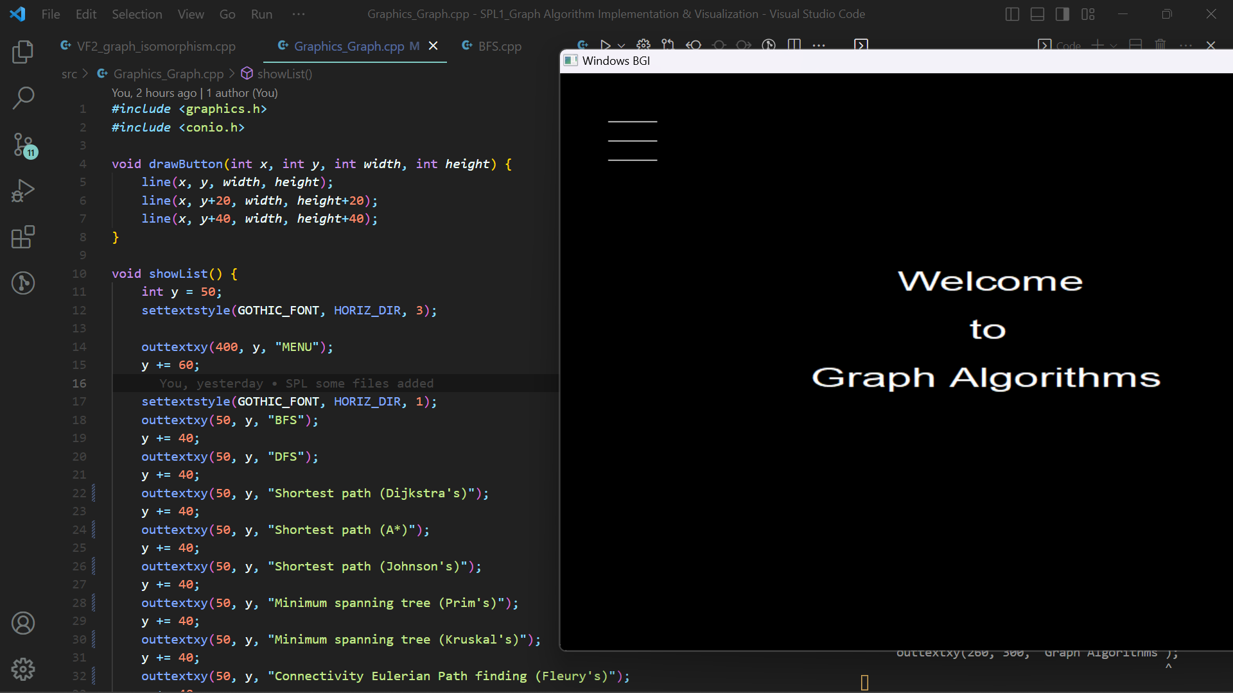
Overview
task that I have already completed
Basic output interface creation: code

Slide 19
Github link
https://github.com/Rafid13iit/SPL_1/

Slide 20
Thank
you

