Slide 1
Graph Algorithm Implementation
&
Visualization
Presented By
Ibne Bin Rafid
Exam Roll: 60919
Supervised By
Kishan Kumar Ganguly
Assistant Professor
IIT, DU
1

Slide 2
# Project Overview
The project on Graph
Algorithm Implementation
and Visualization aims to develop a comprehensive software solution that enables users to explore and understand various graph algorithms
2

Slide 3
# Project Overview
Depth First Search (DFS)
Breadth-First Search (BFS)
Dijkstra's algorithm
Bellman Ford algorithm
Johnson's algorithm
Prim's algorithm
Kruskal's algorithm
Fleury’s algorithm
Tarjan's algorithm
VF2 algorithm
3

Slide 4
# Depth-First Search (DFS): Traverses a graph by exploring as far as possible along each branch before backtracking
# Breadth-First Search (BFS): Traverses a
graph by exploring all neighbours of a node
before moving to the next level of nodes
# Dijkstra's algorithm: Finds the shortest
path in a weighted graph with non-negative
edge weights
4

Slide 5
# Bellman-Ford algorithm:
Finds the shortest path in a graph with negative edge weights and detects negative cycles
Johnson's algorithm: Finds the shortest
paths between all pairs of nodes in a
graph, even with negative edge weights
#
# A* algorithm: Finds the shortest
path in a graph by using heuristics to guide the search towards the goal
5

Slide 6
# Prim's algorithm: Constructs a minimum spanning tree by adding edges with the smallest weight that connect the tree to new nodes
# Kruskal's algorithm: Constructs a minimum
spanning tree by repeatedly adding the smallest- weighted edge that does not create a cycle
# Tarjan's algorithm: Finds strongly connected
components in a directed graph, which are subgraphs
where there is a path between any two nodes
6

Slide 7
# Fleury's algorithm: Finds
an Eulerian circuit or path in
a graph, which visits each
edge exactly once
# VF2 algorithm: Determines
whether two graphs are isomorphic,
meaning they have the same
structure but may have different
labels on nodes and edges
7

Slide 8
# Features
8

Slide 9
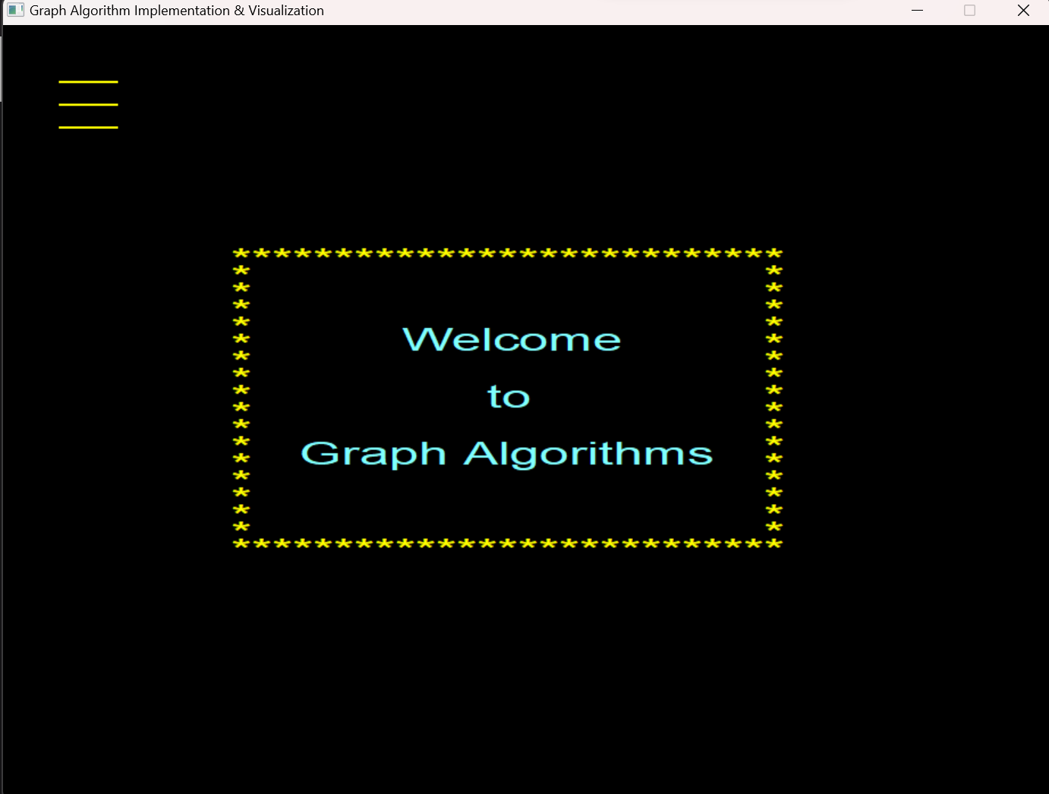
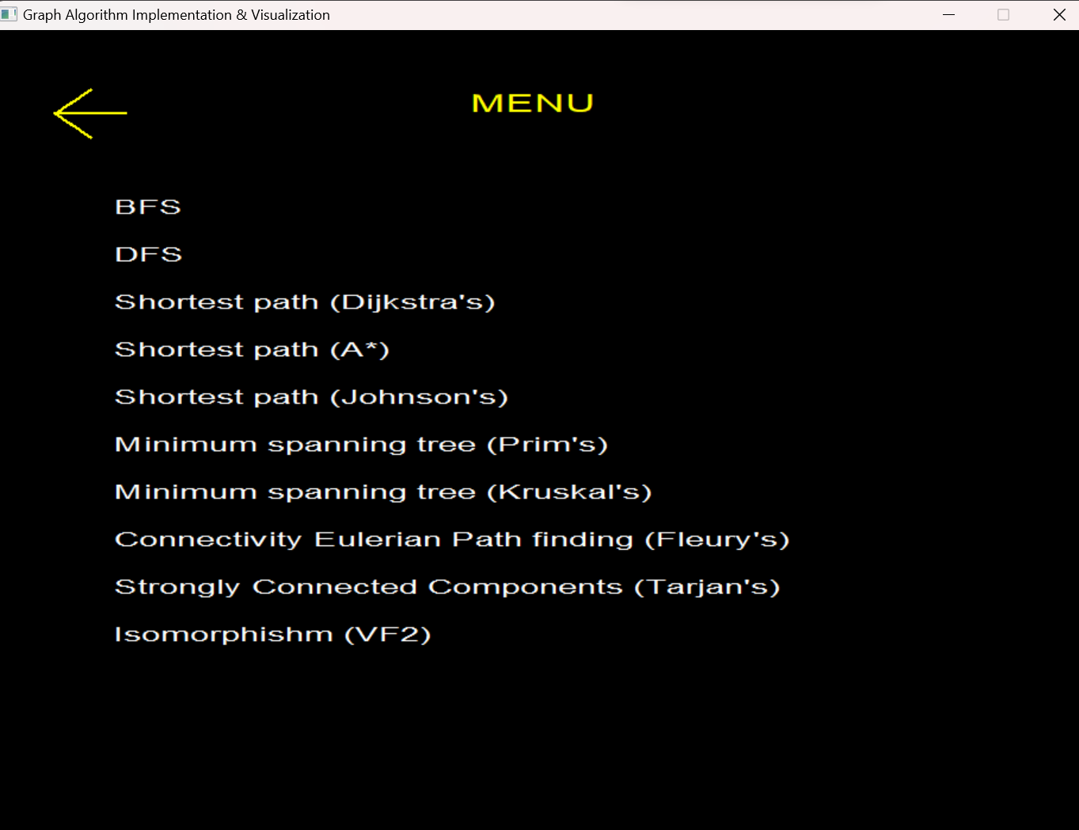
User-friendly interface to create and
interact
9

Slide 10
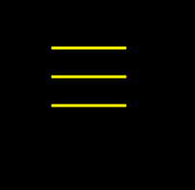
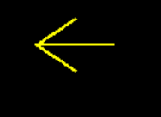
Buttons that will help a lot !
This is Menu button that will take user
to the graph algorithm names window
This Previous window button that will take user to the previous window
10

Slide 11
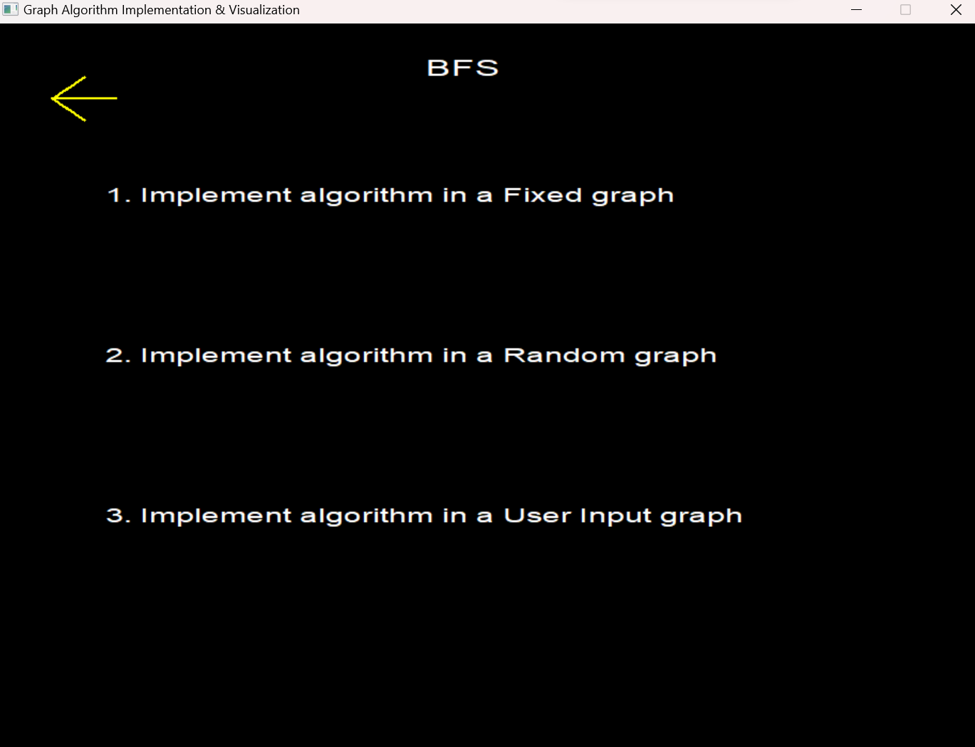
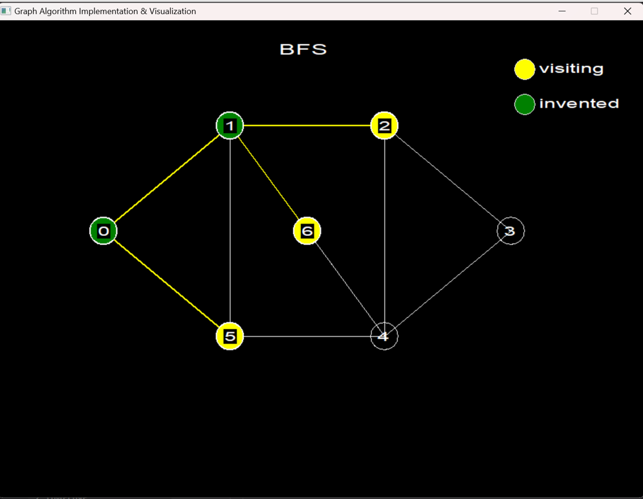
Clicking on the names will start the visualization process
11

Slide 12
# Tools & Technologies
12

Slide 13





13

Slide 14
# Challenges
14

Slide 15
The implementation of graph algorithms presented several challenges, including:
Developing an understandable visualization system using graphical window to enhance user understanding
Understanding the intricacies of each algorithm and their underlying concepts
Handling different graphs and try to optimize their performance
Improving the correctness of the algorithms and the graphical window
15

Slide 16
THANK
YOU
Github : SPL_1 github link
16

