Slide 1
Temperature Controlled DC Fan using Microcontroller

Slide 2
Group Number: 04
Group Members:
Rafid Mahboob(1103011)
Sk pavel(1103013)
Tafsir Haque Arnob(1103080)
Arik Md. Isthiaque (1103096)
Showrav Nath (1103096)
Md. Ashikur Rahman(1103093)
Hasan Imam Chowdhury (1103071)
Delwar (1103104)

Slide 3
Required Components:
Microcontroller Section
AT Mega32A Microcontroller
Burner
11.0592 MHz Quartz Crystal
33pF Ceramic Capacitor
2 x 10KΩ Resistor
10µF Electrolytic Capacitor
Push Button
16 X 2 LCD Display
10KΩ POT

Slide 4
Temperature Sensor Section
LM35
150pF Ceramic Capacitor
Load Section
2N2222 NPN Transistor
1N4007 Diode
12V Relay
Fan

Slide 5
Block Diagram
I/O Interfacing Unit
I/O Unit
Control Unit

Slide 6
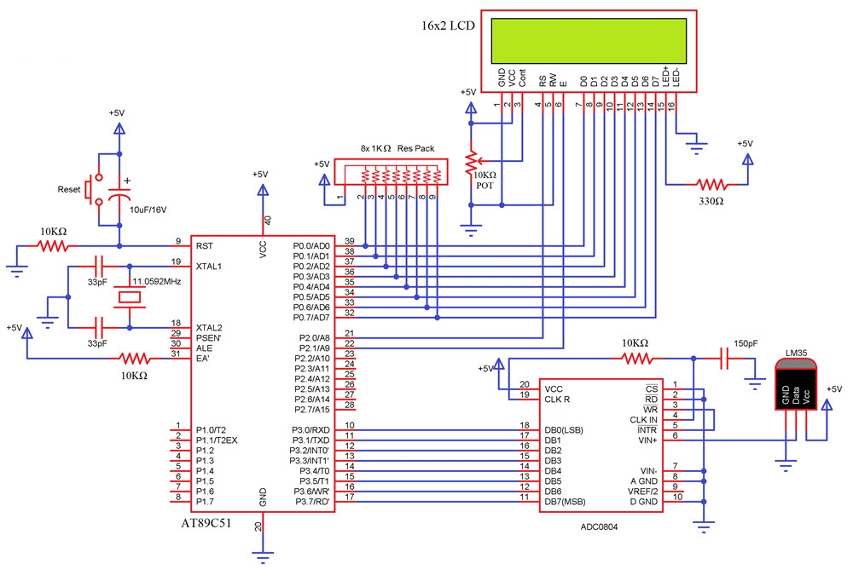
Circuit Diagram

Slide 7
Application:
Temperature Controlled Fan Can Be Used To Control The Temperature Of Devices , By Monitoring The Temperature.
The Circuit Can Be Used For Car Engine To Reduce The Heat .
Cooling Pads On Personal Computers.
Digital Temperature Sensors Can Be Found In Air Conditioners Where It Adjusts The Temperature According To The Room Temperature.
They Can Be Seen In Digital Clocks Displaying Room Temperature Along With Time.

Slide 8
Working procedure:
The Basic Principle Working Principle Of Temperature Controlled Dc Fan Is Based On The Thermistor.
LM 358 Compares The Voltage Across The 4.7k Ohm Resistor.
At Room Temperature The Voltage Across The NTC Will Be Greater Than Or Equals To The Voltage Across The 4.7k Ohm Resistor . So The Op Amp Output Will Be Either Negative Or Zero Voltage Which Can Not Turn ON The Transistor

Slide 9
If The Temperature Rises Above The Preset Value, It Leads To Decrement Of Thermistor Resistance And Voltage Across It.
Then If This Voltage Lesser Than The Voltage Across 4.7k Ohm Resistor, The Output Of Op Amp Will Be Positive Voltage Which Can Turn On The Transistor.
When Transistor On , The Motor (Fan) Will Be Connected Across The Dc Supply And Starts To Rotate.
The Motor Will Be Turns Off When The Temperature Returns Back To Room Temperature,

Slide 10
Source Code
#include <avr/io.h>
#define F_CPU 1000000
#include <util/delay.h>
#include <stdlib.h>
#define enable 5
#define registerselection 6
void send_a_command(unsigned char command);
void send_a_character(unsigned char character);
void send_a_string(char *string_of_characters);

Slide 11
int main(void)
{
DDRB = 0xFF;
DDRA = 0;
DDRD = 0xFF;
_delay_ms(50);
ADMUX |=(1<<REFS0)|(1<<REFS1);
ADCSRA |=(1<<ADEN)|(1<<ADATE)|(1<<ADPS0)|(1<<ADPS1)|(1<<ADPS2);
int16_t COUNTA = 0;
char SHOWA [3];
send_a_command(0x01); //Clear Screen 0x01 = 00000001
_delay_ms(50);
send_a_command(0x38);
_delay_ms(50);
send_a_command(0b00001111);
_delay_ms(50);

Slide 12
ADCSRA |=(1<<ADSC);
while(1)
{
COUNTA = ADC/4;
send_a_string ("Temp(C)=");
send_a_command(0x80 + 0x40 + 0);
itoa(COUNTA,SHOWA,10);
send_a_string(SHOWA);
send_a_string (" ");
send_a_command(0x80 + 0x40 + 8);
}
}

Slide 13
void send_a_command(unsigned char command)
{
PORTB = command;
PORTD &= ~ (1<<registerselection);
PORTD |= 1<<enable;
_delay_ms(20);
PORTD &= ~1<<enable;
PORTB = 0;
}
void send_a_character(unsigned char character)
{
PORTB = character;
PORTD |= 1<<registerselection;
PORTD |= 1<<enable;
_delay_ms(20);
PORTD &= ~1<<enable;
PORTB = 0;
}

Slide 14
void send_a_string(char *string_of_characters)
{
while(*string_of_characters > 0)
{
send_a_character(*string_of_characters++);
}
}

Slide 15
Advantages
It Is Very Economical And Easy To Handle
Motor Fan Runs Autonomically , So That Its Controls The Temperature Without Using It Manually.
It Is Very Easy To Install At Heat Dissipating Devices To Cool Down Them.
Saves The Energy By Turns Off The Motor Fan At Normal Or Low Temperature Automatically.

Slide 16

Thank You ☺

