Slide 1
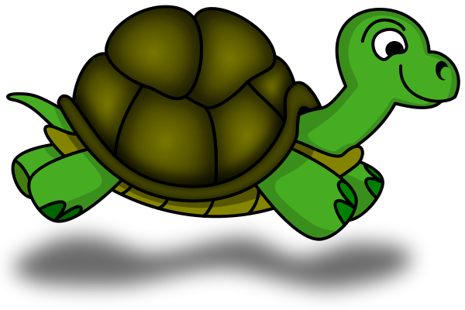
Programming in Python Turtle Graphics
Dr. Kristine Nagel
Genie Yang
Raquel Lawrence
Georgia Gwinnett College Super Saturday Series (S3)

Slide 2





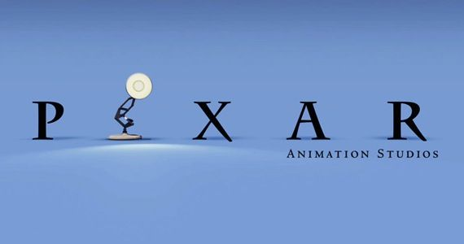
The programming language we will be using is called Python
http://www.python.org
What can you do with python?
Instagram
Google
Pixar
Dropbox
YouTube
Notes:
Instagram is powered by Django, which is a high-level Python Web framework that encourages rapid development and clean, pragmatic design.
Google- use extensive use of python in its web search engines.
Pixar- use Python in the production of animated movies.
Dropbox- uses Python code in their server for hosting their file service.
YouTube-the video sharing services is largely written in Python. Every time you watch a video you are executing a bunch of Python code.

Slide 3
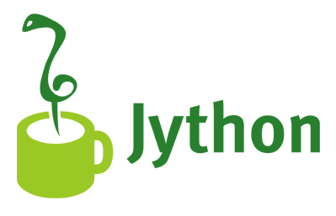
Jython
The kind of Python we’re using is called Jython
It’s Java-based Python
Jython is Python and Java combined!
http://www.jython.org

Slide 4

Using Turtle Graphics
Dr. Seymour Papert, at MIT, used Turtle as a graphical and mathematical object to help children think computationally.
A turtle is an object.
The turtle had a pen in the middle of it that could be raised and lowered to leave a trail of movements.
These turtles objects can only move around in what's called a world.
World = window in your computer.

Slide 5
We will program in JES
JES: Jython Environment for Students
A simple editor for entering in our programs: Well call that the program area
A command area for entering in commands for Python to execute.

Slide 6
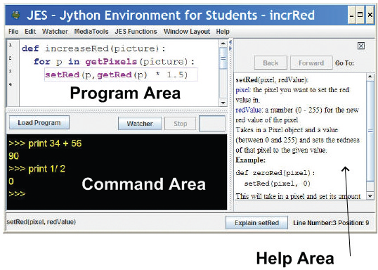
JES with Help displayed
Use Window Layout to get the view you want

Slide 7
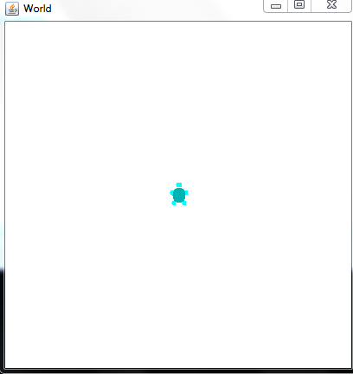
Creating World and Turtle
Use following commands in JES to create Worlds and Turtles:
earth = makeWorld(400, 400)
The input parameters describe the size of the world in pixels If you do not provide inputs, get default 640 x 480 pixel world.
turtle = makeTurtle(earth)
This creates a new turtle inside the world.

Slide 8
Turtle Commands
turtle.forward(distance)- command to move the turtle in the directions it’s facing. Default distance is 100 pixels.
turtle.turn(degrees)- turns the turtle in 90 degrees depending on the direction its facing.
turtle.moveTo(x, y)- command to place the turtle in a new location in the world.
turtle.penUp()- command to pick the pen up.
turtle.penDown()- command to put the pen down again to draw.
turtle.penWidth = (1-10) - allows you to change the size of the pen
turtle.color = red (blue, green . . .) -or- (255, 255, 255) RGB notation- allows you to change the color of the pen and turtle.

Slide 9
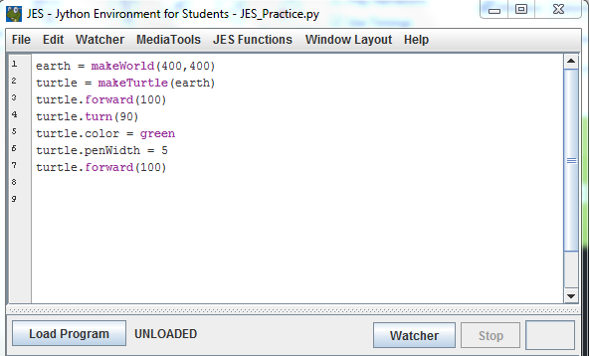
Turtle Commands Activity

Slide 10
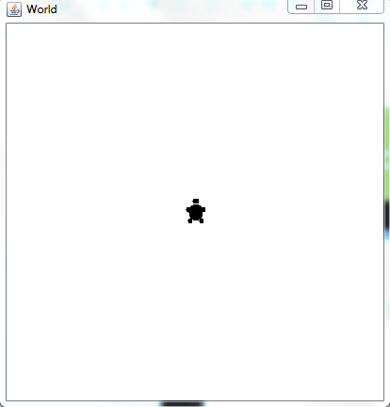
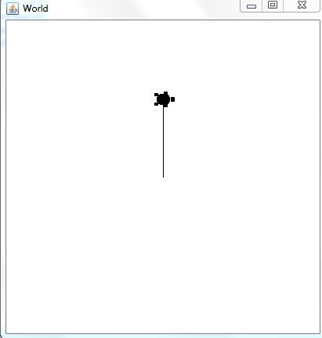
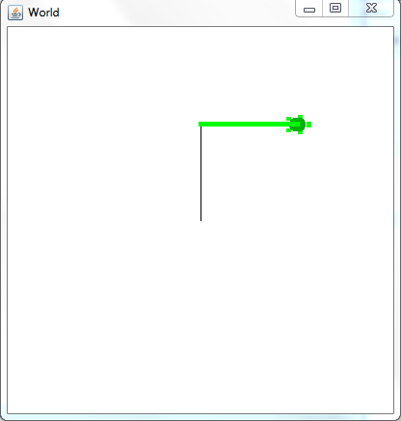
Turtle Commands Activity

Slide 11
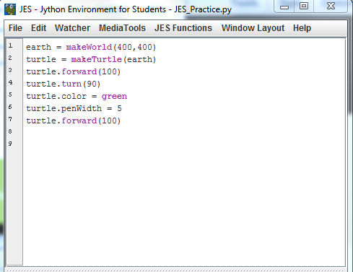
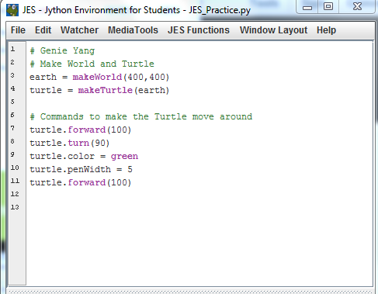
Comments in JES
Make your programs easier to read and understand by creating comments to describe your program.
To create a comment in JES, you start by typing the # key.

Slide 12
Drawing Shapes and Designs with Python and Turtles
Students in this activity will use the Python programming language and JES program to create simple shapes and designs.
Python Turtles Tutorial is intended to:
Get students familiar with JES software: Program and Command Area
Teach students how to properly define, program, and call a Python function.
Learn how to think computationally and problem solve.
Bonus/Challenge:
Create your own designs.
Add colors to your designs.
Create your Initials with Python Turtles.

Slide 13
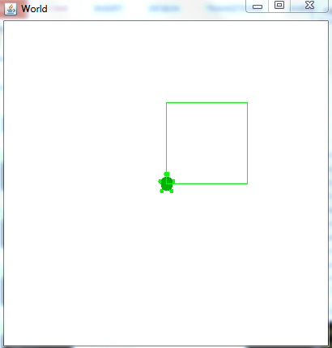
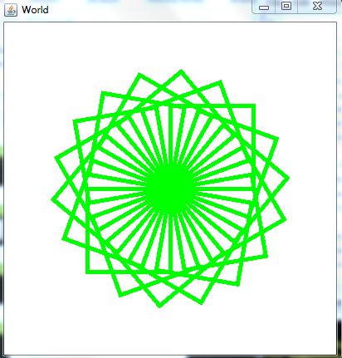
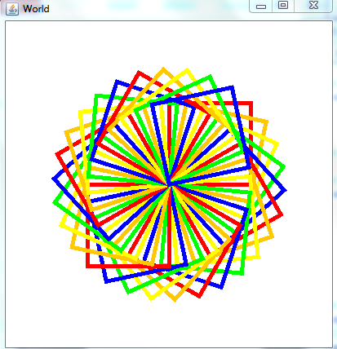
TURTLE GRAPHICS: SQUARES
SQUARE SHAPE
SPIRAL DESIGN
RAINBOW SPIRAL DESIGN

Slide 14
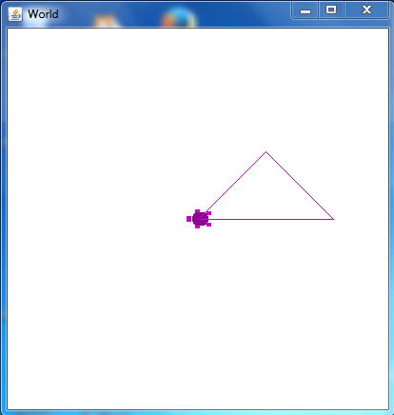
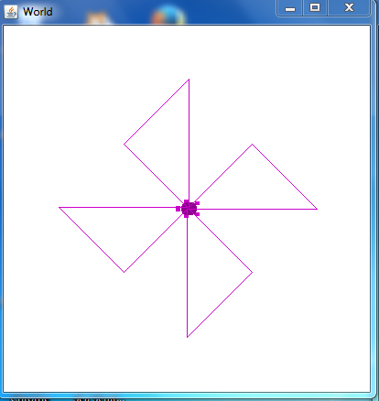
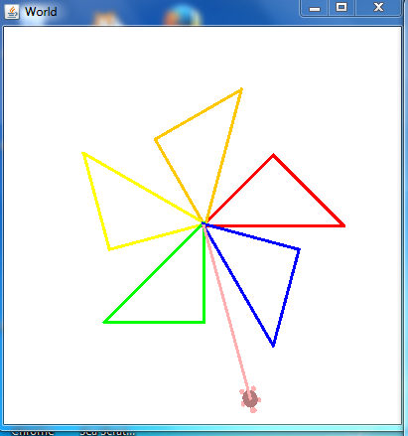
TURTLE GRAPHICS: TRIANGLES
TRAINGLE S HAPE
WINDMILL DESIGN
RAINBOW WINDMILL DESIGN

Slide 15
Let’s get started! Begin the JES Python Turtle Tutorial!
Get with a partner and complete the tutorials in JES.
Navigator- telling the tutorial instructions to the Pilot.
Pilot- will be the programmer!
Be sure to Switch Roles!
Please raise your hand if you need any assistance.
Explore and have fun!

Slide 16
Resources
Media Computation Website
http://coweb.cc.gatech.edu/mediaComp-teach
Jython Website at Georgia Tech:
http://coweb.cc.gatech.edu/mediaComp-plan/94

