Slide 1
Oral Cancer Detection using Deep Learning
Md. Imtiaz Hoque
Md. Azmi Siddique
Md. Jahirul Islam
1811330042
1812307042
1821368642

Slide 2
List of Contents
Background
Problem statement
Review of similar existing systems
Objective of the project
Feasibility study indicating solutions
Expected result after developing
Diagrams, Working steps, Gantt chart
Result analysis
Future work
Conclusion

Slide 3
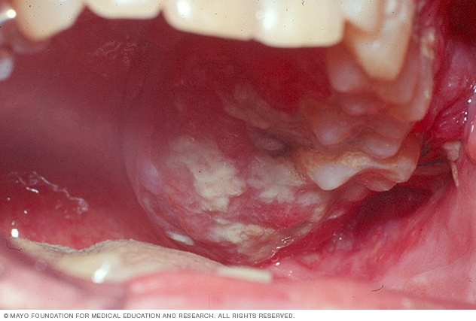
Background
Oral cancer is a tumor that develops in a part of the mouth. It may be on the surface of the tongue, the inside of the cheeks, the roof of the mouth (palate), the lips or gums. It is difficult, widespread cancer with a high fatality rate.
Deep learning is a machine learning and artificial intelligence (AI) technique inspired by human learning. Data science, which covers statistics and predictive modeling, contains deep learning as a major component.
We have applied custom CNN model. Also we used deep pooling, Flatten, Dense, conv2d, maxpool, dropout. For performance analysis we will use confusion matrix such as true positive, true negative etc. For datasets we used kaggle

Slide 4
Problem Statement
Oral cancer at early stage if can be detected than the survival chance gets high. Oral cancer being one of the deadliest cancer is costly to detect and if diagnosed then the expense for treatment is high too. In poor countries where betel leaf, tobacco is common has high risk of oral cancer and due to high cost detection test and treatment becomes unaffordable for a large number of people. We’ll build a system which will use deep learning and will be able detect oral cancer at early stage.

Slide 5
Review of Existing Similar Systems
In the paper, "Computer-assisted Medical Image Classification for Early Diagnosis of Oral Cancer Employing Deep Learning Algorithms," by Jeyaraj, P. R., and Samuel Nadar, E. R, they conceived and built a deep learning method for an autonomous cancer diagnostic system based on a partitioned convolution neural network.
In the paper, "Automated Detection and Classification of Oral Lesions Using Deep Learning for Early Detection of Oral Cancer" by Roshan K, Alex Welikala, Paolo Remagnino, Jian Han Lim, Chee Seng Chan, Senthilmani Rajendran, Thomas George Kallarakkal, Rosnah Binti Zain, Ruwan Duminda Jayasinghe, Jyotsna Rimal, Alexander Ross Kerr, Rahmi Amtha, Karthikeya Patil, and Wanninayake Mudiyanselage Tilakaratne, John Gibson discussed how to take and analyze images of the oral cavity, as well as how to automate oral cancer diagnosis. The contribution of this work is a novel method for merging bounding box annotations from many doctors, followed by a comparison of two deep learning-based automation methods.

Slide 6
Review of Existing Similar Systems
In the paper, "Deep Machine Learning for Oral Cancer: From Precise Diagnosis to Precision Medicine", by Rasheed Omobolaji Alabi, Alhadi Almangush, Mohammed Elmusrati, and Antti A. Mäkitie, they concentrated on deep learning's technical skills and approaches for OSCC. It looks into how deep learning may help identify cancer, classify photos, segment them, synthesize them, and plan treatments.
In the paper, "Computer-assisted Medical Image Classification for Early Diagnosis of Oral Cancer Employing Deep Learning Algorithm Paper," by Jeyaraj, P. R., and Samuel Nadar, E. R., they created a new learning system that uses weighted majority voting on given criteria to categorize normal, pre-, and post-cancerous areas in hyperspectral image datasets

Slide 7
Objective of The Project:
Detect Oral Cancer: Successful detection of oral cancer.
Percentage of Accuracy: Accurate result up to acceptable accuracy.
Cost Friendly : Cost effective, affordable.
Widely Useable for Medical Institutions : Develop a system which can be widely and easily used.

Slide 8
Feasibility Study Indicating Possible Solutions
Deep Learning :
Custom CNN Model
Flatten layer
Dense layer
Pooling layer
Max Pool
Conv2d
Dropout
Confusion matrix
Datasets

Slide 9
Expected Results of The Project:
We'll take a number of different models and put them through their paces one by one. We have already used mobilenetv2 model and custom CNN model which had accuracy of 76% and 86% following. Our goal is to reach a 94 to 98 percent accuracy rate. When matching, there's a chance we'll make a mistake or have a percentage error, or the system can contain erroneous data but our dataset contains clear images and the training data isn’t be hampered. We’ll apply 10-k-fold custom CNN model for more accuracy.

Slide 10
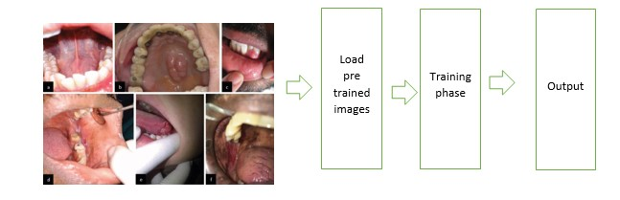
Detailed Diagrams for The Complete System and All Subsystems

Slide 11
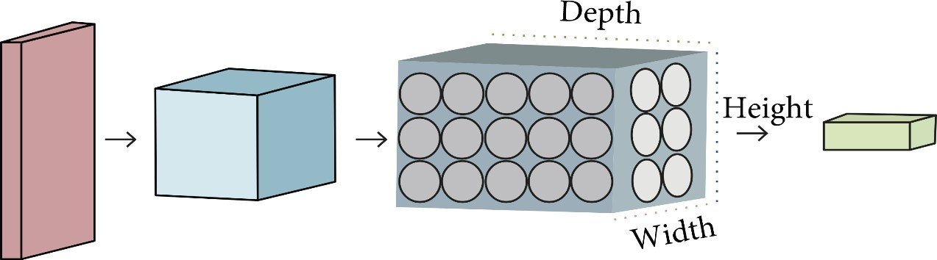
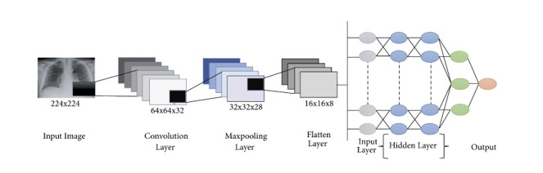
CNN Model
Custom CNN Model
Flatten layer
Dense layer
Pooling layer
Max Pool
Conv2d
Dropout
Confusion matrix
Datasets

Slide 12





CNN Model
CNN model layers have equations which are given below:

Slide 13
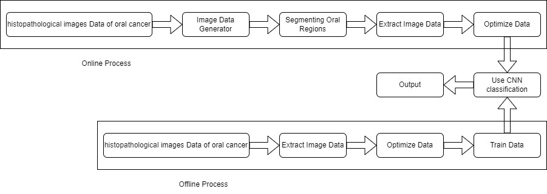
Input and Output Data Diagram

Slide 14
Working Steps
Background Study
Proposal Writing
Present Proposal
Data Collection
Train Data
Develop the System
Testing
Report Writing

Slide 15
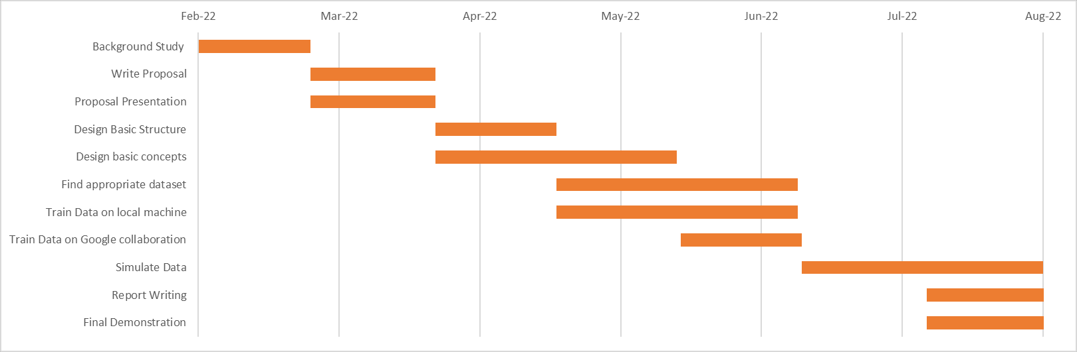
Gantt Charts Showing the Expected Timeline of Progress or Milestones

Slide 16
Required software tools
Google collaboration:
Jupiter notebook:
Collab is a Python editor for the web that allows anyone to develop and run Python programs. Machine learning, data analysis, and education are all areas where it comes in handy.
Jupiter Notebook is an open-source web tool that allows a user, scientist, scholar, or analyst to create and share a Notebook document that contains live codes, documentation, graphs, plots, and visualizations

Slide 17
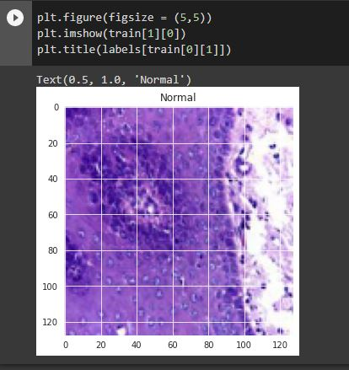
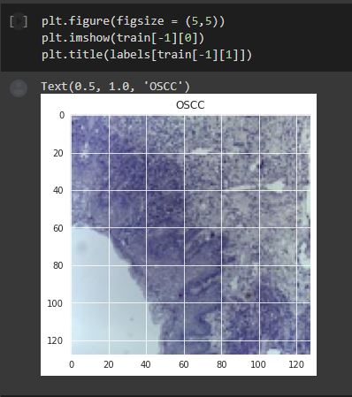
Dataset
We collected our datasets from kaggle and it was a dataset which contained histopathological images data and had total of 5192 files. This dataset is a image dataset. It contains 2435 images for normal and 2511 images of OSCC(Oral squamous cell carcinoma).
Fig: Dataset

Slide 18
Result analysis
We’ve implemented custom CNN model in which we have dense, flatten, conv2d, maxpool, dropout. We’ve used confusion matrix to show our result. We imported the model from keras. At first we used mobiloenetv2 but it had only 76% accuracy where our custom CNN model has 86% validation accuracy. Also at 100 epoch our training accuracy is 94% and our validation accuracy is 86%. We used confusion matrix for our result. Also our system is not overfitting because our training accuracy is higher than our validation accuracy and our training loss is less than our validation loss.

Slide 19
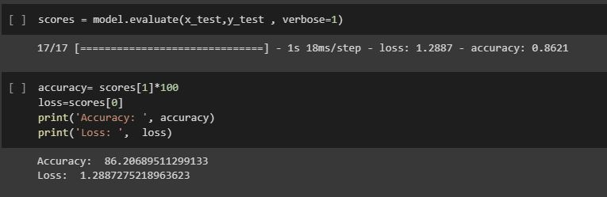
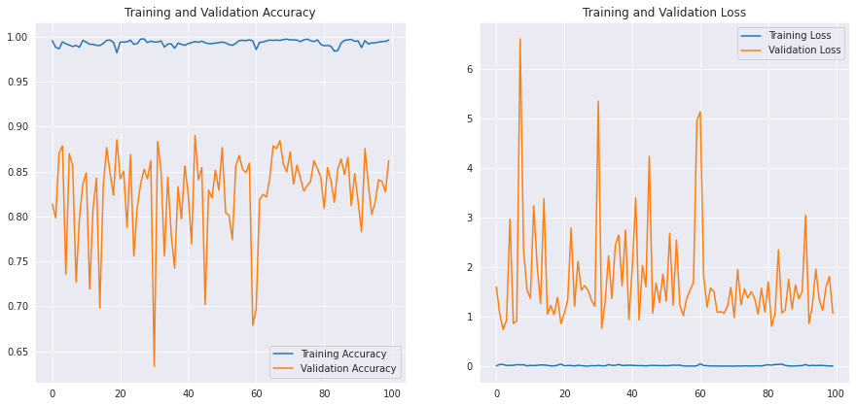
Result analysis
Fig: Model Accuracy
Fig: Training accuracy and loss vs.
validation accuracy and loss

Slide 20
Future Work
In near future we will be applying 10-k-fold custom CNN model and more algorithms so that we can get significant improvement in our accuracy which is around from 96-98%.

Slide 21
Conclusion
Early detection of oral cancer.
10-k-fold CNN model will be employed.
We have massive dataset that we can segment and train effectively.
After successful development, it will produce findings with an accuracy of up to 98 percent.

