Slide 1



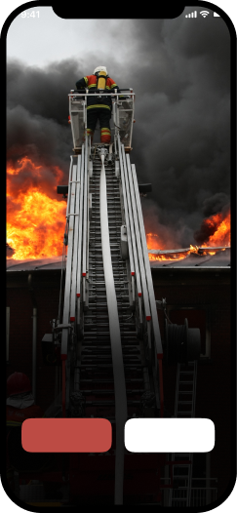
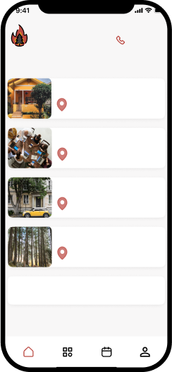
FindFire
App development for the Fire Prediction, Prevention, Control, Management
A4TB
Find Fire
Emergency
All for the best
Addresses
Home
Anny Akhmatovoi St, 24, Kyiv, Ukraine, 02000
Work
Anny Akhmatovoi St, 24, Kyiv, Ukraine, 02000
Find
Car
Tentative (Anny Akhmatovoi St, 24, Kyiv, Ukraine, 02000)
Fire
Nearby forest
Anny Akhmatovoi St, 24, Kyiv, Ukraine, 02000
Login
Sign up
+
Add new address
1

Slide 2


A4TB
Project idea
The aim of the project is to predict fire before it happens in the household/office/car or any other environment with the help of the sensors system. The data will then be sent to the app to make the users aware of the possible danger.
2

Slide 3


A4TB
Customer value proposition
Predicting probability of fire and showing results on screen
Accessibility feature which includes audio and visual alarms for people with special needs
Emergency call to the fire department (governmental organization)
3

Slide 4

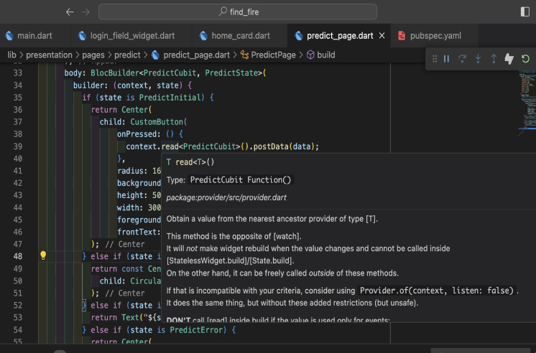


App development
App development - Flutter Framework of Dart
UI process
Typography
Aa
Poppins
Regular
Medium
SemiBold
Color palette
#BC4B44
#000000
4

Slide 5

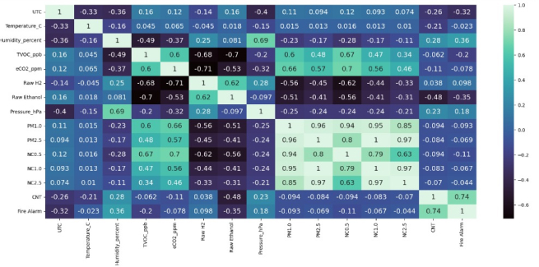
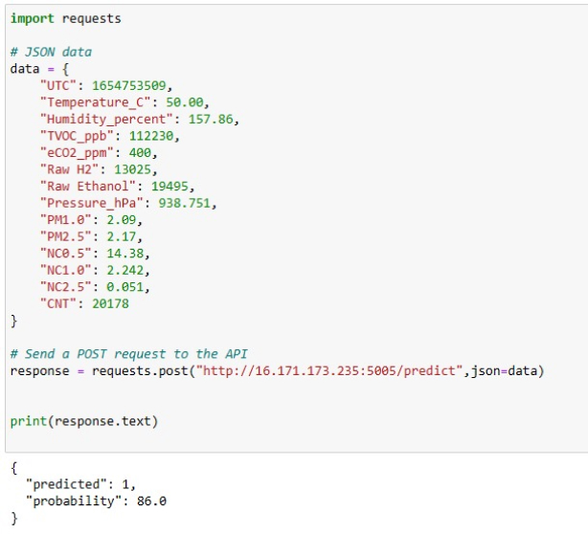
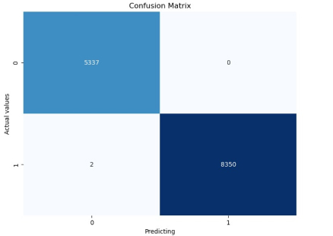
A4TB
ML algorithms & MLOps
Correlation and confusion matrix
Requesting AWS EC2 Server
5

Slide 6
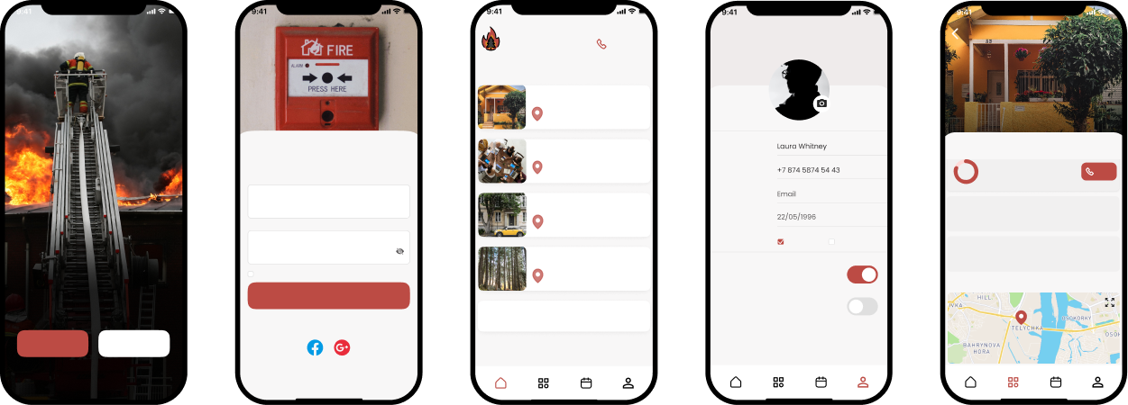


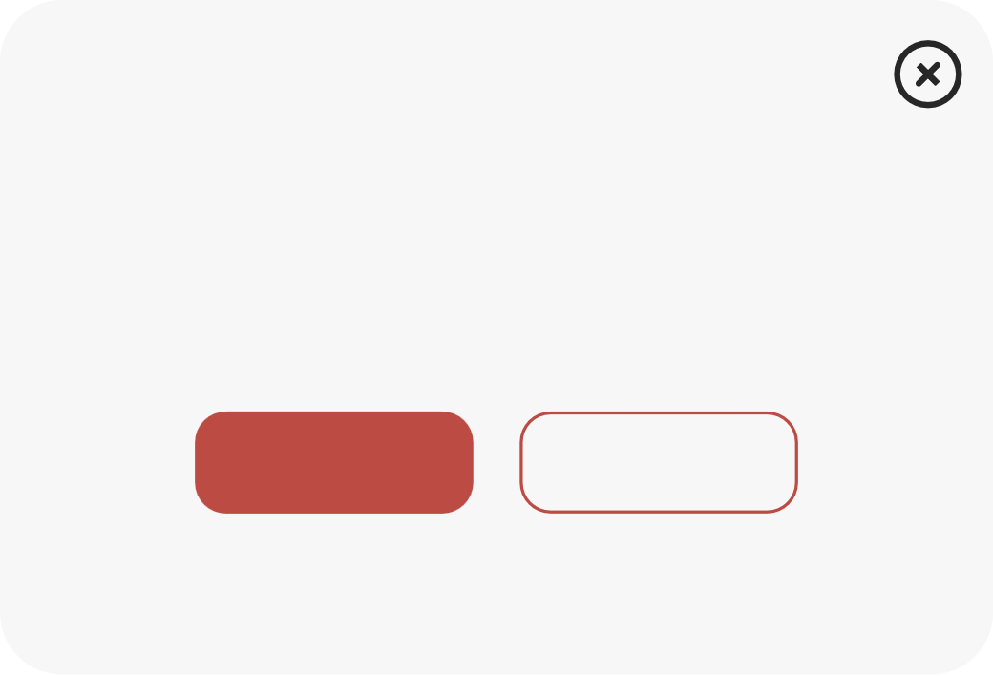
A4TB
App demonstration
Find Fire
Emergency
Cancel
Edit Profile
Done
Addresses
Home
Anny Akhmatovoi St, 24, Kyiv, Ukraine, 02000
Home data:
Login
Work
Name
New location
Anny Akhmatovoi St, 24, Kyiv, Ukraine, 02000
Fire probability
Phone Number
96%
Call
Email
Car
Email
Temperature alarm
email@gmail.com
Tentative (Anny Akhmatovoi St, 24, Kyiv, Ukraine, 02000)
Date of Birth
25% higher than usual at 35.5 °C
04/09/23
Find
Password
Gender
Female
Male
CO2 level alarm
*********
Nearby forest
25% higher than usual at 28 mmol/L
03/09/23
Fire
Remember me
Forgot password?
Anny Akhmatovoi St, 24, Kyiv, Ukraine, 02000
Visual alarms
My home address
Edit
Login
+
Audio alarms
Or Login with
Add new address
Login
Sign up
Don’t have any account? Sign Up
Do you want to call emergency center?
YES
NO
6

Slide 7

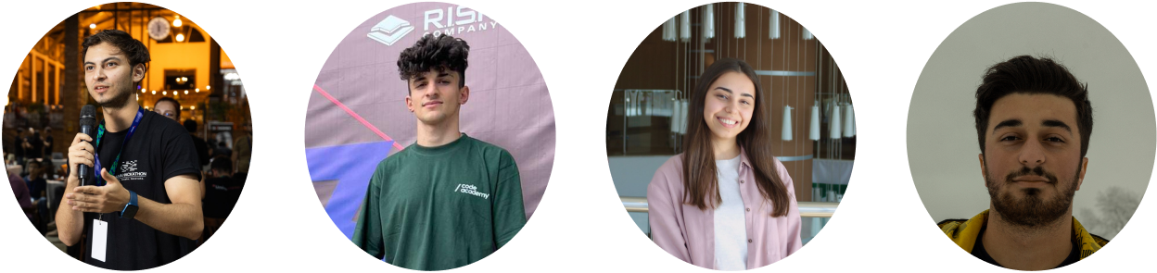
A4TB
Team
Rafig Rafigzada
Niyyat Rzayev
Aytan Sadirova
Yusif Aghasalamli
Project Manager
ML engineer, MLOps
UI/UX designer
Mobile developer
7

Slide 8

A4TB
Thank you!
8

