Slide 1
Capstone Project Presentation Finding Ice cream shop location 10/11/2019

Slide 2
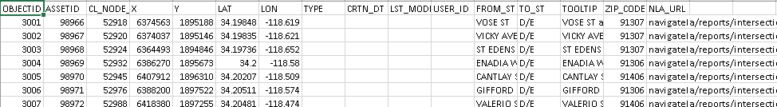
Initial raw data

Slide 3
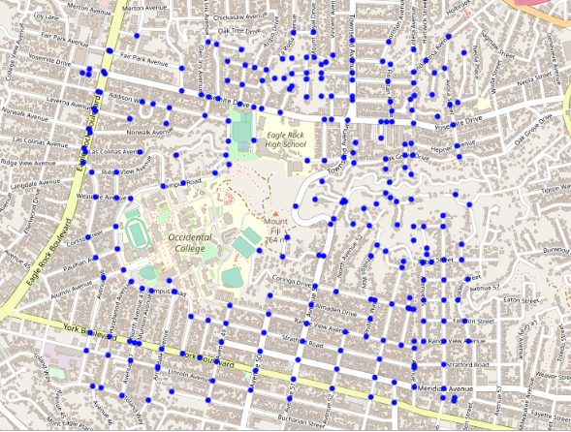
Map of the normalized raw data and specifying all the intersections

Slide 4
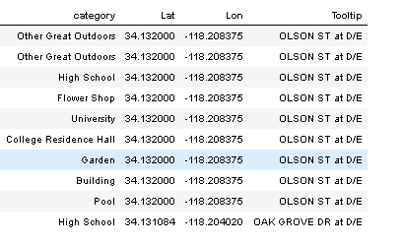
Business categories in each intersection using Foursquare

Slide 5
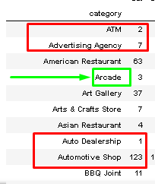
Business categories that are neutral and can be removed from the data shown in red, and example of businesses that are desirable to be close is shown in green

Slide 6
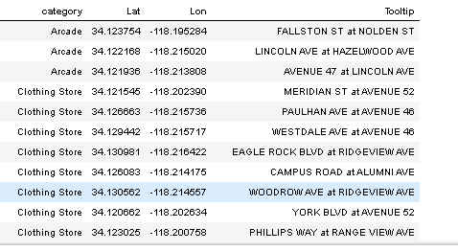
Arcade, Clothing Stores, and Schools are desired (for this assignment)

Slide 7
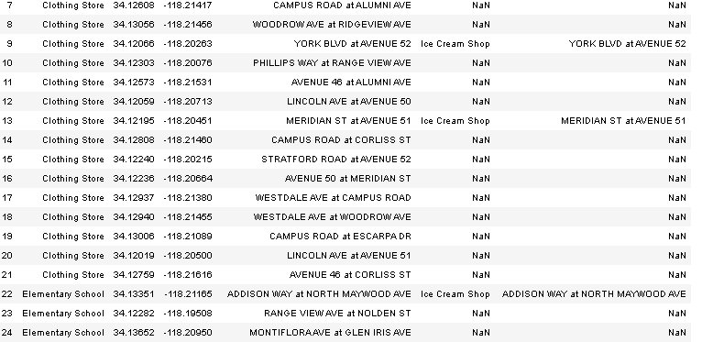
Joining two data-frames to eliminate intersections close to existing ice cream shops

Slide 8
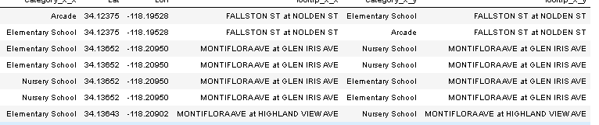
Joining the desired location to find the best locations having multiple desired locations in one place

Slide 9
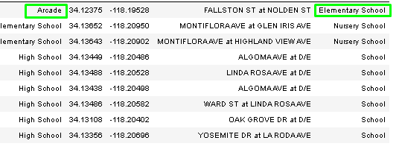
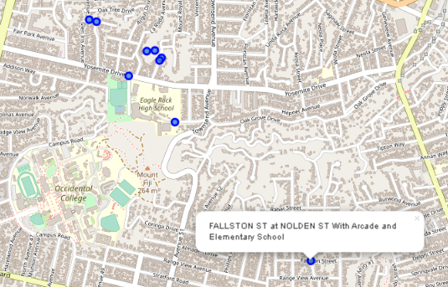
Best locations data-frame and shown on the map

