Slide 1


ACADEMIC WRITING SKILLS FOR RESEARCH JOURNAL ARTICLE
Mamun Bin Ibne Reaz
Department of Electrical, Electronic and Systems Engineering
Faculty of Engineering and Built Environment
Universiti Kebangsaan Malaysia
43600 UKM, Bangi, Selangor
Malaysia
Email: mamun.reaz@gmail.com, mamun@ukm.edu.my

Slide 2
Why do you write research or review article?
To let other people know about your invention
To share your knowledge
To promote yourselves and to fulfill the organization requirement
In academia, we tend to emphasize the number of papers; however, the quality and the reception of the papers is also important
20-December-2016 M. B. I. Reaz, SUST, Sylhet, Bangladesh

Slide 3
Why do we write research or review article?
Develop a good reputation
For example, granting agencies may consider other factors (such as related publications, citation counts)
The number of people who read and cite your papers depends on how well you communicate your ideas and their importance
Every profession is sales: In science, you are selling your ideas and your reputation
20-December-2016 M. B. I. Reaz, SUST, Sylhet, Bangladesh

Slide 4
Papers communicate ideas
Your goal: to infect the mind of your reader with your idea, like a virus
The greatest ideas are (literally) worthless if you keep them to yourself
20-December-2016 M. B. I. Reaz, SUST, Sylhet, Bangladesh

Slide 5
When to start?
Do Research
Write Paper
Idea
Write
Paper
Do
Research
Idea
20-December-2016 M. B. I. Reaz, SUST, Sylhet, Bangladesh

Slide 6
Conveying the idea
Here is a problem
It’s an interesting problem
It’s an unsolved problem
Here is my idea
My idea works (details, data)
Here’s how my idea compares to other people’s approaches
20-December-2016 M. B. I. Reaz, SUST, Sylhet, Bangladesh

Slide 7
General principles
Scientific writing does not have to be boring
It is like a story book. Your writing should attract the reader to read it to the end.
Learning to write is learning to edit yourself
Many students do a brain dump, edit it once and call it done, expecting the advisor to clean it up
20-December-2016 M. B. I. Reaz, SUST, Sylhet, Bangladesh

Slide 8
General principles
You should be giving your advisor work that you feel you have put your best effort into, not some half-baked writing that you have been too lazy to improve yourself
Good writers edit themselves repeatedly
Keep editing yourself until you cannot see any changes, your changes make it worse, or the thing is due
Editing often works best when done after a break
20-December-2016 M. B. I. Reaz, SUST, Sylhet, Bangladesh

Slide 9
General principles
Know the audience and the journal
One of the first things to think about as you write is who your audience will be
Go through the journal scope to know about the probable readers
For example, a journal is dominated by the medical related articles but they also publish biomedical engineering related articles OR your article is hardware dominated of an application and you are trying to publish it in a journal dominated on the application
20-December-2016 M. B. I. Reaz, SUST, Sylhet, Bangladesh

Slide 10
General principles
Know how people read
Your readers are time-pressed academics, not vacationers on a beach
Most are going to read things as quickly as possible to get the gist
A few are going to read things carefully and critically
Your reader may be reading long pieces in short bursts (e.g., the reviewers read a section or two at one time, with long interruptions)
20-December-2016 M. B. I. Reaz, SUST, Sylhet, Bangladesh

Slide 11
General principles
Your reader may be frequently interrupted (e.g., a surprising number of things get read on airplanes and your reader may be disrupted by crying babies or flight attendants selling duty free goods every 10 min)
Do not overestimate your readers attention span (e.g., do not assume that while reading section 4 of your article, they remember what you did in section 1)
20-December-2016 M. B. I. Reaz, SUST, Sylhet, Bangladesh

Slide 12
General principles
Some repetition is good (but do not overdue it)
Your reader should be able to get the basics of your article by:
reading the abstract
skimming the intro
reading the intro-methods transition
looking at the figures
skimming the discussion
20-December-2016 M. B. I. Reaz, SUST, Sylhet, Bangladesh

Slide 13
Before starting to write
Write down ideas in a free form, creating a general outline for the paper
What is the message of the paper?
What is the new result or contribution that you want to describe?
What do you want to convince people of?
Conduct a thorough literature search to identify those important contributions that are related to your work
20-December-2016 M. B. I. Reaz, SUST, Sylhet, Bangladesh

Slide 14
Before starting to write
Try to summarize the initial ideas into concrete bullets that will eventually become paragraphs.
Start to organize these bullets into a logical structure
Develop them in the form of key sentences.
If the outline is convincing, then the article will be successful.
20-December-2016 M. B. I. Reaz, SUST, Sylhet, Bangladesh

Slide 15
Type of articles
Research paper
Long paper (more than 5 pages till 30 pages)
Letter (1 to 3 pages)
Short communication (3 to 5 pages)
Review paper
20-December-2016 M. B. I. Reaz, SUST, Sylhet, Bangladesh

Slide 16
Structure (Research Article)
Title
Author’s name and affiliation
Abstract
Keywords
Introduction
Methodology
Results and Discussion
Conclusions
Acknowledgement
Reference
20-December-2016 M. B. I. Reaz, SUST, Sylhet, Bangladesh

Slide 17
Title
Should perfectly highlight your principal work
Avoid ornamental words
“Expert System for Power Quality Disturbance Classifier” - OK
“Design and Analysis of UHF Micropower CMOS DTMOST Rectifiers” - OK
“A Novel EMG Signal Analysis to Determine Muscle Fatigue” – NOT OK
Reliable, scalable, high performance, robust, low-complexity
20-December-2016 M. B. I. Reaz, SUST, Sylhet, Bangladesh

Slide 18
Author’s name and affiliation
You should use the same abbreviated name in all articles that you are going to write
Now a days, people use to communicate through email. Thus, be sure about your correct email address
Put your affiliation and address correctly
Each journal has different style thus follow the author’s guide
20-December-2016 M. B. I. Reaz, SUST, Sylhet, Bangladesh

Slide 19
Abstract
Abstract is the most important part of the article to attract the readers to go through the article
Your readers are time-pressed academics…
The abstract should be as concise as possible but tell the gist of whole story in one paragraph
So that reader feels to read the whole story
20-December-2016 M. B. I. Reaz, SUST, Sylhet, Bangladesh

Slide 20
Abstract
As a summary of work done, it is always written in past tense
An abstract should stand on its own, and not refer to any other part of the paper such as a figure or table
Focus on summarizing results - limit background information to a sentence or two, if absolutely necessary
What you report in an abstract must be consistent with what you reported in the paper
20-December-2016 M. B. I. Reaz, SUST, Sylhet, Bangladesh

Slide 21
Abstract
I always write the abstract last
No of words
50 words (letter)
50 – 100 words (short communication)
150 – 250 words (long paper)
Four sentences (for long paper)
State the problem
Say why it’s an interesting problem
Say what your solution achieves
Say what follows from your solution
20-December-2016 M. B. I. Reaz, SUST, Sylhet, Bangladesh

Slide 22
Abstract
It’s a summery of the whole article without any references and any ornamental words
Any sentences in abstract should not be repeated in the text
Hints:
Introduction – 1 to 2 lines
Methodology – 2 to 3 lines
Results & Discussion – 1 to 2 lines
Conclusion – ½ to 1 line
20-December-2016 M. B. I. Reaz, SUST, Sylhet, Bangladesh

Slide 23
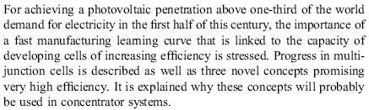
Abstract (long paper)
State the problem
Say why it’s an interesting problem
Say what your solution achieves
Say what follows from your solution
Ok
Ok
Ok but better put some value
OK
20-December-2016 M. B. I. Reaz, SUST, Sylhet, Bangladesh

Slide 24
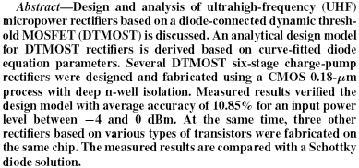
Abstract (long paper)
State the problem
Say why it’s an interesting problem
Say what your solution achieves
Say what follows from your solution
Not Ok (no problem stated)
Not Ok
Ok
Not OK
20-December-2016 M. B. I. Reaz, SUST, Sylhet, Bangladesh

Slide 25
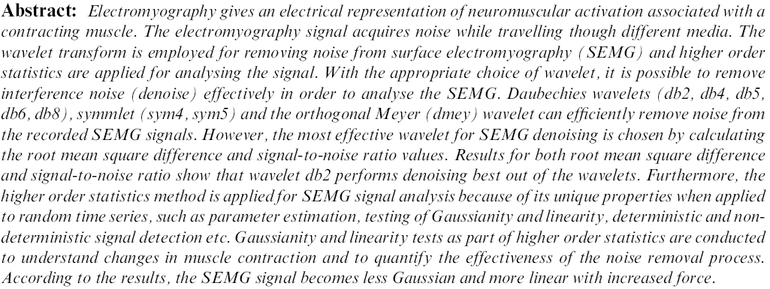
Abstract (long paper)
State the problem
Say why it’s an interesting problem
Say what your solution achieves
Say what follows from your solution
Ok
Not Ok
Ok
OK
20-December-2016 M. B. I. Reaz, SUST, Sylhet, Bangladesh

Slide 26
Abstract (letter & short paper)
Say what you have done
Ok
20-December-2016 M. B. I. Reaz, SUST, Sylhet, Bangladesh

Slide 27
Abstract (letter & short paper)
In this letter we show a fault localization system implemented by using policy-based thresholds for triggering alarms or self-healing mechanisms. Alarms are collected and organized within a codebook, which is a fundamental component of our fault management system. The relevant performance is analysed by using a real network deploying VoIP services.
Say what you have done
Ok
20-December-2016 M. B. I. Reaz, SUST, Sylhet, Bangladesh

Slide 28
Abstract (letter & short paper)
We formulate the issue of joint image segmentation and recognition as an integrated statistical inference problem. A two-layer graphical model is proposed that supports the optimal segmentation and recognition in an unified Bayesian framework. Due to the explicit modelling of two tasks in the graphical model, an efficient non-iterative belief propagation algorithm is used for state estimation. The proposed approach is applied to automatic licence plate recognition (ALPR), and it outperforms traditional methods where the two tasks are implemented independently and sequentially.
Say what you have done
Ok
20-December-2016 M. B. I. Reaz, SUST, Sylhet, Bangladesh

Slide 29
Keywords
Why keywords needed?
To search for a similar kind articles
The most common generic words that focuses your work should be used
CMOS analog circuits, power quality, fuzzy logic, electromyography
20-December-2016 M. B. I. Reaz, SUST, Sylhet, Bangladesh

Slide 30
Introduction
If ‘Abstract’ is interesting then the reader will go through the ‘Introduction’
If ‘Introduction’ fail to keep the readers interest then the paper is lost
Nearly every reader will at least skim through the introduction
20-December-2016 M. B. I. Reaz, SUST, Sylhet, Bangladesh

Slide 31
Introduction
Describe the importance (significance) of the study - why was this worth doing in the first place? Provide a broad context.
Defend the model - why did you use this particular system? What are its advantages?
Provide a rationale. State your specific hypothesis or objectives, and describe the reasoning that led you to select them.
Very briefly describe the experimental design and how it accomplished the stated objectives.
20-December-2016 M. B. I. Reaz, SUST, Sylhet, Bangladesh

Slide 32
Introduction
Use past tense except when referring to established facts
Organize your ideas, making one major point with each paragraph
Present background information only as needed in order to support a position
State the hypothesis/objective precisely - do not oversimplify.
20-December-2016 M. B. I. Reaz, SUST, Sylhet, Bangladesh

Slide 33
Introduction
The first paragraph should follow the inverted triangle principle
Start with a broad statement and become more detailed until finally identifying the specific problem
The purpose of the first paragraph is to interest the reader in the paper
The paragraph should end with the general problem addressed by the paper
20-December-2016 M. B. I. Reaz, SUST, Sylhet, Bangladesh

Slide 34
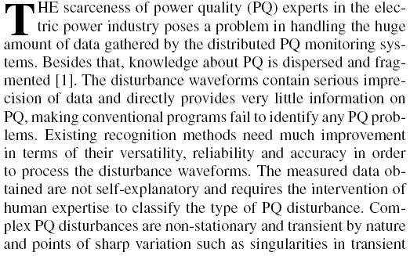

Introduction
Describe the problem
20-December-2016 M. B. I. Reaz, SUST, Sylhet, Bangladesh

Slide 35
Introduction
The remaining parts of the introduction is a series of paragraphs that traditionally function as a literature review
The beginning of the literature review should cite the most important historical contributions
For the research article, cite the seminal contributions that directly lead to the problem the article addresses
The literature review should be based on refereed journal articles to the extent possible
20-December-2016 M. B. I. Reaz, SUST, Sylhet, Bangladesh

Slide 36
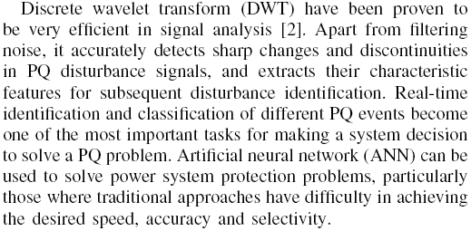
Introduction
Describe the features and advantages of the methods that you are going to use
20-December-2016 M. B. I. Reaz, SUST, Sylhet, Bangladesh

Slide 37
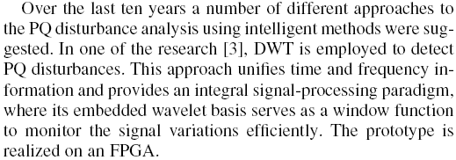
Introduction
Describe the similar works with their disadvantages
Is this paragraph following the rules of good introduction?
20-December-2016 M. B. I. Reaz, SUST, Sylhet, Bangladesh

Slide 38
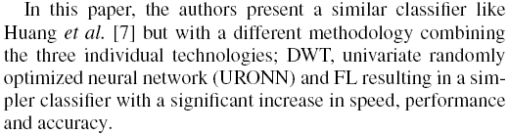
Introduction
Describe your work in brief with key achieved advantages i.e. state your contributions
Instead of ‘the author’ use ‘we’, ‘our’
20-December-2016 M. B. I. Reaz, SUST, Sylhet, Bangladesh

Slide 39
Introduction (letter)
It will follow almost same structure like the ‘Introduction’ for long paper but in brief
There will be no paragraph of describing the similar works with their disadvantages
20-December-2016 M. B. I. Reaz, SUST, Sylhet, Bangladesh

Slide 40
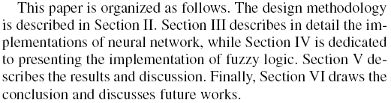
Introduction
Never put the organizational structure of the article
This is an example of bad INTRODUCTION
20-December-2016 M. B. I. Reaz, SUST, Sylhet, Bangladesh

Slide 41
Introduction (wrap up)
Describe the problem so that readers know the context of the article
Describe the features and advantages of the methods that you are going to use
Describe the similar works with their disadvantages
Describe your work in brief with key achieved advantages i.e. state your contributions
20-December-2016 M. B. I. Reaz, SUST, Sylhet, Bangladesh

Slide 42
Introduction (few things to note…..)
All works should be properly referenced except yours (your early work also should be referenced)
Failing to give credit to others can kill your paper
If you imply that an idea is yours, and the referee knows it is not, then either
You don’t know that it’s an old idea (bad)
You do know, but are pretending it’s yours (very bad)
There should have a flow from one paragraph to the next paragraph
Be brief
Do not leave the reader to guess what your contributions are!
20-December-2016 M. B. I. Reaz, SUST, Sylhet, Bangladesh

Slide 43
Methodology
Describe the methodology that you are adopting in detail
State the assumption clearly (if any)
Justify all the stated assumptions
Use diagrams, flowcharts and clear (high resolution) illustrations to make the description more understandable
20-December-2016 M. B. I. Reaz, SUST, Sylhet, Bangladesh

Slide 44
Methodology
Use appropriate equations but avoid deriving the equation
Too many equations make the article less interesting
Each equation must be numbered consecutively
Avoid detail description of known algorithms such as ANN, FL, DWT etc
Methodology is not a set of instructions thus avoid all explanatory information and background
20-December-2016 M. B. I. Reaz, SUST, Sylhet, Bangladesh

Slide 45
Methodology (letter)
It will follow almost same structure like the ‘Methodology’ for long paper but in brief (avoid excessive words to describe)
Usually there is a limitation of using certain numbers of figures and illustrations
20-December-2016 M. B. I. Reaz, SUST, Sylhet, Bangladesh

Slide 46
Results and discussion
Results should be clear, convincing, and general and free from interpretations or opinions
It is better to write the data source (if any) at the beginning of this section
Summarize your findings in text and illustrate them, if appropriate, with figures and tables
Presenting the results graphically or through table helps to understand
20-December-2016 M. B. I. Reaz, SUST, Sylhet, Bangladesh

Slide 47
Results and discussion
Use past tense when you refer to your results
In text, describe each of your results, pointing the reader to observations that are most relevant
Describe results of control experiments and include observations that are not presented in a formal figure or table, if appropriate
20-December-2016 M. B. I. Reaz, SUST, Sylhet, Bangladesh

Slide 48
Results and discussion
Your introduction makes claims
Disadvantages of other works
Advantages of your work
The methodology part of the paper provides evidence to support each claim
Check each claim in the introduction, identify the evidence, and forward-reference it from the claim
Evidence can be: analysis and comparison, theorems, measurements, case studies
20-December-2016 M. B. I. Reaz, SUST, Sylhet, Bangladesh

Slide 49
Results and discussion
The most important part of the discussion is comparison among various methods
How do the results compare with earlier work?
What is new and significant?
Comparison should be on apple to apple
The same data should be used with other methods to compare your results
Never claim any sort of superiority of your work without any proof from your result and comparison
20-December-2016 M. B. I. Reaz, SUST, Sylhet, Bangladesh

Slide 50
Results and discussion
Do not simply dismiss a study or part of a study as "inconclusive.“
Research papers are not accepted if the work is incomplete
Draw what conclusions you can based upon the results that you have, and treat the study as a finished work
Explain all of your observations as much as possible
Try to offer alternative explanations if reasonable alternatives exist
20-December-2016 M. B. I. Reaz, SUST, Sylhet, Bangladesh

Slide 51
Results and discussion
Refer to work done by specific individuals (including yourself) in past tense.
Refer to generally accepted facts and principles in present tense
Do not present a superficial interpretation that more or less restates the results
20-December-2016 M. B. I. Reaz, SUST, Sylhet, Bangladesh

Slide 52
Results and discussion
In text, refer to each figure as "figure 1," "figure 2," ; same goes for table
Place figures and tables, properly numbered
Either place figures and tables within the text of the result, or include them in the back of the report
For the same data, do not use both table or graph
20-December-2016 M. B. I. Reaz, SUST, Sylhet, Bangladesh

Slide 53
Results and discussion
Each figure must be numbered consecutively and complete with caption (caption goes under the figure)
Each table must be titled, numbered consecutively and complete with heading (title with description goes above the table)
Each figure and table must be sufficiently complete that it could stand on its own, separate from text
20-December-2016 M. B. I. Reaz, SUST, Sylhet, Bangladesh

Slide 54
Results and discussion (letter)
It will follow almost same structure like the ‘Result and Discussion’ for long paper
There will be no comparison study
20-December-2016 M. B. I. Reaz, SUST, Sylhet, Bangladesh

Slide 55
Conclusions
State the principal object of your work
State the achieved results (only the final outcome)
State the benefits that can be achieved from the acquired final outcome
Suggest future research from the end point of your research
Here you should not present any new information
20-December-2016 M. B. I. Reaz, SUST, Sylhet, Bangladesh

Slide 56
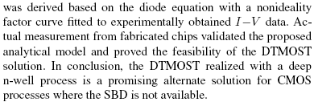
Conclusions
Suggesting future research is not mandatory
20-December-2016 M. B. I. Reaz, SUST, Sylhet, Bangladesh

Slide 57
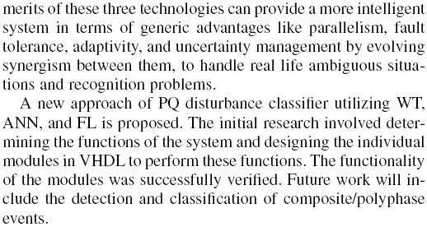
Conclusions
Is it following the primary rules of writing a conclusion?
If NOT then what should be deleted or need to be added?
State the principal object of your work
State the achieved results (only the final outcome)
State the benefits that can be achieved from the acquired final outcome
Suggest future research from the end point of your research
20-December-2016 M. B. I. Reaz, SUST, Sylhet, Bangladesh

Slide 58


Acknowledgement
In this section, you can acknowledge those who helped conducting the research including financial support
Example 1:
Example 2:
20-December-2016 M. B. I. Reaz, SUST, Sylhet, Bangladesh

Slide 59
References
Put here all the cited reference in the text chronologically (1, 2, … or A, B, …)
There are two types of reference styles are being used
A numbered list of references
[1] Name, Title, Publisher name, Vol (if any), Issue (if any), Page no., Date (month and year for journal and date for conference, Place (for conference)
Note: the reference should be cited in the text in numbers i.e. [1], [2]…..
20-December-2016 M. B. I. Reaz, SUST, Sylhet, Bangladesh

Slide 60
References
A author list of references
Same as above but chronologically on authors first/last name
Note: the reference should be cited in the text by author’s name i.e. (Ali et. al., 2007)
Usually journal citation is more stronger than citation from conference proceedings
Avoid citing unpublished thesis, internal report and private correspondence
Try to put webpage reference as little as possible
20-December-2016 M. B. I. Reaz, SUST, Sylhet, Bangladesh

Slide 61
Structure (Review Article)
Title
Author’s name and affiliation
Abstract
Keywords
Introduction
No Methodology
No Results
Key researches on the topic
Discussion
Conclusions
Acknowledgement
Reference
20-December-2016 M. B. I. Reaz, SUST, Sylhet, Bangladesh

Slide 62
Title
Should perfectly highlight your principal review work
Usually review article cited more than research article
You need to make title such that it sounds like a review rather than technical article
Techniques of EMG Signal Analysis: Detection, Processing, Classification and Applications.
Detection and Processing Techniques of FECG Signal for Fetal Monitoring
Image Compression System for Mobile Communication: Advancement in the Recent Years
Advances in Signal Processing and Artificial Intelligence Technologies in the Classification of Power Quality Events: A Survey
20-December-2016 M. B. I. Reaz, SUST, Sylhet, Bangladesh

Slide 63
Abstract
The abstract is almost like research article but it will rather give a guideline instead of result.
Electromyography (EMG) signals can be used for clinical/biomedical applications, Evolvable Hardware Chip (EHW) development, and modern human computer interaction. EMG signals acquired from muscles require advanced methods for detection, decomposition, processing, and classification. The purpose of this paper is to illustrate the various methodologies and algorithms for EMG signal analysis to provide efficient and effective ways of understanding the signal and its nature. We further point up some of the hardware implementations using EMG focusing on applications related to prosthetic hand control, grasp recognition, and human computer interaction. A comparison study is also given to show performance of various EMG signal analysis methods. This paper provides researchers a good understanding of EMG signal and its analysis procedures. This knowledge will help them develop more powerful, flexible, and efficient applications.
20-December-2016 M. B. I. Reaz, SUST, Sylhet, Bangladesh

Slide 64
Key Researches on the Topic
Download at least 150 articles based on the keywords
Scan each article and keep only which are related (at least 70 articles)
Read each article and note down the following:
Citation of the article
Key research method and findings
Advantages
Disadvantages
20-December-2016 M. B. I. Reaz, SUST, Sylhet, Bangladesh

Slide 65
Key Researches on the Topic
Complete the same for all 70 articles
Then append all and make a complete story
The review can be based on HISTORY or can be based on the popular BASIC METHODS
20-December-2016 M. B. I. Reaz, SUST, Sylhet, Bangladesh

Slide 66
Discussion
The most important part of the review article is discussion
Your discussion should be based on all the review that you have made
From your expert analysis you will give a future direction on the review topic
20-December-2016 M. B. I. Reaz, SUST, Sylhet, Bangladesh

Slide 67
Structure (Conference Article)
Title
Author’s name and affiliation
Abstract
Keywords
Introduction
Methodology
Results and Discussion
Conclusions
Acknowledgement
Reference
20-December-2016 M. B. I. Reaz, SUST, Sylhet, Bangladesh

Slide 68
Structure (Conference Article)
Conference article can be an idea only
Conference article is the preliminary results of a research
Even if you have the complete result, please do not put all the results in the conference article to avoid the duplication in publishing to journal
20-December-2016 M. B. I. Reaz, SUST, Sylhet, Bangladesh

Slide 69
Which journal?
Many factors are involved in the decision
Impact of the journal vs probability of acceptance
Publication lag
Desired audience
Read the ‘Scope’ of the journal
Read carefully the “Instructions for authors”
20-December-2016 M. B. I. Reaz, SUST, Sylhet, Bangladesh

Slide 70
Reviewers
Most articles usually reviewed by 2 to 4 external reviewers
These are experts in your field who read the article and give their opinions
They comment on scientific merit, suitability to the journal for which you are applying, and readability
They are not likely to correct grammar or poor organization; however, negatives in these areas will probably lead to a negative assessment of the scientific merit
20-December-2016 M. B. I. Reaz, SUST, Sylhet, Bangladesh

Slide 71
Reviewers
By writing the best literary article, you maximize the chances that the reviews will be favorable
The bulk of the decision will then land where it should: on the scientific merit of your contribution
The best-written article that presents poor science is still not publishable
20-December-2016 M. B. I. Reaz, SUST, Sylhet, Bangladesh

Slide 72
How to Make Responses
Try to understand every single comments that has been given by the reviewer.
Though the comments are presented in descriptive way but try to figure out the number of questions from every paragraph of the description.
Once questions are figured out, give answer for every single question.
Show your extreme politeness in your responses even though the questions are not appropriate.
20-December-2016 M. B. I. Reaz, SUST, Sylhet, Bangladesh

Slide 73
How to Make Responses
Always try to give answer in detail rather than only YES or NO.
Remember that the reviewer will feel comfortable to get the answer from the RESPONSE rather opening the manuscript again to understand your response.
Your response should reflect in the manuscript thus you need to revise the article accordingly.
20-December-2016 M. B. I. Reaz, SUST, Sylhet, Bangladesh

Slide 74
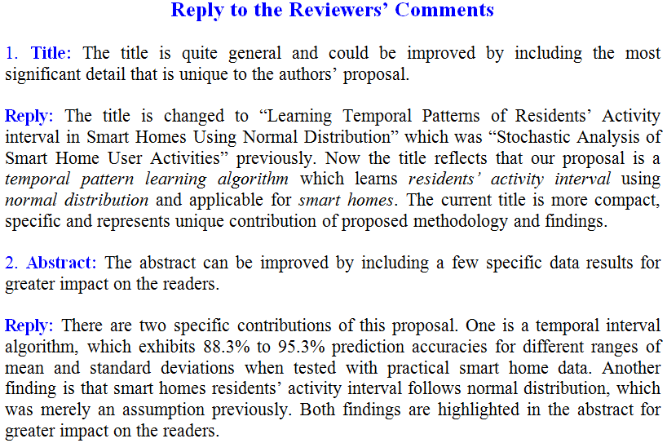
How to Make Responses
20-December-2016 M. B. I. Reaz, SUST, Sylhet, Bangladesh

Slide 75
Thank You
20-December-2016 M. B. I. Reaz, SUST, Sylhet, Bangladesh

