Slide 1














Abstractive
text summarization

Slide 2

Introduction
Abstractive Text Summarization is a technique that involves generating concise and fluent summaries by understanding the semantic meaning of the original text. Unlike extractive summarization, which selects sentences from the original text, abstractive summarization generates new text that captures the key ideas.

Slide 3
Strong Foundation: T5 is pre-trained on a massive dataset, providing a strong foundation for various NLP tasks, including summarization.
01.
Problem
Methodology
High-Quality Summaries: T5's ability to understand the semantic meaning of text allows it to generate concise and informative summaries.
02.
We used a pre-trained model which is T5 for fine-tuning
Transfer Learning: By fine-tuning the pre-trained T5 model on a specific summarization dataset, we can quickly adapt it to our task.
03.

Slide 4
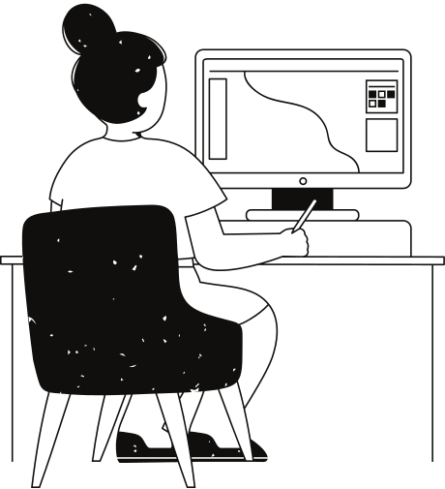
T5
T5 (Text-To-Text Transfer Transformer) is a powerful language model developed by Google AI.
It's designed to handle a wide range of natural language tasks, including text summarization, translation, question answering, and more.

Slide 5
T5 Architecture
01
02
03
04
Input Encoding: The input text (article or document) is tokenized and converted into a sequence of numbers.
Encoder-Decoder Architecture: The T5 model processes the input sequence using an encoder, which generates a contextual representation.
Decoder Generation: The decoder generates the summary token by token, conditioned on the encoder output and previously generated tokens.
Decoding Process: The decoding process continues until a special end-of-sequence token is generated, indicating the completion of the summary.

Slide 6

Creation process
first for choosing the model we tested T5 and BART pre-trained models to see which one would generate the shortest summarization.

Slide 7
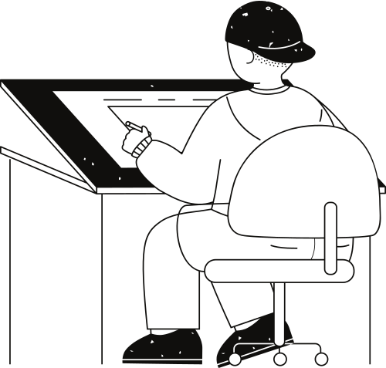



Loading the model
Training args:
num_train_epochs=2
learning_rate=2e-5
gradient_accumulation_steps=500
training
Making a tokenizer which receives a batch of dialogue and a target batch from the summary using auto tokenizer

Slide 8
Result
Mohamed: what work you planning to give Tom?
Ahmed: i was hoping to send him on a business trip first.
Mohamed: cool. is there any suitable work for him?
Ahmed: he did excellent in last quarter. i will assign new project, once he is back.
Mohamed: i was hoping to send him on a business trip first . i will assign new project once he is back .
Mohamed: i was hoping to send him on a business trip first . i will assign new project once he is back .

Slide 9
Thank you very much!

