Slide 1


Final project:
Neural Machine Translation
Team:
Rafik Sameh Mario Gamal Rahma Samy
Presented to:
Dr. Mahmoud Farag

Slide 2

Steps of Implementation
Data Preparation: Cleaned and preprocessed text, tokenized sentences, and split datasets.
Model Selection: Started with RNN, then LSTM, and finally implemented a Transformer model.
Training: Trained each model, optimizing hyperparameters for each architecture.
Comparison: Highlighted improvements in accuracy and speed from RNNs to Transformers.

Slide 3
Exploring RNN, LSTM, and Transformer Models
 | RNN | LSTM | Transformer
Advantages | Good for handling sequential data by maintaining memory of previous inputs. | Better at handling long dependencies with gating mechanisms | - Excels with long dependencies due to self-attention - Allows parallel processing
Disadvantages | Struggles with long sequences due to vanishing gradient, resulting in loss of context for long sentences. | Sequential processing is slow, limits parallelization | Computationally intensive but manageable with modern hardware

Slide 4
RNN Model
Load Data
Preprocessing
Tokenization
Padding
Encoding
Embedding / Bidirectional Network
Decoding
Compilation and testing
Deployment

Slide 5
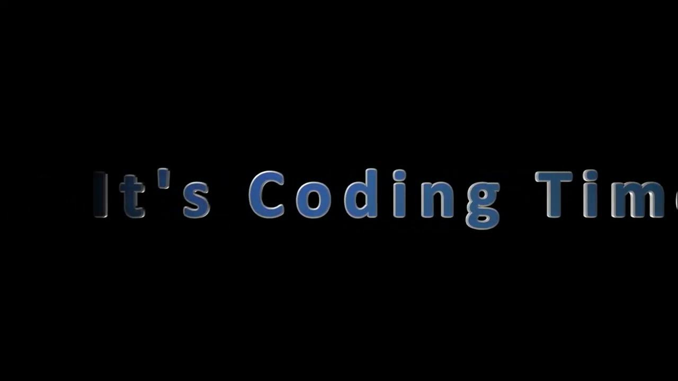

Slide 6
Introduction to LSTM
What is LSTM?
LSTM (Long Short-Term Memory) is a type of recurrent neural network (RNN) designed to capture long-term dependencies in sequential data.
Crucial in handling text and language for machine translation, retaining context across longer spans.

Slide 7
Why Choose LSTM for Machine Translation?
Handling Long Dependencies:
LSTMs effectively handle long sequences and retain context better than standard RNNs.
Mitigating Vanishing Gradient Problem:
LSTMs' cell state structure allows maintaining information across long sequences, avoiding the vanishing gradient issue seen in RNNs.

Slide 8

Sequence-to-Sequence (Seq2Seq) Approach with LSTM
Overview:
Seq2Seq model has an encoder and decoder, both using LSTMs.
Encoder:
Processes source language sentence, creating a fixed-length context vector.
Decoder:
Uses context vector to generate the target language sentence token-by-token.
Applications:
Machine translation, chatbots, text summarization.

Slide 9
Advantages of Seq2Seq in Translation
Flexible Length Handling:
Seq2Seq models handle variable-length input/output sequences, ideal for diverse sentence structures.
Contextual Understanding:
Encoder-decoder pairs enable better contextual understanding and translation accuracy.

Slide 11
Marian Pre-trained
MarianMT (Marian Transformer) is a highly efficient and specialized Transformer model designed by the OpenNMT team for neural machine translation (NMT). Here are several reasons why Marian Transformer is well-suited for machine translation:
1. Optimized for Machine Translation
2. Performance and Speed
3. Multilingual Support
4. Pre-trained Models Availability
5. Quality of Translation
6. Flexibility with Deployment
7. Resource-Efficient
8. Open-Source and Customizable

Slide 12
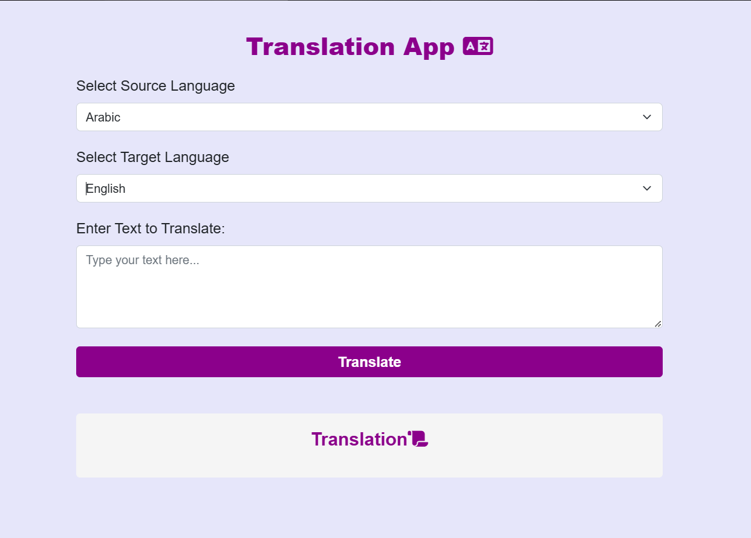
Introduction to Deployment
Goal:
- Deploy a neural machine translation model for real-time English-to-Arabic translation using Django.
- Platform: Use Django to build a web application and serve the model with REST APIs.
Deployment Components
Django Framework:
-Serves as the backend application to manage requests and responses.
-Model Serving: Load and use the trained model within the Django app using TensorFlow/Keras.
-API Endpoints: Expose RESTful API endpoints for text translation.

Slide 14

Thank You

