Slide 1

“Bangladesh Covid Situation Analysis and Tracking”

Slide 2




Group No:05 Members are:
Maria Mehjabin Shenjuti (2018-1-60-244)
Rafina Afreen (2018-1-60-119)
Md. Tanvir Hossain Joarddar (2018-1-60-242) Zubayar Mahatab Md Sakif (2018-1-60-105)
Use hand sanitizer
Wear a mask
Cover your sneezes and coughs
Avoid close contact

Slide 3

The COVID-19 (Coronavirus Disease 2019), also known as SARS-CoV-2 has spread rapidly around the world and the current condition is becoming worse day by day. This is a pandemic disease that spreads from person to person on a daily basis.
Introduction:
In our project we used supervised machine learning algorithms like (linear regression and time series forecasting) where for different time, lab-tests, death case etc. as input we perform regression and classification to analyse data for a particular time and also predict the number of confirmed cases in future days from this disease.

Slide 4
Objectives:
This research aims to build two kind of supervised machine learning models to predict the status of recovered and death coronavirus Covid-19 patients in Bangladesh.
Use Linear Regression algorithms to predict confirmed case.
Use Time series prediction algorithms to identify future Covid situation and the pick point.
Interpret different visualizations over the Covid dataset.
How much similarity there is between actual data and predicted data.

Slide 5
Flowchart:
Covid-19 dataset of Bangladesh
Feature Extraction
Preprocessing
Linear Regression
SARIMA
Prediction
Output the total no. of confirmed cases

Slide 6

Dataset Characteristics:
Covid Dataset |  | Covid Dataset
SN | Column | Number | Data Type | Null Count
1 | Day | 626 | datetime64 | 0
2 | Lab Test | 626 | int64 | 0
3 | Confirmed case | 626 | int64 | 0
4 | Death Case | 626 | int64 | 0

Slide 7
Dataset Characteristics:
Dataset | Minimum | Maximum | Sum | Mean | Standard Deviation
Date | 04-April-2020 | 20-December-2021 | - | - | -
Lab Test | 367 | 55284 | 11289181 | 18033.84 | 9357.62
Confirmed Case | 9 | 16230 | 1581282 | 2526.01 | 2936.76
Death Case | 0 | 264 | 28044 | 44.79 | 54.53

Slide 8
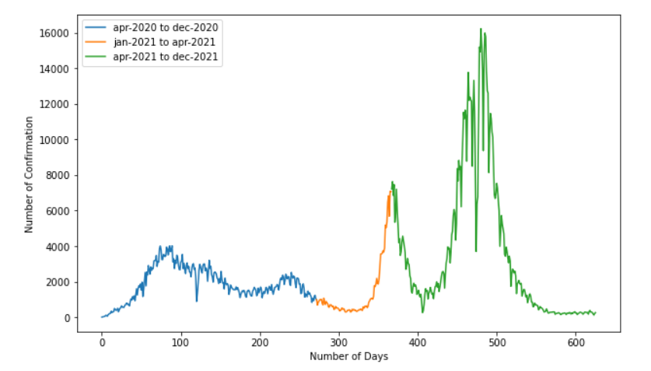

Dataset Analysis:
In our dataset we see that there is a huge difference among the confirmed case data between 2020 and 2021. The data in the blue area (from apr-2020 to dec-2020) have lower curve then the data in green area (from apr-2021 to dec-2021). So, it is very difficult for predicting the accurate confirmed case value with the model.

Slide 9
Data Preprocessing:
Check the null values and dropped it from the dataset.
Drop Day column for the Regression model as the date had no significant to predict the output.
For time series model, we cast our date column in datatype and set it as our index.
We grouped by our data using Day column to merge the same date info together.
Then we resampled our data to weekly format.
We also dropped Lab test and Death Case column in our time series model.

Slide 10
Machine Learning Models:
Linear regression:
The linear regression algorithm, as the name suggests, shows a linear relationship between a dependent and one or more independent variables. Since linear regression reveals a linear relationship, it finds the change in the dependent variable’s value as a function of the independent variable’s value.
Y = β₀ + β₁ * Xi₁ + β₂ * Xi₂ + ….. β_{n} * Xi_{n}
Here, Y is the Output,
Xi, is the feature,
β₀, is the intercept and
β_{n} is the coefficient. β₀ and β_{n} are the model coefficient for feature Xi.

Slide 11
Linear regression:
LR Model
Input Column | Lab Test, Death Case
Output Column | Confirmed Case
Here, In Regression model we get the Model Score = 0.8823 means 88%

Slide 12

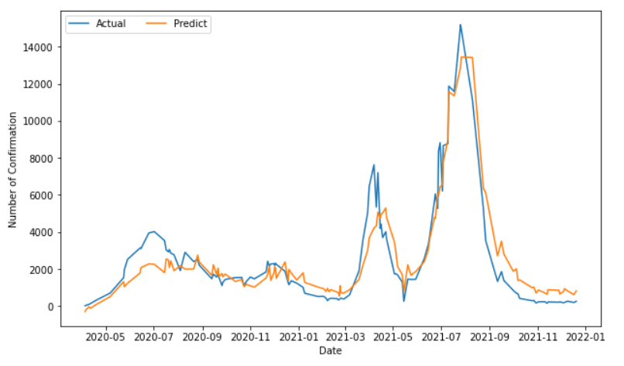
Performance Evaluation(LR):
Fig: Actual vs Predicted result in LR
Here, the actual and the prediction result graphs show much similarity. but at some point, it gives a dissimilar result which is negligible.

Slide 13
Machine Learning Models:
Time Series(SARIMA):
A time series is a collection of observations of well-defined data items obtained through repeated measurements over time.
ARIMA (p, d, q) * (P, D, Q) S
Here,
p = non-seasonal AR order,
d = non-seasonal differencing,
q = non-seasonal MA order,
P = seasonal AR order,
D = seasonal differencing,
Q = seasonal MA order, and
S = time span of repeating seasonal pattern.

Slide 14
Get P,D,Q Value From Iteration:
Here, we have taken a set of value from 0 to 8 for P and Q. For D we take a set of value 0-2. and also take a seasonal value for s.
Then for all the combination of p,d,q value and seasonal value s, we have calculated the RMSE value.
After sorting the RMSE value in ascending order we take the lowest p,d,q value for the SARIMA model.

Slide 15
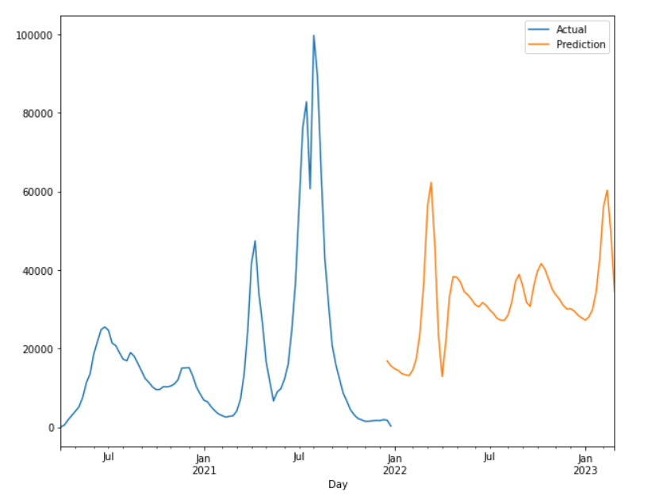
Performance Evaluation(SARIMA):
Fig: Future Prediction of SARIMA
Here, we have forecast the confirm case value for 6 months. And from the graph we can see some pick point of confirmed case in January - March, May.

Slide 16
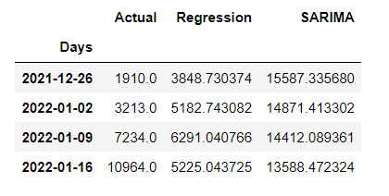
Comparison:
Till now we have seen the algorithm wise prediction result by the model LR and SARIMA. the predictions made by the model based on the algorithm may be more or less accurate. Thus, it requires comparison with the actual data of number of Confirmed Cases. So, The below diagram shows the result containing comparison of the trained model output with LR, SARIMA and Actual data.

Slide 17
Result Analysis:
Here, the accuracy of time series model is not very good in our model due to the Dataset. but the advantage of this model is we can predict the future value by using the past value through this model and there is no need of new data for prediction. By this model we can see the future pick point for a variable in the dataset.
In our project, Regression model predicts much more accurate result than the Time Series model. but the Regression can’t measure the seasonality. But, at the current situation of the COVID -19 rising the Time Series model predicts more accurate result then the Regression.
The model can be further trained by increasing the number of training set to fit over the actual data.

Slide 18

Conclusion:
In our project we have discussed how we can use machine learning to predict the growth of an epidemic called COVID-19. We have used linear regression model and time-series forecasting of supervised machine learning. Mainly, COVID-19 outbreaks are predicted based on past trends.
In our dataset the present values are less similar to past values. In the time series approach we found non-seasonal values more than seasonal values, that's why in SARIMA the result values are not much similar to accurate values.

Slide 19
“Stay Home, Stay Safe” Thank you……

