Slide 1
MINI PROJECT PRESENTATION
HOTELPRO
MANAGEMENT SUITE
Manage rooms, bookings, guests and billing from one web dashboard.
RAFIQ ROSHAN M
B.Tech – Information Technology
Rajalakshmi Engineering College, Chennai
Roll No: 2116241001182
HTML5 | CSS3 | JavaScript | Bootstrap

Slide 2
Project Overview
A web-based system for managing day-to-day hotel operations
What is the project?
Problem addressed
HotelPro Management Suite is a web application that lets hotel staff manage rooms, reservations, guest records and billing, and view live occupancy and revenue summaries.
Manual registers and scattered spreadsheets cause double bookings, slow check-ins, billing errors and no clear view of room availability or revenue.
The proposed solution
• Keep room, guest and booking data in organized management sections.
• Provide real-time room status and a live dashboard.
• Generate invoices and download them as a PDF.
2

Slide 3
Objectives
The main goals of the HotelPro Management Suite
Easy booking
Room management
Live dashboard
Create and manage guest reservations quickly.
Track room status: available, occupied, cleaning.
Show occupancy, check-ins and revenue instantly.
Billing & invoices
Usable interface
Calculate charges, GST and export invoices.
Keep the interface clear and responsive.
3

Slide 4
Technologies Used
Technologies used in the project
HTML5
CSS3
Defines the page structure, forms and content sections.
Styles the dashboard, layout, room cards and responsive presentation.
JavaScript
Bootstrap 5.3.3
Handles form validation, booking logic and live dashboard updates.
Provides responsive layout and ready-to-use interface components.
html2pdf.js
Supports exporting invoices and reports as a PDF.
The project is implemented as a browser-based web application.
4

Slide 5
Main Modules
Hotel operations are grouped into modules for easier management
Dashboard
Room Management
Booking Management
Occupancy, check-ins, check-outs and revenue at a glance.
Add rooms, set types and rates, and update room status.
Create, modify and cancel reservations with date checks.
Guest Management
Billing & Invoices
Reports & Analytics
Store guest details, stay history and contact information.
Add room, food and service charges with GST calculation.
View revenue and occupancy reports and export them.
5

Slide 6
Working Procedure
Basic workflow followed by the hotel staff
01
02
03
04
05
Login
Add guest
Book room
Check-in/out
Bill & Pay
Staff log in with their role.
Enter guest details and stay dates.
Choose an available room and confirm.
Update room status at arrival and departure.
Generate the invoice and download PDF.
Staff input → Booking → Dashboard update → Invoice
6

Slide 7
Key Features
Core capabilities available in the HotelPro interface
• Role-based staff login (Admin, Front Desk, Housekeeping)
• Room management with live status: available, occupied, cleaning and maintenance
• Booking creation with check-in/check-out dates and automatic amount calculation
• Guest records with stay history and contact details
• Dashboard with occupancy rate, check-ins, check-outs and revenue
• Billing with room, food and service charges plus GST
• Invoice and report download as PDF
7

Slide 8
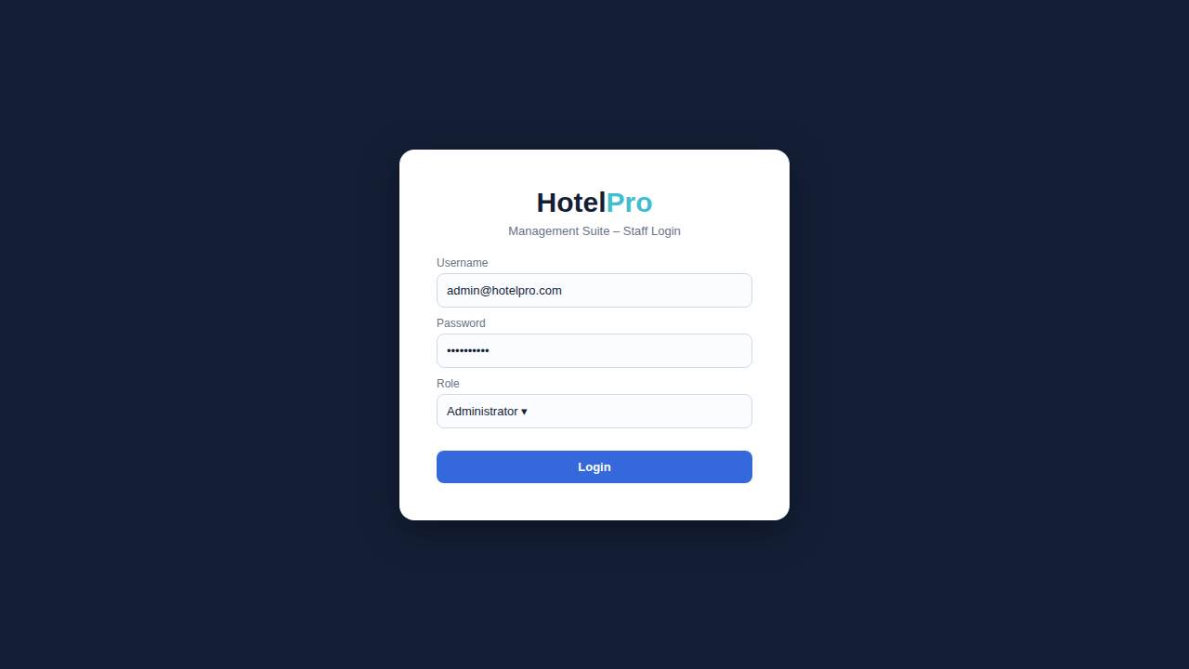
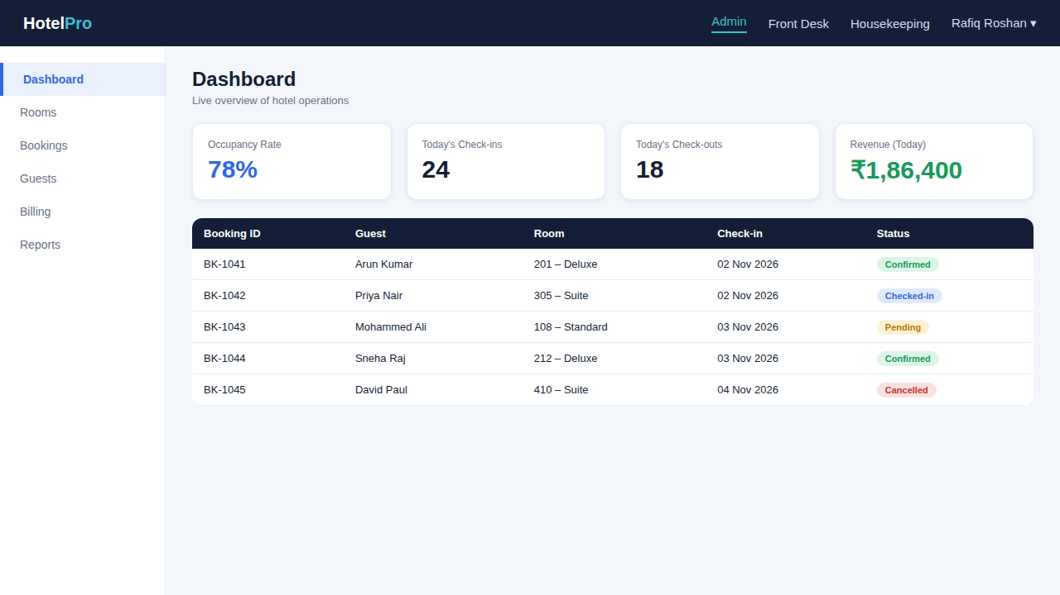
Application Screenshots – Login & Dashboard
Staff authentication and live overview of hotel operations
Staff Login
Dashboard
Role-based access for Admin, Front Desk and Housekeeping
Occupancy, check-ins, check-outs, revenue and recent bookings
8

Slide 9
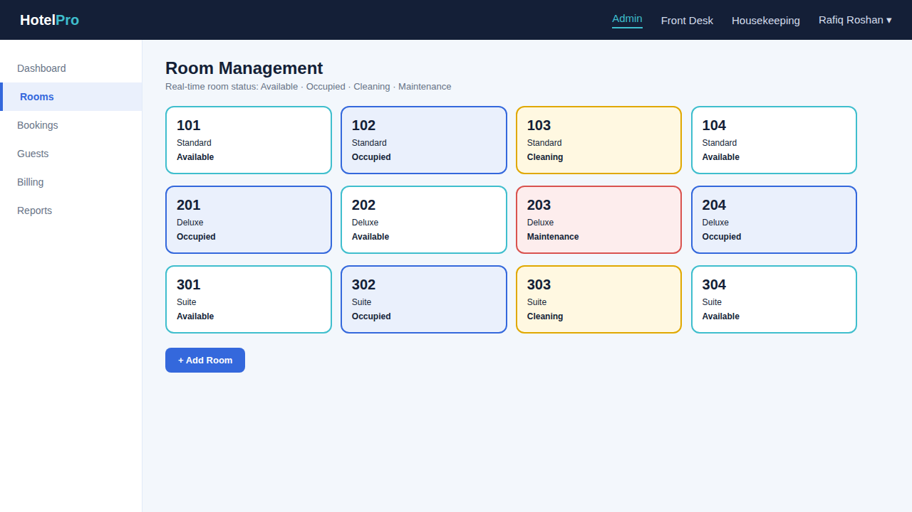
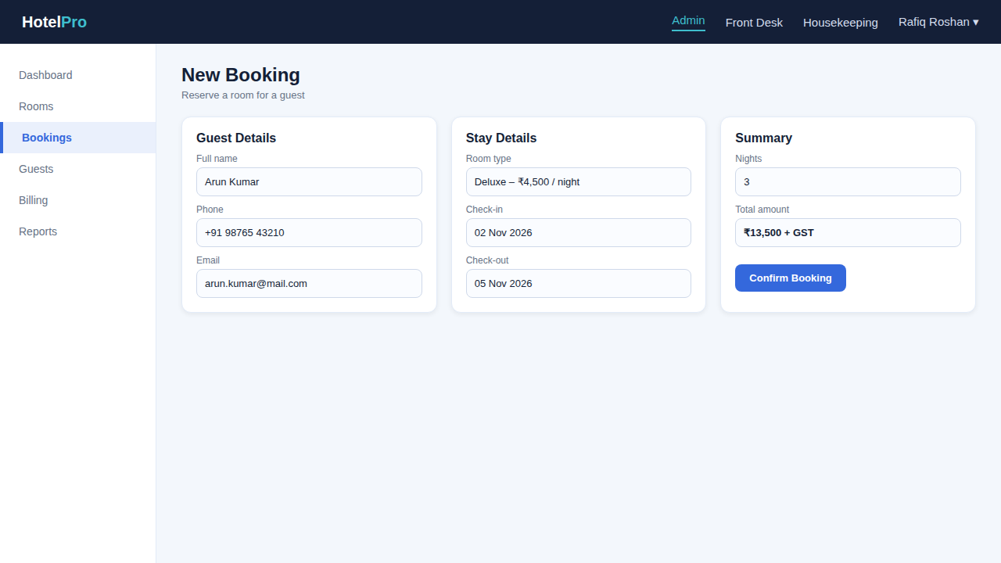
Application Screenshots – Rooms & Booking
Room status tracking and reservation creation
Room Management
New Booking
Live status: available, occupied, cleaning, maintenance
Guest and stay details with automatic amount calculation
9

Slide 10
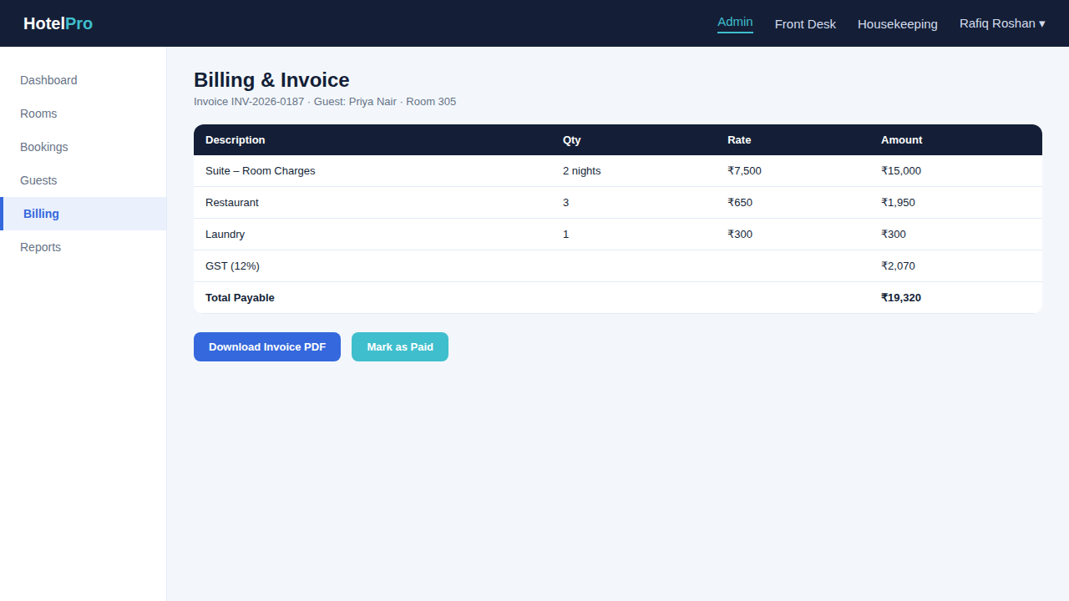
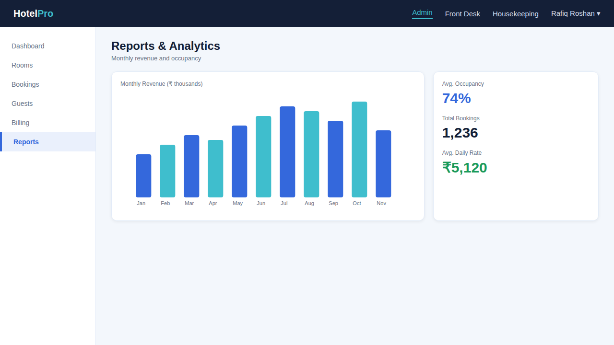
Application Screenshots – Billing & Reports
Invoice generation and analytics
Billing & Invoice
Reports & Analytics
Room, food and service charges with GST, exportable as PDF
Monthly revenue, occupancy and booking statistics
10

Slide 11
Scope and Limitations
Current project boundaries and possible future improvements
Current scope
Possible future enhancements
• Browser-based hotel management
• Room, booking and guest modules
• Dashboard and reports
• Billing and PDF invoices
• Staff-entered data is used to run operations
• Online payment gateway integration
• Cloud database and multi-branch support
• Guest self-booking portal
• Email / SMS booking confirmations
• Accessibility and cross-browser testing
Note: The current version is a demonstration build; payment gateways and multi-branch cloud storage are not included.
11

Slide 12
CONCLUSION
A smarter way to run a hotel.
The HotelPro Management Suite brings room management, bookings, guest records, billing and live reports together in one web interface. It helps hotel staff reduce manual work, avoid booking errors and serve guests faster.
THANK YOU

