Slide 1

Data Science Training

Slide 2
THE GOALS OF DATA SCIENCE
Actionable Insights
Impact Analysis
Prescription

Slide 3
WHAT DATA SCIENTISTS DO
TO ACHIEVE DATA SCIENCE GOALS, DATA SCIENTIST PERFORM WORKFLOW

Slide 4
DATA SCIENCE TRAINING
TO TRAIN THE PARTICIPANTS IN PERFORMING THE WORKFLOW
01
THERE WILL BE A STATISTICS SESSION. HOWEVER, THE STATISTICAL ASPECTS ARE ALWAYS PRESENT IN ALL SESSIONS.
02
PARTICIPANT WILL HAVE TO DO A WEEKLY PROJECT.
And there will be a final project
03

Slide 5
WORKFLOW
Exploration
Preparation
Analyze
Report
Action

Slide 6
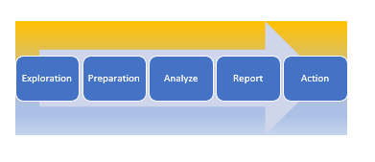
WORKFLOW
EXPLORATION
Identify The Problem,
Define The Problem, Identify Data, Import Data

Slide 7
WORKFLOW
PREPARATION
Exploratory Data Analysis (EDA)
Data Visualization
Data Preparation, Data Cleaning
Descriptive Analytics.

Slide 8
WORKFLOW
ANALYZE
Feature Selection
Model Selection
Results Analyzing/Interpreting

Slide 9
WORKFLOW
REPORT
Present Findings
Visualize Results
Credibility Counts

Slide 10
WORKFLOW
ACTION
Actionable Insights
Impact Analysis
Prescription

Slide 11
Learning Outcomes
Perform Data Science Workflow
Perform Descriptive, Predictive, and Prescriptive Analytics
Understand basic statistical analysis
Communicate the findings effectively

Slide 12
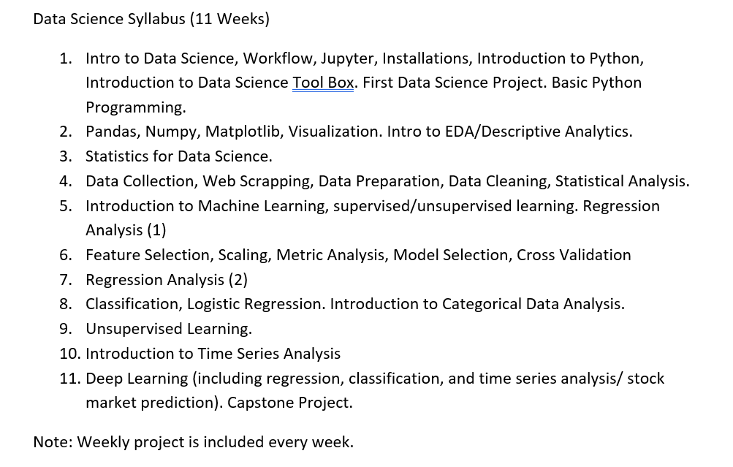
Syllabus 11 Weeks

Slide 13
Student Evaluation
Weekly Project
Capstone Project
Daily Class Activity

