Slide 1
Russia vs Ukraine War Impact on World Economy & Bangladesh Economy

Slide 2
Effect In Bangladesh Economy

Slide 3
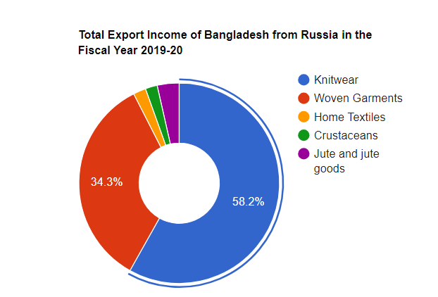
Energy Prices: Any disruption in the global energy market, particularly a spike in oil and gas prices, can have a significant impact on Bangladesh's economy. Bangladesh is heavily reliant on imported oil and gas for its energy needs. If energy prices rise, it can increase the cost of production and transportation, potentially leading to inflation and reduced economic growth.
Remittances: Bangladesh relies heavily on remittances from its expatriate workforce, particularly those working in the Middle East and Europe. Any economic downturn or job losses in these regions, which could be influenced by global economic conditions including geopolitical tensions, can impact remittance flows back to Bangladesh.

Slide 4
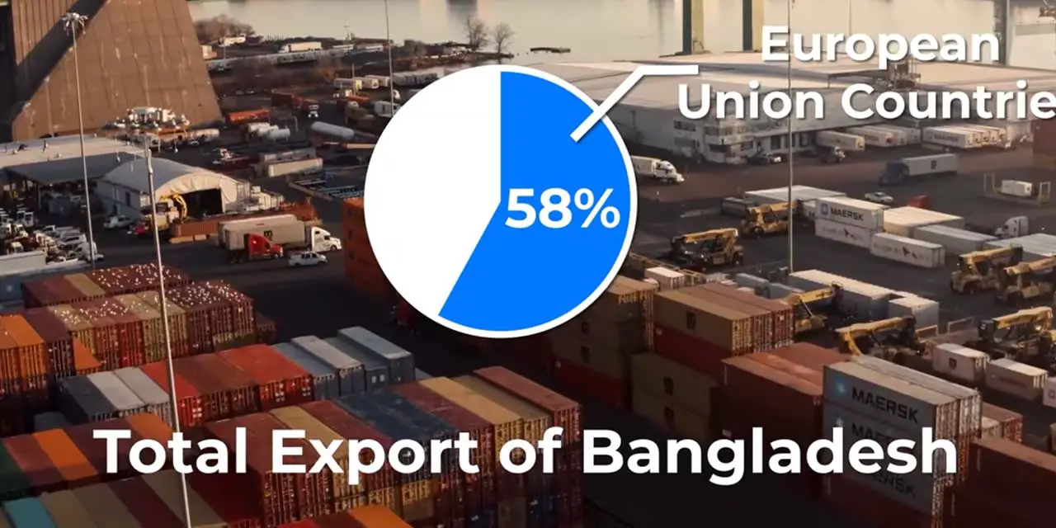

Slide 5
Foreign Currency Exchange:
Turbulence in international financial markets can affect the flow of capital and currency exchange rates, potentially impacting Bangladesh's foreign exchange reserves and the value of its currency.
Aid and Assistance:
Bangladesh receives aid and assistance from various international organizations and countries. Changes in the priorities or allocations of aid due to global events can affect development programs and projects.

Slide 6
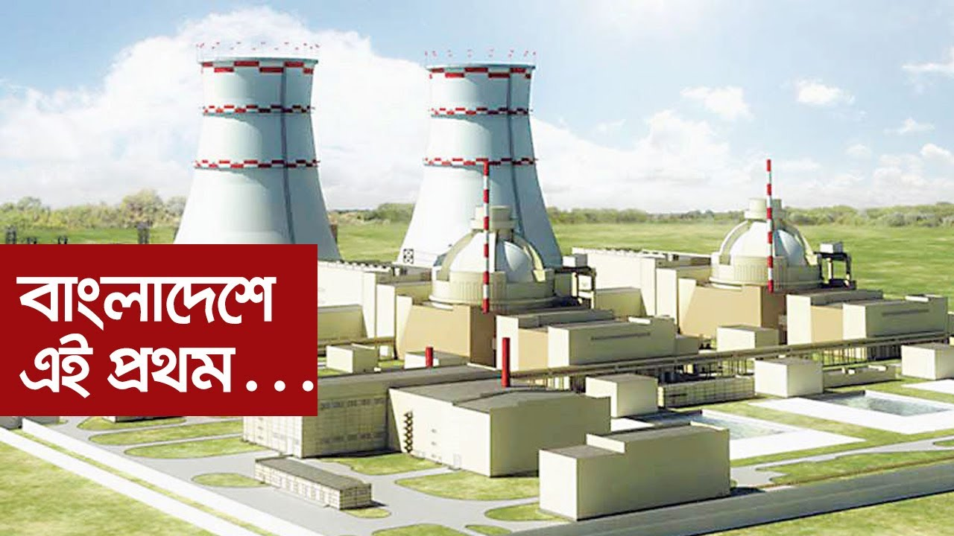
Ruppur Nuclear Power Plant

Slide 7
How Developing Countrys’ Are Affected
Economic impact
Energy Prices: Developing countries that are heavily dependent on energy imports, particularly oil and natural gas, can be significantly affected by fluctuations in global energy prices. Russia is a major energy exporter
Trade: The war has led to sanctions on Russia by Western countries, which can impact global trade. Developing countries engaged in trade with either Russia or Ukraine may face disruptions or reduced trade volumes due to these sanctions.
Geopolitical Alliances
Developing countries often align themselves with various international actors based on their strategic interests. The Russia-Ukraine conflict has strained relations between Russia and Western powers, and some developing countries may face pressure to choose sides, which can have diplomatic and economic consequences

Slide 8
Political Impact
The Russia-Ukraine war has had a profound political impact on developing countries, particularly in terms of their alliances and diplomatic relations. Many countries have been forced to choose sides, either aligning themselves with Russia or with Ukraine and its Western allies. This has created a complex web of relationships that has strained international diplomacy and threatened to destabilize entire regions.
Refugee Crisis
The conflict has led to a significant displacement of people, with many Ukrainians seeking refuge in neighboring countries and even beyond. Some developing countries may bear the burden of hosting and providing assistance to Ukrainian refugees, which can strain their resources and social services.

Slide 9
Impact on Food Prices
Ukraine is known as the "breadbasket of Europe" due to its significant agricultural production. A disruption in Ukrainian agriculture, whether due to conflict or economic sanctions, can affect global food prices, which can have repercussions for food security in developing countries.
Arms Sales and Military Aid
Some developing countries purchase arms and military equipment from Russia or Ukraine. The conflict can disrupt arms supplies and lead to changes in the availability of military equipment, impacting the defense capabilities of these countries.

Slide 10
Efeect in World Economy
The Ukrain-Russia war has had an impact on the world economy.These effects can be dire in the future. Below are some key implications:
Energy prices : Russia is a major exporter of oil and natural gas. The conflict has led to fluctuations in energy prices and which caused energy prices to rise.
Commodity Prices: Ukraine is a significant exporter of agricultural products, including wheat, corn, and sunflower oil. Disruptions in Ukrainian agriculture due to the conflict affecting global food prices.
Sanctions and Trade: The imposition of sanctions on Russia by Western countries affecting international trade and investment.
Financial Markets: Geopolitical tensions, including those arising from the conflict has lead to increased market volatility.
Investor Confidence: Geopolitical conflicts has erode investor confidence and effecting on global investment flows.
Geopolitical Uncertainty: Geopolitical tensions, such as the Russia-Ukraine conflict has lead to broader uncertainties in international relations.
Humanitarian Costs: The conflict has resulted in a significant humanitarian crisis, including displaced populations and infrastructure damage.

Slide 11
Efeect in World Economy
The Ukrain-Russia war has had an impact on the world economy.These effects can be dire in the future. Below are some key implications:
Energy prices : Russia is a major exporter of oil and natural gas. The conflict has led to fluctuations in energy prices and which caused energy prices to rise.
Commodity Prices: Ukraine is a significant exporter of agricultural products, including wheat, corn, and sunflower oil. Disruptions in Ukrainian agriculture due to the conflict affecting global food prices.
Sanctions and Trade: The imposition of sanctions on Russia by Western countries affecting international trade and investment.
Financial Markets: Geopolitical tensions, including those arising from the conflict has lead to increased market volatility.
Investor Confidence: Geopolitical conflicts has erode investor confidence and effecting on global investment flows.
Geopolitical Uncertainty: Geopolitical tensions, such as the Russia-Ukraine conflict has lead to broader uncertainties in international relations.
Humanitarian Costs: The conflict has resulted in a significant humanitarian crisis, including displaced populations and infrastructure damage.

Slide 12
INFLATION
1. Energy Price Shock: The Ukraine war has disrupted energy markets, particularly natural gas supplies from Russia. This has led to higher energy prices in Europe, impacting industries and households.
2. Rising Fuel Costs: The conflict has caused an increase in oil prices globally. This has a direct impact on transportation costs, which can lead to higher prices for goods and services.
3. Currency Depreciation: Geopolitical tensions can lead to currency depreciation. The Ukrainian crisis has caused fluctuations in currencies, affecting exchange rates and, consequently, the prices of imported goods.
4. Supply Chain Disruptions: The war has disrupted supply chains, causing delays and shortages of critical goods. This can drive up prices due to increased demand and decreased supply.
5. Food Insecurity: Ukraine is known as the "breadbasket of Europe" due to its significant agricultural production. The war has disrupted agricultural activities, potentially leading to food shortages and price increases.

Slide 13
INFLATION
Economic Uncertainty: Ongoing conflict can create economic uncertainty, which may discourage investment and lead to reduced economic growth. This can further exacerbate inflationary pressures.
Monetary Policy Response: Central banks may respond to rising inflation by increasing interest rates. This can have implications for borrowing costs, housing markets, and overall economic stability.
Global Implications: Inflationary pressures in one region can have spillover effects globally. The Ukraine war's impact on inflation may be felt beyond Europe, affecting international trade and financial markets.
Consumer Behavior: High inflation can alter consumer behavior, with people making purchases sooner to avoid rising prices, potentially leading to demand spikes.
Government Policies: Governments may implement various measures to counter inflation, such as price controls or subsidies, which can have both short-term and long-term consequences.

Slide 14
HISTORY
1. Annexation of Crimea (2014): The conflict escalated in 2014 when Russia annexed Crimea, a region in southern Ukraine. Russia's actions were condemned internationally, and it led to tensions and violence in eastern Ukraine.
2. Ethnic and Linguistic Divisions: Ukraine has a diverse population with a significant Russian-speaking minority, particularly in the eastern and southern regions. Differences in language, culture, and identity have played a role in the conflict.
3. Historical Ties to Russia: Ukraine has historical ties to Russia, dating back to the Kyivan Rus era. The complex historical relationship has contributed to Ukraine's struggle for independence and autonomy.
4. Nationalism and Identity: Ukraine's push for closer ties with Europe and aspirations for EU and NATO membership clashed with Russia's desire to maintain influence in the region. Nationalist sentiments in Ukraine and Russia have also played a role.

Slide 15
HISTORY
5. Geopolitical Interests: Ukraine's strategic location, including its access to the Black Sea, has made it a focal point of geopolitical interests for both Russia and Western countries. The conflict has been seen as part of a broader struggle for influence in Eastern Europe.
6. Economic Factors: Economic issues, including trade agreements and energy resources, have influenced the conflict. Russia has used its control over energy supplies as a tool in the dispute.
7. Support for Separatist Movements: Russia has been accused of providing support, including weapons and fighters, to separatist movements in eastern Ukraine, particularly in Donetsk and Luhansk.
8. Failed Diplomacy: Despite numerous attempts at ceasefires and peace negotiations, a lasting resolution has proven elusive. The Minsk agreements, aimed at ending the conflict, have faced challenges and violations.

Slide 16
Thank You

