Slide 1
Welcome
To our presentation.

Slide 2
Database Operating System
Presented By: Md Rafiqul Islam (Team Lead.),IT-17054 Amirul Hasan Shanto,IT-17027 Tanveer Ahmed Nirjhor ,IT-17001 Binodon, IT-17046 | Project Supervisor and Mentor : Nazrul Islam Assistant prof. Dept Of ICT MBSTU

Slide 3
Objectives:
Database is widely used to store data. Database operating system is our software that make it extremely easy for us to create a local web server for testing & developing. We use database through SQL query in general. But via this application we don’t require command line but dynamically.

Slide 4
Main advantages :
Set up the environment required to run WordPress on local machine.
Develop user loyalty.
Provide better user service.
Launching new way of enriching our storage.

Slide 5
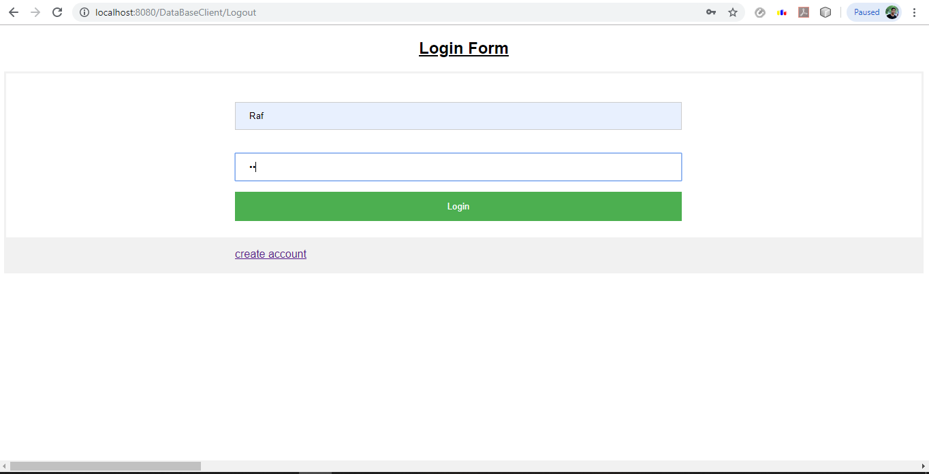
Login Page

Slide 6
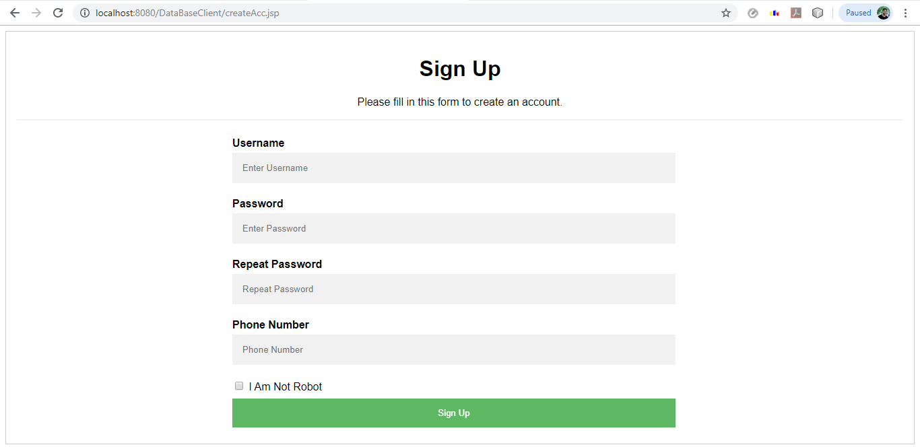
Registration:

Slide 7
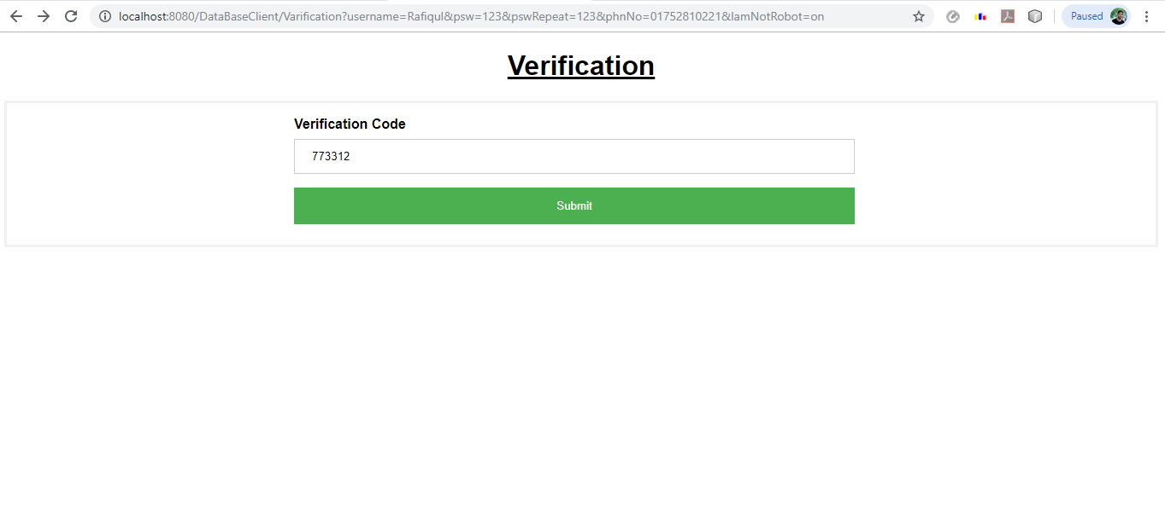
Verification:

Slide 8
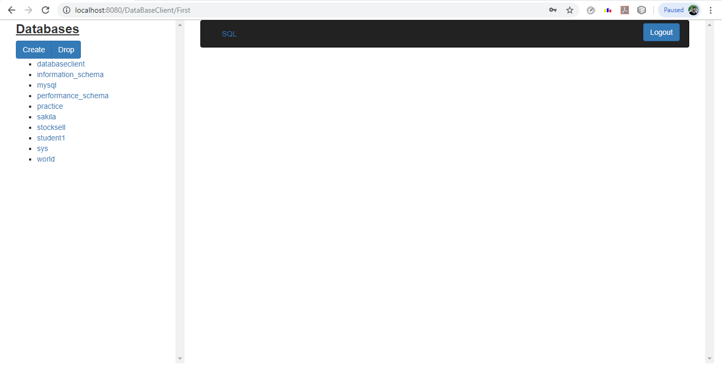
First look:

Slide 9
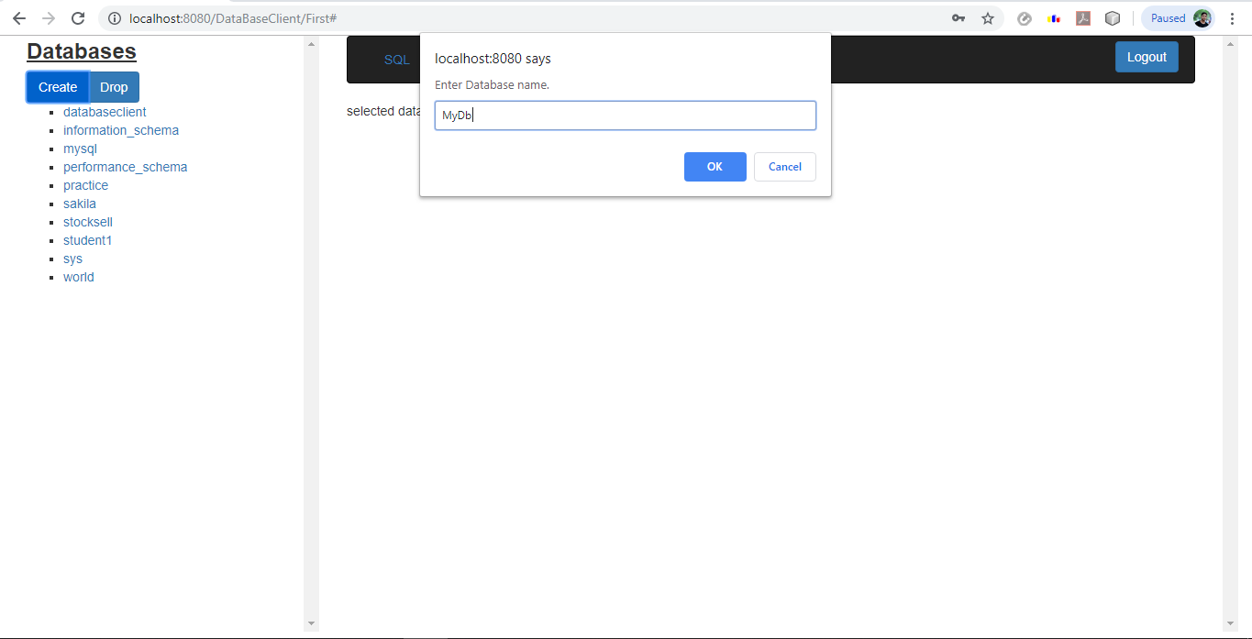
Create Database:

Slide 10
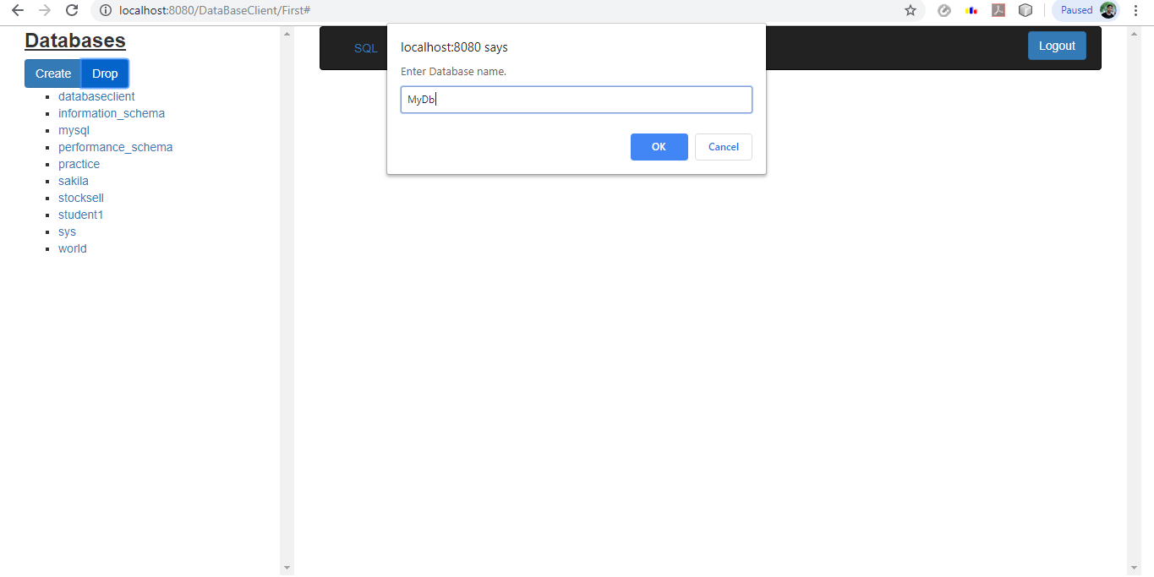
Drop Database:

Slide 11
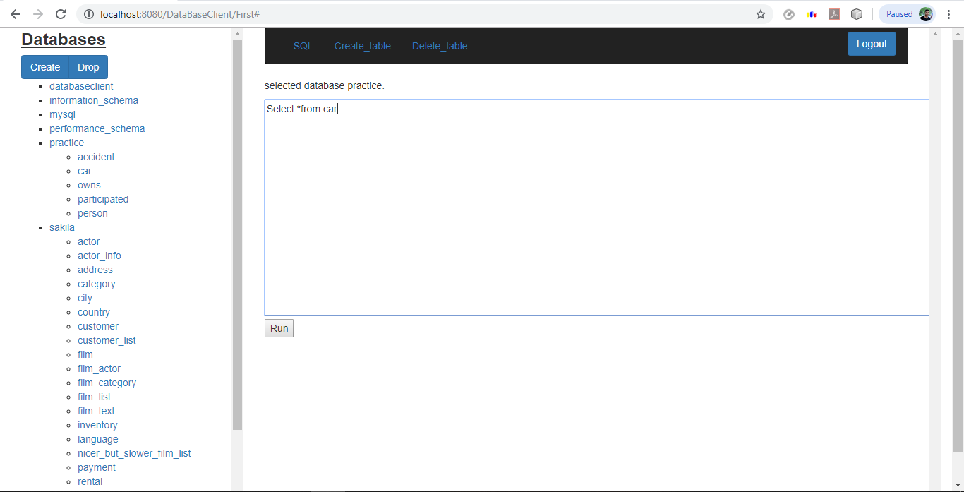
SQL Command Prompt:

Slide 12
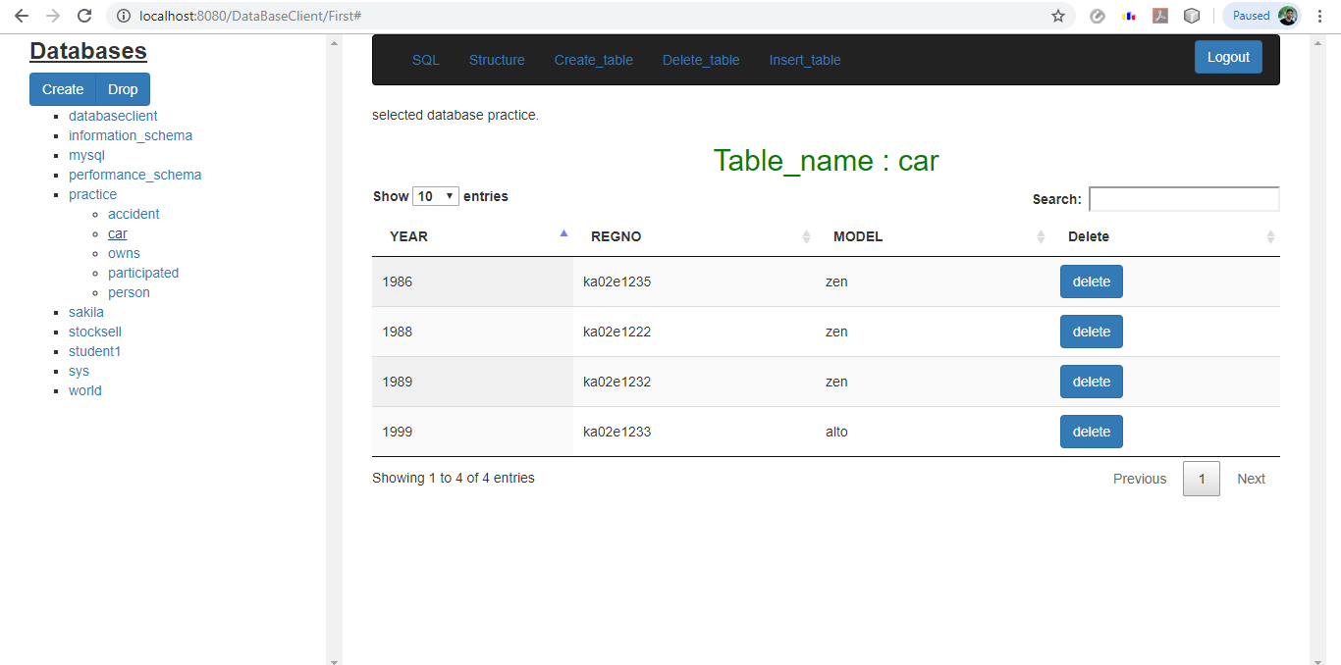
Show Table:

Slide 13
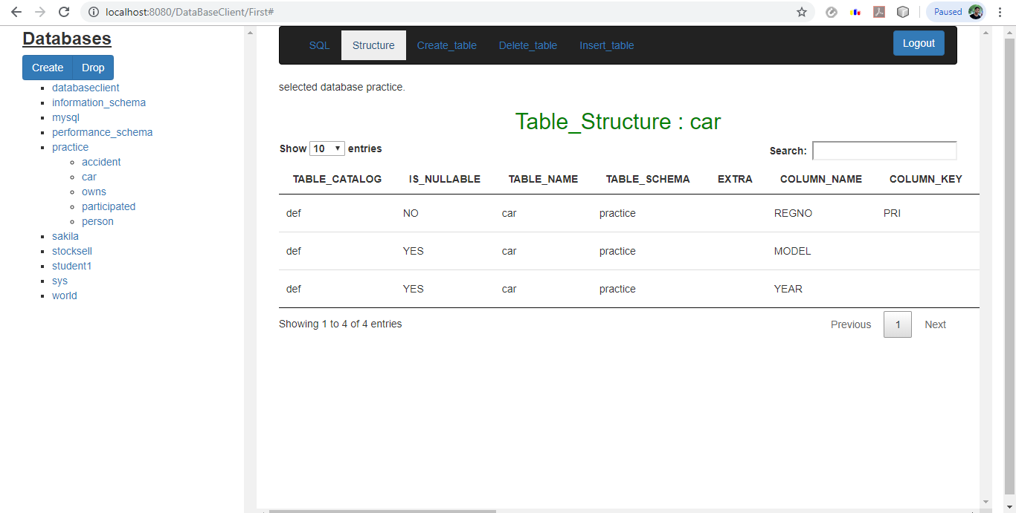
Table Structure:

Slide 14
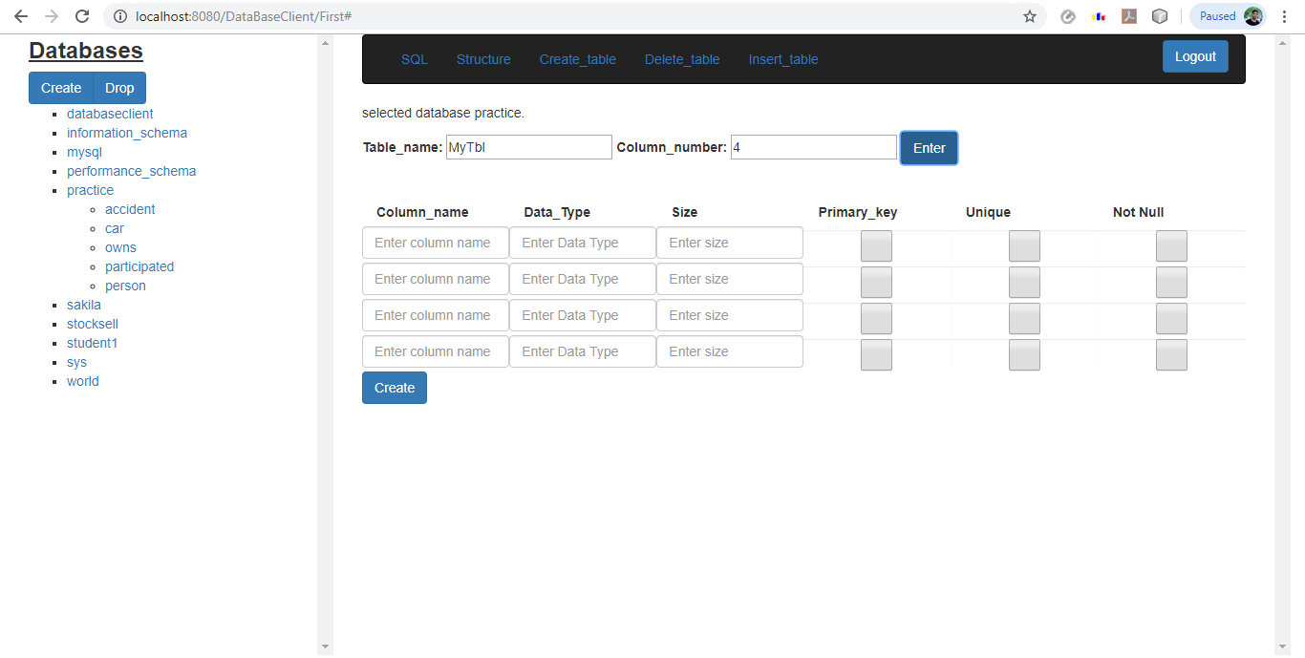
Create Table:

Slide 15
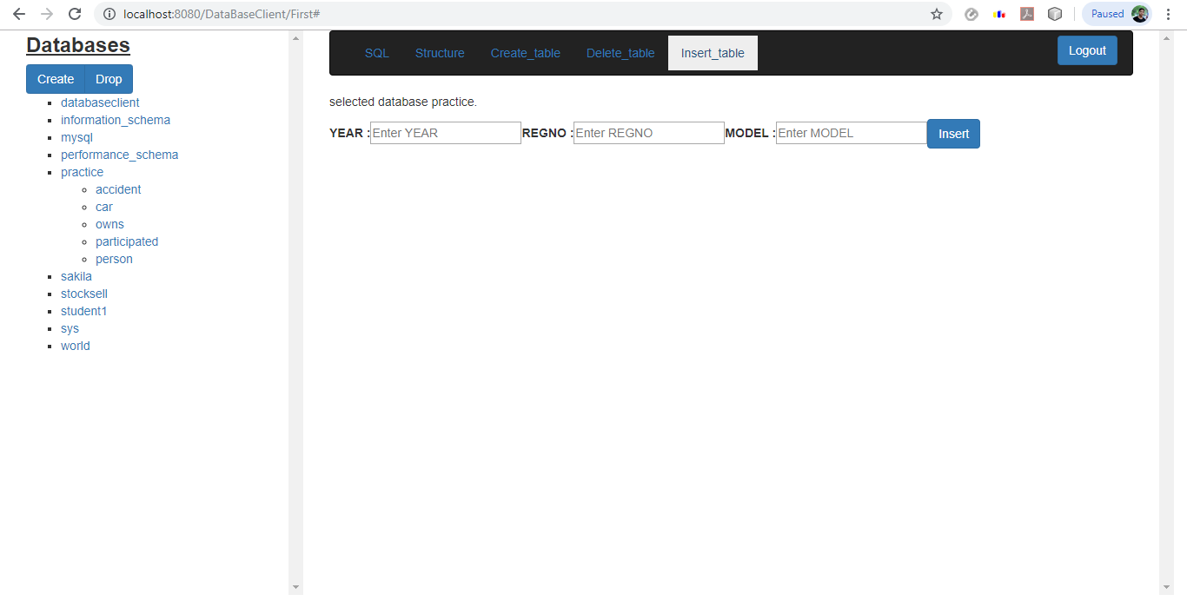
Insert Table:

Slide 16
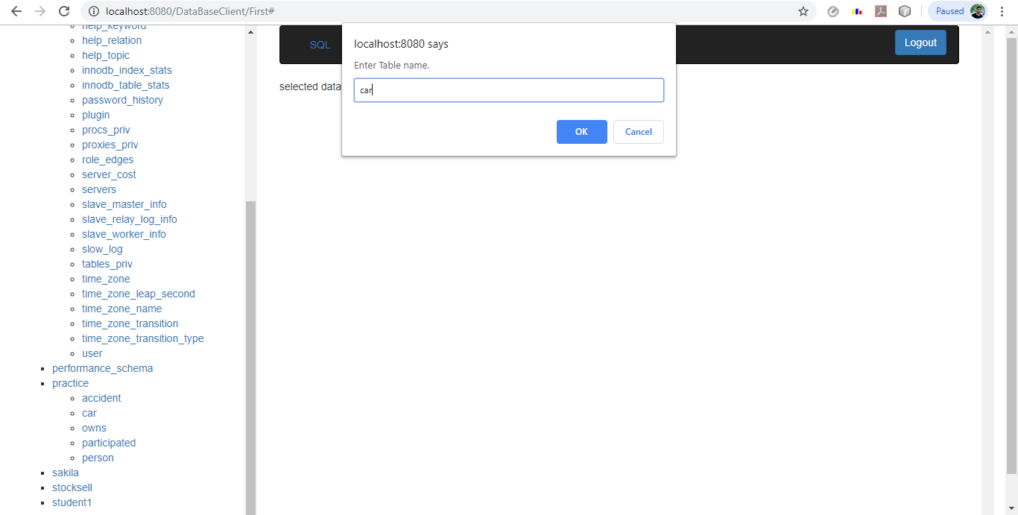
Delete Table:

Slide 17
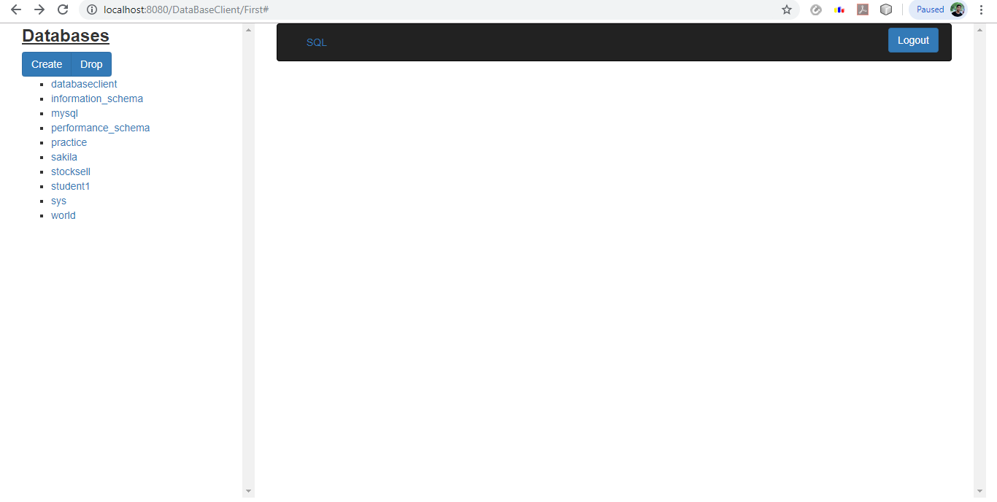
Logout:

Slide 18
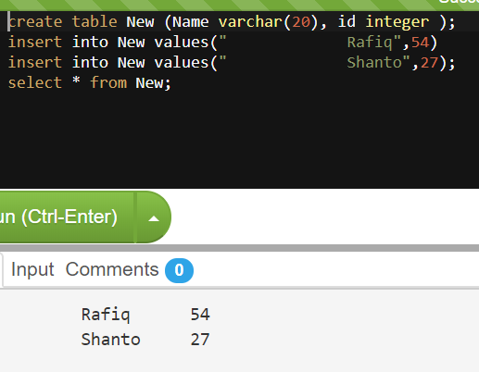
What we did earlier :

Slide 19
Thank You..

