Slide 1



Multimodal Misinformation Detector
Three tracks, one question: what does each kind of evidence really tell us?
Harika Etikela
Text track
Ananya
Image track
Rafiul Haider
Combined track
CS 668 Analytics Capstone · Pace University · Midterm
Notes:
All: introduce the team. Our project builds three detectors, one for each way misinformation spreads: false text, fake images, and real images paired with the wrong caption. Harika presents the text track, Ananya the image track, and Rafiul the combined track with the LAYA-Vision model.

Slide 2
One problem, three ways it spreads
False text
Edited or generated image
Real image, wrong caption
The claim in the article is wrong
The picture itself is fake
Both are real; the pairing misleads
Text track
Harika Etikela
Image track
Ananya
Combined track
Rafiul Haider
WELFake
CIFAKE
MMFakeBench · VERITE · NewsCLIPpings
Each track has its own dataset and task, so scores are read within a track, never across tracks.
Notes:
Misinformation travels three ways. Sometimes the text is false. Sometimes the image is edited or generated. And often both are real, but a photo from one event is shown with a caption about another. Each of us took one of these and built a detector for it, each on a dataset designed for that problem.

Slide 3




How we work, in every track
Clean the data first
Start from a floor
Remove duplicates and leaks before any test
Know what simple guessing scores
Measure uncertainty
Say what it can't do
95% ranges, not single numbers
Limits travel with every result
Notes:
All three tracks follow the same habits. We clean duplicates and leaks before testing. We always compare against what guessing would score. We report uncertainty ranges. And every result comes with its limits.

Slide 4

Real and fake articles leave different clues
Text track · Harika Etikela
63,678
Good to know
Strong source and style cues mean a model can learn the outlet's style, not only the facts.
articles after removing 8,456 duplicates
70 · 15 · 15
train · validation · test split
54.6%
accuracy from always guessing "Real"
Text track midterm results, Harika Etikela (WELFake training split).
Notes:
Harika: WELFake has 72,134 news articles; after removing 8,456 exact duplicates we keep 63,678 and freeze a 70/15/15 split. Real and fake articles look different: most real articles mention Reuters, while fake ones use far more exclamation marks and the word video. Always guessing Real gives 54.6%, which is our floor.

Slide 5
From simple to deep models
Text track · Harika Etikela
Good to know
DistilBERT is an early run: 5,000 training articles, one epoch. It does not yet show transformers are better.
Text track midterm results, Harika Etikela. Axis starts at 50%.
Notes:
Harika: we compared four classical models on TF-IDF features. Accuracy rises from 87.6% for Naive Bayes to 97.4% for a linear SVM on raw text. A first DistilBERT run reached 98.3%, but it used only 5,000 articles for one epoch, so we treat it as exploratory.

Slide 6

Words carry the signal, partly through style
Text track · Harika Etikela
Next for the text track
Good to know
97.4%
96.2%
1
Ensemble
SVM + DistilBERT, soft voting
Results so far report accuracy; precision, recall and F1 come with the next phase.
Linear SVM test accuracy with the word "reuters" removed
2
Explanations
LIME and SHAP feature comparison
About 1.3 points come from a single source word.
3
New datasets
ISOT and LIAR, no retraining
Text track midterm results, Harika Etikela.
Notes:
Harika: removing just the word Reuters drops the SVM from 97.4% to 96.2%, so part of the score is outlet style. Next we build the SVM plus DistilBERT ensemble, compare features with LIME and SHAP, and test on ISOT and LIAR without retraining.

Slide 7
Clean first, then test
Image track · Ananya
Good to know
120,000
Duplicate audit
Clean split
Pixel-identical copies were found across splits and removed before the final run, so test scores are not inflated.
CIFAKE images, 32×32
half real, half generated
2,218 train · 454 test
378 shared across splits
10,000 · 1,996 · 3,986
0 images shared with train
Train · validation · test images in the clean working subset
Image track midterm results, Ananya (CIFAKE: Bird and Lotfi, 2024).
Notes:
Ananya: CIFAKE has 120,000 tiny images, half real from CIFAR-10 and half generated by Stable Diffusion. Before training, an audit found thousands of duplicates, including 378 files shared between train and test. We removed them and built a clean working split of 10,000, 1,996 and 3,986 images with zero overlap.

Slide 8
Climbing the model ladder
Image track · Ananya
96.3%
Good to know
One run so far; three seeds and the full training set are planned.
fine-tuned ResNet18 accuracy
0.995
AUC for the same model
39×
smaller small CNN, only 2.1 points behind
Image track midterm results, Ananya. 95% range for ResNet18: 95.7% to 96.8%.
Notes:
Ananya: we climbed a ladder of models. Guessing gets about 50%. Twenty-one handcrafted features reach about 87%. A small CNN reaches 94.2%, and fine-tuned ResNet18 reaches 96.3% with an AUC of 0.995. The small CNN is 39 times smaller for only 2.1 points less.

Slide 9
Fine detail, not color, carries the signal
Image track · Ananya
Strong blur (σ = 1)
AUC 0.995 → 0.77
Good to know
Grad-CAM shows where the model looks; it is not proof of a true generator fingerprint.
Grayscale
AUC stays 0.98
JPEG quality 75
No change
Next: test on images from other generators and real-photo sources.
Image track midterm results, Ananya.
Notes:
Ananya: stress tests show what the model relies on. A mild blur drops accuracy from 96.3% to 85.6%, and a strong blur drops AUC to 0.77, while grayscale and JPEG compression barely matter. So the model uses fine detail, not color. Next we test it on generators it has never seen.

Slide 10

What does a pretrained model already know?
Combined track · Rafiul Haider
Image + caption
LAYA-Vision
Answer
Good to know
This is the reference point a fine-tuned model must beat later.
Frozen: no training, no prompt tuning
MMFakeBench
10,000 test rows
4 labels
VERITE
1,001 rows
3 labels
NewsCLIPpings
7,024 pairs
2 labels
Same rows, three ways: image + text · text only · image only
Combined track, Rafiul Haider. LAYA-Vision checkpoint f2fe3c12, one fixed question set.
Notes:
Rafiul: before fine-tuning, we asked what the pretrained LAYA-Vision model already knows. We froze it and asked each dataset's own question on three benchmarks, using the same rows with the image and text, the text only, and the image only. That gives the reference a fine-tuned model has to beat.

Slide 11
Asked cold, it mostly guesses
Combined track · Rafiul Haider
91.5%
Good to know
The MMFakeBench test split had been looked at before, so its numbers are a check-up, not a final exam.
of MMFakeBench labels guessed from source names alone, without seeing the image or text
−1.5 pts
average change when the model also sees the image (from −18 to +18 by source)
Combined track, Rafiul Haider. n = 9,999 · 1,001 · 7,024. Floors: always-majority, 1 in 3, coin flip.
Notes:
Rafiul: asked cold, the model is close to guessing on all three: 26.4% on MMFakeBench where always picking the most common answer gets 30%, 35.7% on VERITE against one in three, and 50.8% on NewsCLIPpings against a coin flip. Two surprises: on MMFakeBench, the source names alone predict 91.5% of the labels. And adding the image lowered accuracy by 1.5 points on average, with large swings by source.

Slide 12

The signal is there, just unused
Combined track · Rafiul Haider
+6.2 pts
Good to know
On VERITE the gain (+4.4 pts) sits inside its 95% range of zero, so it may be luck.
on 7,264 sealed test pairs, read once (95% range +4.8 to +7.7)
The helper learns from 71,072 NewsCLIPpings examples on top of the frozen model; the model itself never changes.
Combined track, Rafiul Haider. Helper = linear probe on frozen 576-d LAYA-Vision features.
Notes:
Rafiul: published systems train on NewsCLIPpings and test on the target, so we did the same without changing the model. A small linear helper trained on the model's frozen features raised accuracy from 51.1% to 57.4% on a test set we kept sealed until the end. So the information is inside the model; its direct answer just does not use it. On VERITE the gain is smaller and could be chance.

Slide 13
What the three tracks teach together
Text track
Image track
Combined track
Strong signal from words
Strong on its own benchmark
The signal sits inside the model
Part of it is outlet style ("reuters")
Mild blur costs about 11 points
Source names give MMFakeBench labels away
Every benchmark hides a shortcut. Finding it is part of the result.
Notes:
All: put together, each track found real signal and a weak spot. Text models read outlet style. The image model depends on fine detail that blur removes. And on MMFakeBench, source names give the labels away. We are not ranking the tracks; the tasks differ. The shared lesson is that every benchmark hides a shortcut.

Slide 14

Road to the final
Text track
Ensemble
LIME / SHAP
ISOT and LIAR
Good to know
The combined track's stretch targets (84.8% and 76.3%) come from fully trained systems and are not met yet.
Image track
Unseen generators
Three seeds
Full training set
Combined track
Attention and Gate heads
CLIP classifier
Three seeds
One shared output format → one app that gives a verdict for text, image or both
Notes:
All: for the final, Harika adds the ensemble, explanations and two new datasets. Ananya tests on unseen generators with three seeds. Rafiul trains Attention and Gate heads on the frozen model and adds a CLIP classifier. Then we agree on one output format and build a single app that gives a verdict for text, an image, or both.

Slide 15
Thank you
Questions welcome
Harika Etikela
Text track
Ananya
Image track
Rafiul Haider
Combined track
Notes:
All: thank you. We are happy to take questions on any of the three tracks.

Slide 16
Backup: published systems on NewsCLIPpings
Combined track · Rafiul Haider
Good to know
Published systems retrain the whole model; CCN and SNIFFER also search the web. These are reference points, not a ranking.
Values checked against each paper's results table on 25 Oct 2026.
Notes:
Backup: published systems reach 60% to 88% on the same test split, but they retrain their whole model, and two of them look up evidence online.

Slide 17
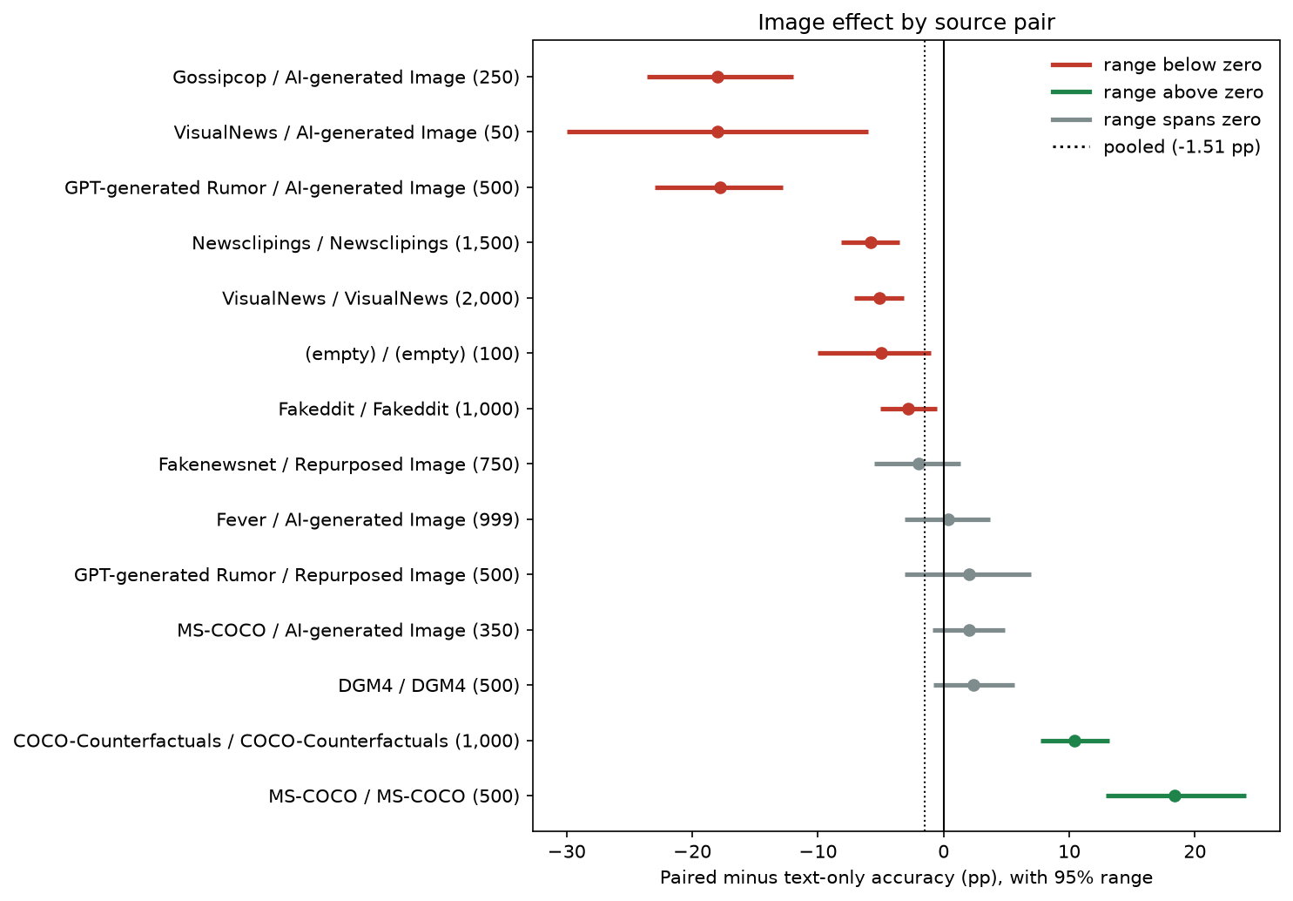
Backup: the image effect by source
Combined track · Rafiul Haider
Good to know
On 13 of 14 sources every row has the same label, so the image mainly changes which answer the model picks.
MMFakeBench test, 9,999 rows, paired minus text-only accuracy with 95% ranges.
Notes:
Backup: split by source, the image effect ranges from minus 18 to plus 18 points; the average of minus 1.5 hides that spread.

Slide 18
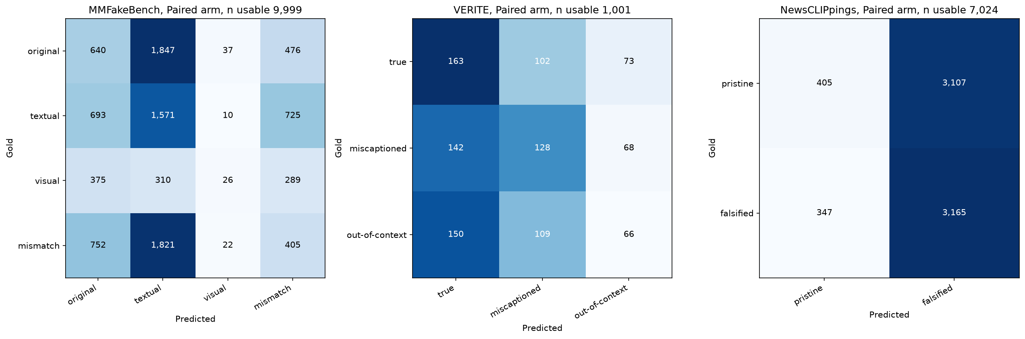
Backup: where the model's answers go
Combined track · Rafiul Haider
Zero-shot, image + text. MMFakeBench test (9,999), VERITE (1,001), NewsCLIPpings validation (7,024).
Notes:
Backup: confusion matrices for the three zero-shot runs.

Slide 19
Backup: where to find everything
Showcase folder
MIDTERM_PRETRAINED_BASELINE/README.md
Executed notebooks
notebooks/01 to 04, each with self-checks
Detailed dashboard
http://localhost:8501
Plain-language dashboard
http://localhost:8502
Notes:
Backup: the showcase folder holds the synthesis, notebooks, figures and reports for the combined track.

