Slide 1


Slide 2
Easy Physics Lab High Voltage Shock
Presented By

Slide 3
Members
Rafnun Nusrat(314)
Nusrat Jahan Rose(2533)
Mustafijur Rahman Robin(338)
Ahsan Bayzid(342)
Tania Rahman(2594)
Md Sohag Mia(336)
Notes:
NOTE: To change images on this slide, select a picture and delete it. Then click the Insert Picture icon in the placeholder to insert your own image.

Slide 4
Work Division
Animation Making & Voice : Rafnun Nusrat Story Writer & Voice :Nusrat Jahan Rose Sound Editor: Mustafijur Rahman Robin
Script Writer : Ahsan Bayzid
Video Editor: Tania Rahman
Production Manager: Md Sohag Mia
Producer : Md Zahidur Rahman

Slide 5
About The Project
Here we will learn about the practical laboratory work of class 10 physics.

Slide 6
Our Goals
Making Physics interesting for students. Normally doing these practical work is time consuming and confusing .With our infographics e learning material this work will become easy.

Slide 7
Tools
Animation: Animaker ,Blender
Video Editor: Kdenlive
Sound Editor: Ardour
Slide Making :Canva

Slide 8
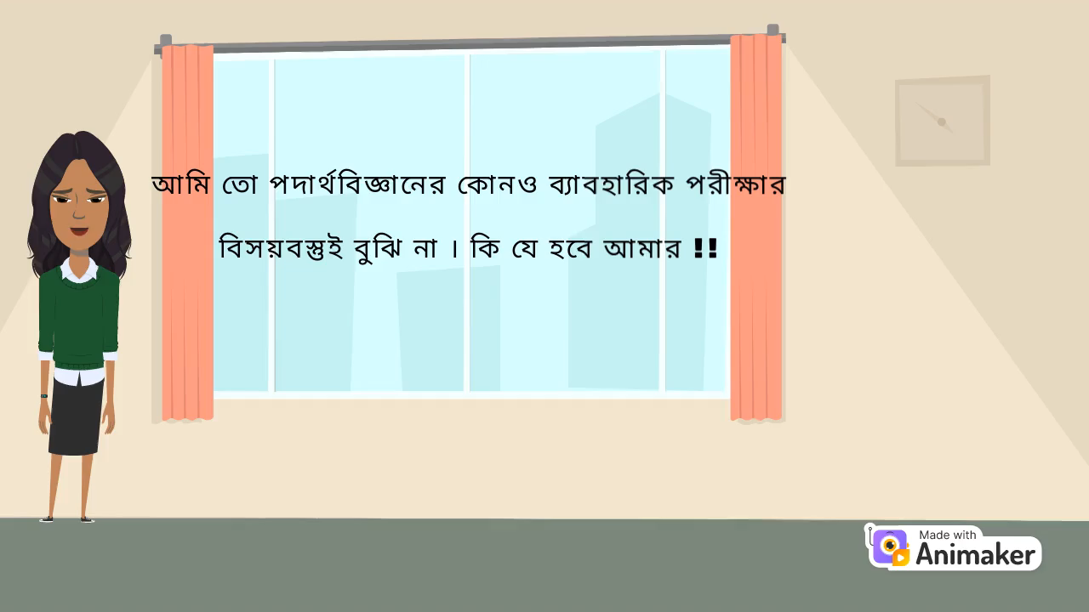
Animation First Draft

Slide 9
Problems:
To make character we needed graphics tab.
To customize character if we need to add more feature we need to pay .That's why couldn't make dress to match our culture.
As the animaker works in online, here at JU due to internet problem it takes much time than originally needed.
In my personal Pc the Ardour takes lots of time to load .

Slide 10
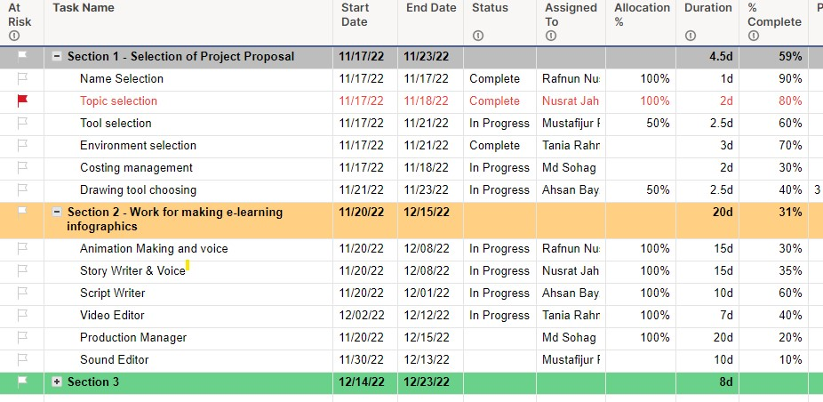
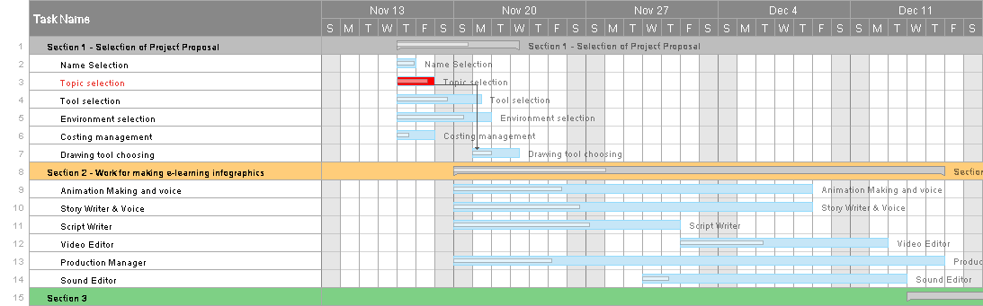
GanttChart

Slide 11
Next week Progress Proposal
We will add make intro video
Add audio to animation along with voice over.
Try to add our logo to the Video.
Make Progress in animation

Slide 12
Thank you!!

