Slide 1
Top Ten Slide Tips
Made By MD Rafsan Jani Shazid
Roll 23

Slide 2

Keep it Simple
PowerPoint uses slides with a horizontal or “Landscape” orientation. The software was designed as a convenient way to display graphical information that would support the speaker and supplement the presentation. The slides themselves were never meant to be the “star of the show” (the star, of course, is your audience).

Slide 3
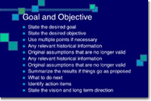
ii. Limit bullet points & text
Bullet And Point Sample
Your presentation is for the benefit of the audience. But boring an audience with bullet point after bullet point is of little benefit to them. Which brings us to the issue of text. The best slides may have no text at all. This may sound insane given the dependency of text slides today, but the best PowerPoint slides will be virtually meaningless with out the narration (that is you). Remember, the slides are meant to support the narration of the speaker, not make the speaker superfluous.

Slide 4
iii. Limit transitions & builds (animation)
Use object builds and slide transitions judiciously. Object builds (also called animations), such as bullet points, should not be animated on every slide. Some animation is a good thing, but stick to the most subtle and professional (similar to what you might see on the evening TV news broadcast). A simple “Wipe Left-to-Right” (from the “Animations” menu) is good for a bullet point, but a “Move” or “Fly” for example is too tedious and slow (and yet, is used in many presentations today). Listeners will get bored very quickly if they are asked to endure slide after slide of animation. For transitions between slides, use no more than two-three different types of transition effects and do not place transition effects between all slides.

Slide 5
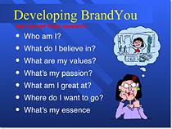

iv. Use high-quality graphics
Use High Quality Graphics
Use high-quality graphics including photographs. You can take your own high-quality photographs with your digital camera, purchase professional stock photography, or use the plethora of high-quality images available on line (be cautious of copyright issues, however). Never simply stretch a small, low-resolution photo to make it fit your layout – doing so will degrade the resolution even further.Avoid using PowerPoint Clip Art or other cartoonish line art. Again, if it is included in the software, your audience has seen it a million times before. It may have been interesting in 1993, but today the inclusion of such clip art often undermines the professionalism of the presenter. There are exceptions, of course, and not all PowerPoint art is dreadful, but use carefully and judiciously.

Slide 6
v. Have a visual theme, but avoid using PowerPoint templates
You clearly need a consistent visual theme throughout your presentation, but most templates included in PowerPoint have been seen by your audience countless times (and besides, the templates are not all that great to begin with). Your audience expects a unique presentation with new (at least to them) content, otherwise why would they be attending your talk? No audience will be excited about a cookie-cutter presentation, and we must therefore shy away from any supporting visuals, such as the ubiquitous PowerPoint Design Template, that suggests your presentation is formulaic or prepackaged.

Slide 7
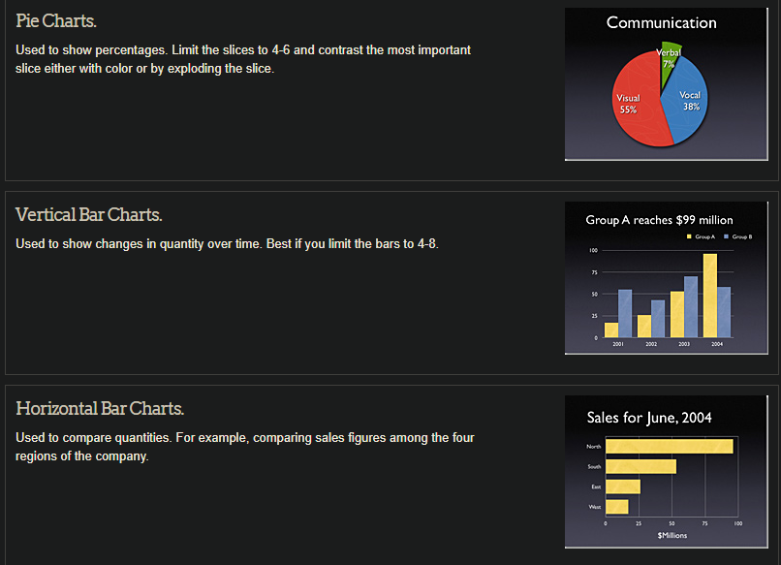
Vi. Use appropriate charts
Always be asking yourself, “How much detail do I need?” Presenters are usually guilty of including too much data in their on-screen charts. There are several ways to display your data in graphic form; here are a few things to keep in mind:

Slide 8
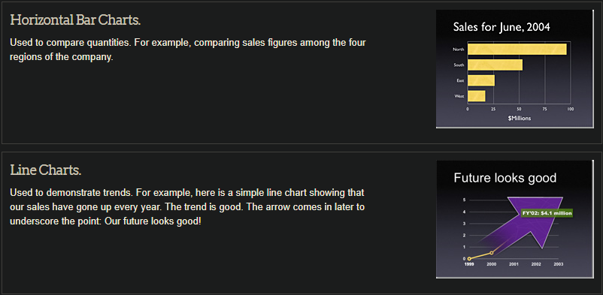
In general, tables are good for side-by-side comparisons of quantitative data. However, tables can lack impact on a visceral level. If you want to show how your contributions are significantly higher than two other parties, for example, it would be best to show that in the form of a bar chart (below, right). If you’re trying to downplay the fact that your contributions are lower than others, however, a table will display that information in a less dramatic or emotional way.

Slide 9
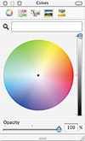
Vii. Use color well
Showing Color Combination
Color evokes feelings. Color is emotional. The right color can help persuade and motivate. Studies show that color usage can increase interest and improve learning comprehension and retention

Slide 10
Thank You

